Slide 1
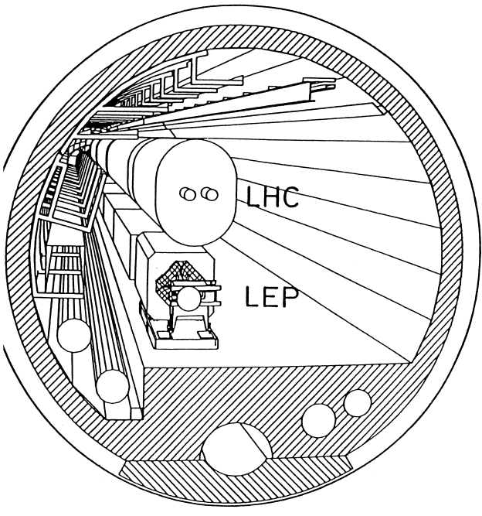


LEP3: Reusing the LEP/LHC Tunnel
T. Camporesi, May 8, 2025, LIP
https://indico.cern.ch/event/1439855/abstracts/191093/

Slide 2
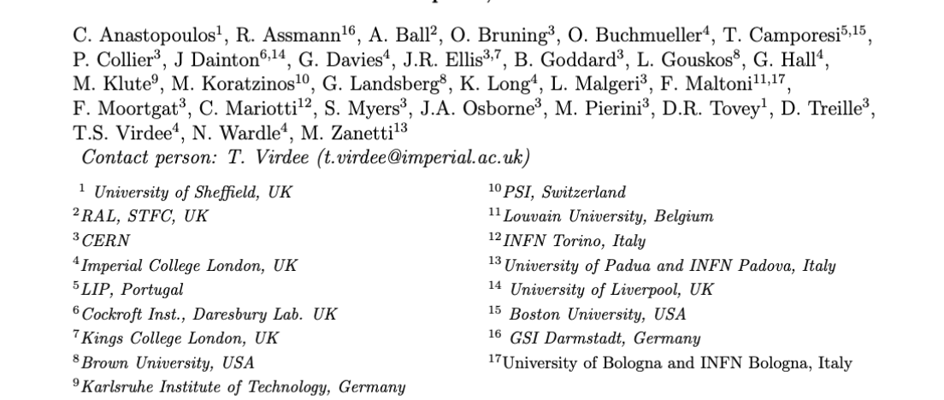
A group of concerned people
We thought that a PLAN b (wrt to FCC ee) would need to be a project which can be built within acceptable financial constraints and still address the fundamental questions which had led to recommend a Higgs Factory as the ‘necessary ‘ next step…and a linear collider does not fit this definition ( it is an alternative plan A)

Slide 3
Setting the Scene 1: 2019 ESPP
Recall Recommendations 2019 ESPP
The successful completion of the HL-LHC
Neutrino Platform
An electron-positron Higgs factory is the highest-priority next collider.
R&D effort focused on advanced accelerator technologies, in particular that for high-field superconducting magnets, including high-temperature superconductors
investigate the technical and financial feasibility of a future hadron collider at CERN with √s ~ 100 TeV and with an e⁺e⁻ Higgs and electroweak factory as a possible first stage.
Point e. clearly points to the FCC project, which has been extensively discussed.
Notes:
At the Large Hadron Collider (LHC) at CERN, Geneva we can probe Nature moments after the Big Bang to tackle the questions about the origin, evolution and composition of our universe. These include: What is the origin of mass? What constitutes dark matter? How many dimensions of space and time do we live in? Why is the universe composed of matter and not antimatter? The answers have the potential of altering our perception of how Nature operates at the fundamental level.
The discovery in July 2012 of the Higgs boson at the Large Hadron Collider (LHC), one of the most important of this new century, completes the particle content of the standard model (SM) of particle physics, a theory that describes our visible universe in exquisite detail.
This talk will briefly look into the evolution of our universe from the Big Bang, the fundamental particles and their interactions, the journey to the discovery of the Higgs boson, and look ahead. The CMS experiment is used as an example to briefly recall the physics of the LHC, outline some of the challenges faced during its construction, and major physics results produced so far, including the searches for widely anticipated new physics beyond the SM.

Slide 4
Setting the Scene 2: Request for Alternatives
We support FCC-ee and FCC-hh as the preferred option for CERN’s future
LEP3 is not competitive with FCC-ee, and hence CEPC. If CEPC goes ahead then we would advocate that CERN proceed to FCC-hh in as timely a manner as possible.
ESG Guidance
ESG's remit explicitly states that “The Strategy update should include the preferred option for the next collider at CERN and prioritised alternative options to be pursued if the chosen preferred plan turns out not to be feasible or competitive”.
A major objective in PP: always to operate an accelerator that allows a leap of a factor of 10 in the constituent centre-of-mass (CoM) energy with respect to the previous one.
- Today the two possibilities are the FCC-hh operating at √s~100 TeV or a muon collider operating at √s > 10 TeV.
Notes:
At the Large Hadron Collider (LHC) at CERN, Geneva we can probe Nature moments after the Big Bang to tackle the questions about the origin, evolution and composition of our universe. These include: What is the origin of mass? What constitutes dark matter? How many dimensions of space and time do we live in? Why is the universe composed of matter and not antimatter? The answers have the potential of altering our perception of how Nature operates at the fundamental level.
The discovery in July 2012 of the Higgs boson at the Large Hadron Collider (LHC), one of the most important of this new century, completes the particle content of the standard model (SM) of particle physics, a theory that describes our visible universe in exquisite detail.
This talk will briefly look into the evolution of our universe from the Big Bang, the fundamental particles and their interactions, the journey to the discovery of the Higgs boson, and look ahead. The CMS experiment is used as an example to briefly recall the physics of the LHC, outline some of the challenges faced during its construction, and major physics results produced so far, including the searches for widely anticipated new physics beyond the SM.

Slide 5
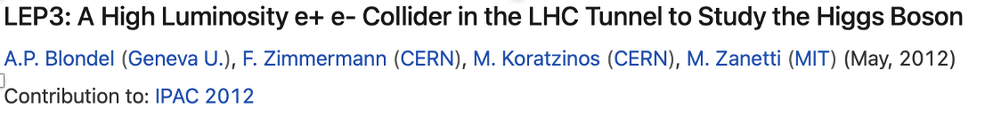
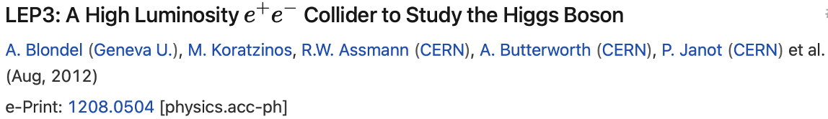
LEP3: why
It is desirable that any back-up to FCC should present fewer technical and/or financial difficulties than those associated with the preferred option, as well as have good physics potential.
To minimise the possibility of such difficulties, the LEP3 strategy is to re-use, as much as possible, the existing infrastructure of CERN, utilise maximally the R&D already carried out for FCCee (needing the same R&D and hardware choices), and keep the required financing within the envelope of the current budget of CERN.
Several others have also discussed such a possibility in the past.
e.g. 2013 ESPP, a Higgs factory (LEP3) was proposed but not pursued any further. [https://cds.cern.ch/record/1471486].
Notes:
At the Large Hadron Collider (LHC) at CERN, Geneva we can probe Nature moments after the Big Bang to tackle the questions about the origin, evolution and composition of our universe. These include: What is the origin of mass? What constitutes dark matter? How many dimensions of space and time do we live in? Why is the universe composed of matter and not antimatter? The answers have the potential of altering our perception of how Nature operates at the fundamental level.
The discovery in July 2012 of the Higgs boson at the Large Hadron Collider (LHC), one of the most important of this new century, completes the particle content of the standard model (SM) of particle physics, a theory that describes our visible universe in exquisite detail.
This talk will briefly look into the evolution of our universe from the Big Bang, the fundamental particles and their interactions, the journey to the discovery of the Higgs boson, and look ahead. The CMS experiment is used as an example to briefly recall the physics of the LHC, outline some of the challenges faced during its construction, and major physics results produced so far, including the searches for widely anticipated new physics beyond the SM.

Slide 6
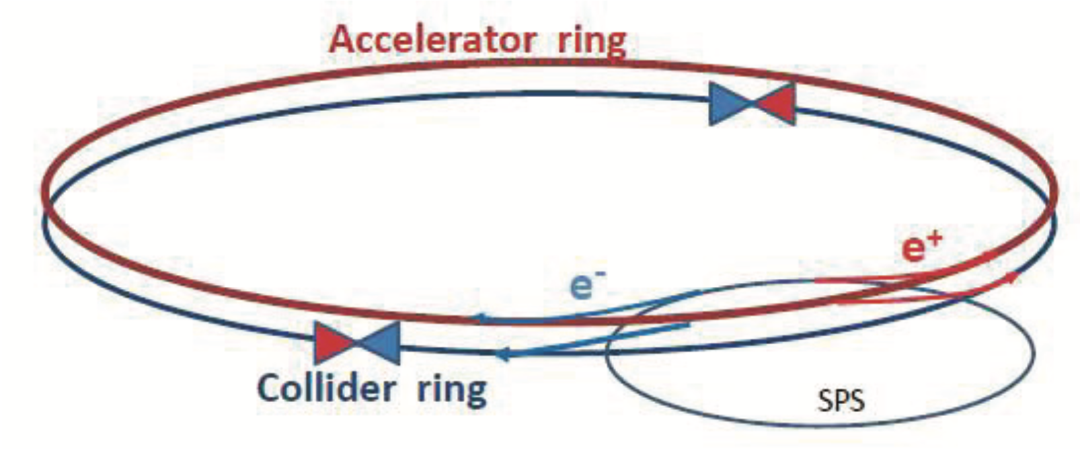
Follow ESPP2013 proposal & FCC(ee) Design
It is not the first time that re-use of the LHC tunnel is proposed
LEP3 installed in the existing LHC/LEP tunnel
Design of LEP3 could follow closely that outlined in FCC MTR and [ESPP 2013: Zimmerman and Blondel (https://cds.cern.ch/record/1471486)].
Separate full energy collider and accelerator (booster) rings, the latter for top-up injection. Electrons and positrons in the collider ring travel in separate beam pipes.
With top-up - beam lifetime ~ 15 minutes (expected to be dominated by loss due radiative Bhabhas) top up ~ few 10¹⁰ electron/s
Earlier work (2013)
Reuse substantial parts of ATLAS and CMS experiments
TLEP(which became FCC later) /LEP3 luminosity ratio of ~5
In our proposal

Slide 7
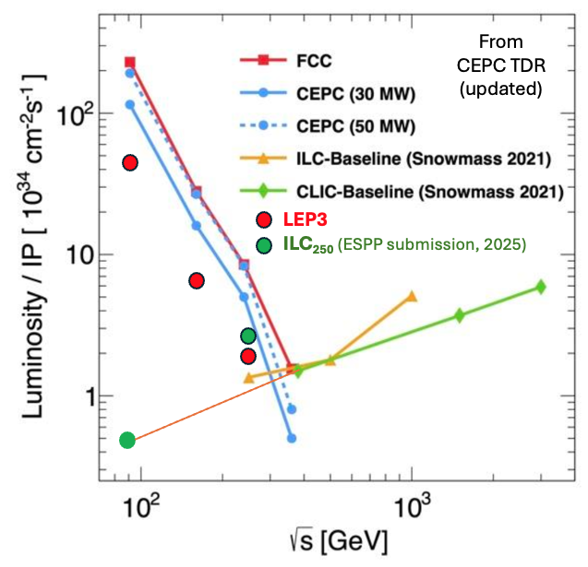
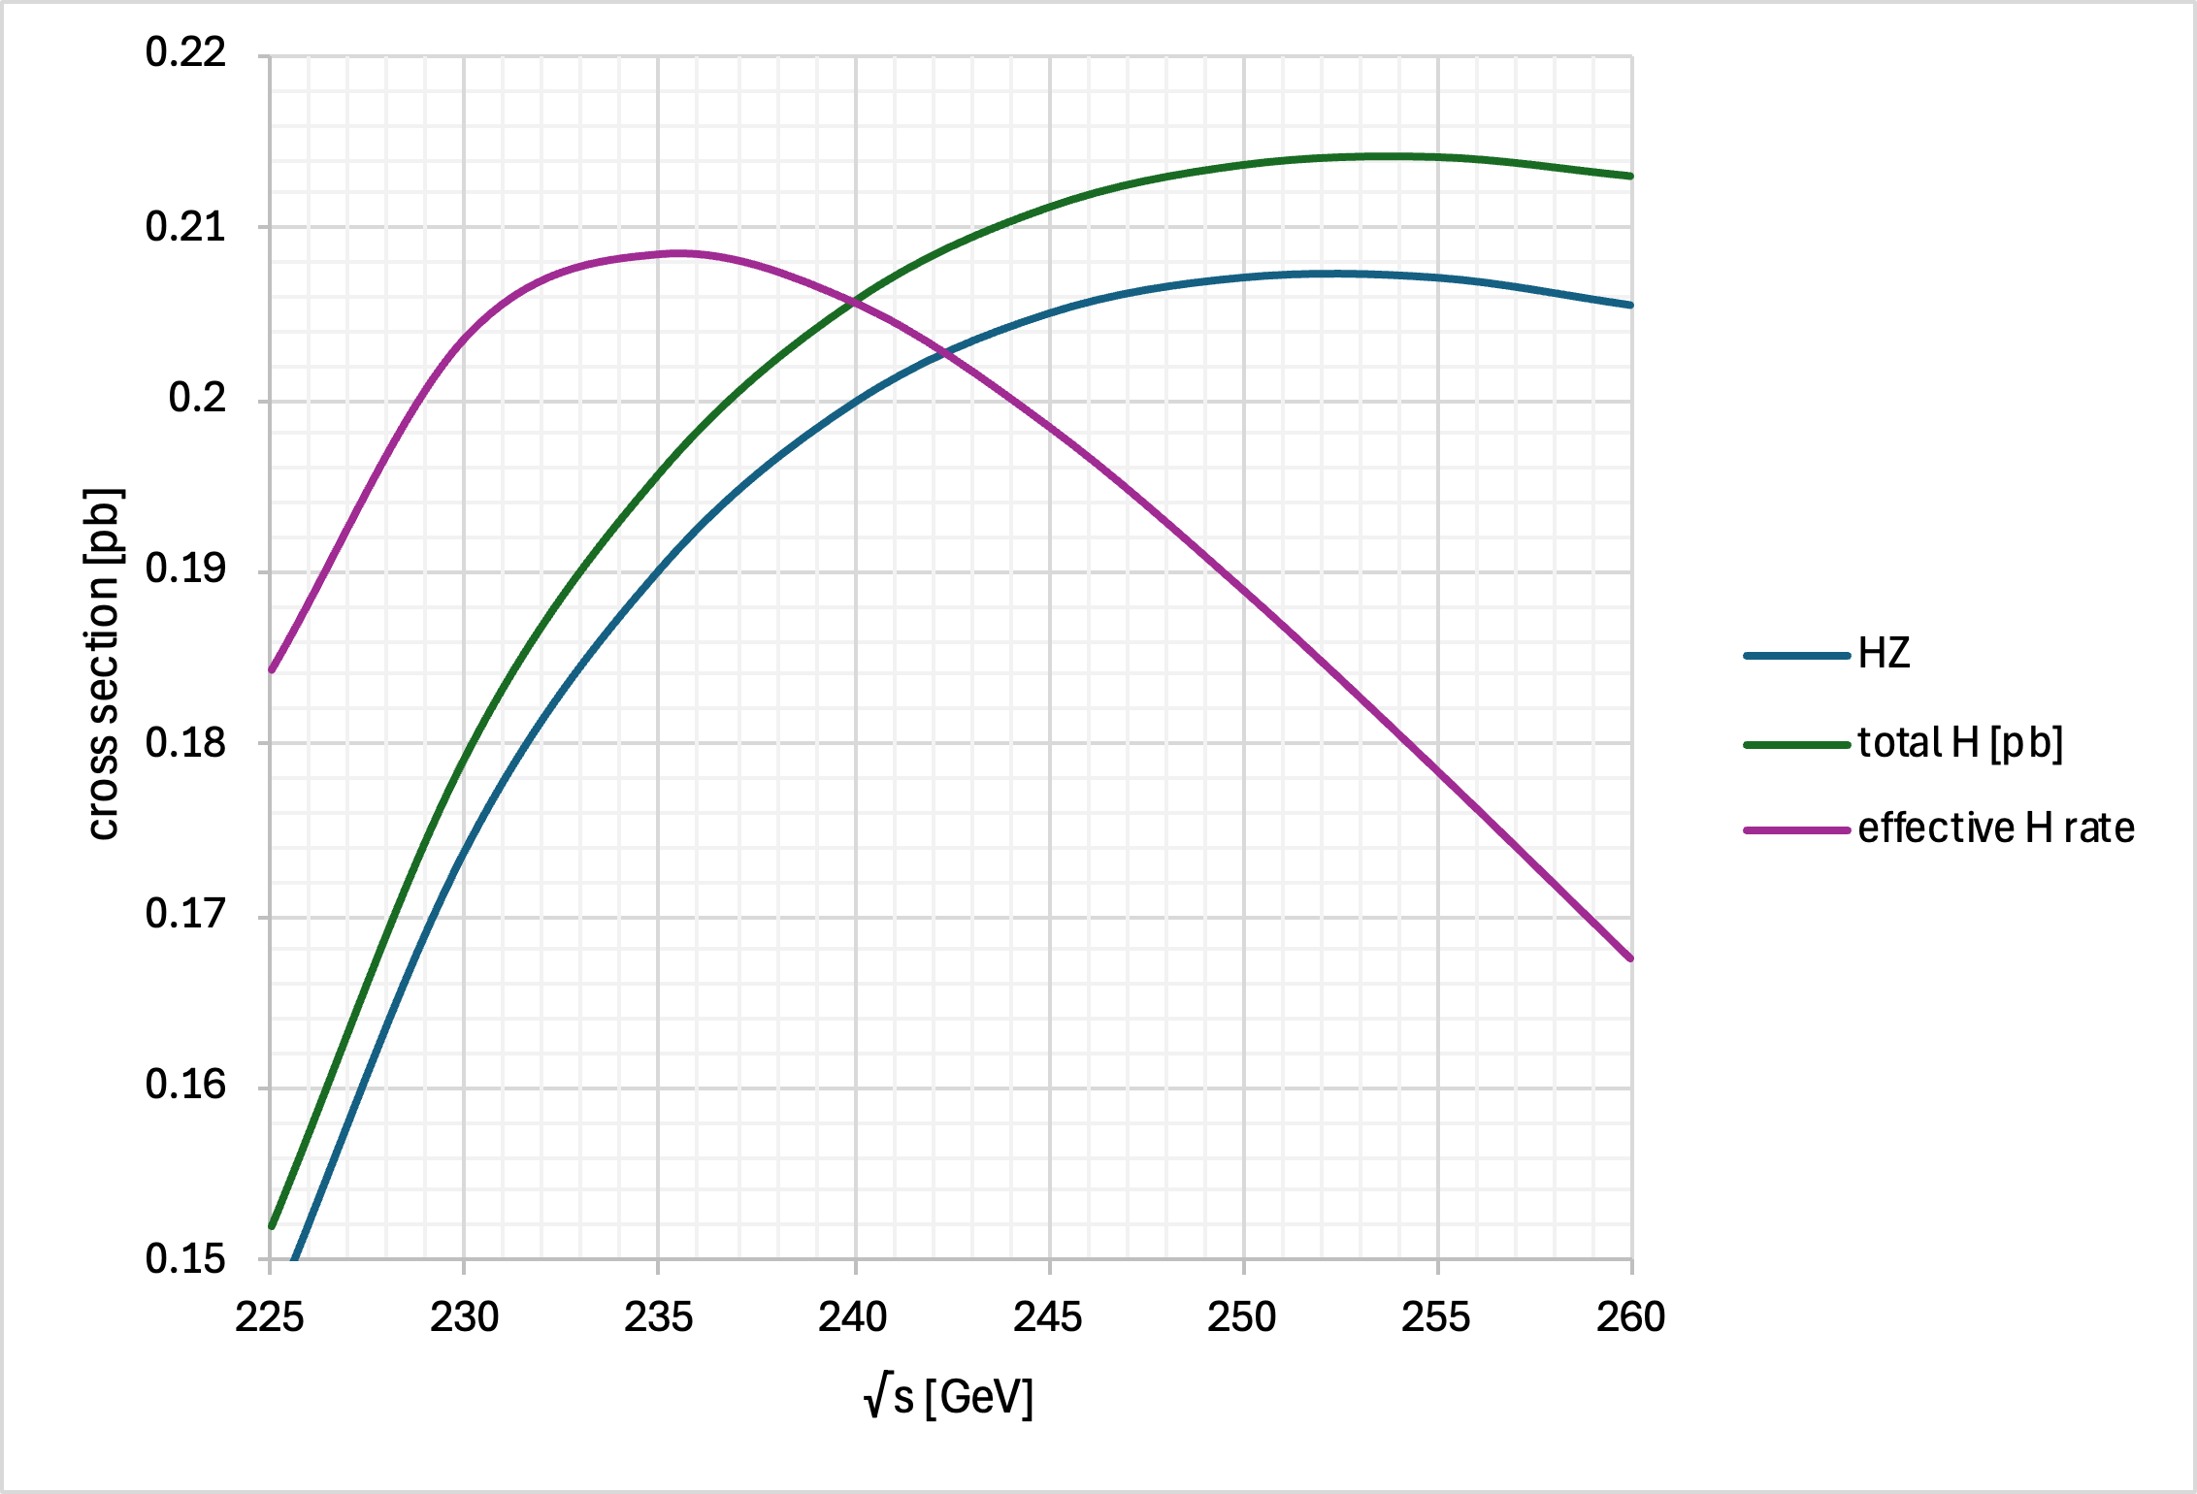
e⁺e⁻ Colliders: Instantaneous Luminosity
In circular e+e- colliders, for the same synchrotron power loss, at a lower energy, more current can be put to increase luminosity.
Htot
HZ
Z
WW
effective H rate
HZ
LEP3: Run at √s =230 GeV
Only 10% higher energy than LEP.
18% lower synchrotron power loss at √s=230 GeV compared with 240 GeV.

Slide 8
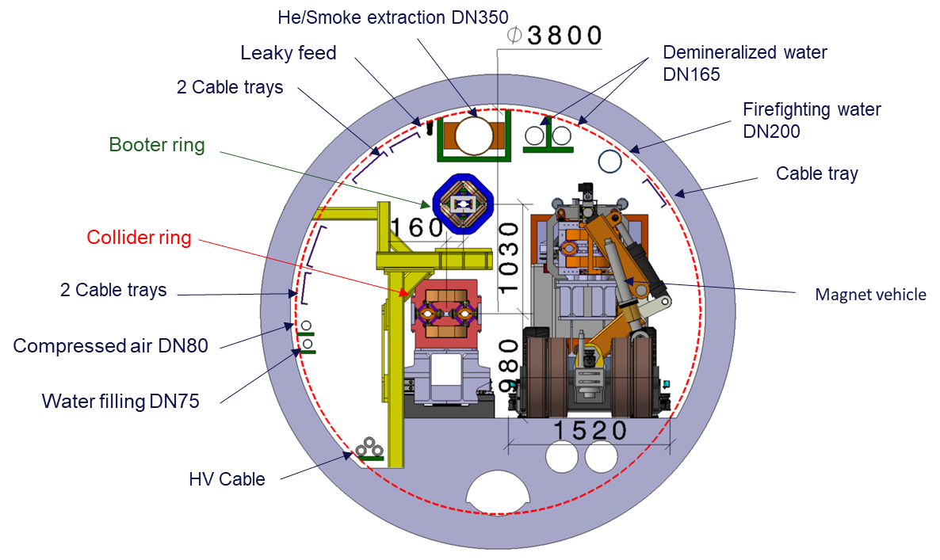
Integration in the tunnel
The LHC has eight arcs and eight long straight sections (LSS). The length of the arcs is ~ 2.45km, and the eight LSS are each~560m long. The inner diameter of the tunnel varies between 3.8m in the arcs and 4.4m in the straight sections (RF would have to be installed in straight sections) .
BOOSTER ring
COLLIDER ring
Integration of the accelerator/booster
and the collider in the arcs.
Note that the booster/accelerator ring
is situated some 1 m above the collider ring.
(courtesy F. Valchkova).

Slide 9
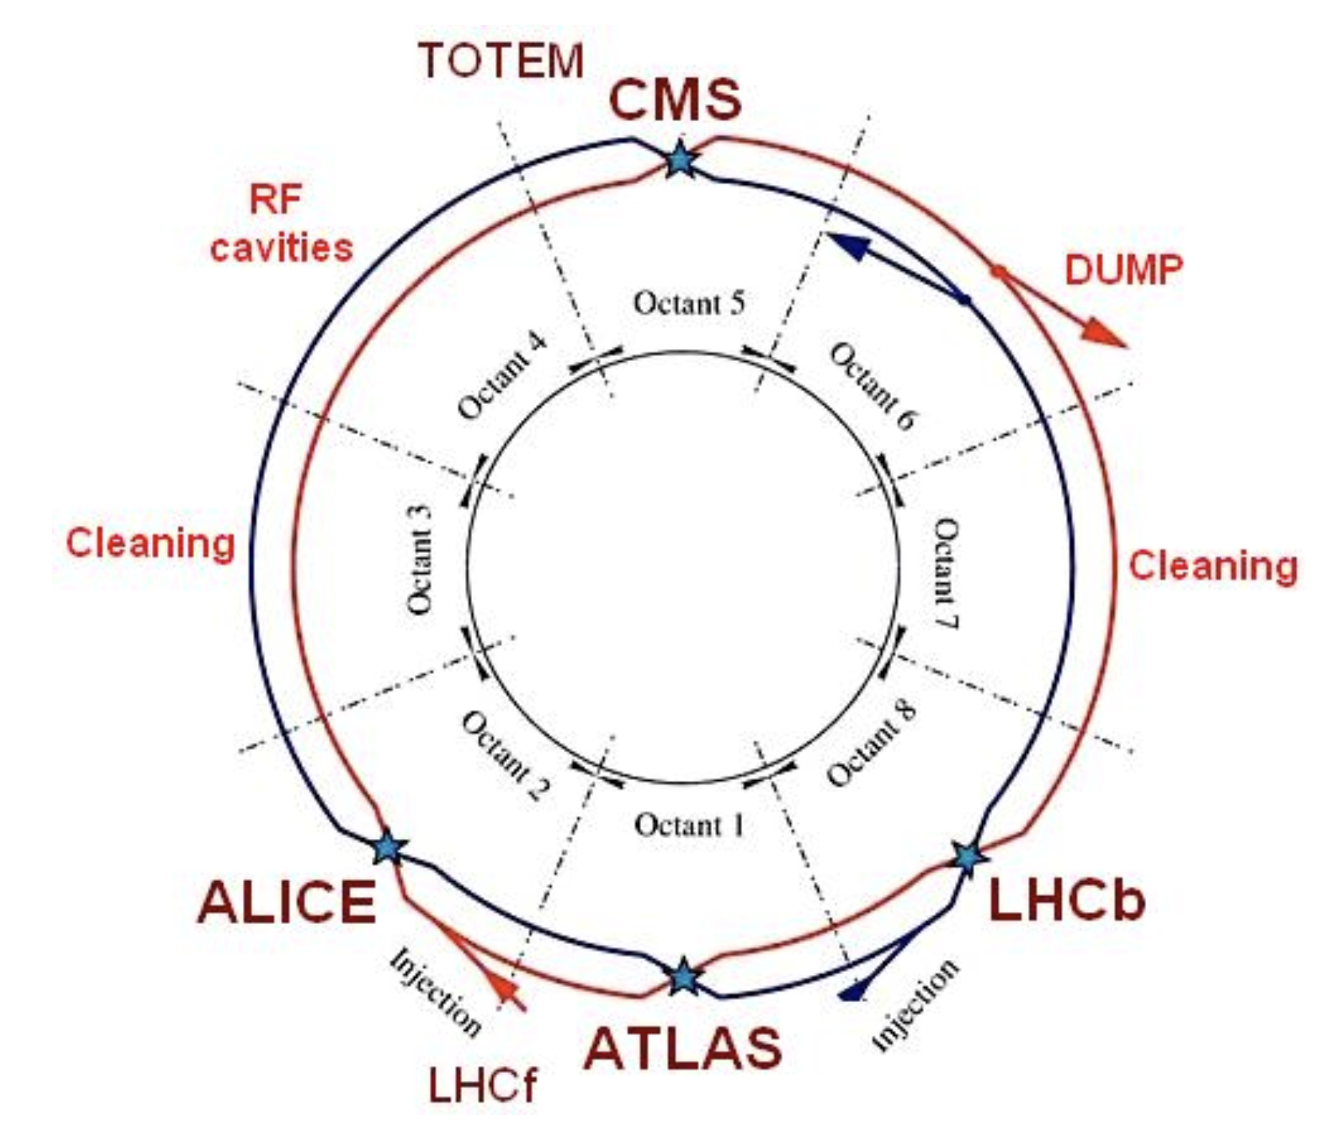
LEP3
The arcs are 2.45-km long, and the straight sections are 545-m long. The inner diameter of the tunnel varies between 3.8m in the arcs and ~ 4.4 m in the straight sections.
Either deploy two new experiment or use re-purposed ATLAS and CMS experiments

Slide 10
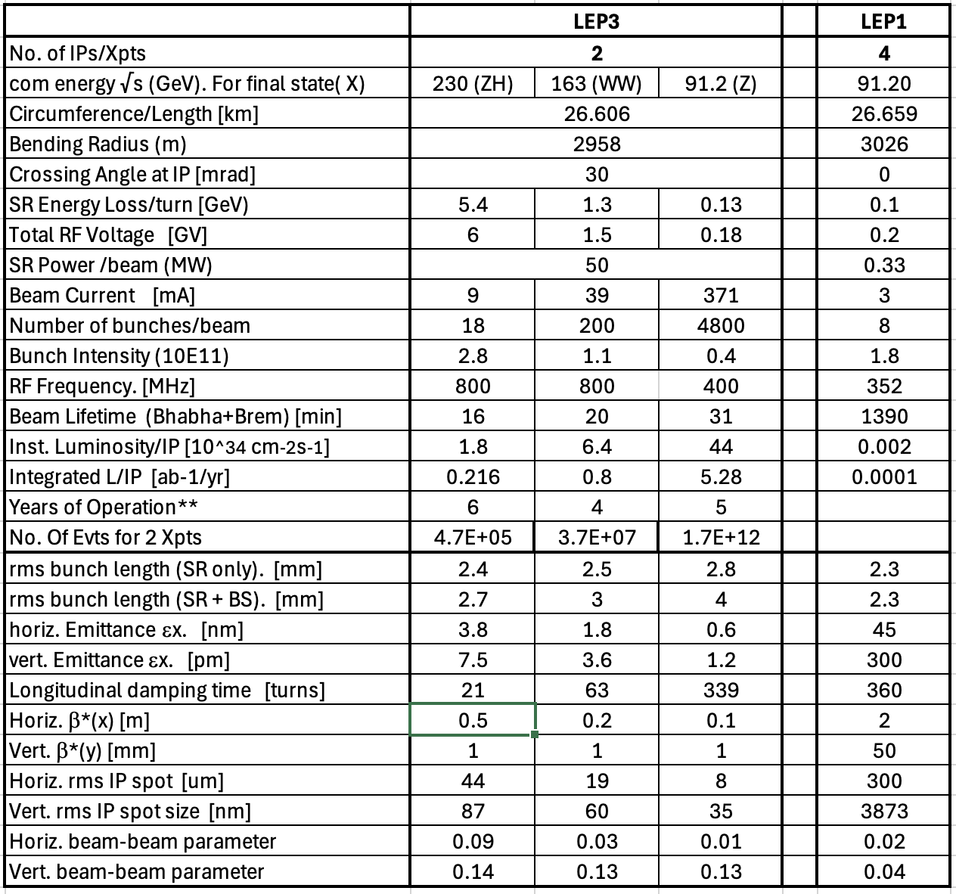
LEP3 Parameters

Slide 11
LEP3 Principal Parameters Abstracted
No. of IPs 2
Highest c.o.m. energy 230 GeV
SR power loss Fix at 50 MW (as for FCC ee)
SR energy loss/turn ~ 5.4 GeV
Total rf Voltage ~ 6 GV (800 MHz, 20MV/m SCRF cavities)
Inst Luminosity ~ 1.8, 6.4, 44 10³⁴ cm⁻²s⁻¹ at 230 GeV, WW threshold and Z- pole resp.
Crossing angle 30 mrad
Running Scenario ~ 20 years programme
e.g. 6 yrs at 230 GeV, 4 years around WW, 5 years around Z
Est. total no. of Events 4.7x10⁵ H, (cf. 6/22 x10⁵H for ILC₂₅₀/FCC-ee)
3.7x10⁷ WW at 163 GeV,
1.7x10¹² Z at 91.2 GeV (cf. 0.001, 6 x10¹²H for ILC₂₅₀ and FCC-ee)
Running time: 185 days of operation at 75% efficiency, with top-up running, giving 1.2 10⁷ s/year of running
LEP3 can be competitive with alternatives wrt Higgs and E-W physics

Slide 12
Why better than LEP ?
LEP3 orders of magnitude increase of luminosity (at Z peak expect ~10000) are due to making it FCC –like
synchrotron power loss that is increased from 0.315 MW to 50MW leading to an increase in the instantaneous luminosity of factor 160. ( RF power is indeed a key cost item!)
LEP was limited in the number of bunches due to its single beam pipe
β*_{y} is 1mm for LEP3 whilst it was ~40mm for LEP (this increases the instantaneous luminosity by a factor of ~ 40)
vertical beam-beam parameter of 0.05 for LEP3 compared with 0.11 for LEP (increase in instantaneous luminosity of a factor of 2.2)
On the minus side: hourglass factor of 0.76 for LEP3 whilst it was 0.99 for LEP (decrease in instantaneous luminosity of a factor of 1.3)

Slide 13
Hourglass effect
Hourglass Shape:
The betatron function often exhibits a "hourglass" shape, meaning it's smaller near the IP and larger further away from it. This shape is a result of the focusing and defocusing of the beams as they travel through the accelerator.
Luminosity Reduction:
Because the beam is larger outside the IP, the actual probability of collisions is lower than if the beam remained at its smallest size throughout. This reduced collision probability translates into a lower luminosity.

Slide 14
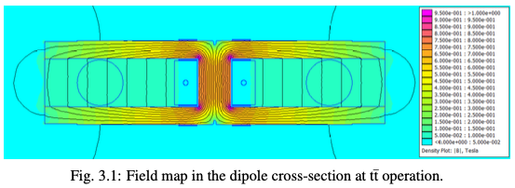
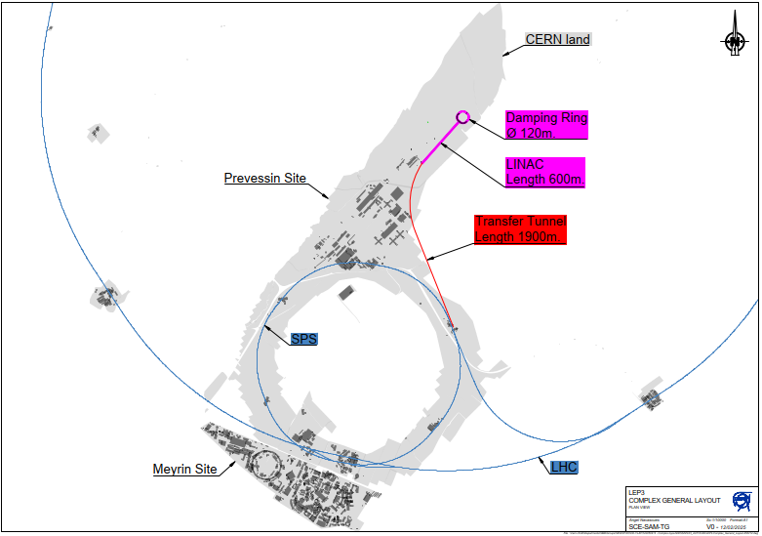
Choice of Components: Dipole Magnets & Injector
Follow FCC(ee) design
Instantaneous Luminosity [CEPC or FCC(ee) / LEP3] ~5; ~ 1.8×10³⁴ cm⁻²s⁻¹ per IP
Use FCC designs
for magnets
Dedicated linac injector on Prevessin site;
Injection energy lowered from 20 to 10 GeV.
(Sensitive to field quality of bending magnets
at injection.)
FCC Feasibility Study

Slide 15
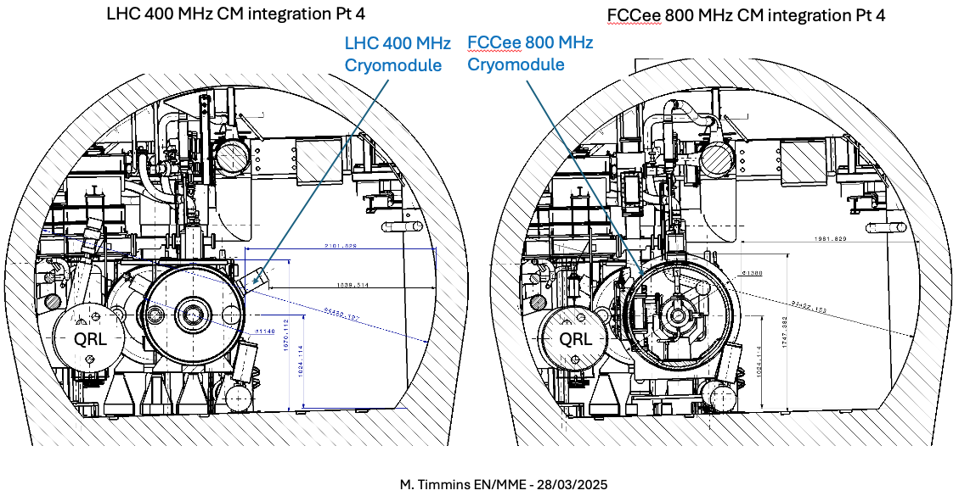
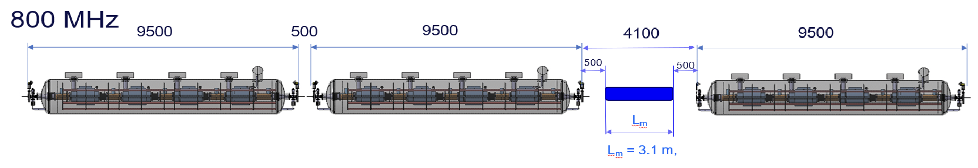
Choice of Components: RF System
RF: Energy loss/turn @ √s=230 GeV: 5.1 GeV.
  A total 6.0 GV to be installed, with the same margin as FCCee
For Z running: Investigating use of 400MHz 1-cell (0.9 MW) cavities/CRM. The beam current is too high to use 800 MHz cavities. Separate cavities for e- and e+
For WW and ZH running, and booster: use 800 MHz 6-cell, 0.9 MW, 20 MV/m sc bulk niobium cavities run at 2K. One set for the booster and one set for the collider, each set in two LSS. The two colliding beams share RF. Still to check integration of booster RF.

Slide 16
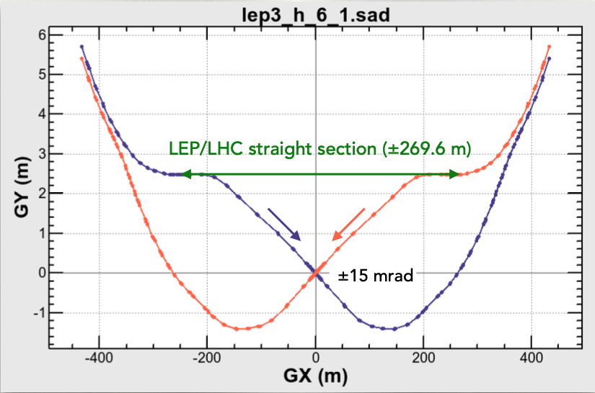
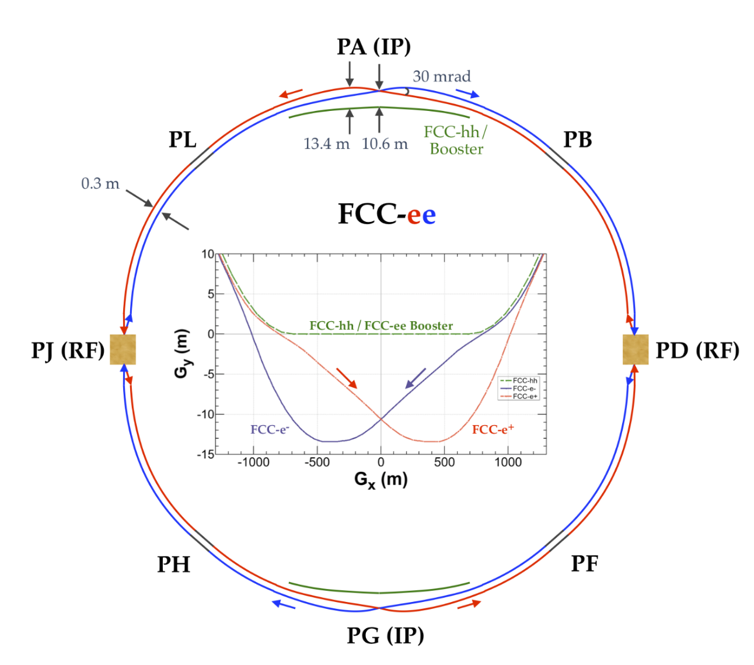
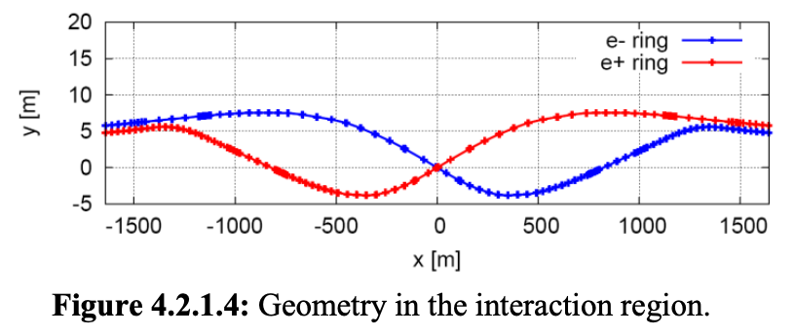
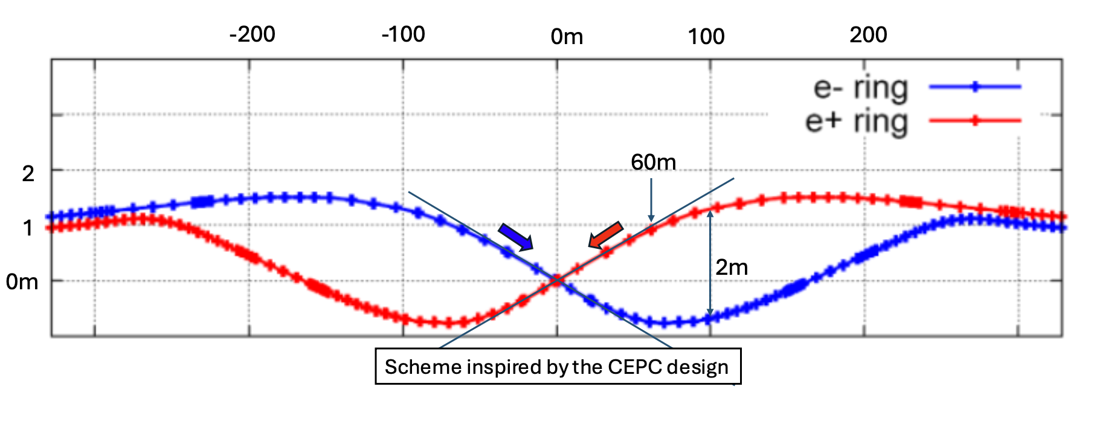
Crossing Angle
FCC ->LEP3
Axis of tunnel off by 2m wrt IP in FCC
CEPC
CEPC-> LEP3
CEPC optics does not have the issue No bending magnets placed in straight section within 70m of the collision points.

Slide 17
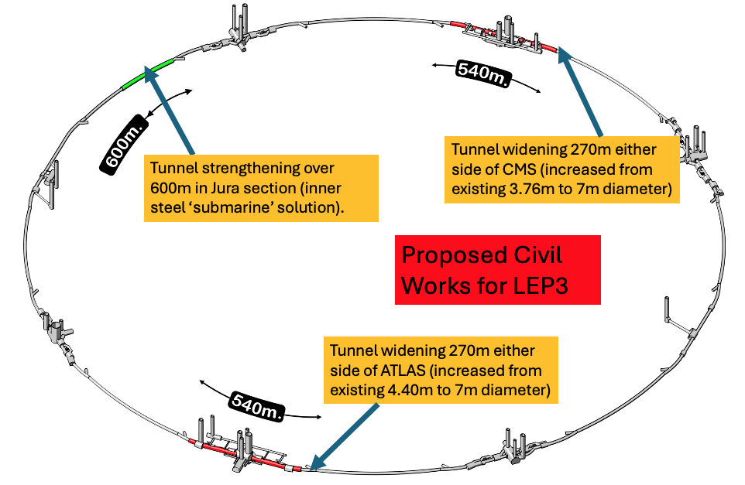
Cvil Engineering
  40 years old infrastructure, some parts need maintainance
  High lumi achieved by crab-waist → large xing-angle → need to widen the LSS cross section on either side of the experiments
  possibly need of by-passes (avoidable if booster Beam pipe goes through detector)
  Overall civil engineering cost estimated: 165 MCHF

Slide 18
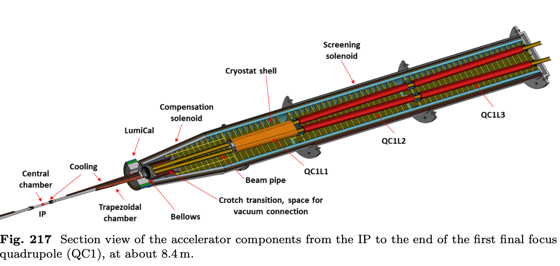
Experiments-Machine Detector Interface
Assume that the ATLAS and CMS experiments can be re-used with suitable modification (rebuilding of the inner trackers and the integration of focusing quadrupoles some 2m from the IP). Keep magnets but at lower fields. Trackers costing around MCHF 100/per experiment are assumed. (Re-using ATLAS & CMS Should save the community >1BCHF)
Exploit all R&D done for ILC, CLIC and FCC(ee) detectors as well as LHC upgrades.
Baseline: Accelerator(booster) beam passes through tracker. If too much of perturbation then need bypasses.
All of the above need detailed studies.
From FCC MTR: Integration of IR optics. Independent beam pipes ~ 1-2m from IP.

Slide 19
Other aspects
Energy Calibration: For Z running, use the FCC-ee approach ( ie. Having non colliding bunches which allow frequent monitoring of the polarization
For WW running, see if under special running conditions adequate levels of polarization can be achieved at energies close to or at the WW threshold. Failing this, aim is to use the resonant depolarization method at the highest energy possible, and extrapolate to the WW threshold. Needs further study.
Beam energy spread: Our estimate is that the total beam energy spread at E_{b}=M_{Z} at LEP3 is 230 MeV, we believe a value similar to that for FCC-ee.
Sustainability: We assume that all building permissions/permits for LEP3 should be in place. Environmental impact should be minimal. Allowance probably needed for regulations that may have changed since the time of the construction of LEP. Benefit should be drawn from any relevant studies in these areas carried out for other proposed projects such as FCC-ee or CLIC.
Power Consumption: We estimate that the total power consumption at the highest LEP3 energy will be about 250MW, like that of HL-LHC. Usage of high-temperature superconducting quadrupoles and sextupoles (HTS) magnets in the arcs would help in keeping this figure low.

Slide 20
Planned Stages
The LEP3 physics programme would have three phases,
near or on the Z peak (91 GeV), recording 1×10¹² Z decays over 5 years
near the WW threshold~ 2.4×10⁷ WW events at and around √s = 163 GeV over four years
near the ZH threshold (at 230 GeV). ~ 4.7×10⁵ e⁺e⁻→ ZH events would be recorded over 5 years at √s = 230 GeV.
For comparison with other projects:
Statistical errors scale as √(ratio of no. of events). Systematic errors have to be evaluated on a case by case basis.
Here comparable detector performance is assumed.
LEP3 is competitive with other alternatives and considerably better for e-w physics

Slide 21
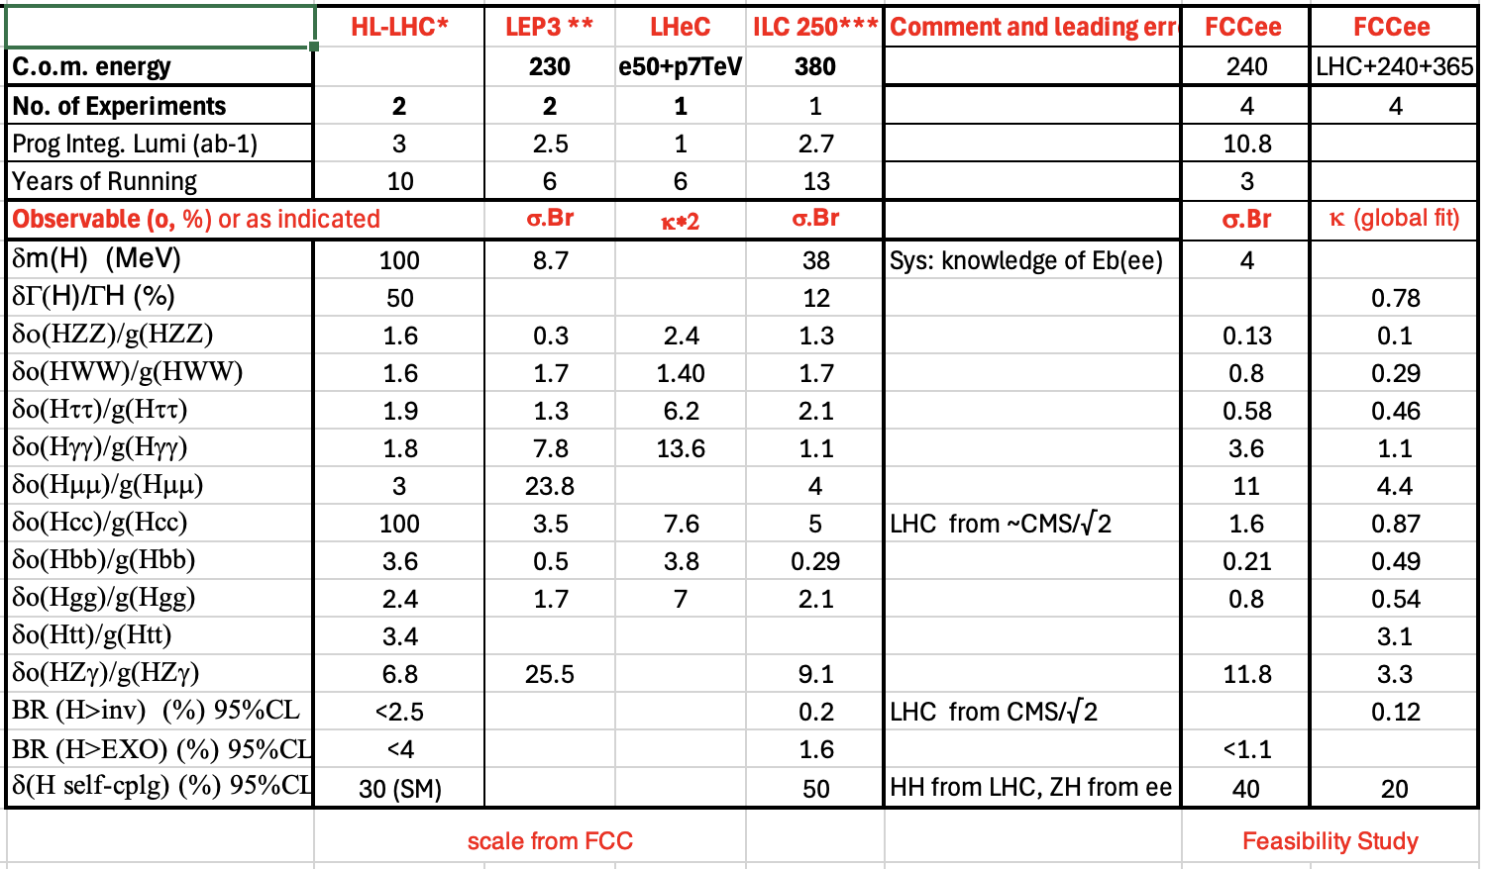
Higgs boson physics 2
Preliminary
To be checked
LEP3 can be competitive with other alternatives
240 (√(22/4.7) )
LEP3 ~ 4.7x10⁵ H bosons (6 yrs 2 expts) cf FCC(ee) ~2.2 × 10⁶ (3 yrs 4 expts)

Slide 22
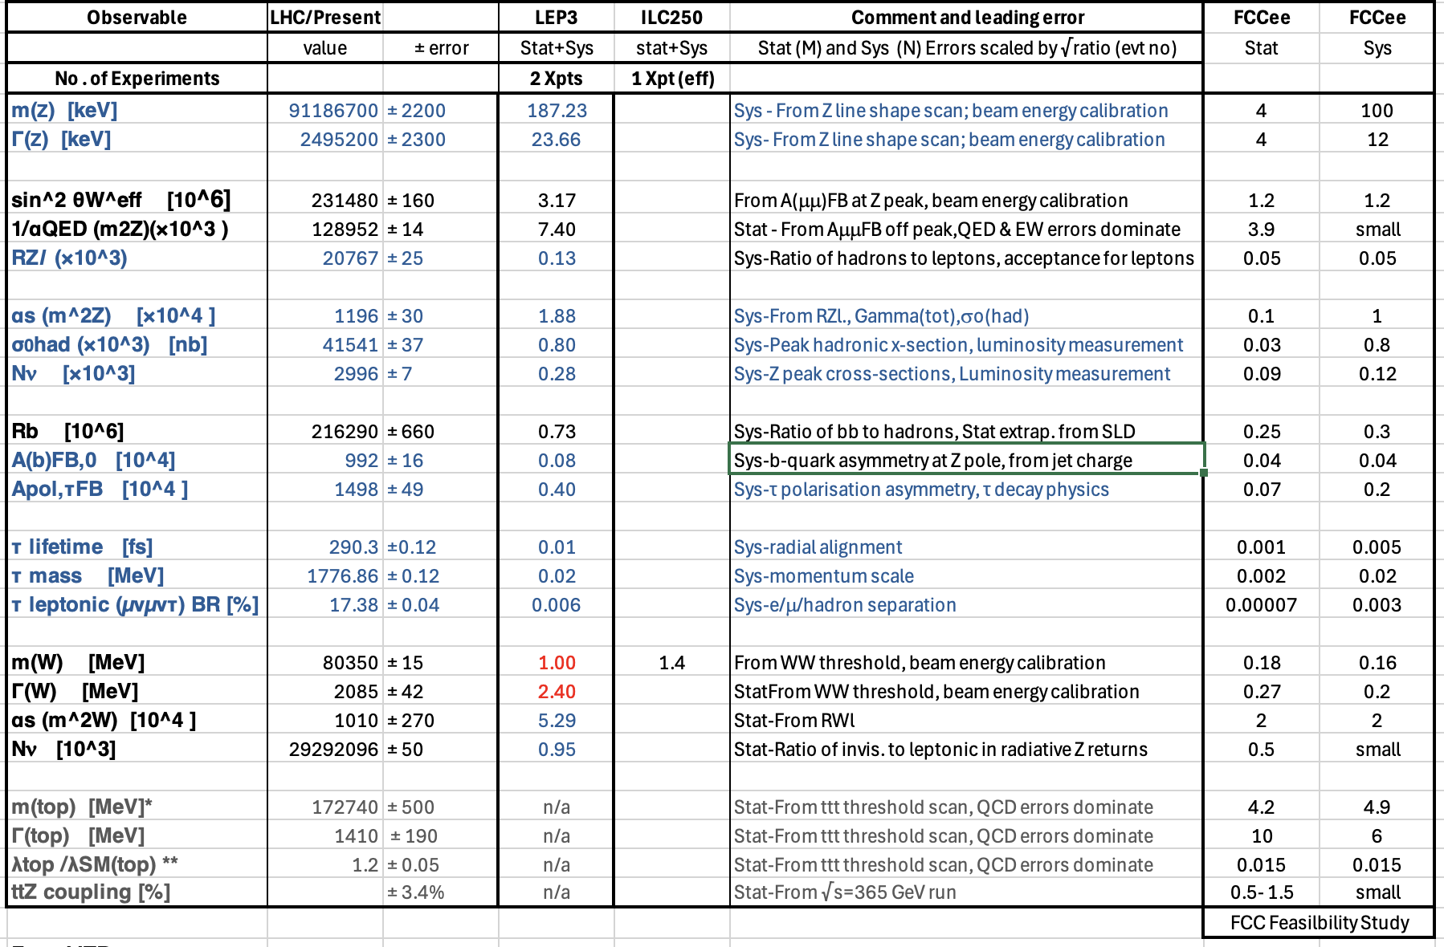
E-W physics 1
~1.7x10¹² Z bosons (5 yrs at 91.2 GeV), and ~ 2.5×10⁷ WW pairs (2 eff yrs at √s=163 GeV)
cf FCC(ee) ~6 × 10¹² and ~1.5 × 10⁸ resp.
Preliminary
To be checked and updated
2920

Slide 23
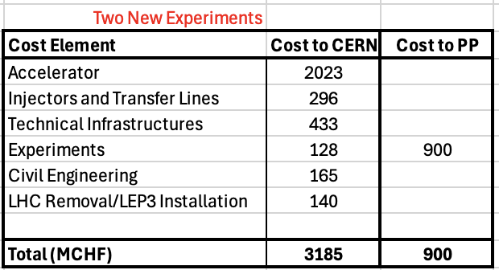
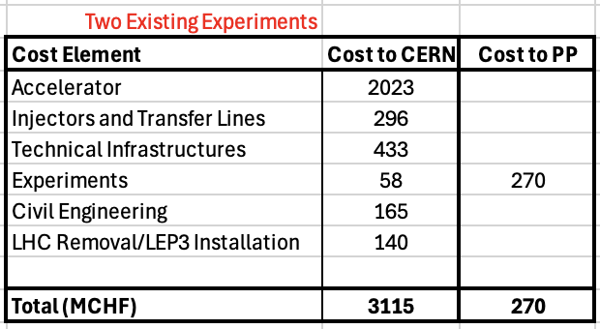
Cost
Use the FCCee costing methodology.
Costs scaled from FCC(ee) MTR costs: scaled according to numbers of components required
With assumed schedule (see next) LEP3 cost would be well within the standard CERN budget, allowing pursuit of other future-oriented initiatives [e.g. R&D on rf cavities (high gradient, low power), high-field magnets, muon collider demonstrator]
Cost: assumes careful removal of LHC machine in case it is needed later as an injector.
Funding assumes CBD paid off by 2035; 250 (350) MCHF saved/year when only running HL-LHC (when in shutdown).
Sustainability is an important issue: use ideas/proposals from the other projects

Slide 24
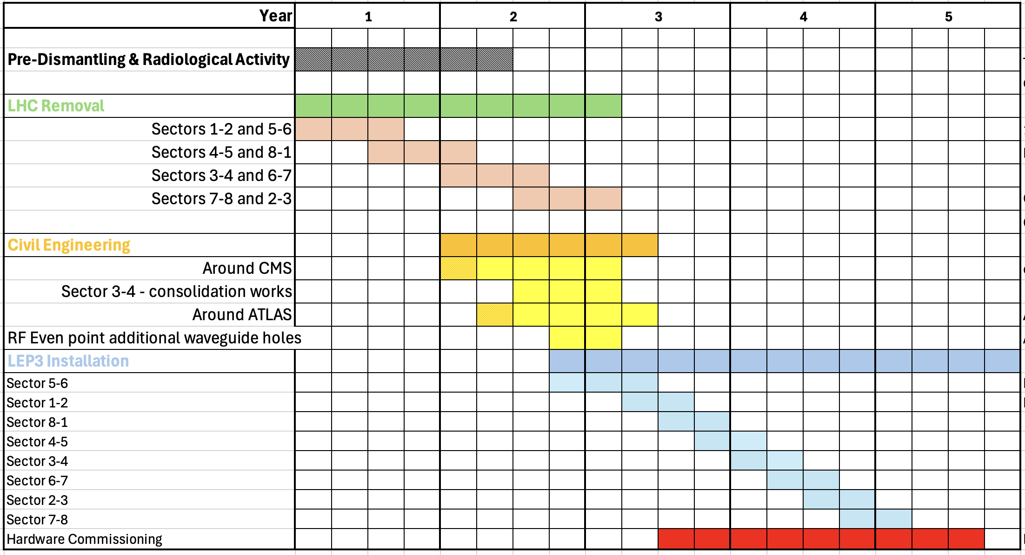
Example: Shutdown Schedule: After LHC stops

Slide 25
Possibilities: The Future Beyond LEP3
Aim: an accelerator with constituent √s ~10 times higher than LHC (1-2 TeV).
If FCC(ee) is built then a ~100 TeV hadron collider would be the obvious next step.
R&D Goal: Develop high field magnets - followed by the setting up for industrial production to provide solid cost estimates.
Muon colliders could provide another approach to reach constituent com energies of 10 TeV or above.
R&D Goal: on muon colliders with along-the-way milestones that still deliver physics as the R&D progresses – e.g. muon driven neutrino beams for experiments such as nuSTORM or those on neutrino/antineutrino factories.
After LEP3 (i.e. after around 30 years from today) perhaps via a worldwide strategy.
If R&D on high field magnets is successfiul and their construction cost and production capacity are known and appear affordable, then a decision could be made to go to a higher energy hadron machine FCC(hh) (~100 TeV).
If R&D on a muon collider is successful, then the option to go to a Muon Collider in the LEP/LHC tunnel could be available.
Another R&D Goal: increase gradient and efficiency of rf cavities and bring down their cost

Slide 26
Summary
We support (FCC-ee + FCC-hh) as the preferred option for CERN’s future
ESPP requests an alternative/ backup option for the preferred one.
An e⁺e⁻ collider in the LHC tunnel, referred to here as LEP3, is proposed as an a backup option
Compared to the linear e⁺e⁻ colliders proposed, LEP3 provides similar luminosity for ZH production, higher luminosity at lower energies and options for multiple experiments, all at much lower cost.
LEP3 is a reasonable (perhaps the best) backup option
Leaves room (time, budget, resources) for further development of THE machine that can probe directly the energy frontier at a constituent √s ~ 10 times LHC.
No showstoppers have yet been identified, and we consider this proposal to be sufficiently interesting to deserve further study. We have identified important areas that would require deeper investigation before CERN could commit to LEP3.

Slide 27
In view of ESSP
Most country submissions seem to support FCC-ee and FCC-hh as the next project for CERN.
Proposing another project with a similar cost would make little sense.
Hence a reasonable backup should be one that builds upon what CERN already has, its infrastructure, its LHC tunnel, use the R&D already carried out, and a cost that can be financed within its current pluri-annual budget.
LEP3 project fulfil such conditions.
In our view the Strategy should recommend
i) find the monies needed for FCC. Give 2-3 years to the CERN DG for doing so.
ii) in parallel recommend that CERN allocates adequate resources to look seriously into the possibility of LEP3. If found attractive, allocate adequate resources to proceed to a TDR by mid-thirties at the latest.

Slide 28
Some open technical Questions
What is the maximum achievable instantaneous luminosity at each planned centre-of-mass energy?
What are the implications of a crossing angle of ~ 30 mrad? Does the tunnel need widening, and over what length, and can the interaction point be centered at the current ATLAS and CMS experiments?
What rf cavities are the most appropriate for LEP3? Can such cavities fit into the existing straight sections in the LEP/LHC tunnel?
If the tunnel needs enlargement or consolidation in some areas, how easily can it be done? How much time will be needed? Is the existing LEP/LHC tunnel concrete (and surrounding rock) activated and to be considered as contaminated waste? Can the cost of civil engineering works be reliably estimated?
What procedures/derogations are required for the removal of LHC elements, especially for those elements considered to be significantly activated? Where will these components be stored?
What is the optimal injection energy into the LEP3 accelerator?
Can the total cost of the whole LEP3 project be kept within CERN’s current budgetary limits.

