Slide 1
Symmetries and quark model
Elisabetta Naldi
May 2, 2025

Slide 2
Indices
Symmetries
Symmetries in physics
The group SU(2)
SU(2) for quarks
SU(2) for antiquarks
The group SU(3)
SU(3) for quarks
The plane $I_{3}−Y$
$q\overline{q}$-state: Mesons
$qqq$-state: Baryons

Slide 3
1. Symmetries
A symmetry is a transformation that leaves a system invariant
For a unitary wavefunction transformation
$$\left|\left.ψ\right\rangle \right.→\left|\left.ψ′\right\rangle =U\left|\left.ψ\right\rangle \right.\right.$$
The physics must be invariant so
$$\left\langle ψ | ψ\right\rangle =\left\langle ψ′ | ψ′\right\rangle →U^{†}U=I$$
Moreover, if $U$ is a symmetry transformation, it must commute with the Hamiltonian of the system
$$\left[H,U\right]=0$$
Furthermore, each symmetry can be built up from a series of infinitesimal transformation of the form:
$$U=I+iεG$$
G is the generator of the transformation
$G^{†}=G$
$\left[H,G\right]=0$

Slide 4
1.1 Symmetries in physics
The fact that proton and neutron masses are similar, leads us to think that they can be two configuration of the same particle named nucleon similarly to the spin of an electron.
So, we introduce the isospin, and say that:
The nuclear force is symmetric for exchange of p and n.
Each nucleon has isospin $I=\frac{1}{2}$ and third component $I_{3} =±\frac{1}{2}$
By replacing $p→u$ and $n→d$ we can extend the isospin symmetry to quarks
$$q=\left({u \atop d}\right)$$
and say that:
The strong interaction possesses a SU(2) flavour symmetry

Slide 5

2. The group SU(2)
The SU(2) is:
Unitary complexes matrices 2x2
$Det =I$
Generators ${(n}^{2}−1)=3$ : $J_{i}=\frac{1}{2}σ_{i}$
$σ_{i}$known as Pauli matrices
$$σ_{1}=\left(\begin{matrix}0 & 1 \\ 1 & 0\end{matrix}\right), σ_{2}=\left(\begin{matrix}0 & −i \\ i & 0\end{matrix}\right), σ_{3}=\left(\begin{matrix}1 & 0 \\ 0 & −1\end{matrix}\right)$$
Algebra: $\left[J_{i},J_{j}\right]=i{ε_{ijk} J}_{k}$ (algebra of rotation)

Slide 6
2.1 SU(2) for quarks
Isospin $∼$ spin
SU(2) symmetry
generators $T_{i}=\frac{1}{2}σ_{i}$satisfy:
$$\left[T_{i},T_{j}\right]=i{ε_{ijk} T}_{k}$$
Acting on the up and down quark in the abstract flavour space
$$u=\left({1 \atop 0}\right), d=\left({0 \atop 1}\right)$$
In analogy with the angular momentum theory, we can label the eigenstate of the system with two quantum numbers
$${T^{2}=T_{1}^{2}+T_{2}^{2}+ T}_{3}^{2} and T_{3}$$

Slide 7
2.1 SU(2) for quarks
Such that:
$$\left\{\begin{aligned}T^{2}u=\frac{3}{4}u \\ T^{2}d=\frac{3}{4}d\end{aligned} , \left\{\begin{aligned}T_{3}u=\frac{1}{2}u \\ T_{3}d=−\frac{1}{2}d\end{aligned}\right.\right.$$
For later convenience we define the following operators: the “ladder operators”
$$T_{±}=T_{1}±iT_{2}$$
Such that:
$$\left\{\begin{aligned}T_{−} u=d \\ T_{+} u=0\end{aligned}\right. , \left\{\begin{aligned}T_{−} d=0 \\ T_{+} d=u\end{aligned}\right.$$

Slide 8
2.2 SU(2) for antiquarks
Example: consider a rotation through $π$ about the 2-axis:
$$q^{′}=\left({u′ \atop d′}\right)=e^{−\frac{iπσ_{2}}{2}}\left({u \atop d}\right)=−iσ_{2}\left({u \atop d}\right)=\left(\begin{matrix}0 & −1 \\ 1 & 0\end{matrix}\right)\left({u \atop d}\right)$$
And then applying the conjugation operator: $Cq=\overline{q}$
$${\overline{q}}^{′}=\left({\overline{u}′ \atop d′}\right)=\left(\begin{matrix}0 & −1 \\ 1 & 0\end{matrix}\right)\left({\overline{u} \atop \overline{d}}\right)$$
To make it transform as the quark doublet we must reorder it and introduce a minus sign:
$${\overline{q}}^{′}=\left({−\overline{d}′ \atop \overline{u}′}\right)=\left(\begin{matrix}0 & −1 \\ 1 & 0\end{matrix}\right)\left({−\overline{d} \atop \overline{u}}\right)$$
The antiquark doublet is $(−\overline{d},\overline{u})$

Slide 9
3. The group SU(3)
Set of unitary matrices 3x3
$Det =I$
Generators ${(n}^{2}−1)=8 →\hat{T_{i}}=\frac{1}{2}λ_{i}$
Algebra ${[λ}_{i},λ_{j}]=i f_{ijk} λ_{k}$
They are written in terms the Gell-Mann matrices $λ_{i}$:
$$λ_{1}=\left(\begin{matrix}0 & 1 & 0 \\ 1 & 0 & 0 \\ 0 & 0 & 0\end{matrix}\right), λ_{2}=\left(\begin{matrix}0 & −i & 0 \\ i & 0 & 0 \\ 0 & 0 & 0\end{matrix}\right), λ_{3}= \left(\begin{matrix}1 & 0 & 0 \\ 0 & −1 & 0 \\ 0 & 0 & 0\end{matrix}\right), { λ}_{4}=\left(\begin{matrix}0 & 0 & 1 \\ 0 & 0 & 0 \\ 1 & 0 & 0\end{matrix}\right),$$
$$λ_{5}=\left(\begin{matrix}0 & 0 & −i \\ 0 & 0 & 0 \\ i & 0 & 0\end{matrix}\right), λ_{6}=\left(\begin{matrix}0 & 0 & 0 \\ 0 & 0 & 1 \\ 0 & 1 & 0\end{matrix}\right), λ_{7}=\left(\begin{matrix}0 & 0 & 0 \\ 0 & 0 & −i \\ 0 & i & 0\end{matrix}\right), λ_{8}=\frac{1}{√3}\left(\begin{matrix}1 & 0 & 0 \\ 0 & 1 & 0 \\ 0 & 0 & −2\end{matrix}\right)$$

Slide 10
3. The group SU(3)
Since Pauli matrices appear in $λ_{1},λ_{2},λ_{3}$ (generators of the SU(2) group) then the
Isospin symmetry is conserved
There are two diagonal matrices:
$$λ_{3}= \left(\begin{matrix}1 & 0 & 0 \\ 0 & −1 & 0 \\ 0 & 0 & 0\end{matrix}\right), λ_{8}=\frac{1}{√3}\left(\begin{matrix}1 & 0 & 0 \\ 0 & 1 & 0 \\ 0 & 0 & −2\end{matrix}\right)$$
The eigenvalues of these matrices label the physical states involved in the strong interaction

Slide 11
3.1 SU(3) for quarks
The group SU(3) is important to extend the flavour symmetry to the strange quark.
Representing the quarks as
$$u=\left({1 \atop \begin{matrix}0 \\ 0\end{matrix}}\right), d=\left({0 \atop \begin{matrix}1 \\ 0\end{matrix}}\right), s=\left({0 \atop \begin{matrix}0 \\ 1\end{matrix}}\right)$$
It can be shown that there is symmetry for $u↔s$ and $d↔s$
The quantum numbers associated to the two diagonal matrices are the eigenvalues of the third component of isospin $T_{3}$ and the hypercharge $Y$:
$$\left\{\begin{aligned}T_{3}=\frac{1}{2}λ_{3} \\ Y=\frac{1}{√3}λ_{8}\end{aligned}→ \left\{\begin{aligned}T_{3} u=\frac{1}{2} u \\ T_{3} d=−\frac{1}{2}d \\ T_{3} s=0\end{aligned}\right., \left\{\begin{aligned}Y u=\frac{1}{3}u \\ Y d=\frac{1}{3}d \\ Y s=−\frac{2}{3}s\end{aligned}\right.\right.$$

Slide 12
3.1 SU(3) for quarks
As before for later convenience we define the ladder operators using the remaining $λ$-matrices
$$\left\{\begin{aligned}T_{±}=\frac{1}{2}\left(λ_{1}±i λ_{2}\right) d↔u \\ V_{±}=\frac{1}{2}\left(λ_{4}±i λ_{5}\right) s↔u \\ U_{±}=\frac{1}{2}\left(λ_{6}±i λ_{7}\right) d↔s\end{aligned}\right.$$
These operators will allow us to move between states t

Slide 13
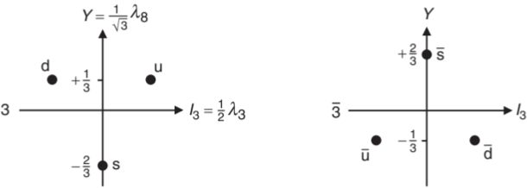
4. The plane $I_{3}−Y$
We saw that
$$\left\{\begin{aligned}T_{3} u=\frac{1}{2} u \\ T_{3} d=−\frac{1}{2}d \\ T_{3} s=0\end{aligned}\right., \left\{\begin{aligned}Y u=\frac{1}{3}u \\ Y d=\frac{1}{3}d \\ Y s=−\frac{2}{3}s\end{aligned}\right., \left\{\begin{aligned}T_{3} \overline{u}=−\frac{1}{2}\overline{u} \\ T_{3} \overline{d}=\frac{1}{2}\overline{d} \\ T_{3}\overline{s}=0\end{aligned}\right., \left\{\begin{aligned}Y\overline{u}=−\frac{1}{3}\overline{u} \\ Y\overline{d}=−\frac{1}{3}\overline{d} \\ Y\overline{s}=\frac{2}{3}\overline{s}\end{aligned}\right.$$
So, we can put the quarks and antiquarks into an abstract plane

Slide 14
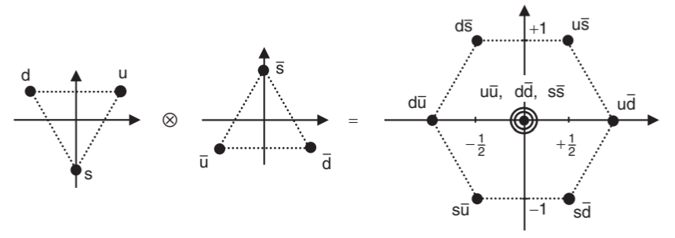
5. $q\overline{q}$-state: Meson
Mesons are obtained by composition of two quarks $q\overline{q}$. Mathematically this corresponds to decompose the tensor product of two quarks into an octect and a singlet that is:
$$3⊗\overline{3}=8⊕1$$

Slide 15
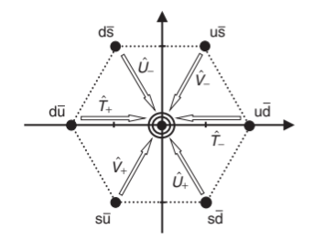
5. $q\overline{q}$-state: Meson
The singlet state can be obtained using one of the ladder operators defined before.

Slide 16
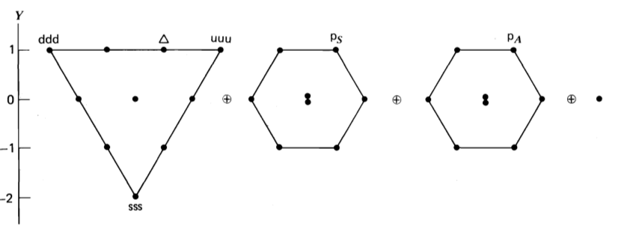
6. $qqq$-state: Baryons
Baryons are obtained by composition of three quarks $qqq$. Mathematically this corresponds to decompose the tensor product as follows:
$$\left(3 ⊗3\right)⊗3=\left(6⊕\overline{3}\right)⊗3→ \left\{\begin{aligned}6⊗3=10 ⨁ 8 \\ \overline{3}⊗3=8 ⨁ 1\end{aligned}\right.$$
$$⇉ \left(3 ⊗3\right)⊗3=10 ⨁ 8⊕8⊕1$$

Slide 17
THE END

Slide 18
References
Thompson, M. (2013). Modern Particle Physics. Cambridge University Press.
Francis Halzen & Alan D. Martin, Quarks & Leptons
Carlo Di Fraia, “Fisica delle Particelle Elementari”. Università degli Studi di Napoli Federico II. (Carlo Di Fraia, “Fisica delle Particelle Elementari”. Università degli Studi di Napoli Federico II)

