Slide 1


The 13th IDPASC School at University of Palermo
September 17–27, 2024
M. Mallamaci & G. Marsella (+ G. M. Cicciari)

Slide 2
IDAPSC School at Palermo
10 Days, lectures and hands-on practical sessions for master students, PhD students and early-career researchers
Program defined by the Advisory Committee:
  Bertrand Laforge (IDPASC Coordinator)
  Nuno Castro,
  Ivan de Mitri
  Manuela Mallamaci
  Giovanni Marsella
  Mario Pimenta
  José Santiago Natalia (IDPASC secretary)

Slide 3


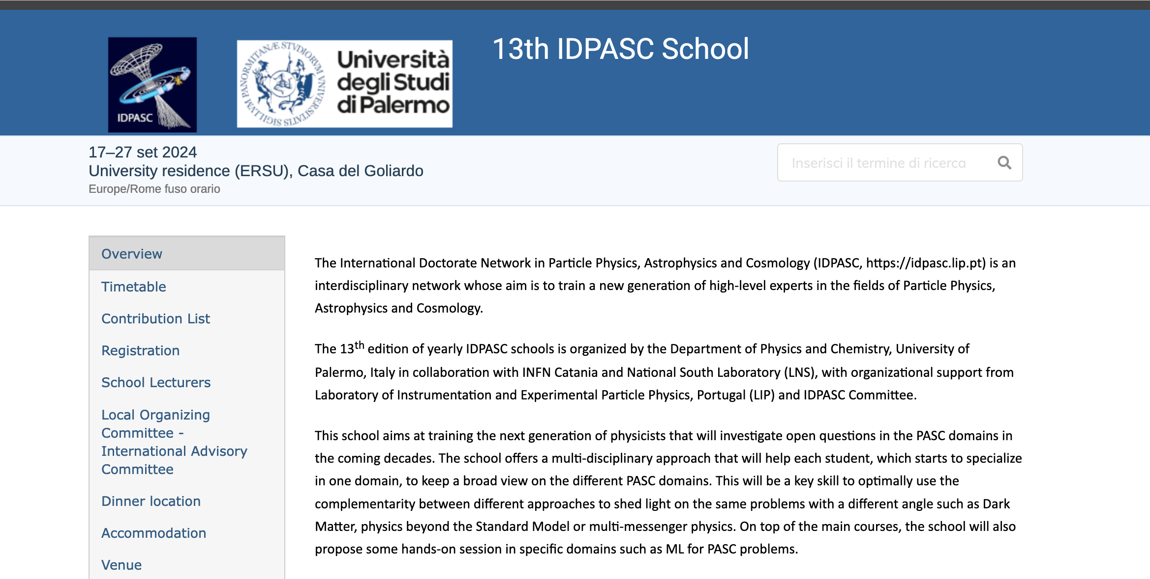
https://indico.lip.pt/event/1710/

Slide 4
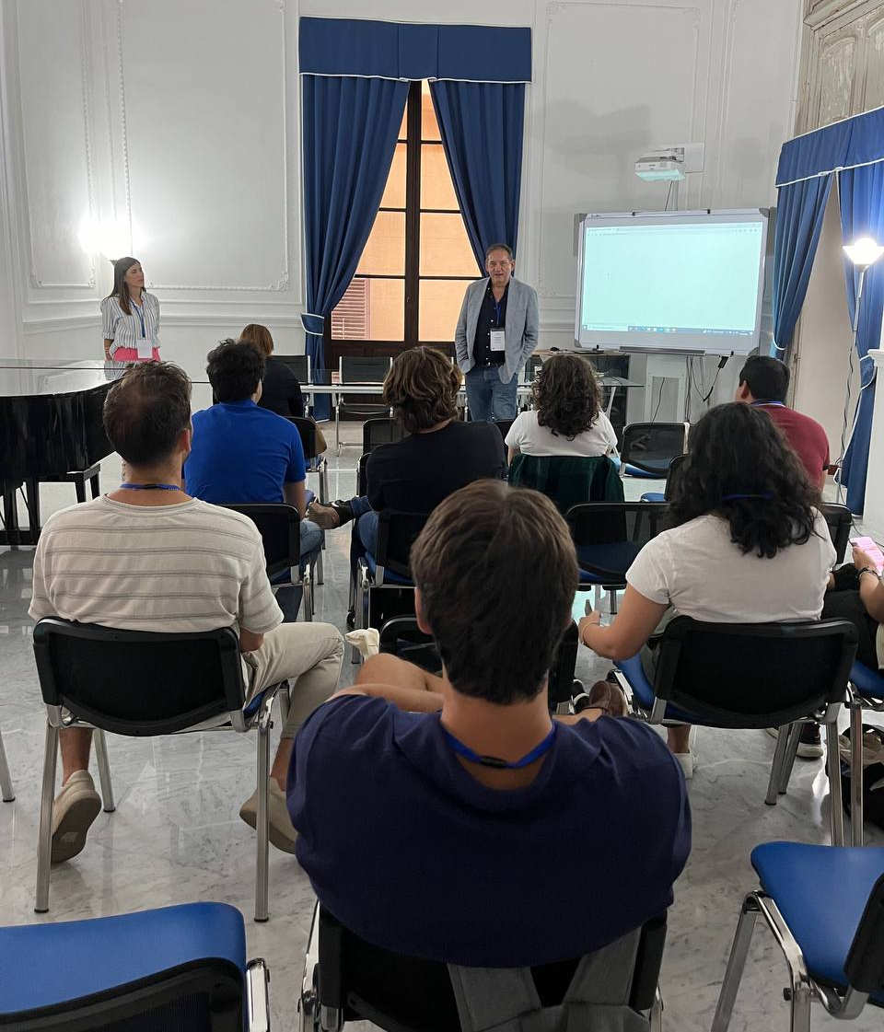
IDAPSC School at Palermo
17-27 September 2024
Location: Casa del Goliardo, Palermo
  Hosted the students (Total 13 Students 🇲🇽🇮🇹🇫🇮🇪🇸🇵🇹🇬🇭🇺🇦)
  Sala Petrosino

Slide 5
Program Topics
Standard Model and beyond
Astrophysics and Dark Matter
Multimessenger Astroparticle Physics
Cosmology & Effective Field Theories
Neutrino Physics
Detectors & Symmetries
Gravitational Waves
Machine Learning in Physics
Special Session:
Public Lecture by Alessandro De Angelis

Slide 6
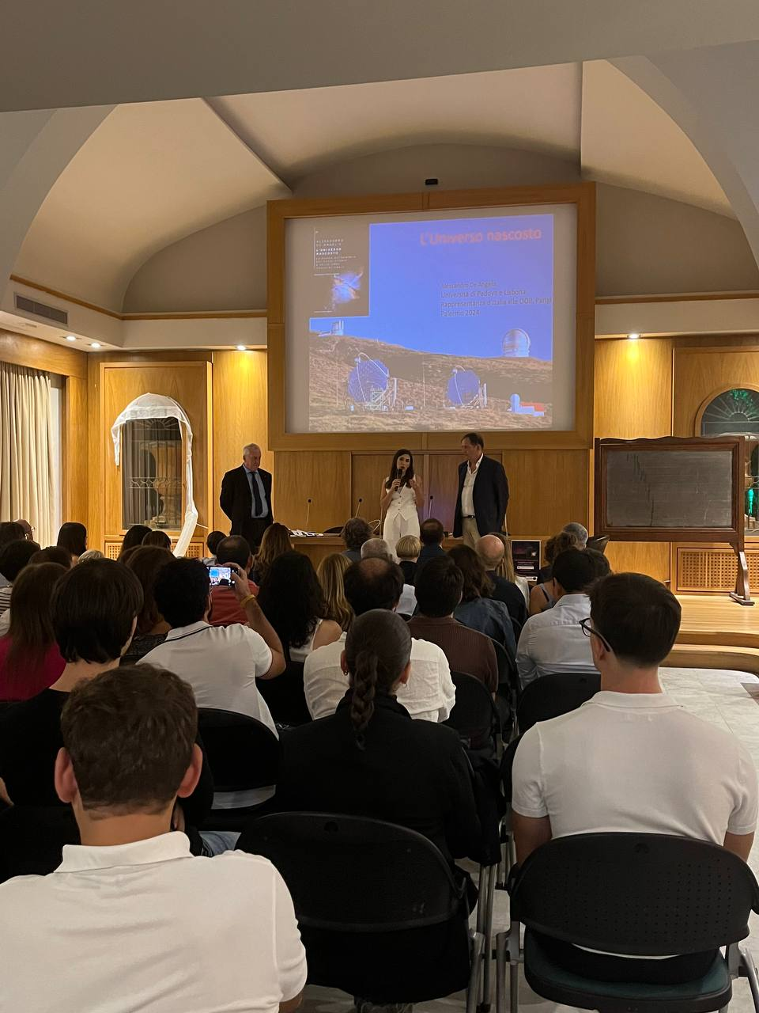
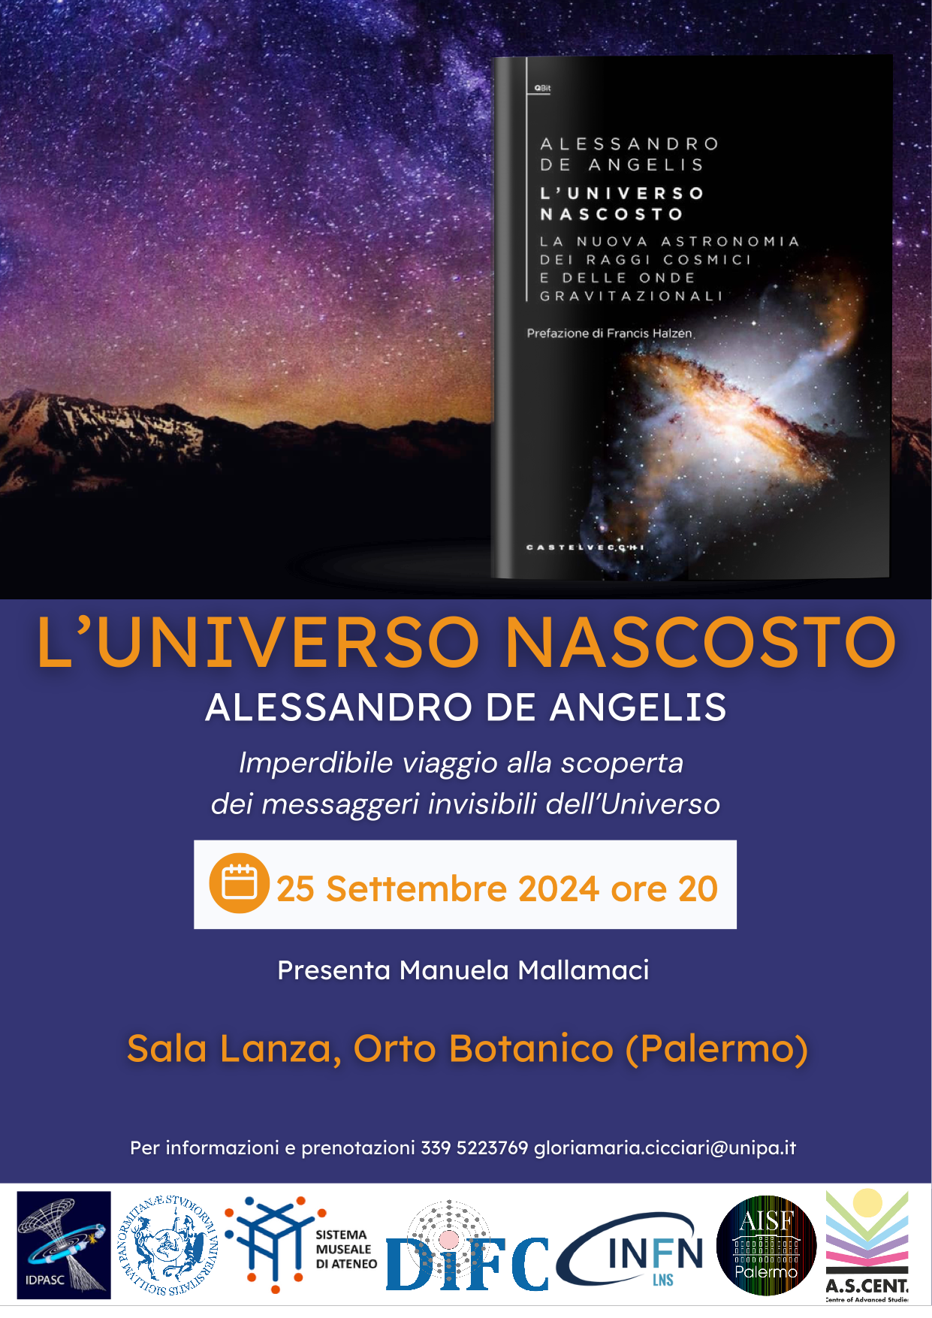
Special Session by Alessandro De Angelis

Slide 7
School lectures
Giovanni Benato, GSSI and INFN
Antonella Castellina, INAF and INFN
Eugenio Coccia, IFAE and GSSI
Roberta Colalillo, INFN
Rosa Coniglione, LNS
Giacomo Cuttone, LNS
Alessandro De Angelis, UniPD and IST
Ivan De Mitri, GSSI and INFN
Natalia Di Marco, GSSI and INFN
Giovanna Ferrara, UniCT and LNS
Guilherme Guedes, DESY
Bertrand Laforge, LPNHE
Ilidio Lopes, IST
Antonio Masiero, UniPD
Cosimo Nigro, IFAE

Slide 8
Scientific Visits
September 22–23:
  Visit to INFN-LNS in Catania
  Visit to KM3NeT Laboratory in Portopalo di Capo Passero

Slide 9
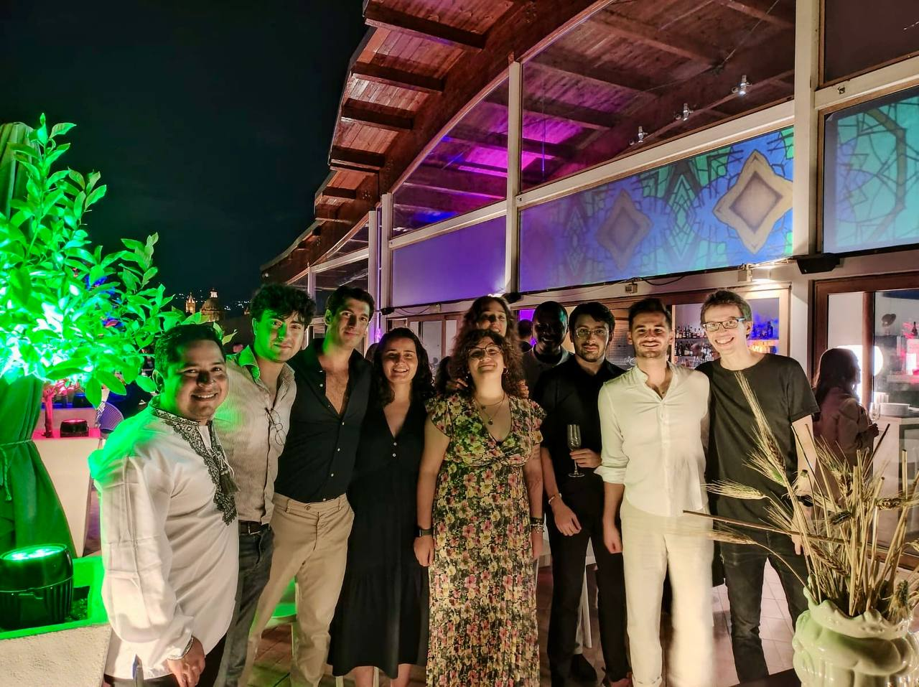
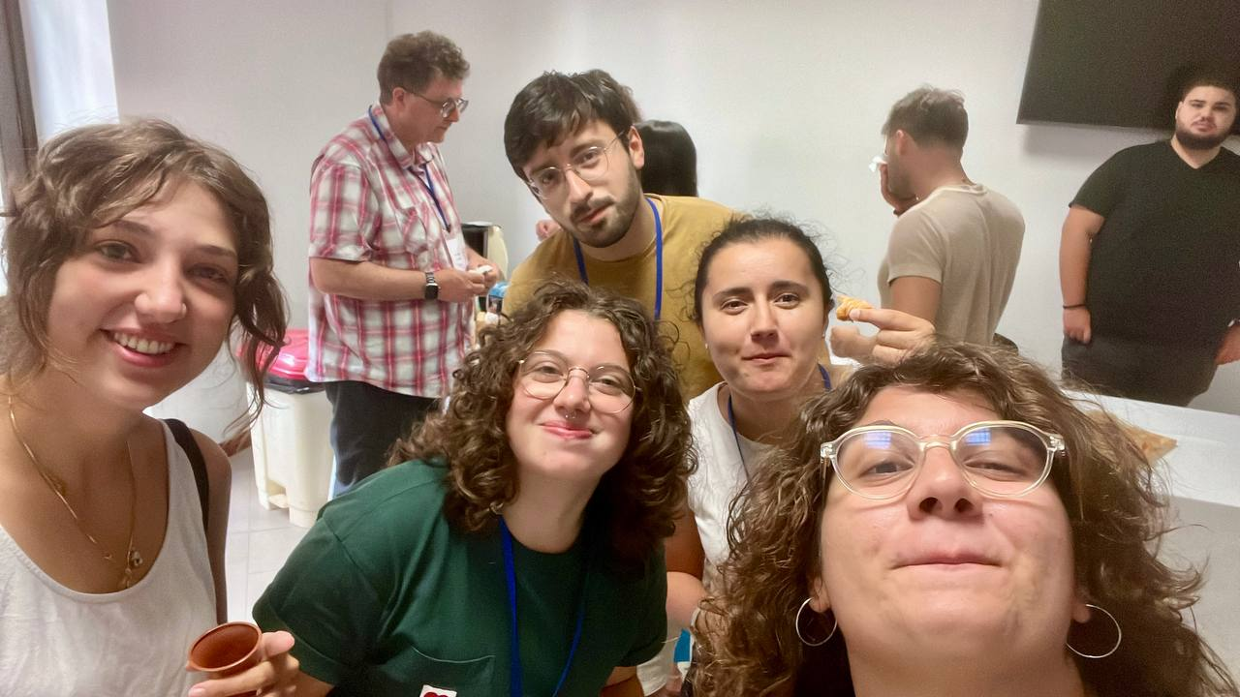
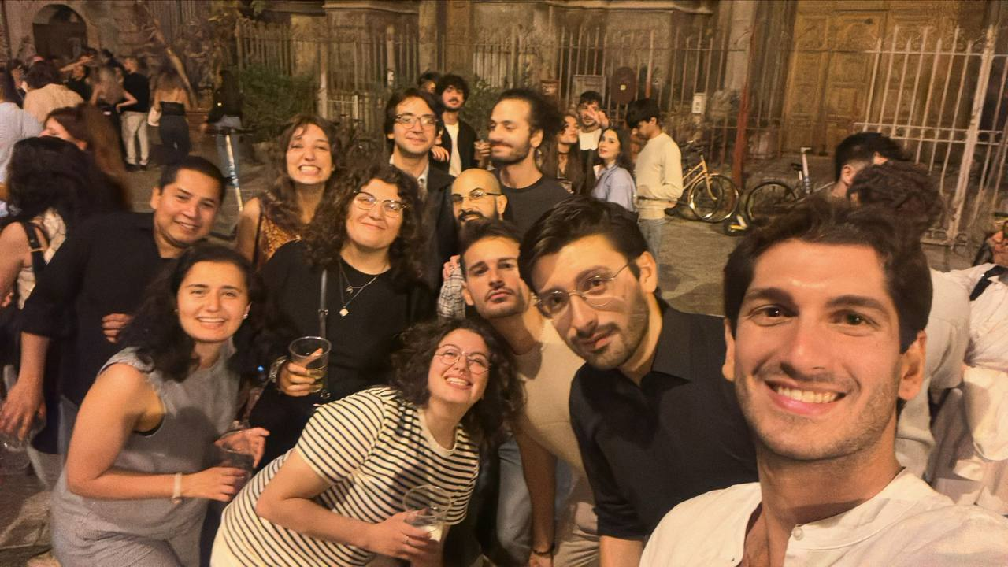
Not only lectures…

Slide 10
Thanks to IDPASC for this nice opportunity
Thanks to all supporters (IDPASC, University of Palermo, DIFC, INFN, ASCENT, AISF)
Special Thanks to Manuela and Gloria who did most of the logistic job!
Thanks to AISF who managed the fees.

