Slide 1
GRANTS OFFICE
Advisory Committee
24.04.2025

Slide 2
The
Grants Office
Margarida Rodrigues
Secretariat
Lisbon & Minho
Rita Saraiva
(50%)
Natália Antunes
Secretariat
Coimbra

Slide 3
The Goal of the Grants Office
Empower researchers to fund their ideas by helping them navigate the diversity and complexity of national and international funding schemes and submit highly competitive research proposals.

Slide 4
Grants Office as a Facilitator
(New) Rules
&
Forms
National Contact Points
Other institutions in proposal
?
Resources
Researcher submitting a proposal
LIP Board of Directors
Notes:
extra info on previous awardees, for instance

Slide 5
Administrative support
Specific questions about the call or LIP
Budget sections
Proposal review & grant writing
Draft non-scientific sections as needed
Review application (clarity and completeness)
Match your research idea to specific calls
Analyse call guidelines and other related documents
“Translate” EU speech
Search for additional information
Networking
National Contact Points (NCPs)
Other researchers relevant to project scope
Previous awardees
List of calls on LIP’s intranet
What we can offer
Notes:
extra info on previous awardees, for instance

Slide 6
Evolution of the Grants Office
Why also FCT (national)?
More competitive PT funding landscape
Convergence with EU funding requirements
2021-2022
Focus on training
EU only
2023 - 2025
EU
FCT
What we learn writing an FCT project is useful for other projects
Notes:
Training: Horizon Europe was just starting

Slide 7
Strategies to increase submissions to EU Funding
(Targeted) dissemination of opportunities
Presentations at Scientific Council meetings:
Upcoming calls
General information & advice
Capacitation of research community
General project writing skills (FCT projects)
Specific training (with IST)
Create awareness

Slide 8
Encourage ERC applications
Permanent Contract at LIP
Tailored support during writing & interview stages
Identification of potential mock reviewers
Access to IST programs (ERC Club)
FCT support for ERC:
€ 250 000 for projects that receive high score (but no funding)
Specialised review before submission & interview preparation (new)
Financial support for hiring ERC grantees

Slide 9
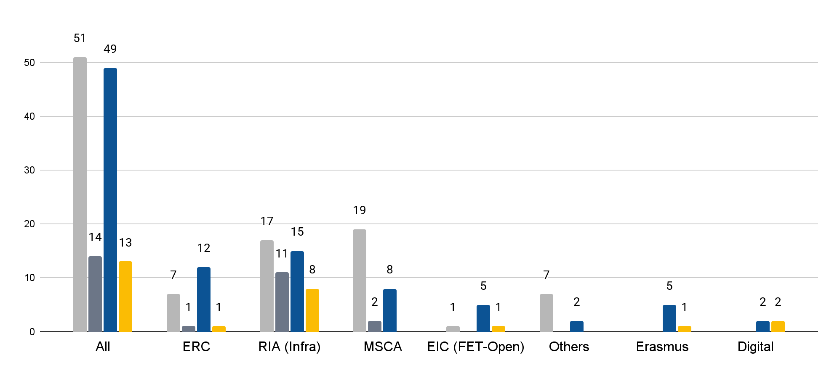
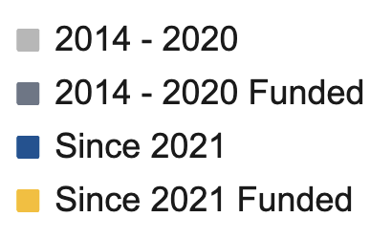
EU Proposals submitted by LIP researchers
Notes:
Does not include La Caixa nor FCT

Slide 10
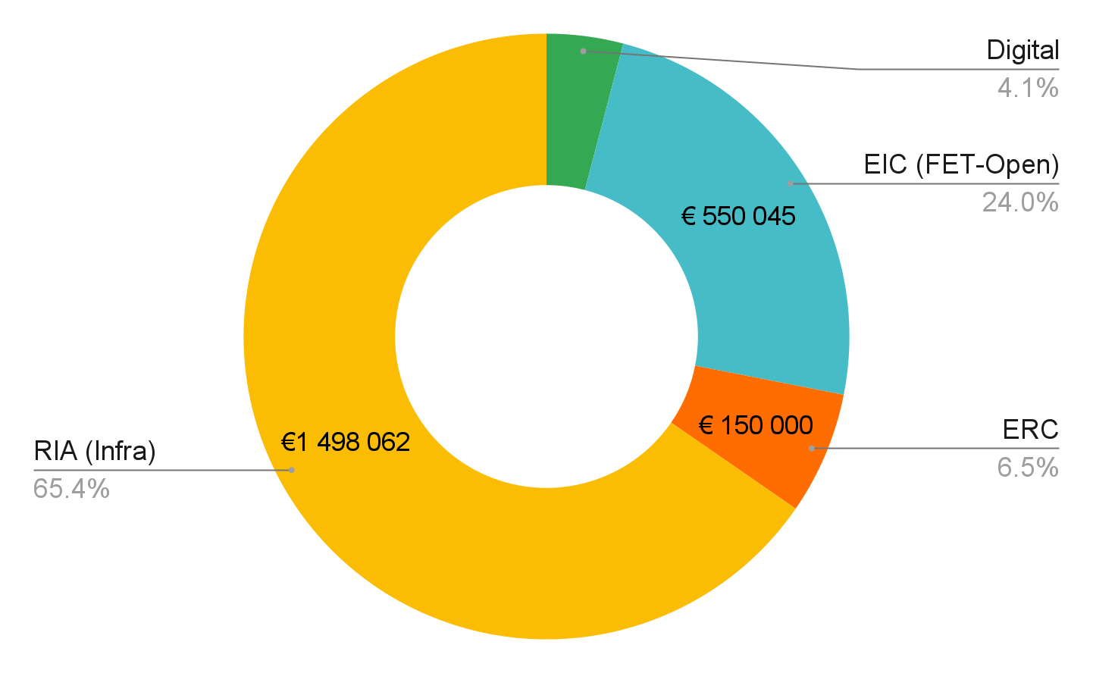
EU financing awarded to LIP since 2021
total €2.3M
Notes:
Does not include proposals that were not submitted through LIP (ERC)

Slide 11
Thanks!
Any questions?
grants.office@lip.pt
ritasaraiva@lip.pt

