Slide 1


SWGO present and (near) future
Mário Pimenta
April 2025

Slide 2
SWGO
Southern Wide-field Gamma-ray Observatory
Argentina, Brazil, Chile, China, Croatia, Czech Republic, France, Germany, Italy, Mexico, Países Baixos, Peru, Portugal, South Korea, United Kingdom, United States
> 90 institutes, 16 countries

Slide 3
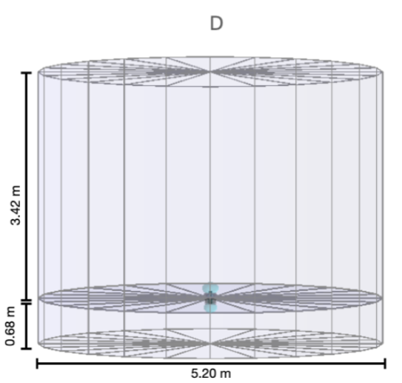
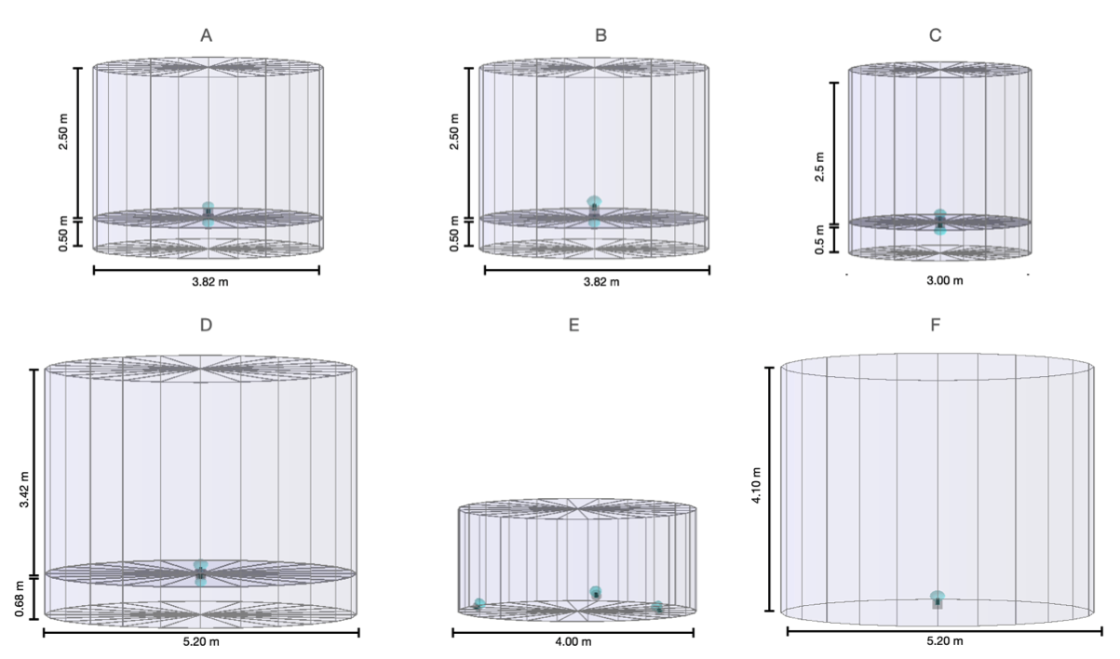
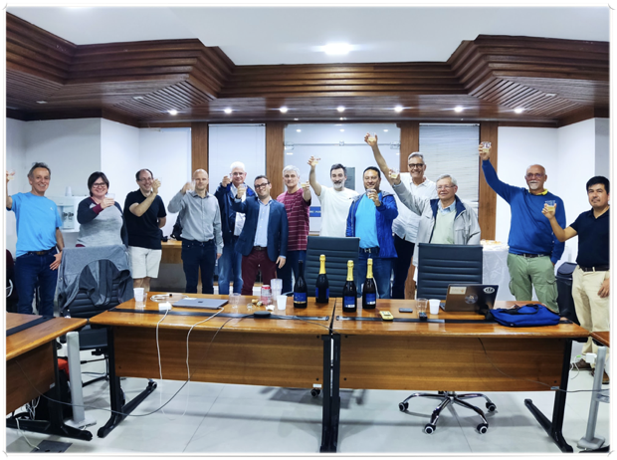
SWGO, 2024: the year of decisions
Baseline Layout and Detectors
Mexico City April 2024
Core
+
Outer Array
Double Layer metallic WCD
1.70 m
Mercedes rotomolded WCD
～ 1 Km²
3.60 m
Site
Pampa La Bola, AAP, Chile
4,770 m a.s.l.
Rio,
July 2024

Slide 4
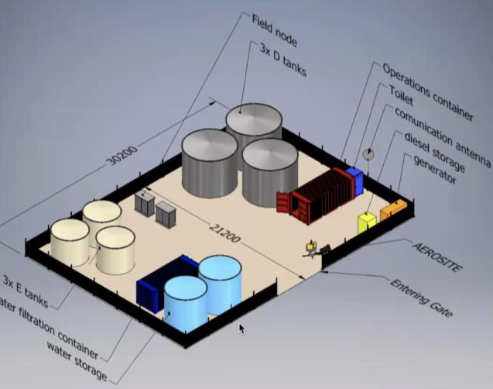
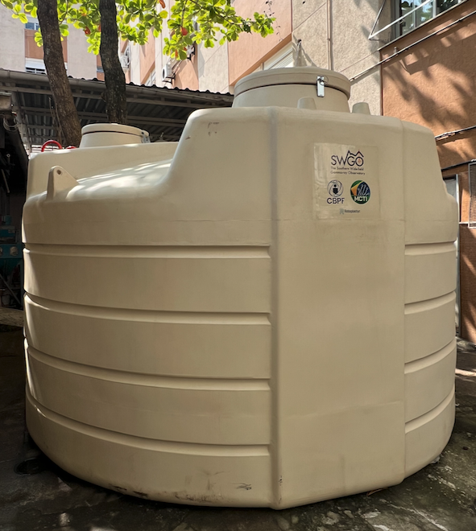
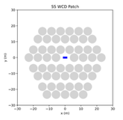
SWGO near Future
Path Finder
First activity @ site
2025/26
2+1 metal D tanks, 2+1 plastic Mercedes tanks
SWGO-A
SWGO-H
1.70 m
3.60 m
core array ～20 000 m²
outer array 1 – 4% FF
USA (NSF – 17M US$) +
Germany, …
Brazil, Italy +
Portugal, Czech Republic, Chile,..

Slide 5
And about LIP ???
PTDC FCT Grant (250 k €) approved yesterday!
LIP@Lower energies
trigger
pattern recognition
tagging muon stations
LIP@Higher energies
LCm
Ptail
…
LIP@Detector,
Mercedes (with CBPF)
Layout optimization
LIP@ …
neutrinos
hadronic interactions
thermal simulations
outreach
…

Slide 7
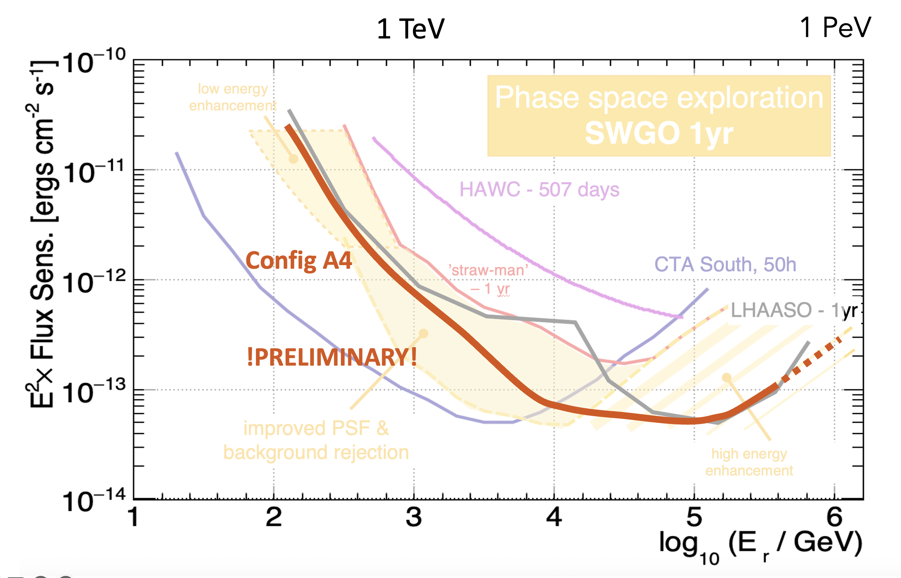
The sensitivity curve
SWGO-1 yr

Slide 8


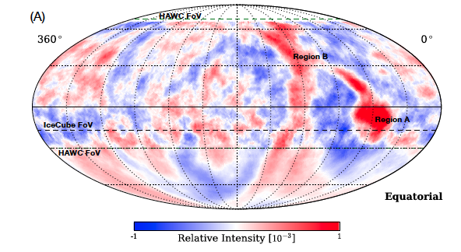
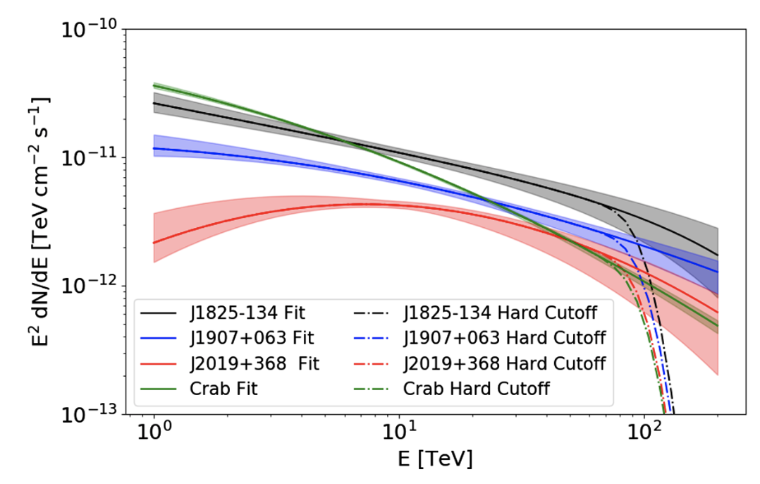
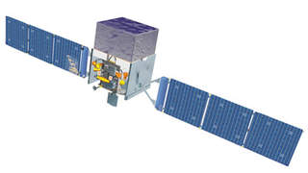
SWGO Science vision
10⁹
10¹⁰
10¹¹
10¹²
10¹³
10¹⁴
10¹⁵
10¹⁶
10¹⁷
Energy [eV]
SWGO-A
SWGO-H
SWGO- extended low E
SWGO- extended high E
8

Slide 10
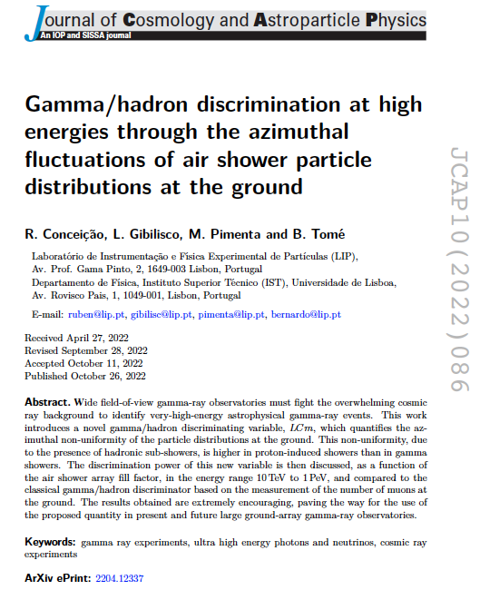
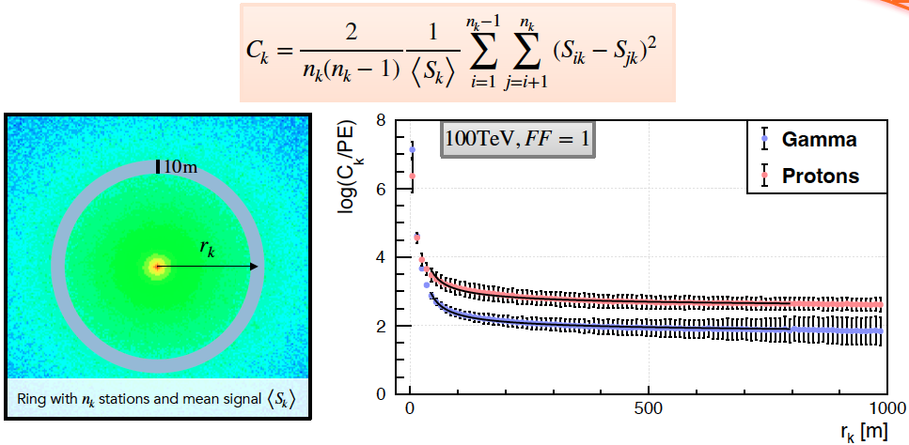

A new variable: LCm
360 m
LCm

Slide 11
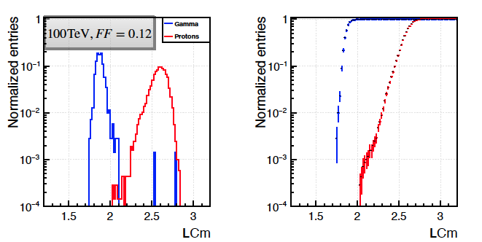
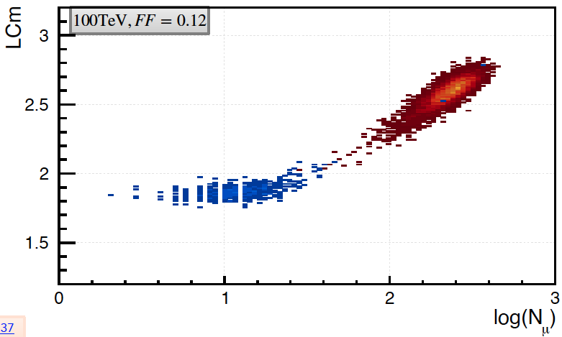
It works!

Slide 12
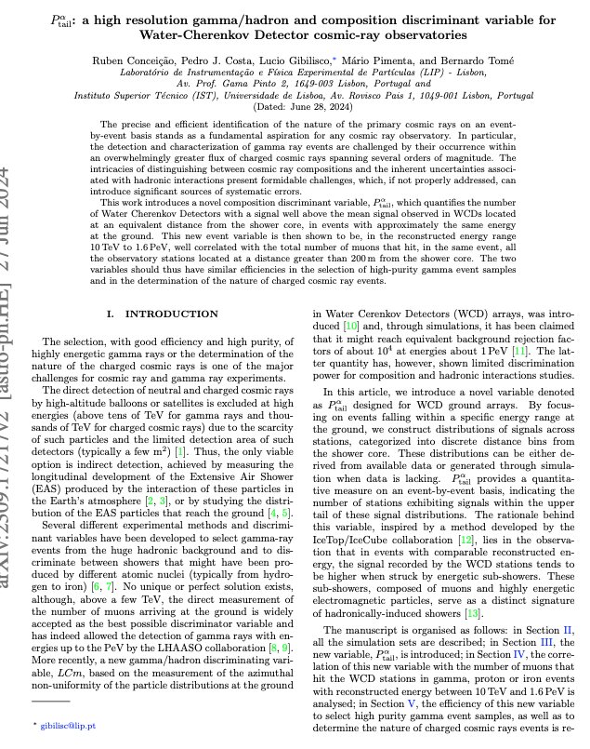
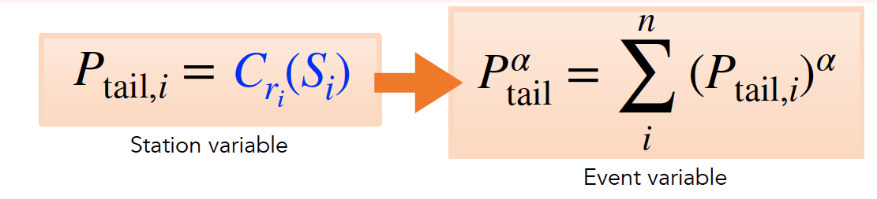
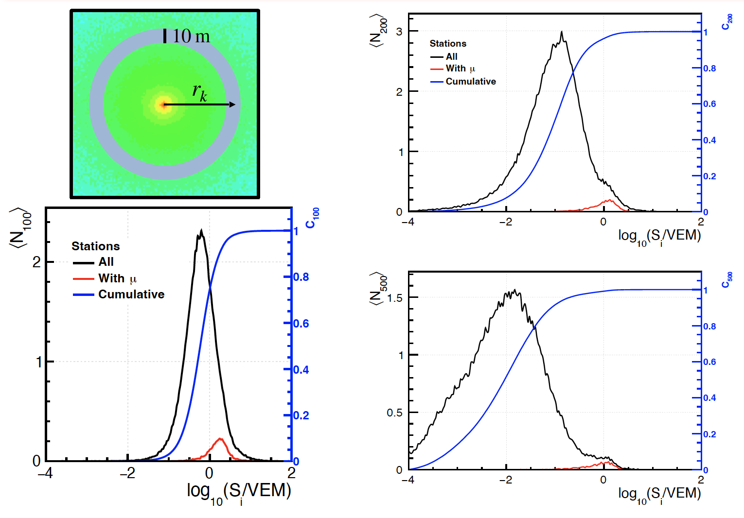

A new variable: $P_{\text{tail}}^{\text{α}}$

Slide 13
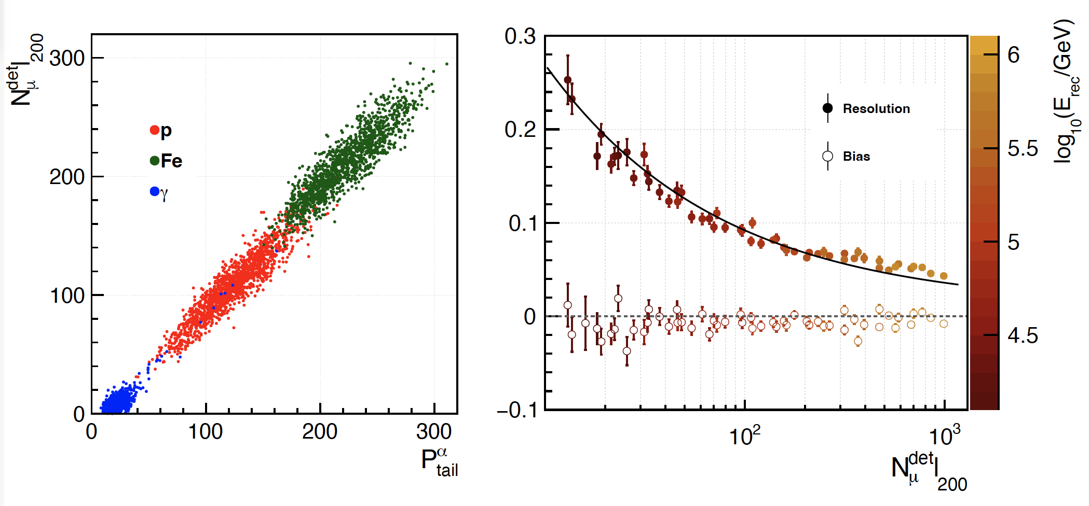
It works!
Access the number of muons without burying the WCDs !

