Slide 1
LIP-ECO: Education, Communication and Outreach
Highlights from 2024
Institutional Communication
Internal & External
Outreach and
support to education
Coord: Sofia Andringa
Coord: Pedro Abreu
With the participation of all the LIP community in
All LIP nodes
Advisory Board meeting, Lisboa, 23-24 April 2025

Slide 2
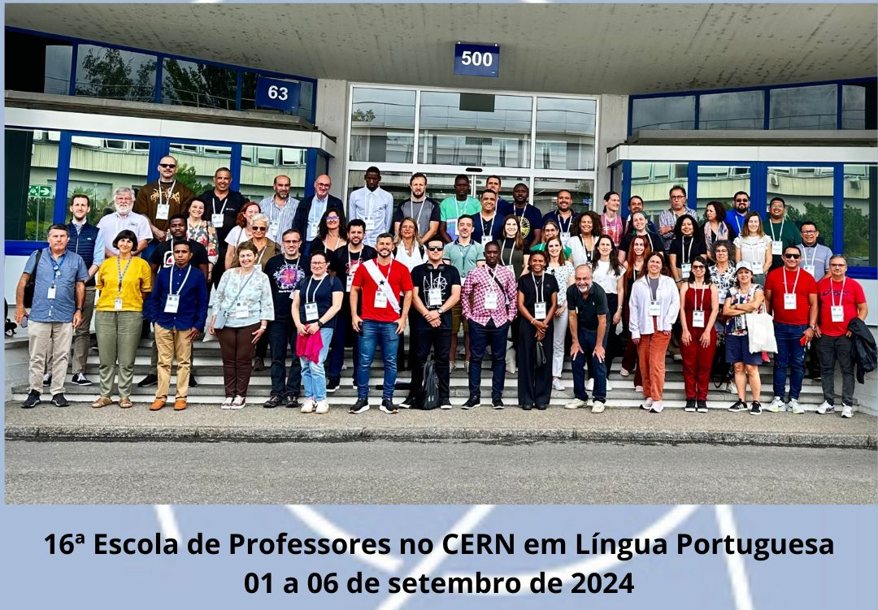

Education & Outreach (Pedro Abreu)
LIP’s flagship programme for the school community recovering participation levels
IPPOG’s International Masterclasses
CERN’s Portuguese Language Teachers Programme(*) (Participants from Africa and East-Timor again fully supported by “Camões Institute”/Ministry of Foreign Office)
High-school students’ internship (“Ciência Viva Summer Network”)
50+ Outreach talks in schools and school visits to LIP
CERN PTLTP24
w/ support from
(*) 4th time with teachers from all PT-Speaking countries at CERN
Advisory Board meeting, Lisboa, 23-24 April 2025

Slide 3
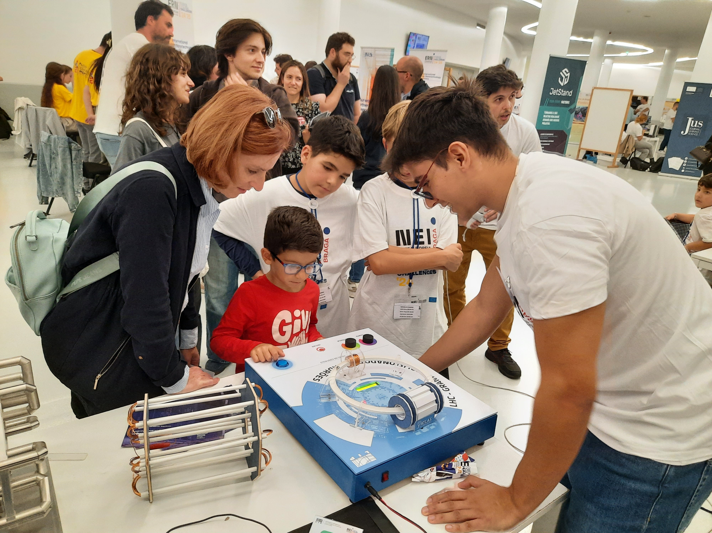
Education & Outreach (Pedro Abreu)
Development of equipment and tools for Outreach (w/ LIP’s infrastructures)
Spark and Cloud Chambers at Coimbra (and components for the cloud chamber construction kit)
3D and Virtual Reality tools at Minho (with Auger MC’s)
Small demonstration kits (circular accelerator, ATLAS Toroidal Magnet model)
EduLab development at Lisboa (also in support of group visits and Open Days)
© Henrique Carvalho, @ERN’2024
Support to 20 “Ciência Viva” Science Clubs in high-schools
Developed Cloud Chamber construction kits for the Clubs
Advisory Board meeting, Lisboa, 23-24 April 2025

Slide 4


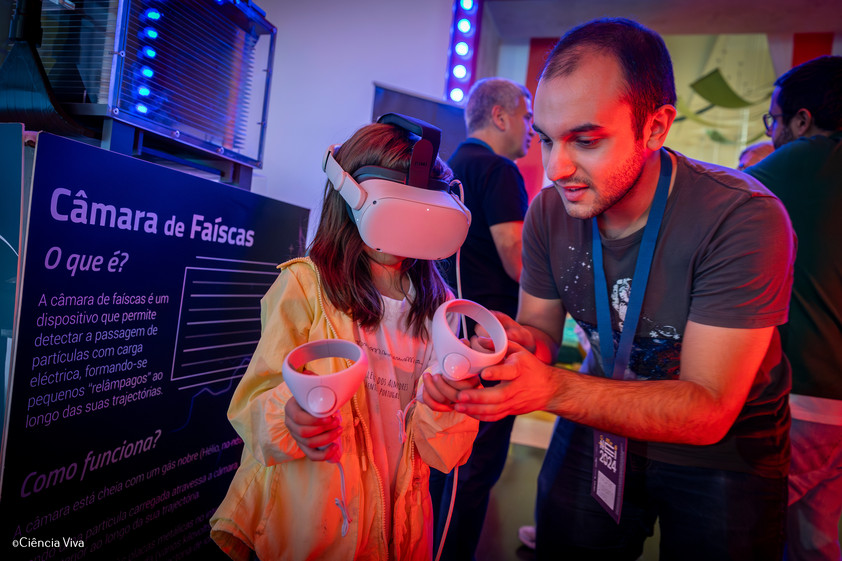
Communication (Pedro Abreu, on behalf of LIP-ECO)
2024 – Highlights
Integration of the Celebration of CERN’s 70th Anniversary in our events
Celebration of the UN’s Int’l Day of Women and Girls in Science – “Who are the LIP Women in the ATLAS Experiment at CERN? - a Generational Meeting”
“LIP into the Future” Anniversary Celebration
Organization of the Spring’2024 EPPCN Meeting in Lisboa (European Particle Physics Communication Network, created in 2006 as result of the European Strategy for Particle Physics)
9.05.2024
Larger involvement of scientists in ECO Activities (@ERN’s, etc)
LIP Open Day, 22.Nov.2024 (within National Week for Science and Technology)
97 news articles published on the website, community on social media reaching 9300 followers
a present and a future scientist @ERN’s 2024
Advisory Board meeting, Lisboa, 23-24 April 2025

Slide 5
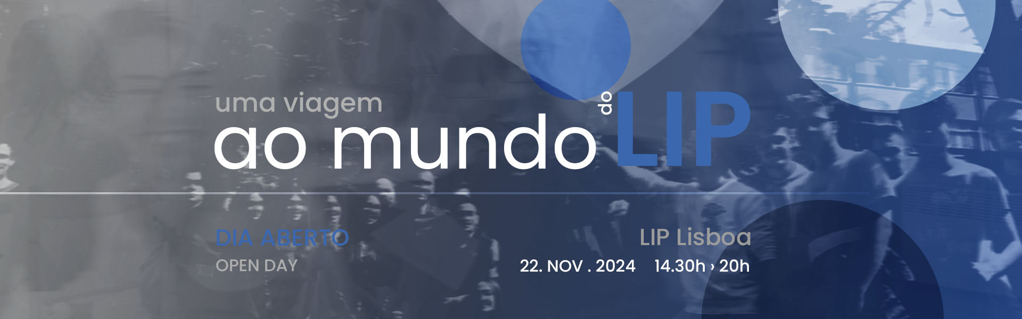
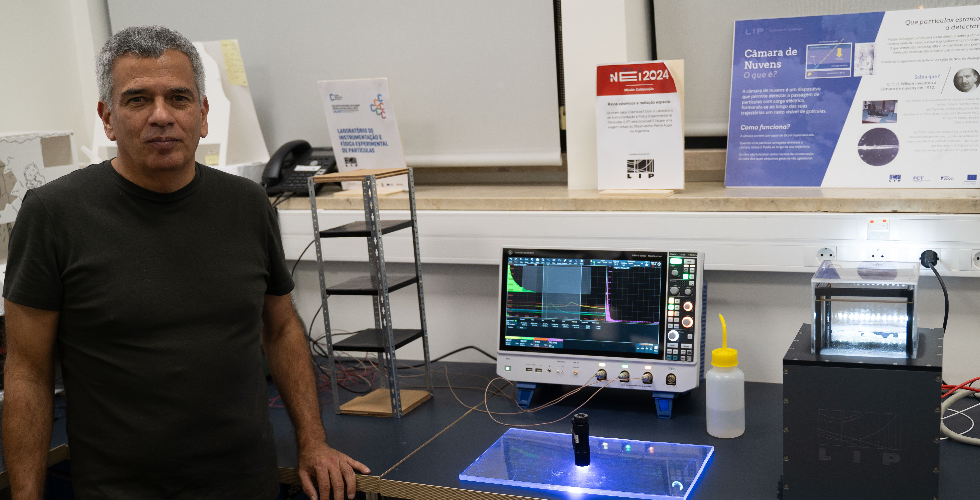
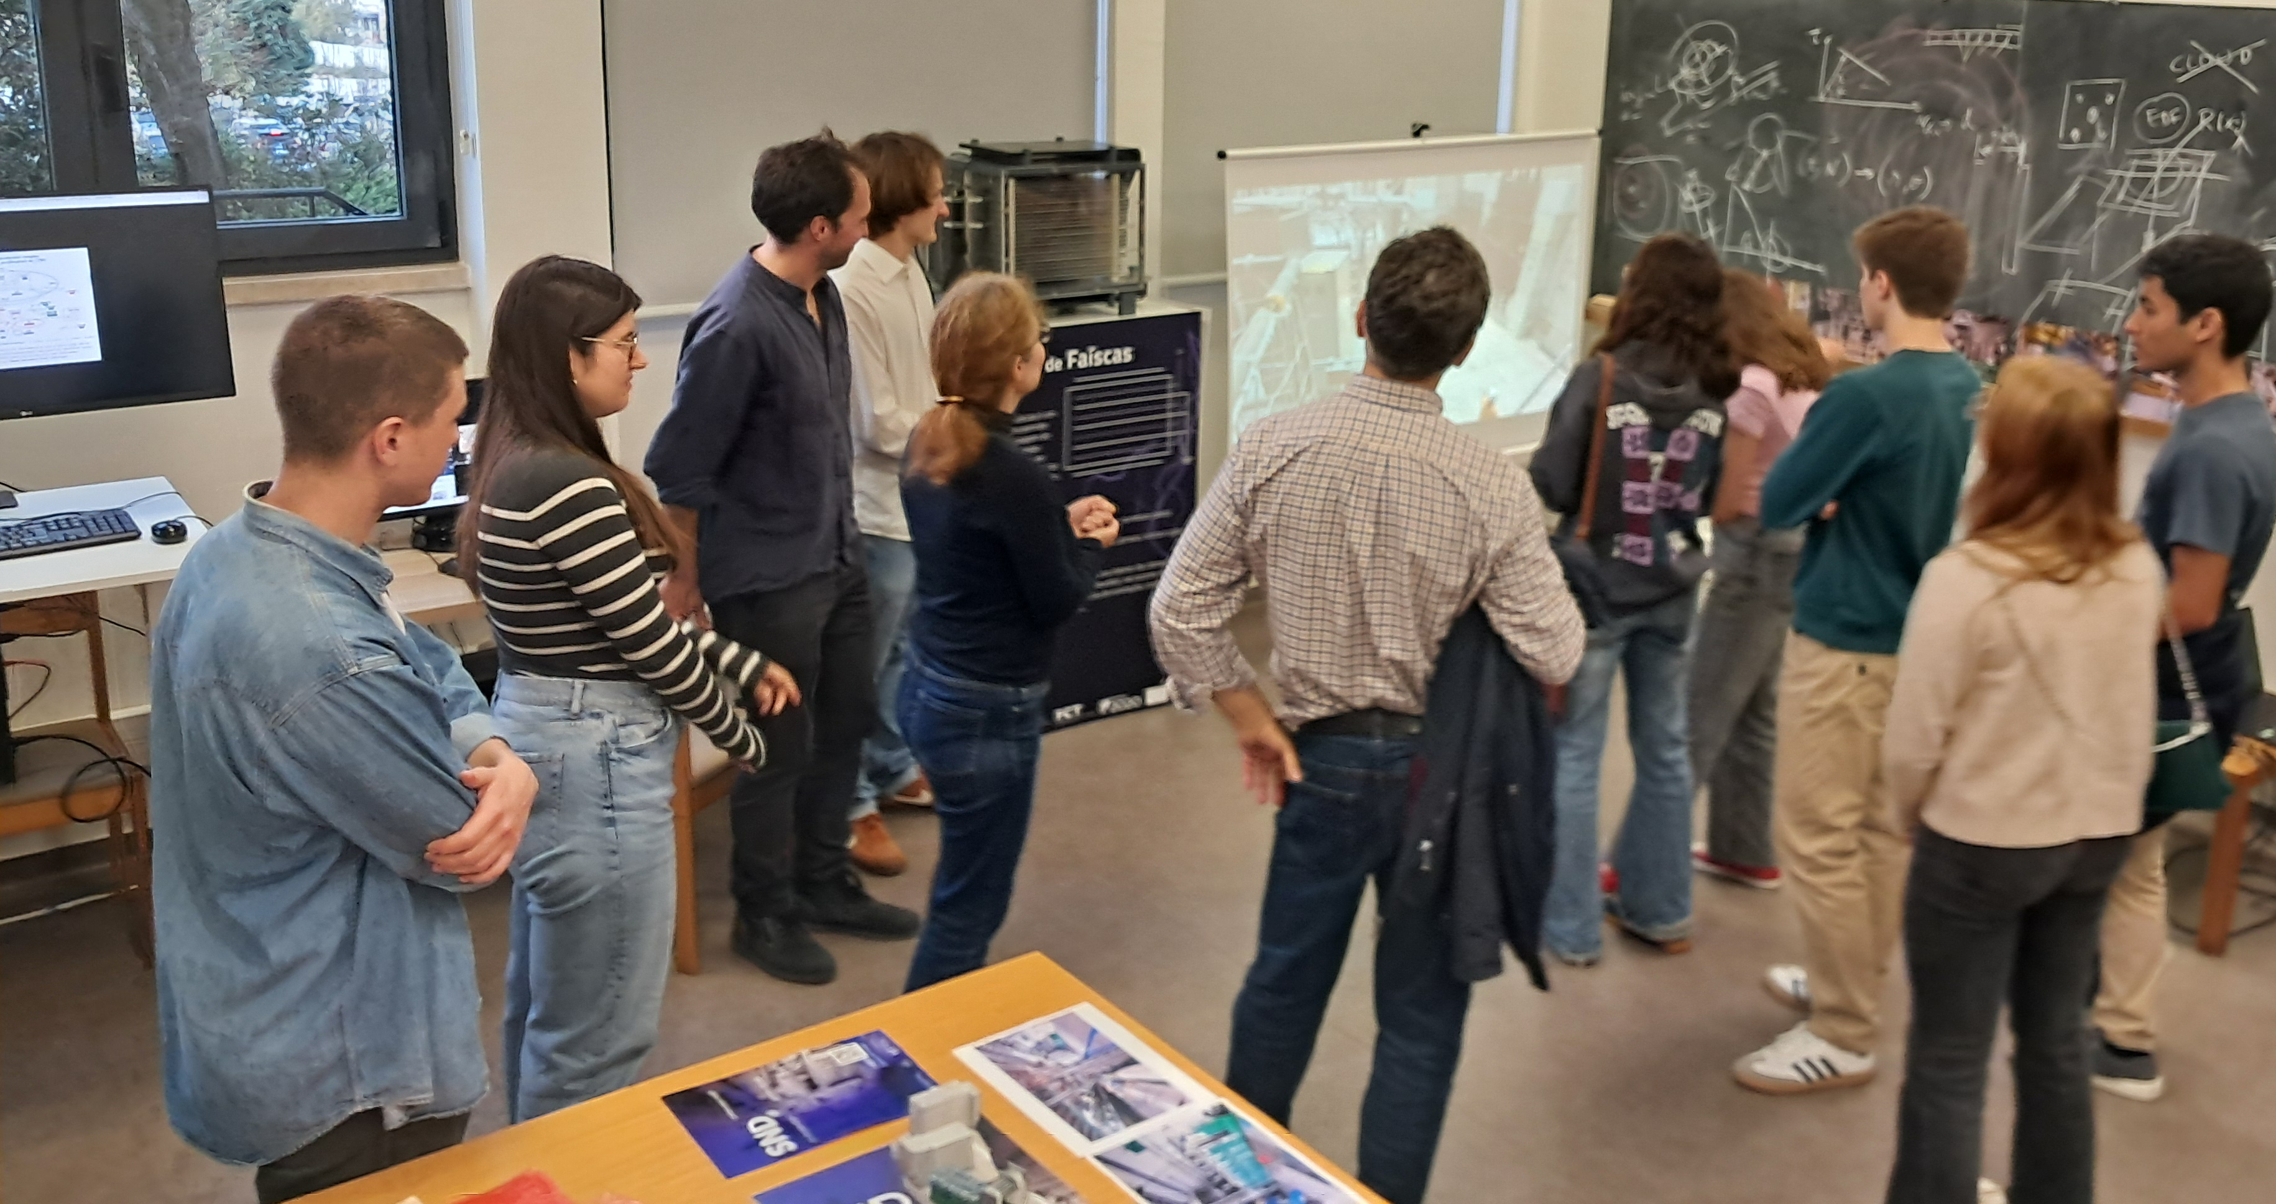
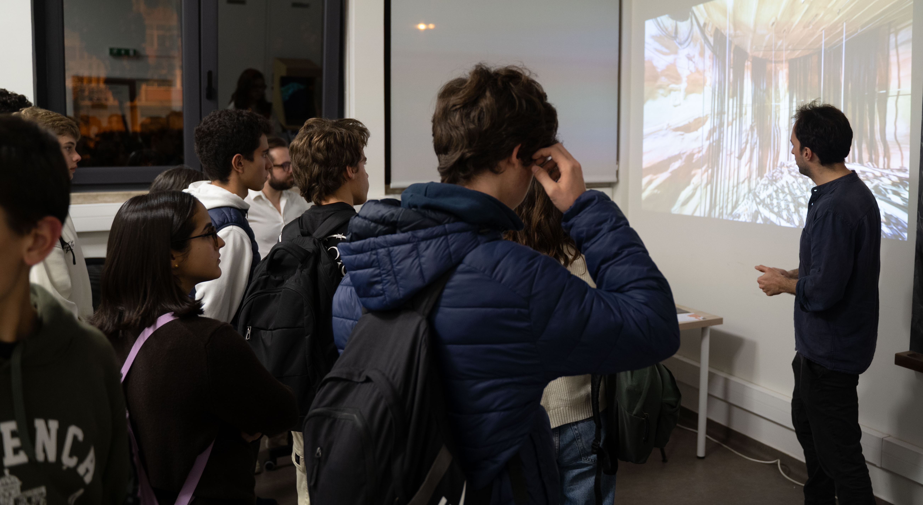
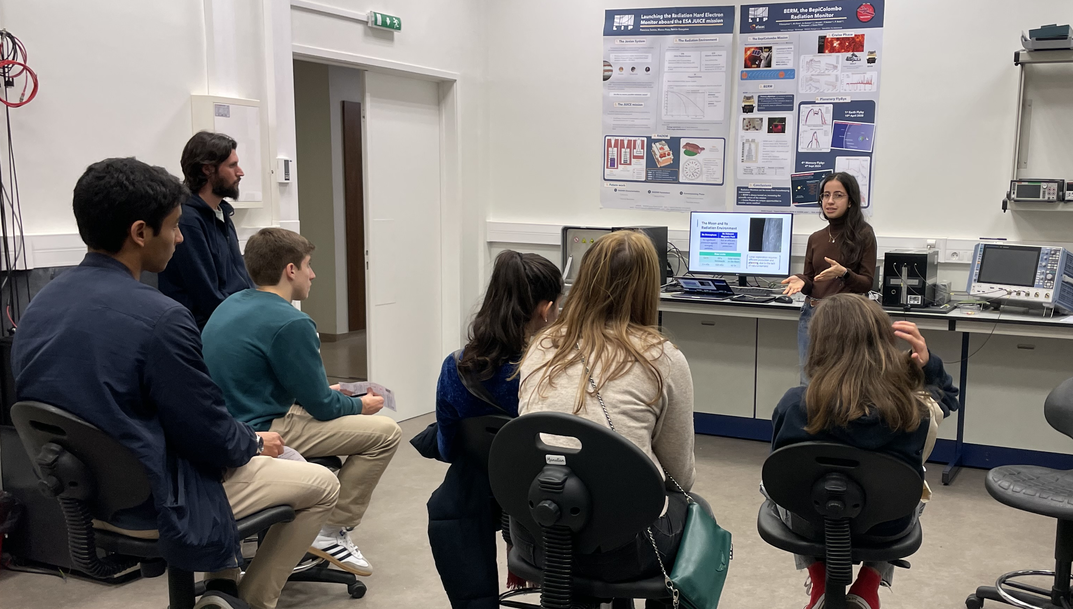
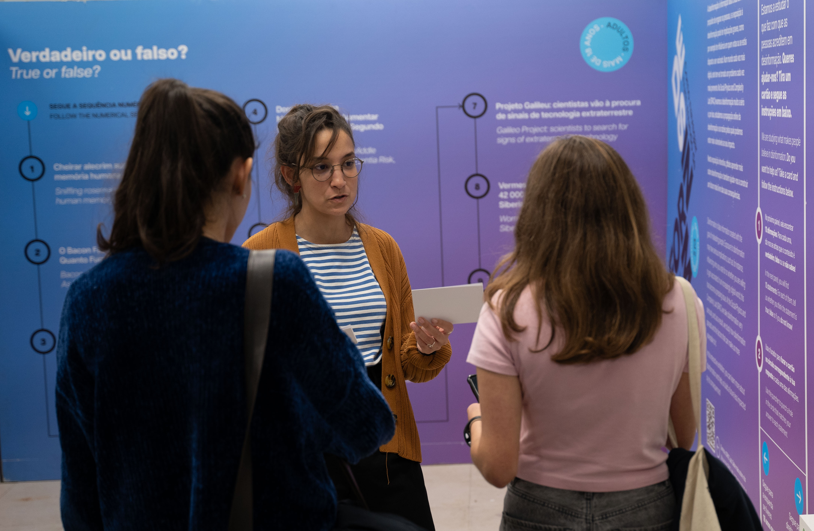
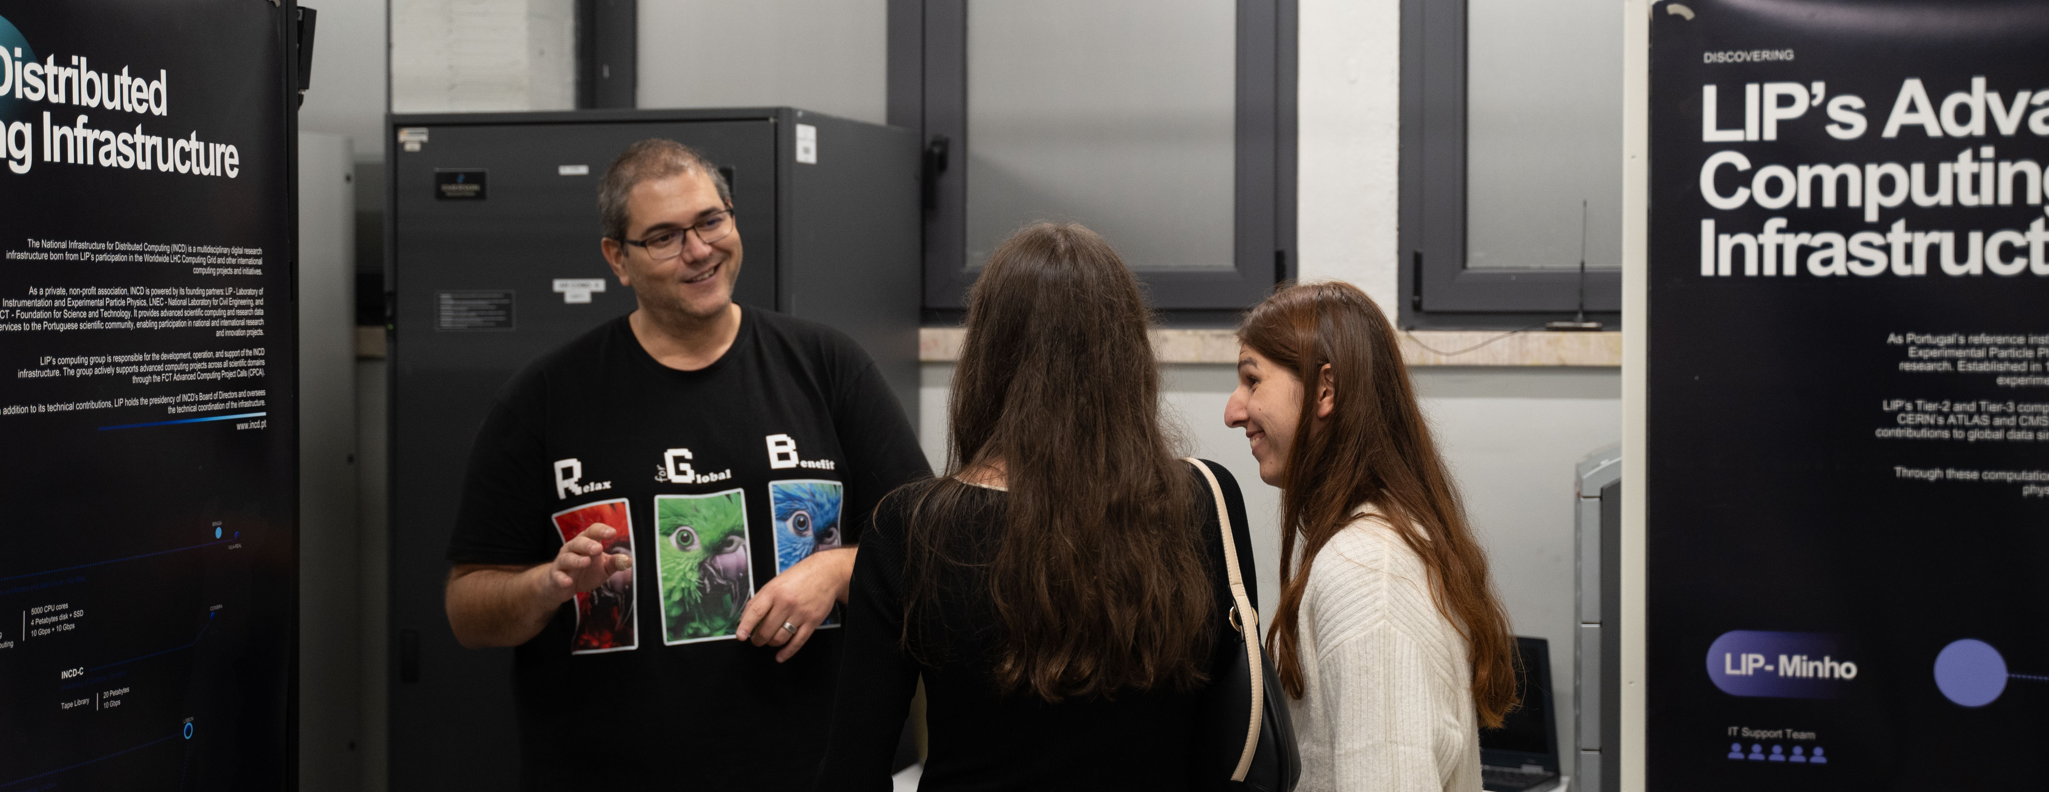
LIP Open Day
Nov.22, 2024
(a voyage to the LIP World)
Coordinated by
Lígia Melo, André Torcato, Carolina Felgueiras
~100 people visited LIP, ~50 LIP scientists involved
very positive feedback (avg.rating of 4,6 / 5)!
Advisory Board meeting, Lisboa, 23-24 April 2025

Slide 6

ECO plans for 2025/2026
Regular activities: International Masterclasses, Teachers Programmes at CERN, “Science in the Summer” – internships for high-school students, celebrations of events (IYQ2025, Talks at Schools, European Researchers Nights, National S&T Weeks)
[PT] Input to the European Strategy for Particle Physics Update 2026
Celebration of the PT@CERN 40th Anniversary (along 2025)
Preparation of the LIP 40th Anniversary (along 2025/2026, special high mark on May 9th, 2026)
Recruitment/integration of a full-time person to handle LIP Communications

