Slide 1
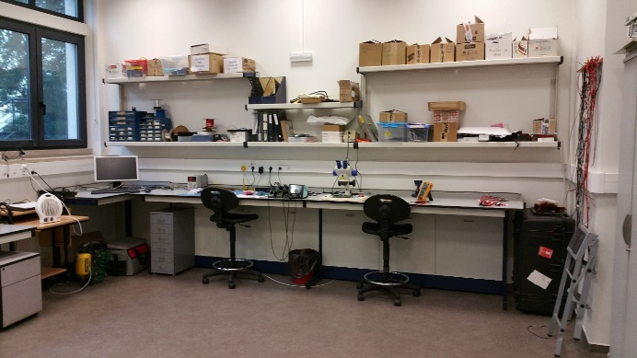
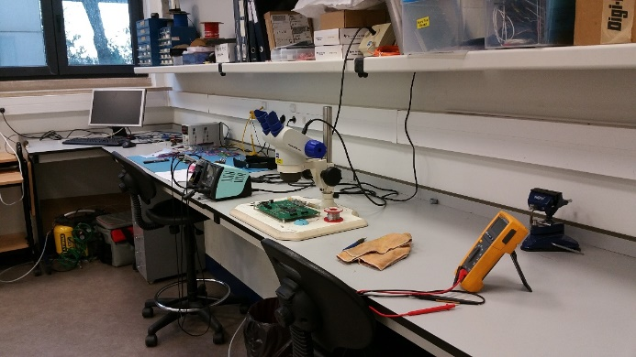
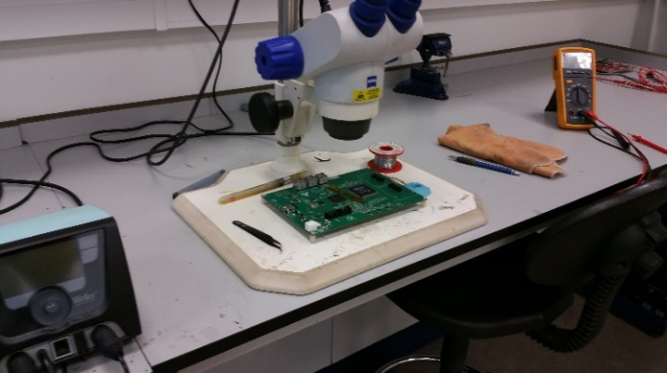
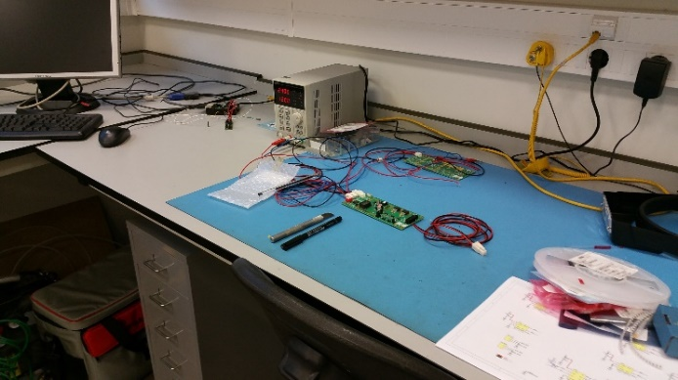
e-CRLab
Cosmic
Rays
Electronics
Laboratory

Slide 2
Electronics Laboratory

Slide 3
A more transversal infrastructure
Support electronics developments not only in astroparticle experiments but also in accelerator experiments and in applications within particle and nuclear physics.
Design of complex PCB, prototypes of simple boards, electronics assembly
Limited to
Small batches
Reasonable pitch packages (hard to do BGA-like components)
a small range of mechanical tools allows for the creation of simple detector prototypes, their testing, and the implementation of corrections or new functionalities.
Consultancy and support to various groups.
Operates with shared human resources, often collaborating closely with research teams.
Electronics for particle, astroparticle and related applications

Slide 4
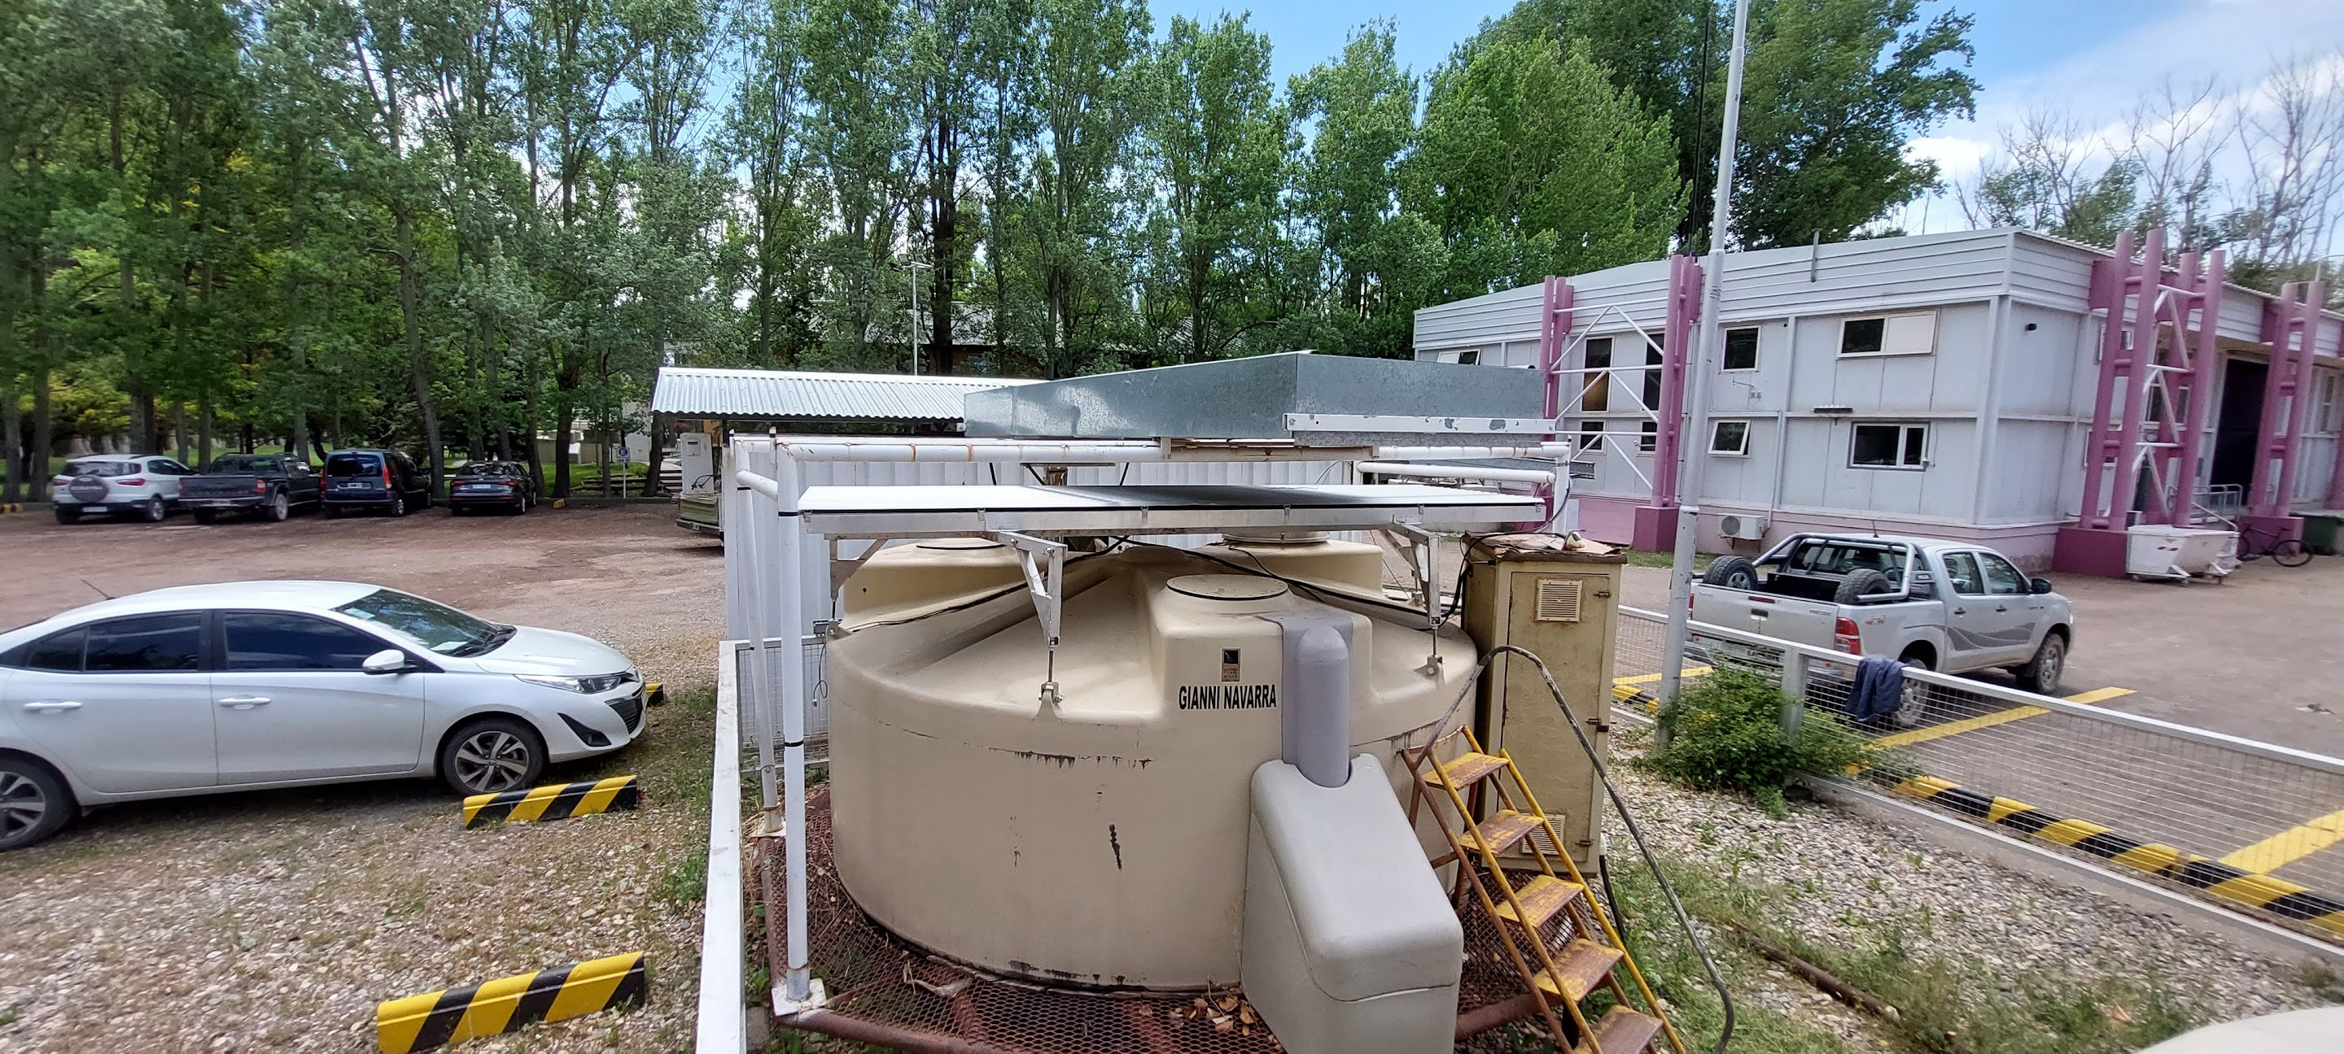
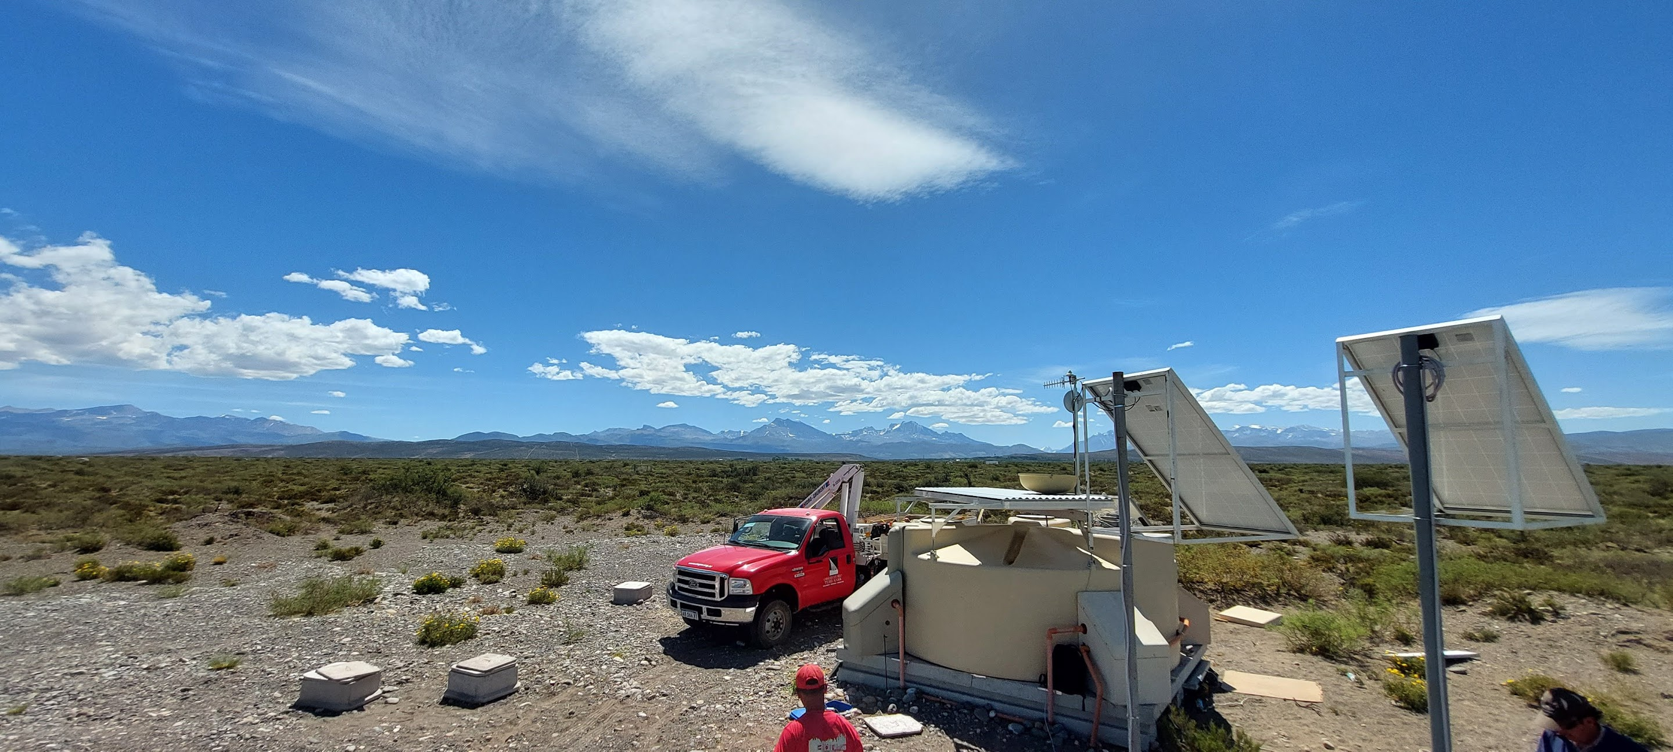
Auger:
Support and operation of DAQ setups and upgrades.
ATLAS
HGTD
Slow Control/Interlock/HV filter/LNB (temperatures)
Radiation test of Altiroc ASIC
Development/consulting of several boards.
Support of two master thesis at Coimbra
Medics:
Development of instrumentation / solutions for medical physics( RT) monitoring
LGADs for medics
Collaboration with CMS
Space RAD:
Support for instrumentation
Component radiation testing

Slide 5
Plans for the future
Boost capabilities with equipment investment:
Flagships:
Laser for Solid State excitation
Irradiation facility (Xray) for radiation testing

Slide 6
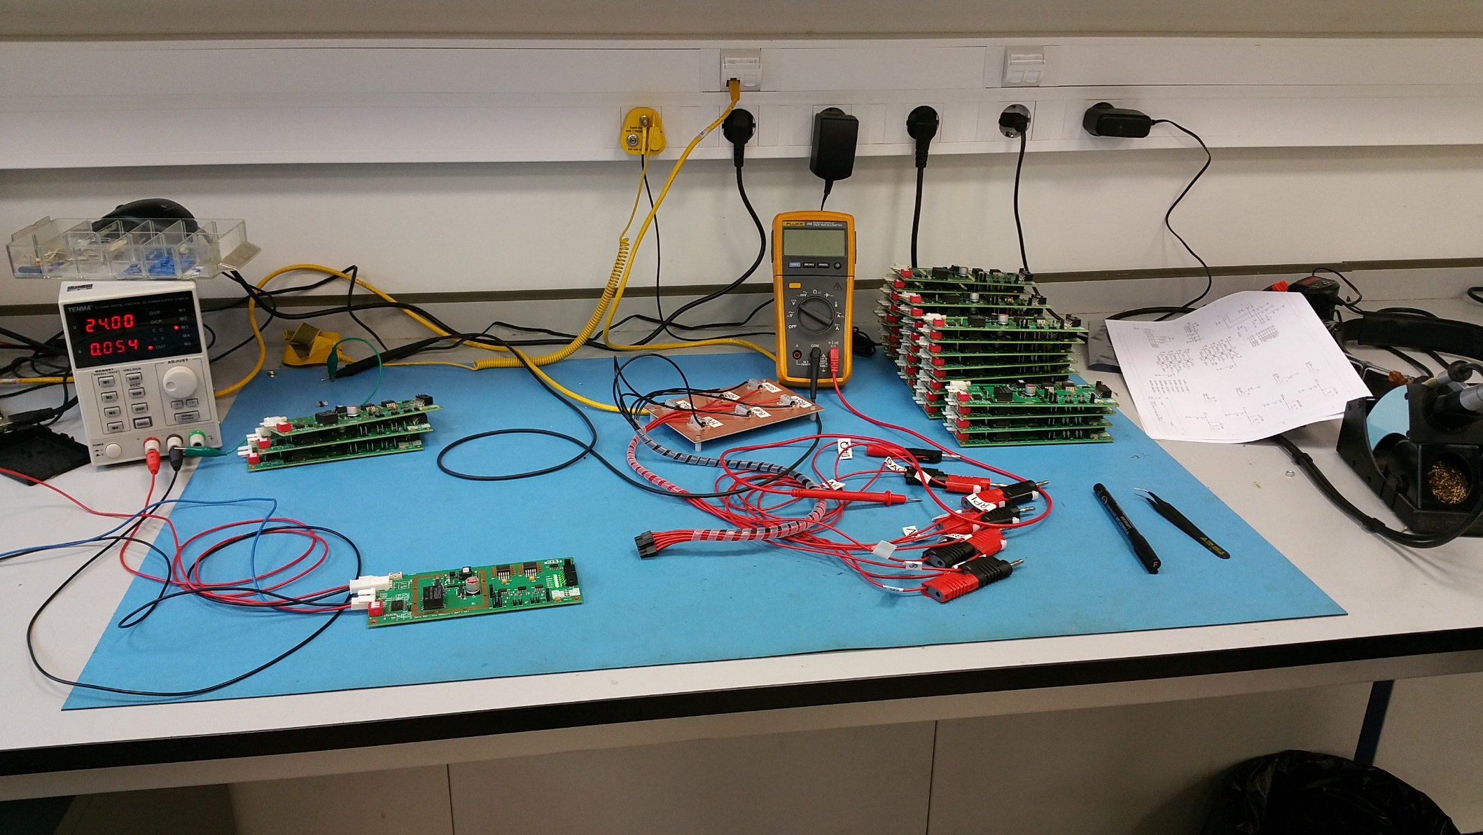
Thank you

Slide 7
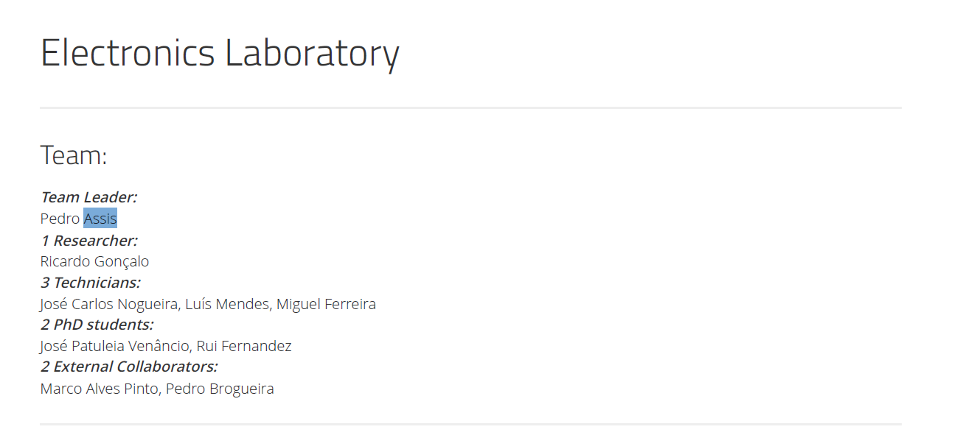

Slide 9
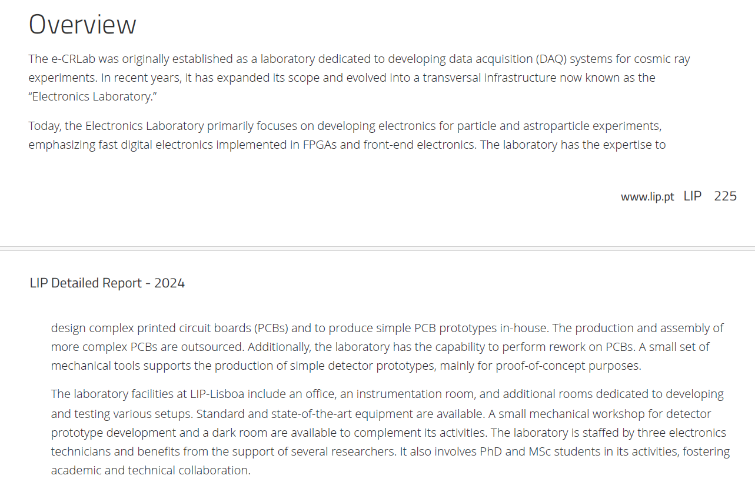

Slide 11
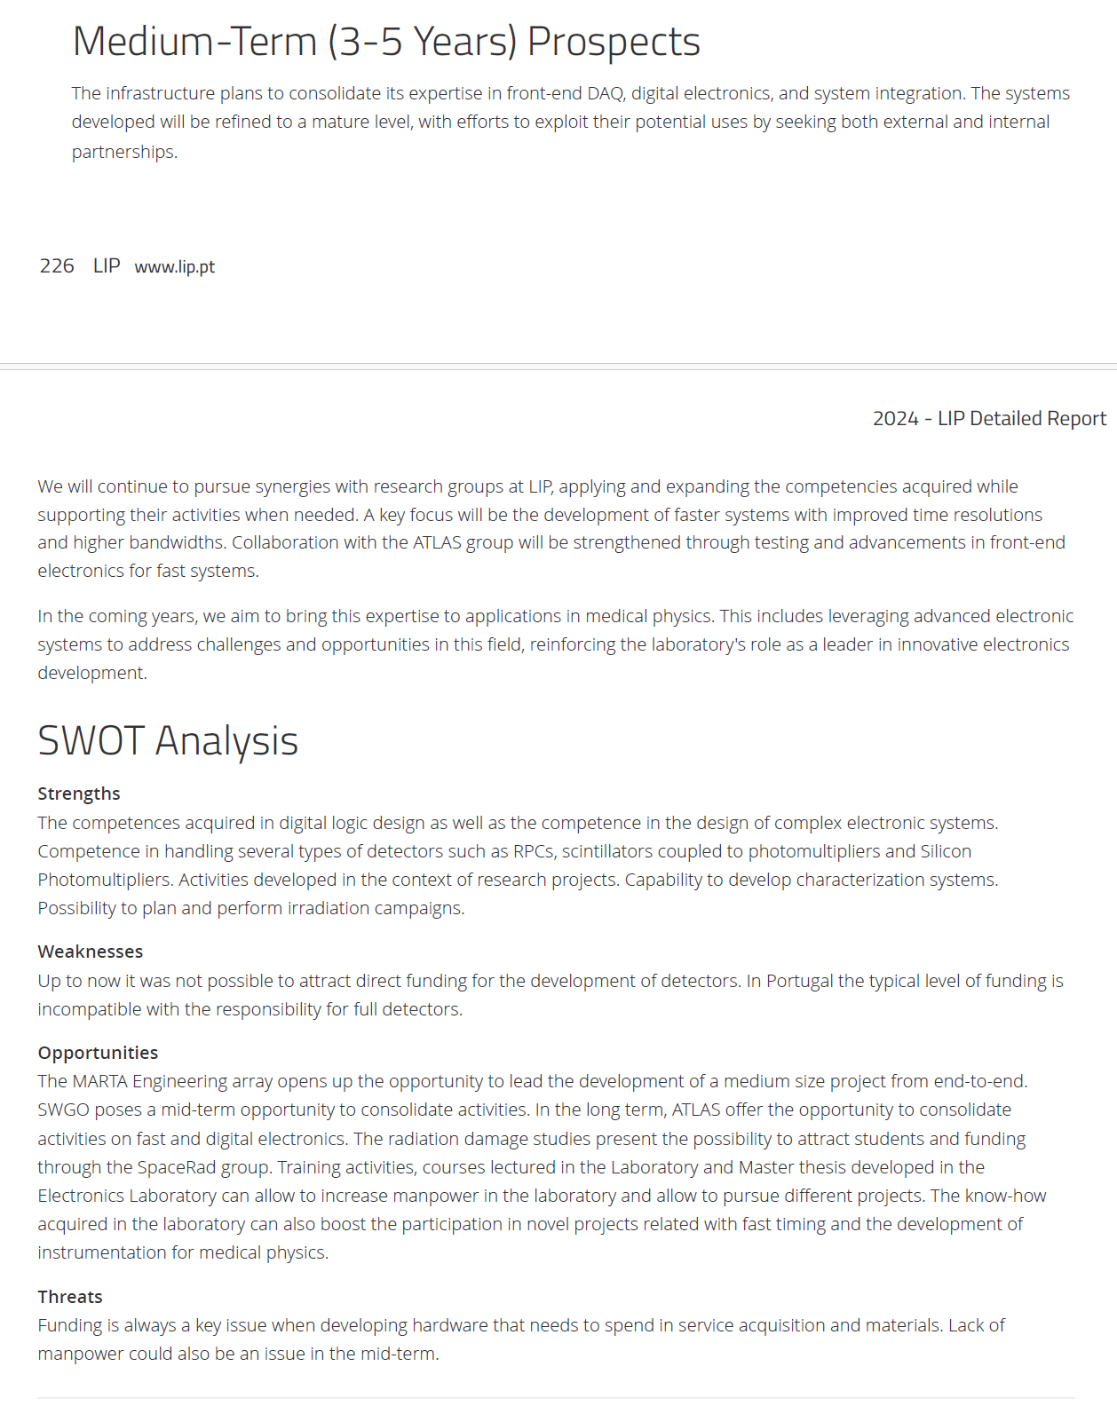

Slide 13
Office

Slide 14
electronics

Slide 15
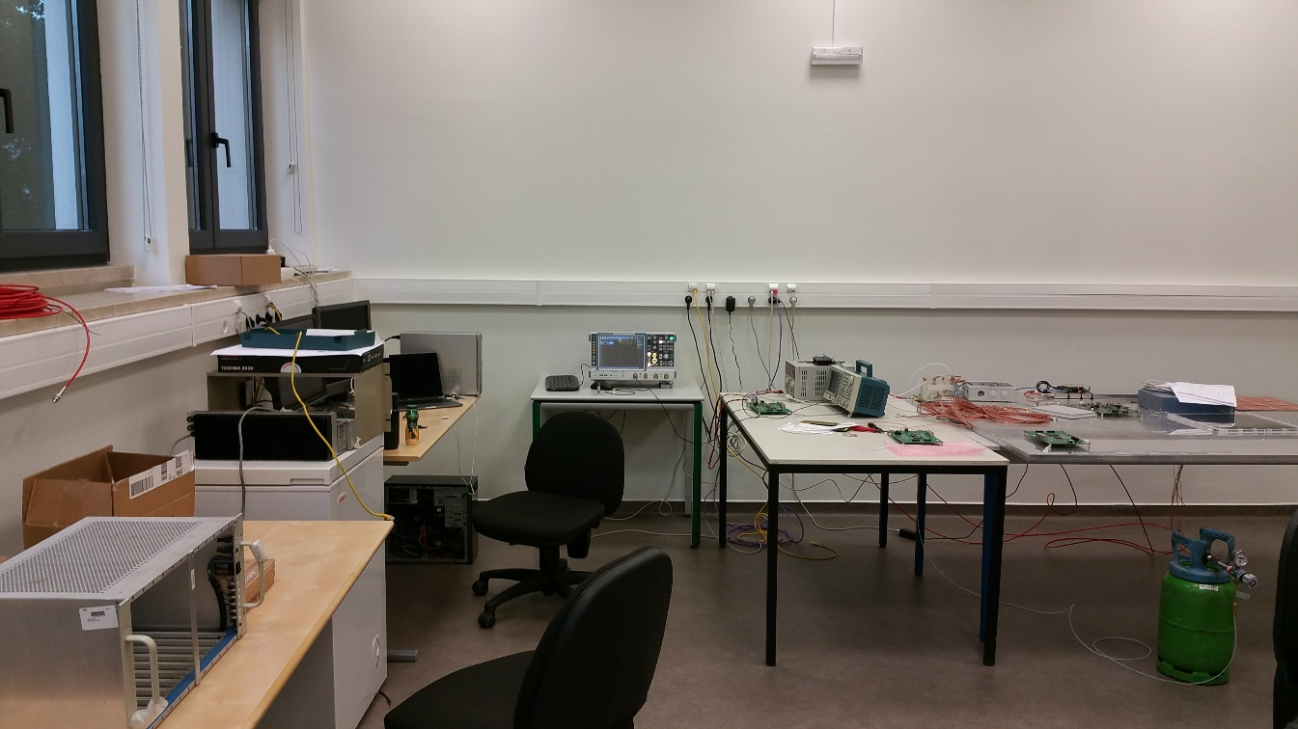
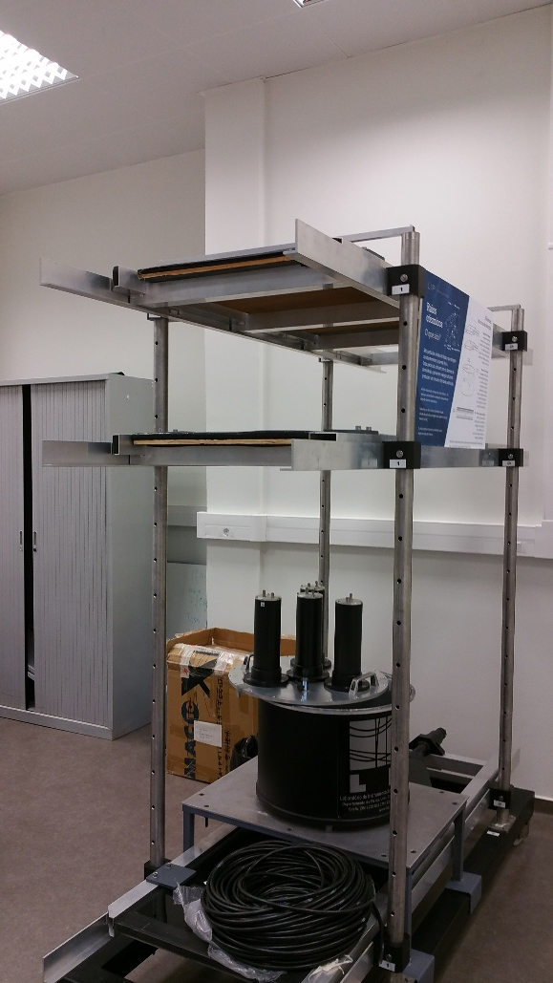
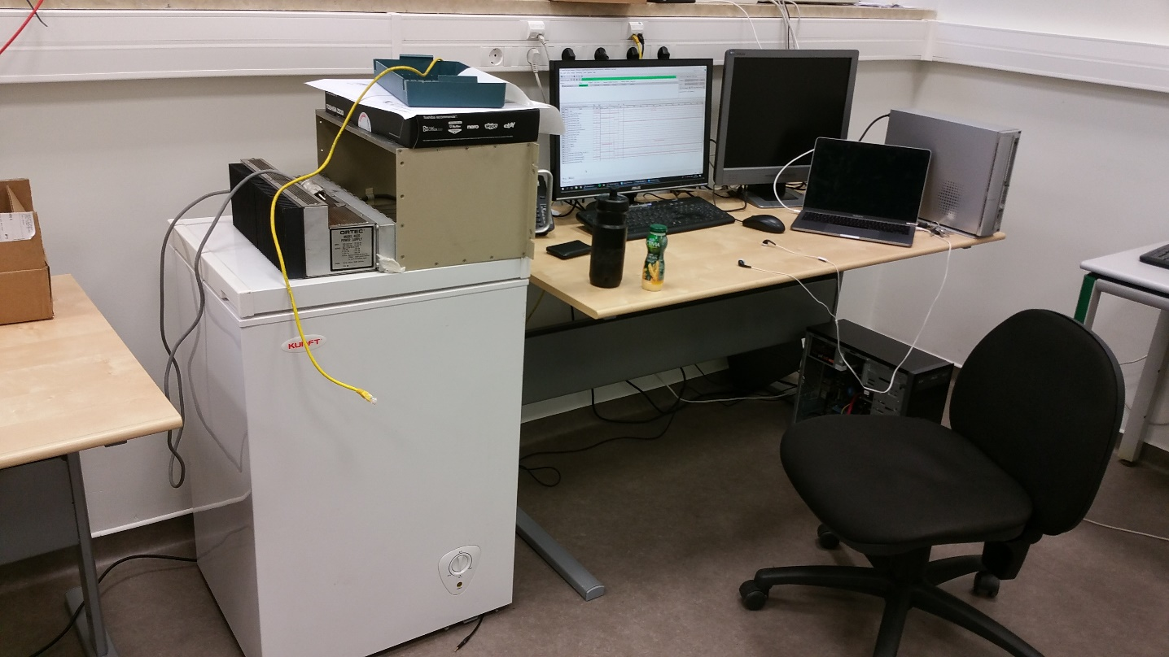
Detector integration and testing

Slide 16
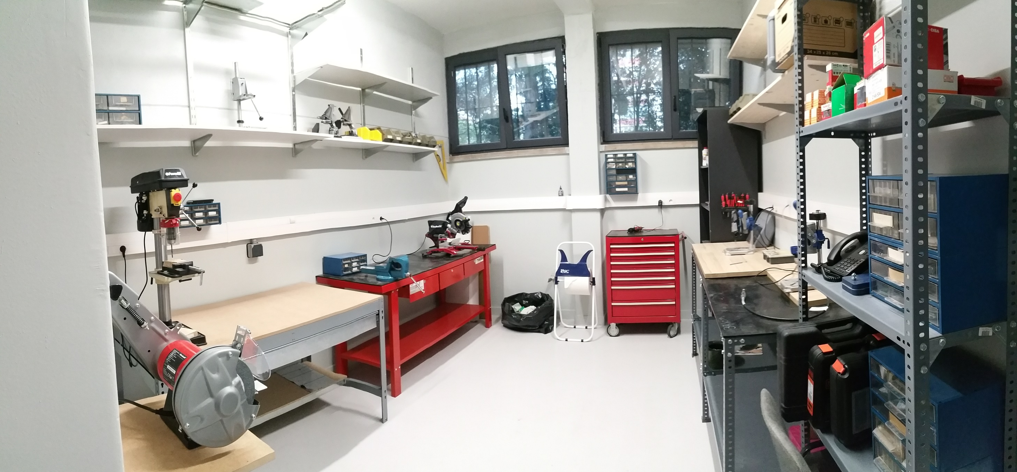
Detector prototyping workshop

Slide 17
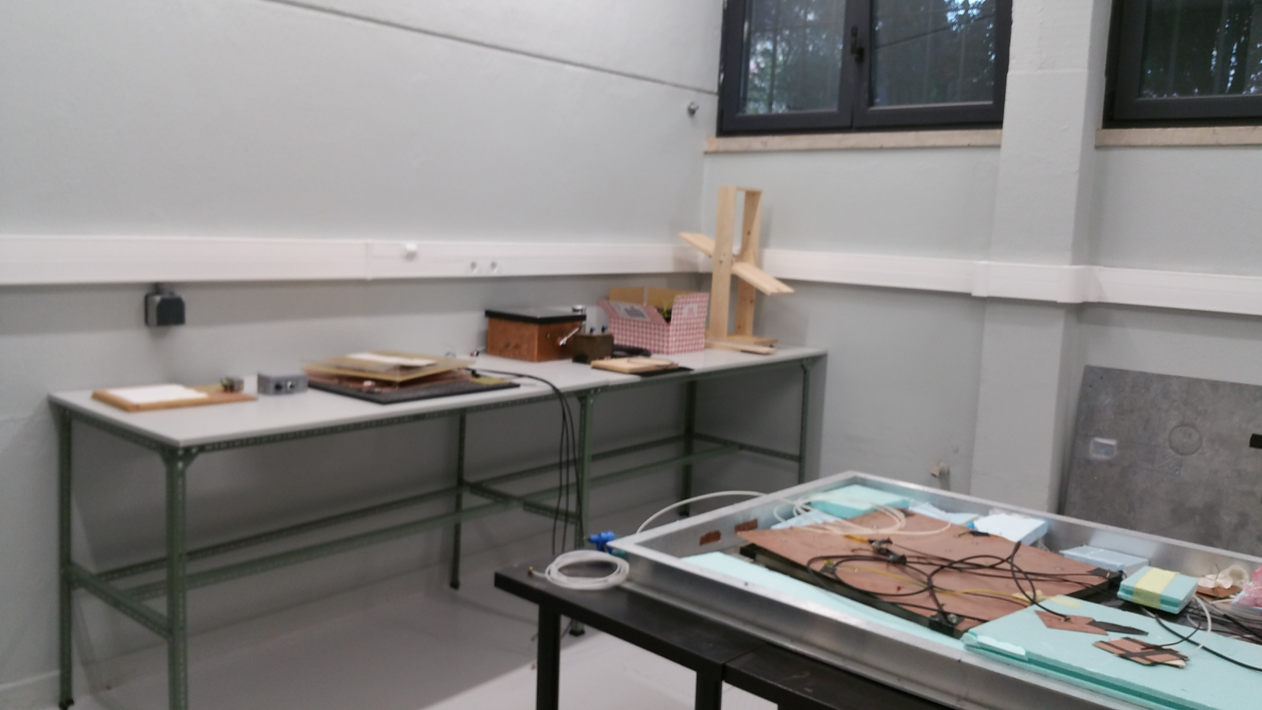
Detector prototypes room

