Slide 1
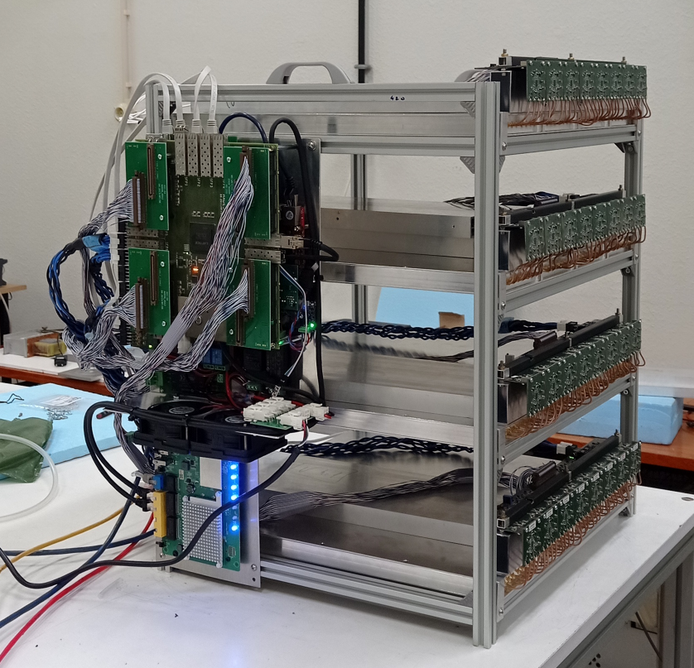
sRPC@LHC
Alexandre Mendonça
27/03/2025

Slide 2
Access sRPC data
Data is located in pauli machine;
First you need to create a new LIP user here;
Then contact helpdesk@lip.pt requesting NCG resources and sending your public ssh;
If you don’t have an ssh key create one;
If you already have one created you can send that one. (make sure you remember the passowrd)
Login: $ ssh -A -l username pauli.a.incd.pt
If you have more than one ssh key you need to create a config file inside ~/.ssh folder called config and write something like:
In order to ssh type: $ ssh pauli
Now inside the pauli machine you can access a shared directory where the data is located in: $ cd /share/deteclab/sRPC/data
More information here.

Slide 3
Data Information
Raw data writen in .dat.tar.gz format;
Data is named like dabc24126215646.dat.tar.gz where:
24: Is the year;
126: Is the day of the year;
215646: Is the hour, minute and second.
You can check the DOY calendar in here;
This data format is compiled and needs to be converted into a .root file with a Ttree.
For that there is a script dataConverter.py.
(Data in pauli from day 120* to 126)

Slide 4
dat.tar.gz vs .root
Already compiled days from 121 to 126;
dat.tar.gz is appear to be heavier than .root;
Weight of .dat.tar.gz
93.8G
Weight of .root
74 G
Problem with day 120 (some files appear to be poorly compiled)

Slide 5
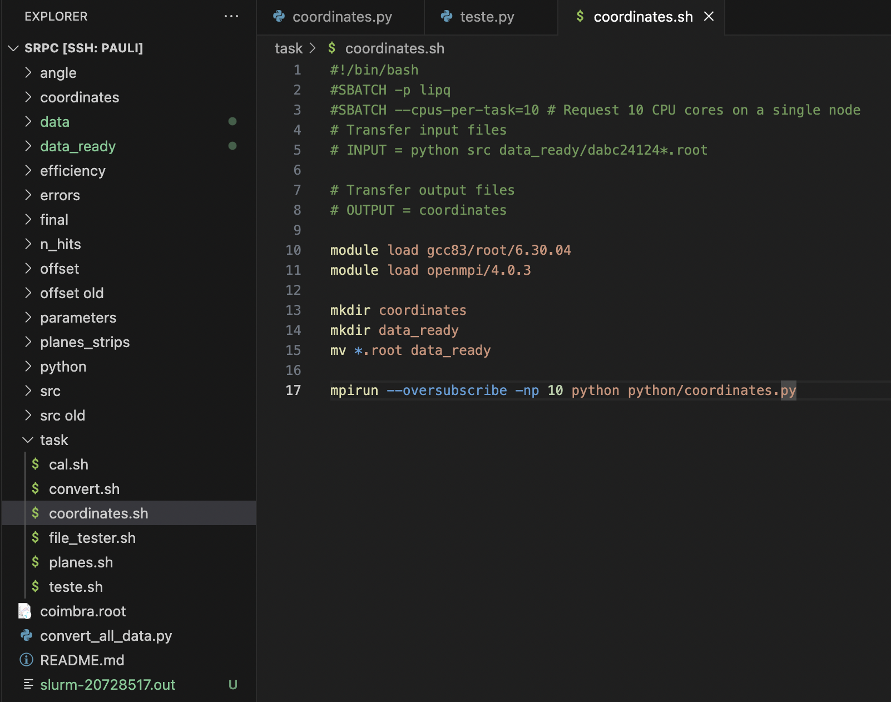
Using LIP SLURM
LIP has a powerfull computer where you can execute your scripts.
If your directory in pauli and have your scripts there you can create a .sh file like:
INPUT = files or folders you want to import into the SLURM machine from the pauli directory you are in.
OUTPUT = files or folders you want to download to the pauli directory you are in from the SLURM machine.
The none green code executes those lines as you are in a console inside SLURM.
Loads modules;
Creates directorysM;
Moves files;
Runs python script;
More information here.
or just write: python3 python/script.py

Slide 6
Modules
A module is a sort of environment which you can load in order to run your scripts.
To see the list of modules type: $ module avail;
To load a module type: $ module load {module_name};
To unload a module type: $ module unload {module_name};
To unload all modules type: $ module purge;
To see list of loaded modules type: $ module list;
Some modules already have a python version in them. If you load two python modules your scripts can generate strange errors.

Slide 7
Running your .sh in slurm
In order to run the .sh type: $ sbatch {job}.sh;
The number/id of your job should appear on your console;
To see your ongoing jobs type: $ squeue;
To cancel a job type: $ scancel {job_id};
You can run multiple jobs.
When your job finishes a file called slurm-{job_id}.out should appear on your directory.
This file contains the information about the output and (if any) errors of your script.

Slide 8
Parallel Computing (Openmpi)
Use 10 processors
When you normally run a python script in a computer it only uses one core of your processor.
With openmpi you can run the same program in multiple cores of your processor.
This is usefull for example to compile the .dat.tar.gz into .root files by splitting them between processors
Run python script with 10 processirs

Slide 9
Conclusion
About the presentation:
My scripts, .root data and other important files in /user/a/ammendonca/sRPC;
Already compiled days 121 to 126;
.root files lighter than .dat.tar.gz;
Errors on day 120;
Other stuff:
Already have access to sharepoint;
Testing scripts in SLURM;

