Slide 1


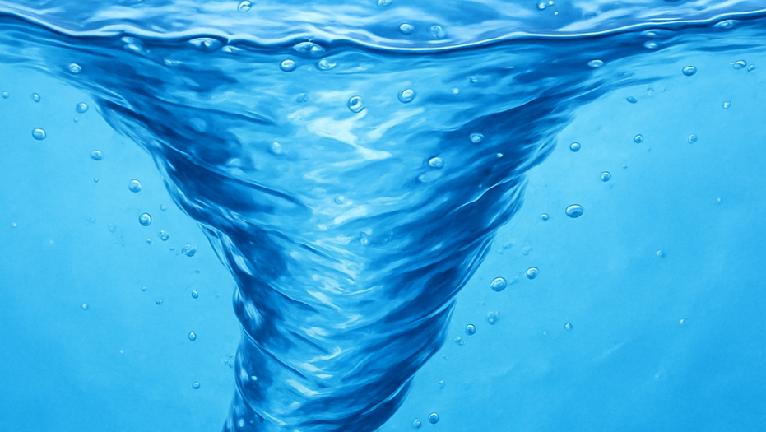
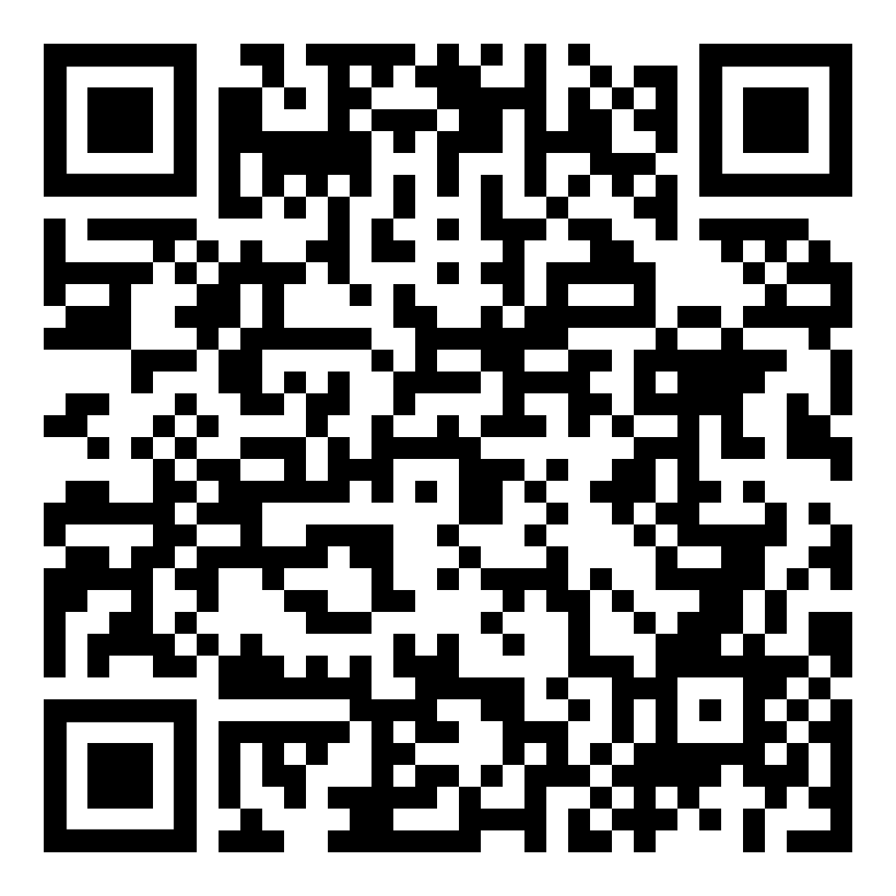
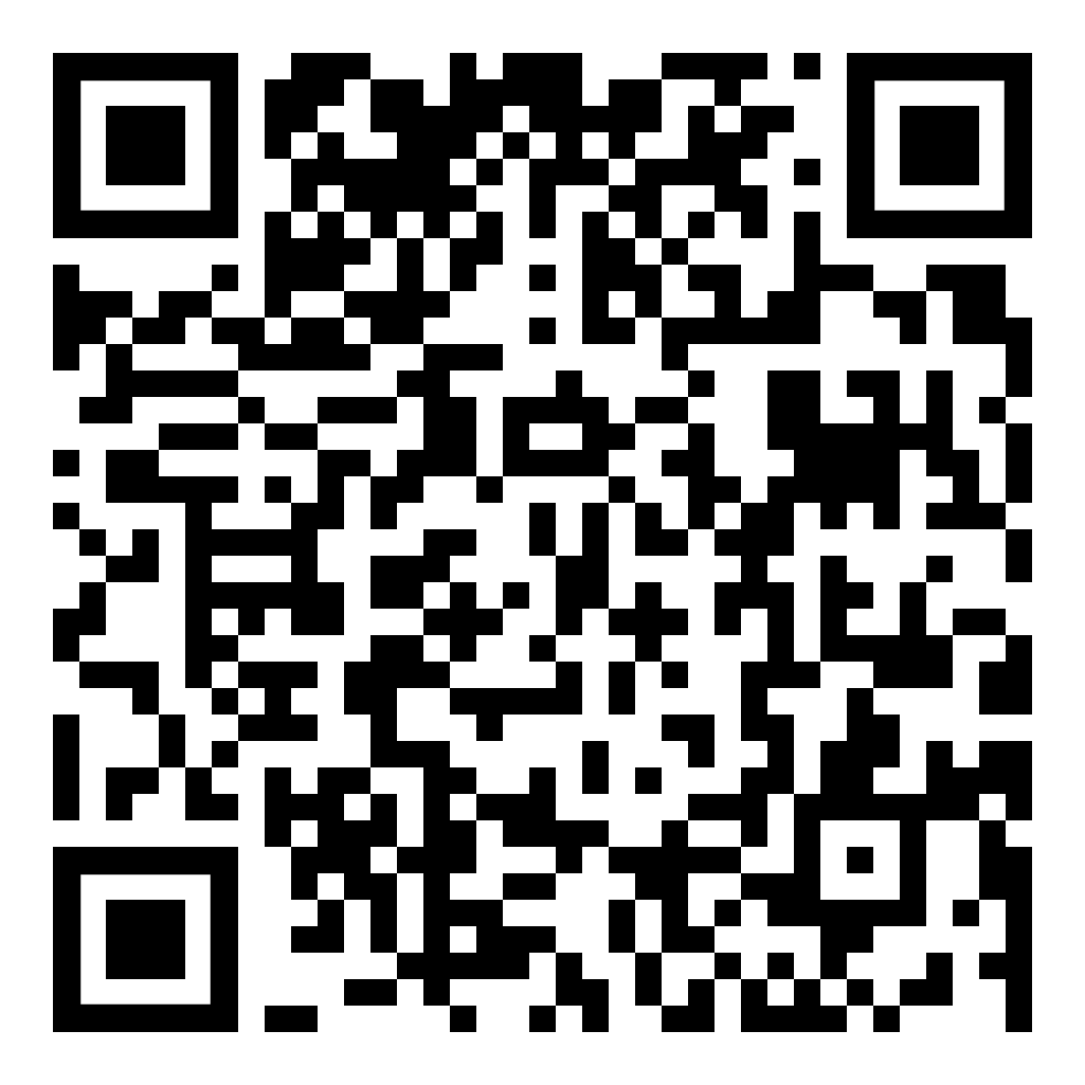
Vortical effects in chiral band structures
Ref: Vortical effects
Nanda, PH, PRB 2023
Ref: Converse vortical
Pavan Hosur
Department of Physics and Texas Center for Superconductivity, University of Houston
Weyl and Dirac semimetals as a Laboratory for High Energy Physics, June 27, 2025
Chen, Nanda, PH, PRB 2024

Slide 2
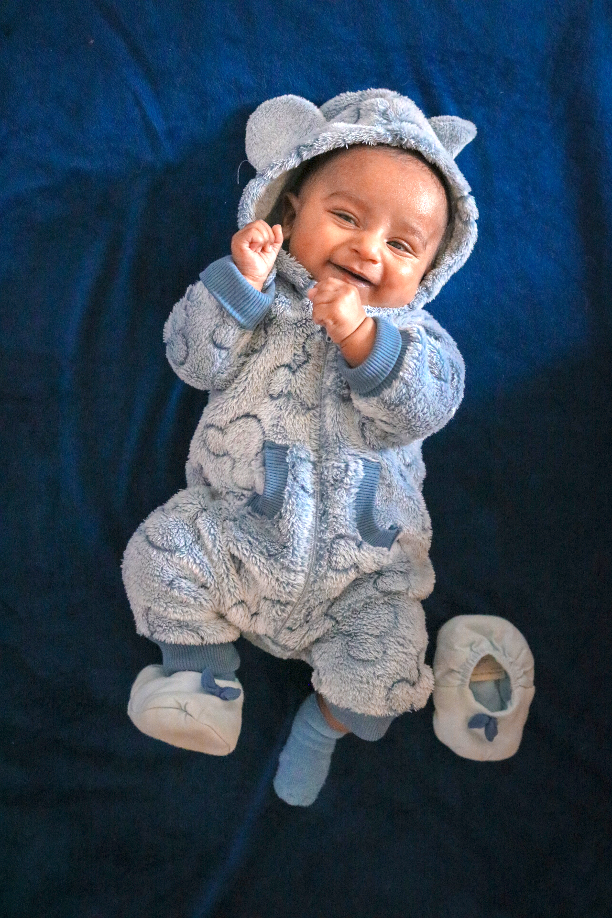
This talk:
Manifestation of chiral vortical effect (CVE) in solids
New effects – gyrotropic vortical effect (GVE), converse CVE, converse GVE
Nanda, PH, PRB 2023
Chen, Nanda, PH, PRB 2024

Slide 3

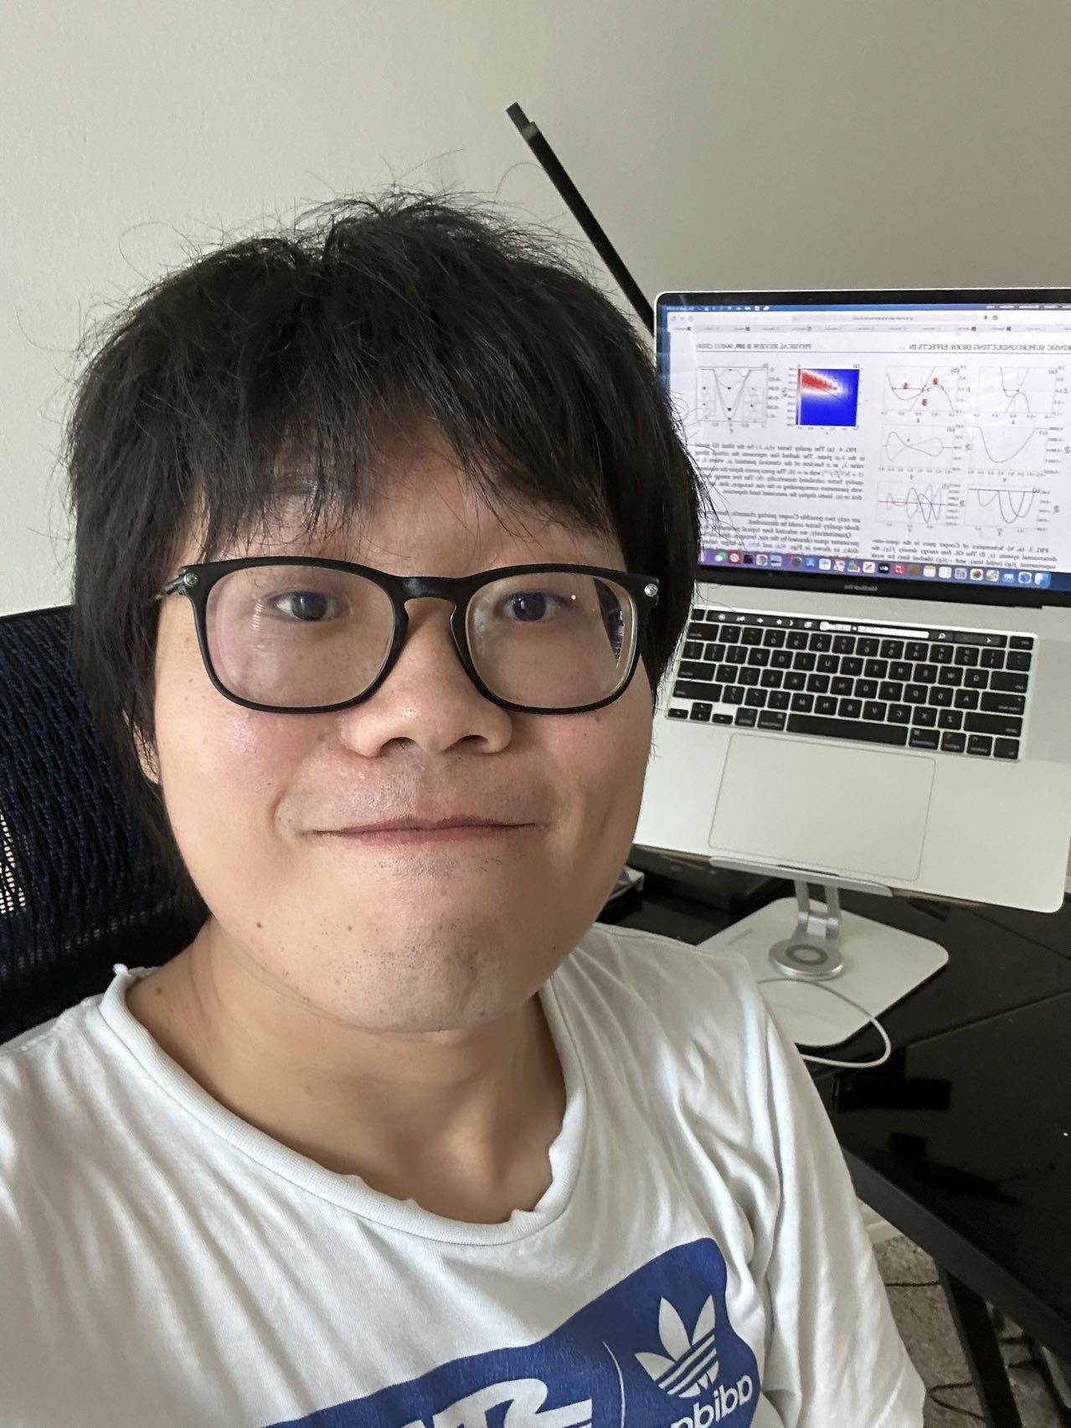

Acknowledgments
Swadeepan Nanda
University of Houston
Kai Chen
University of Houston
↓
Tongji University

Slide 4
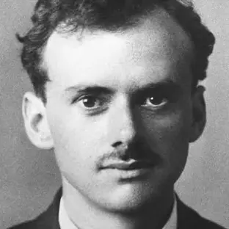
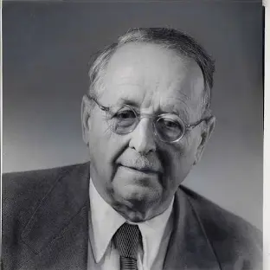
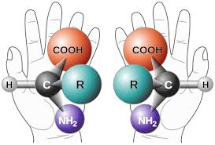
Chirality and Weyl fermions
m = 0
Paul Dirac
Chirality
Hermann Weyl

Slide 5
Chiral magnetic effect and anomaly
Weyl fermions in a magnetic field
L
R
B
Equilibrium current driven by B!
But equilibrium states cannot have current density (Bloch)
Origin of paradox: chiral anomaly
Kharzeev, Progress in Particle and Nuclear Physics, 2014

Slide 6
Chiral magnetic effect and anomaly
Weyl fermions in a magnetic field
L
R
E
Chiral charge non-conservation
Charge transfer mediated by high-energy states
Chiral anomaly and chiral magnetic effect are both properties of low-energy theory
B
Anomaly ↔︎ CME
Adler-Bell-Jackiw, Nielsen Ninomiya

Slide 7
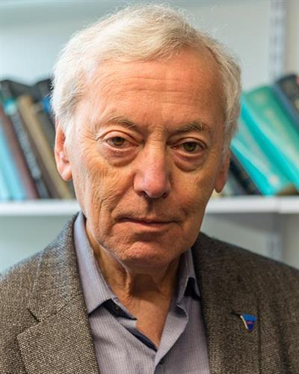
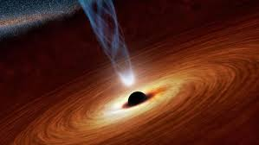
Chiral vortical effect in quantum field theory
Axial current driven by rotation
Weyl fluid
j
Coriolis ~ Lorentz
Ω ~ B
CVE = CME driven by rotation
Alex Vilenkin
Ω
Landsteiner, Loganayagam, Sadofyev, Son, Stephanov, Yin,…

Slide 8
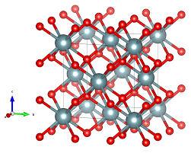
This talk: CVE and more in band structures
Key differences from QFT
1. No Lorentz invariance
2. Always lattice regularized
3. Anomaly-free chirality possible
4. Experimental realization?

Slide 9
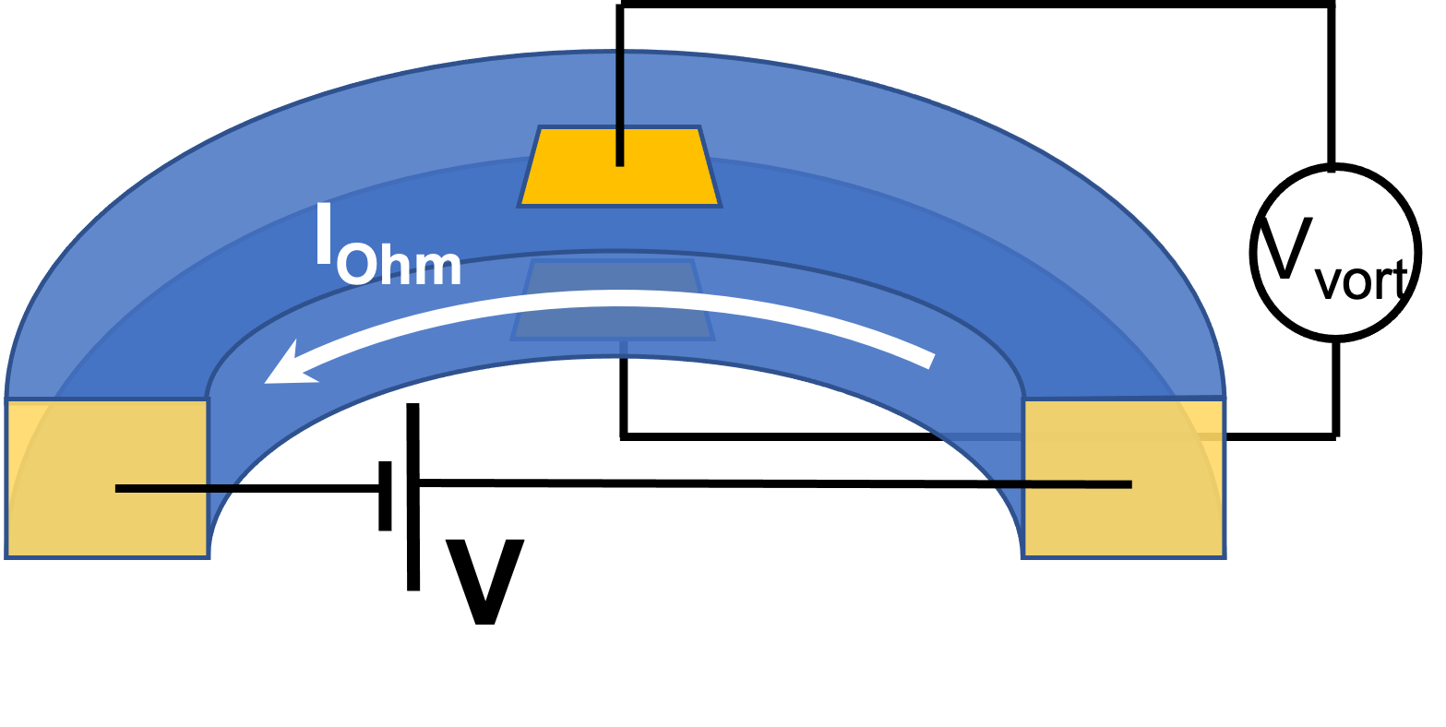
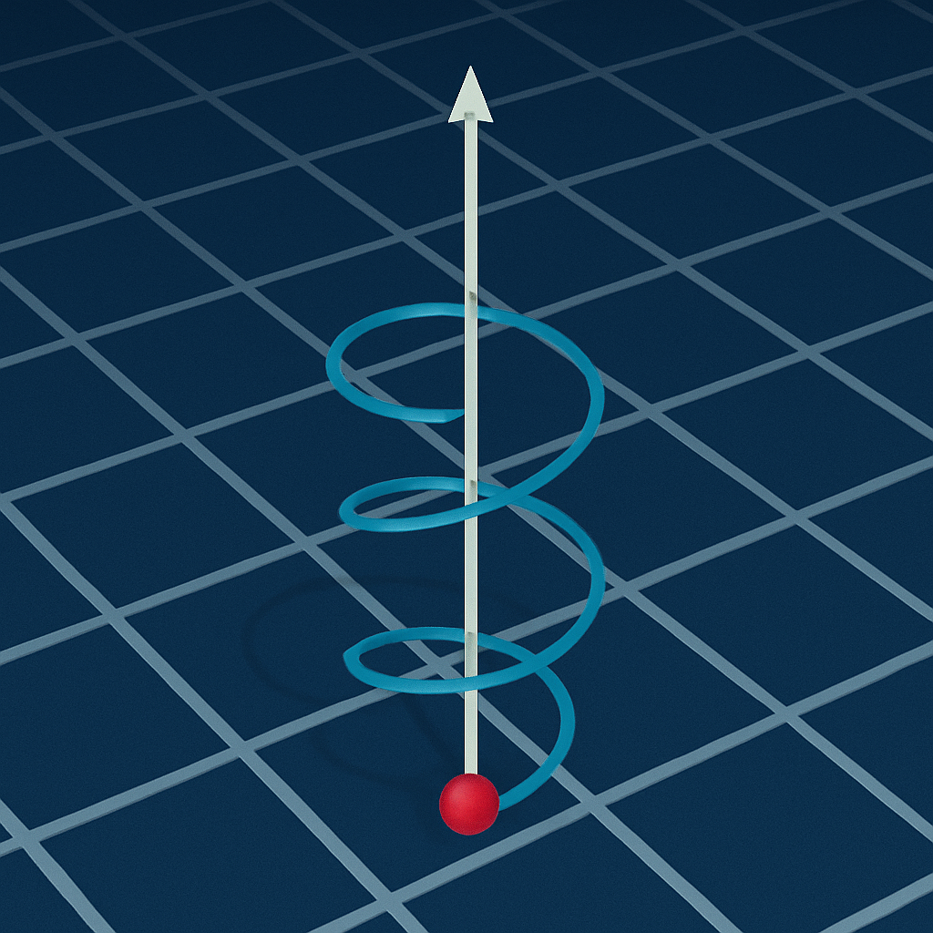
Setup: electrons revolving around an axis
Nanda, PH, PRB 2023
Non-equilibrium steady state: Electrons driven along curved path
Electrons rotate relative to static background lattice
L = r x p Continuum spatial angular momentum
Bloch momentum, not continuum momentum p
k = p in “nearly free electron” limit, i.e., weak lattice potential. Restrict to this limit for now.

Slide 10
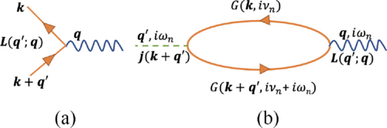
Kubo formula calculation
Nanda, PH, PRB 2023
Angular momentum vertex:
Real-space derivative inside unit cell. Ignore for now.
susceptibility, χ_{αβ}

Slide 11
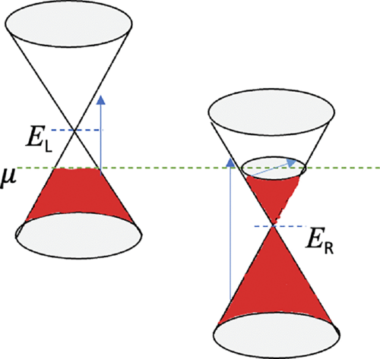
Result: Inter- and intra-band contributions
Nanda, PH, PRB 2023
χ^{inter} χ^{intra}
Focus on T, ω, q, 1/τ → 0
Berry curvature of occupied bands
Orbital magnetic moment on Fermi surface
Non-zero if reflection symmetries are broken. Weyl nodes not necessary (unlike CME)!
Non-zero effect without chiral anomaly because rotation is excited state/violates Bloch’s assumption of lower-bounded spectrum in thermodynamic limit.

Slide 12
Result: Inter- and intra-band contributions
For Weyl semimetal with 2N isotropic Weyl nodes at energies E_{i}, chirality C_{i}, velocity v_{i}
Nanda, PH, PRB 2023
N = 1 shown

Slide 13
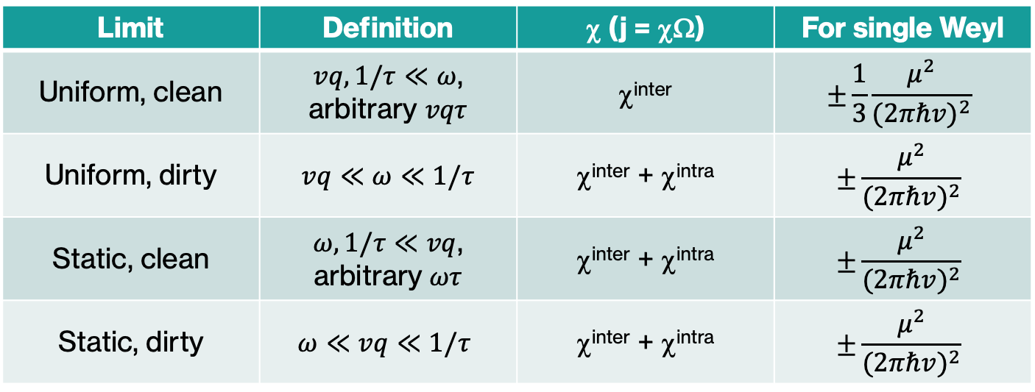
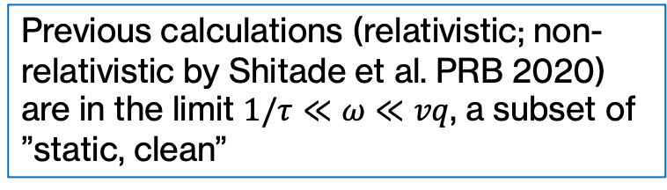
Result: Chiral and gyrotropic vortical effects
Nanda, PH, PRB 2023
Limit | Definition | χ (j = χΩ) | For single Weyl
Uniform, clean | $vq,1/τ≪ω$, arbitrary $vqτ$ | χ^{inter} | $$±\frac{1}{3}\frac{μ^{2}}{{(2πℏv)}^{2}}$$
Uniform, dirty | $vq≪ω≪1/τ$ | χ^{inter} + χ^{intra} | $$±\frac{μ^{2}}{{(2πℏv)}^{2}}$$
Static, clean | $ω,1/τ≪vq$, arbitrary $ωτ$ | χ^{inter} + χ^{intra} | $$±\frac{μ^{2}}{{(2πℏv)}^{2}}$$
Static, dirty | $$ω≪vq≪1/τ$$ | χ^{inter} + χ^{intra} | $$±\frac{μ^{2}}{{(2πℏv)}^{2}}$$
New! Gyrotropic Vortical Effect. Transport in Fermi liquid is in this limit
CVE
Previous calculations (relativistic; non-relativistic by Shitade et al. PRB 2020) are in the limit $1/τ≪ω≪vq$, a subset of ”static, clean”
Recall: χ^{inter} due to Berry curvature of occupied bands
χ^{intra} due to magnetic moment on Fermi surface

Slide 14
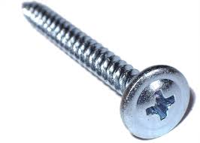
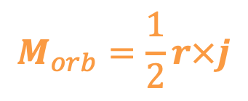
Velocity ⟷ Angular velocity: New effect!
Chen, Nanda, PH, PRB 2024
Vortical effect: Axial current driven by rotation
Converse vortical effect: Orbital magnetization driven by linear current
$$M_{orb}=\frac{1}{2}r×j$$
Chiral fluid
Chiral fluid
j
v
Fundamentally, chirality = coupling b/w linear and rotational motion
Ω
j

Slide 15
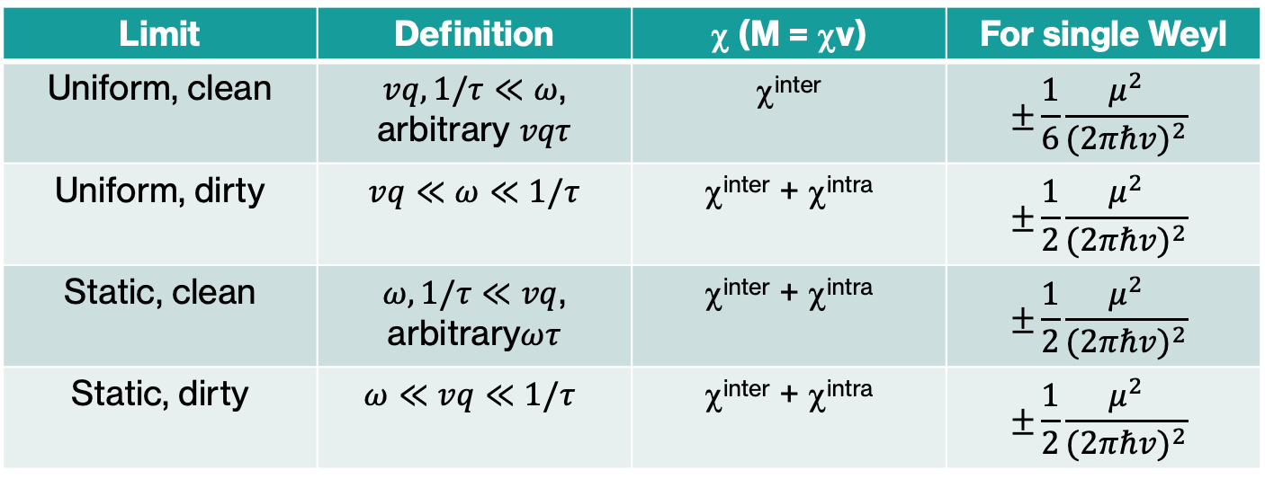
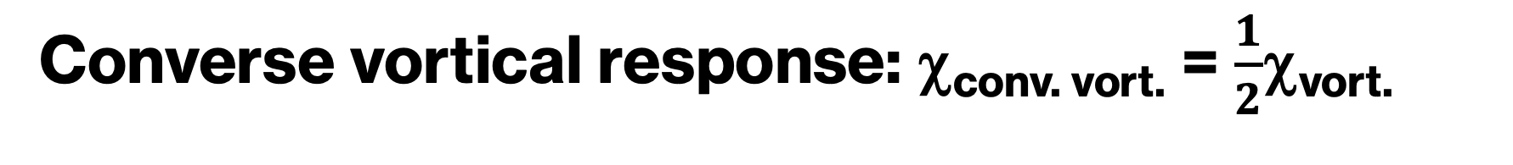
Converse vortical response: χ_{conv. vort.} = $\frac{1}{2}$χ_{vort.}
Chen, Nanda, PH, PRB 2024
Limit | Definition | χ (M = χv) | For single Weyl
Uniform, clean | $vq,1/τ≪ω$, arbitrary $vqτ$ | χ^{inter} | $$±\frac{1}{6}\frac{μ^{2}}{{(2πℏv)}^{2}}$$
Uniform, dirty | $vq≪ω≪1/τ$ | χ^{inter} + χ^{intra} | $$±\frac{1}{2}\frac{μ^{2}}{{(2πℏv)}^{2}}$$
Static, clean | $ω,1/τ≪vq$, arbitrary$ωτ$ | χ^{inter} + χ^{intra} | $$±\frac{1}{2}\frac{μ^{2}}{{(2πℏv)}^{2}}$$
Static, dirty | $$ω≪vq≪1/τ$$ | χ^{inter} + χ^{intra} | $$±\frac{1}{2}\frac{μ^{2}}{{(2πℏv)}^{2}}$$
Converse GVE
Converse CVE
Recall: χ^{inter} due to Berry curvature of occupied bands
χ^{intra} due to magnetic moment on Fermi surface

Slide 16
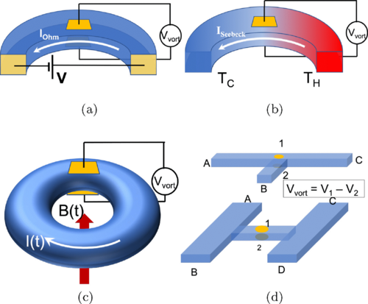
Experimental proposals
Vortical effects: transverse voltage due to travel around curved sample/corners
Converse vortical effects: orbital magnetization due to linear travel
$∇$T = 1 K/μm, S_{Seebeck}=100 μV/K OR E = 0.1 V/m, μ_{mob} = 10⁵cm²/Vs
j^{vort} ~ 100mA/mm² ; M^{orb} ~ 10⁻² A/m

Slide 17
Summary
In band structures, vortical effects can exist without Weyl fermions.
Rely on Bloch function properties such as Berry curvature and magnetic moment.
Distinct vortical effects in different limits. New effects:
  Gyrotropic vortical effect appropriate for transport in Fermi liquids.
  Converse effects – vorticity driven by linear velocity. Both chiral and gyrotropic variants exist.
Experimentally detectable as orbital magnetic moment generated by current.
Ref: Vortical effects
Ref: Converse vortical
Thank you!
Nanda, PH, PRB 2023
Chen, Nanda, PH, PRB 2024

