Slide 1
CFT in Momentum Space for Parity-odd Interactions,
Axions and Dilatons
Claudio Coriano’
Dipartimento di Matematica e Fisica, Universita’ del Salento
INFN – Lecce
J_5 JJ, J_5 TT, T JJ
Work with S. Lionetti
M. Creti’, S. Lionetti, R. Tommasi
S. Lionetti, D. Melle, L. Torcellini
Braga, Portugal, 26-6- 2025

Slide 2
Are axions always asymptotic ?
Are all axion/gauge field interactions described by a local action?
In the UV, conformal field theory tells us that the anomaly interactions do not necessarily
Correspond to asymptotic pseudoscalar states.
One cannot use naively Goldstone’s theorem to derive a local action
CFT in momentum space clarifies in a rigorous way the origin of such interactions
And how they are strictly limited to null surfaces
The proof that these interactions live an propagate on the light cone comes from
The analysis of the Conformal Ward identities

Slide 3
CFT constraints on parity-odd interactions with axions and dilatons arXiv: 2408.02580 with S. Lionetti
Gravitational chiral anomaly at finite temperature and density
arXiv: 2404.06272
Axionlike quasiparticles and topological states of matter: Finite density corrections of the chiral anomaly vertex arXiv: 2402.03151
with M. Creti’, Stefano Lionetti, R. Tommasi
Quantum anomalies and parity-odd CFT correlators for chiral states of matter arXiv: 2409.10480
Parity-violating CFT and the gravitational chiral anomaly arXiv: 2309.05374 with S. Lionetti and M.M. Maglio
CFT correlators and CP-violating trace anomalies arXiv: 2307.03038 with S. Lionetti, M. M. Maglio
CFT and anomalies
The gravitational form factors of hadrons from CFT in momentum space and the dilaton in perturbative QCD
e-Print: 2409.05609
For applications at the EIC

Slide 4
Perturbative analysis of AVV, TJJ
M. Giannotti, E. Mottola
Armillis, Delle Rose, CC
TJJ appears inn the conformal anomaly
Solving the Conformal Constraints from scalar correlators in CFT
in momentum space
Delle Rose, Mottola, Serino, CC 2013
General CFT for tensor correlators
Bzowski, McFadden, Skenderis, 2013
Formulation of general methods
Parity even sector
reviewed in
Maglio, CC, Phys. Rep
(conformal anomaly
Method generalized more recently to
Parity odd sectors + anomalies from CFT
Lionetti, Maglio, CC, 2023, 2024
AVV, AAA, ATT, CS TT
Demonstration of off-shell sum rules in QED (M. Giannotti E. Mottola)
Nonabelian extensions to QCD, Lionetti, Melle, Torcellini, 2025
Applications to Gravit. Form Factors

Slide 5
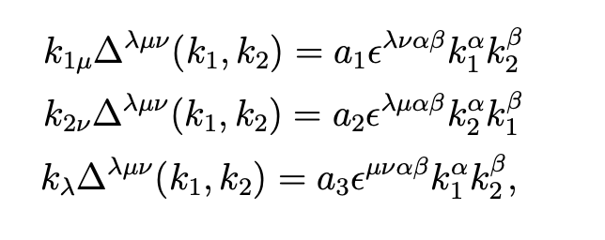
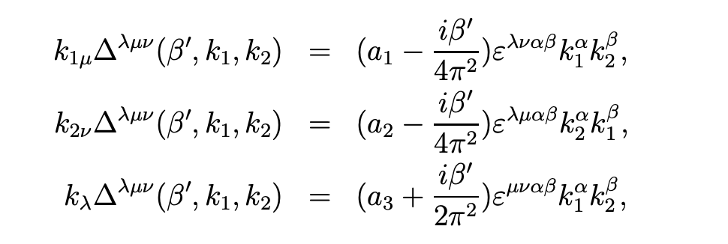
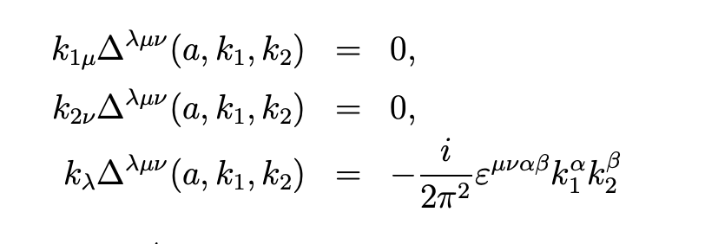
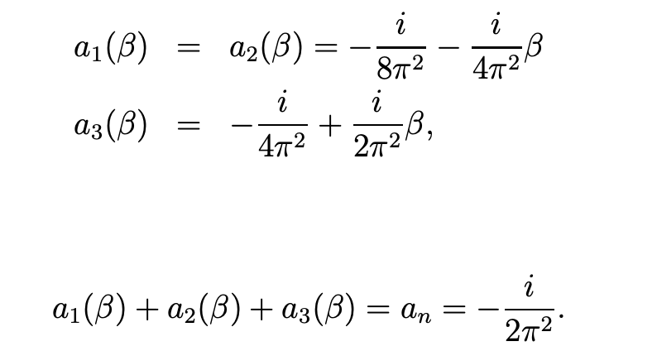

Slide 6
Rosenberg (1963)
Ward identities are local
These interactions are finite as far as we impose Ward identities.
Question: can we costruct these interactions directly from the Ward identites ?

Slide 7
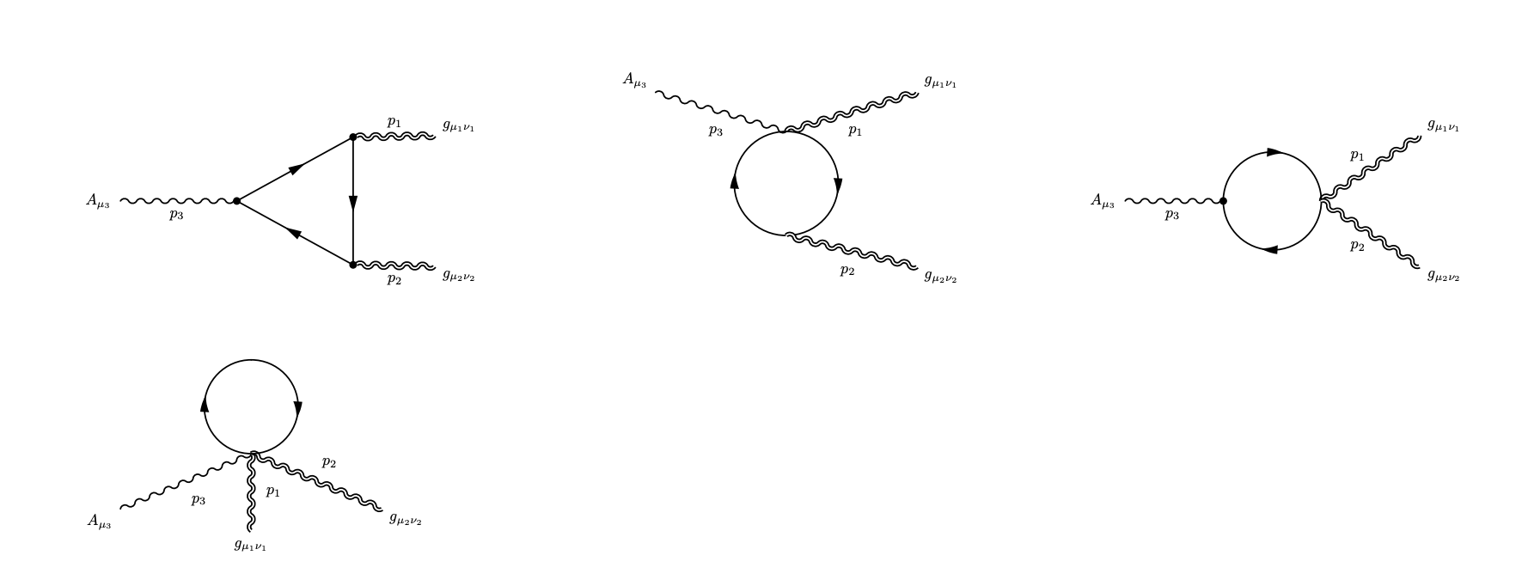
The WIs are sufficient to remove the divergences,
but we need something extra if we want to construct these interactions completely
This “something extra” is Conformal Symmetry
A similar type of analysis can be performed for chiral gravitational anomalies
Lionetti, Maglio, CC 2024
ATT

Slide 8
Conformal Anomalies
TJJ
M. Gannotti, E. Mottola
R. Armillis, L. Delle Rose, CC
AVV (J_5 JJ)
A T T (J_5,TT)
Possible role in the conformal phase of the early universe
Topological materials
Thermal transport, geometry, and anomalies
M. Chernodub, Y. Ferreiros, A. Grushin, K. Landsteiner, M. Vozmediano
Phys.Rept. 977 (2022)

Slide 9
CFT in momentum space
Parity-even Tensor Correlator. (Conformal anomaly correlators)
Bzowski, McFadden Skenderis (2013 and sequel) general methods for the analsysis of 3 point functions
of scalars. Developed the renormalization of the solution, in a completely independent fascion
(no reference to field theory realization)
For correlators involving TJJ, TTT (conformal anomaly), the method can be equivalently formulated
in generic free field theories, (Maglio, CC)
2018

Slide 10
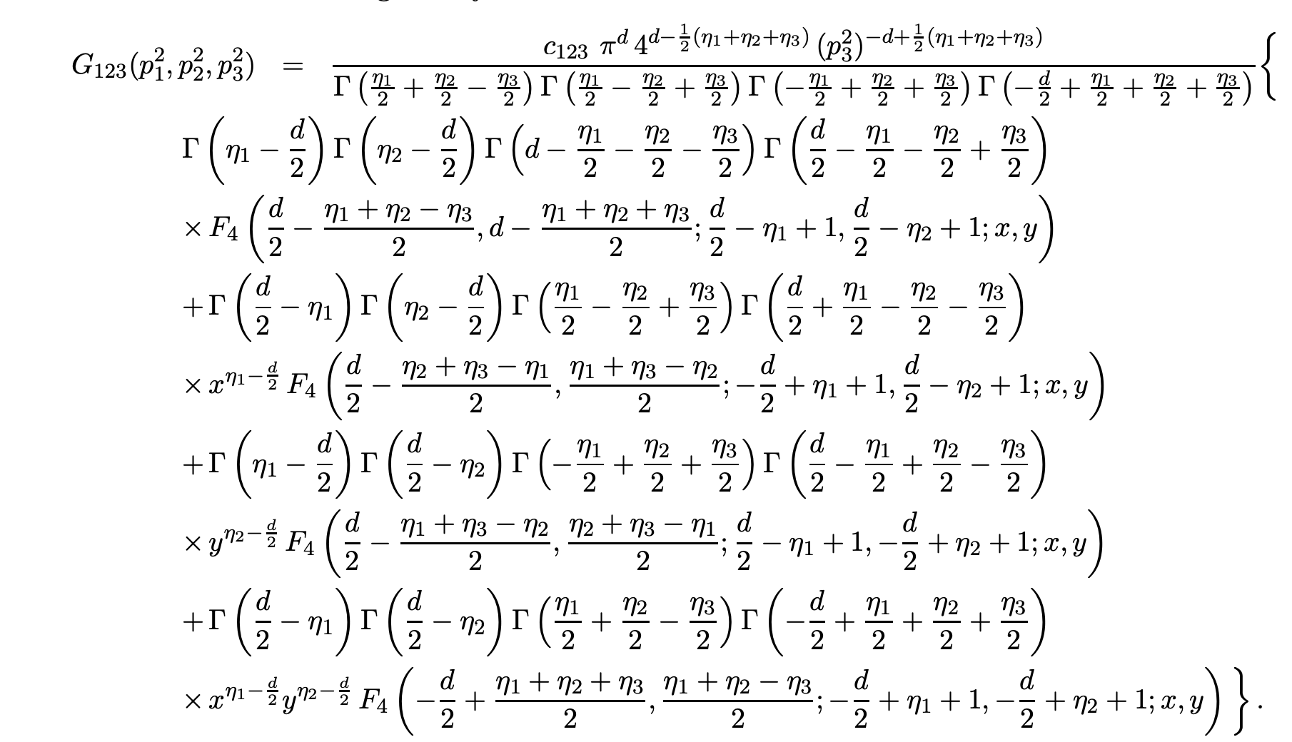
Scalar Correlators from CWIs. 2013
(Delle Rose, Mottola, Serino, CC
Solving the Conformal Constraints for Scalar Operators
in Momentum Space and the Evaluation of Feynman's Master Integrals

Slide 11
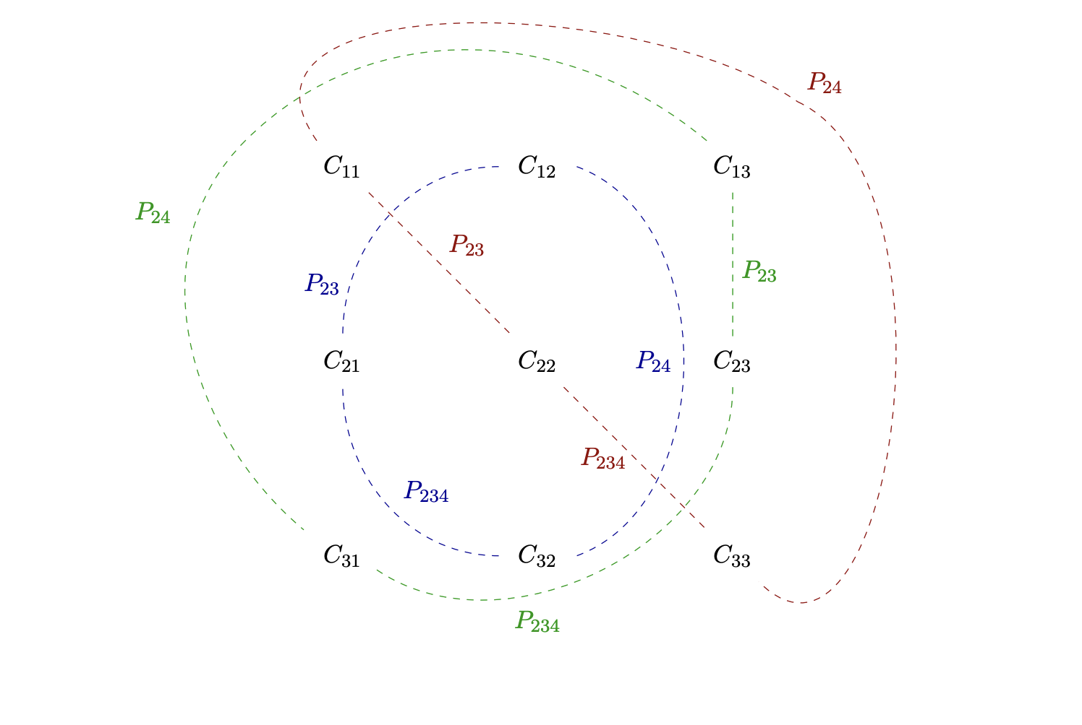
extensions to 4-point functions
Four-Point Functions in Momentum Space: Conformal Ward Identities in the Scalar/Tensor case
Maglio, Theofilopoulos, CC
Eur.Phys.J.C 80 (2020)
Orbits of form factors
4K INTEGRALS

Slide 12
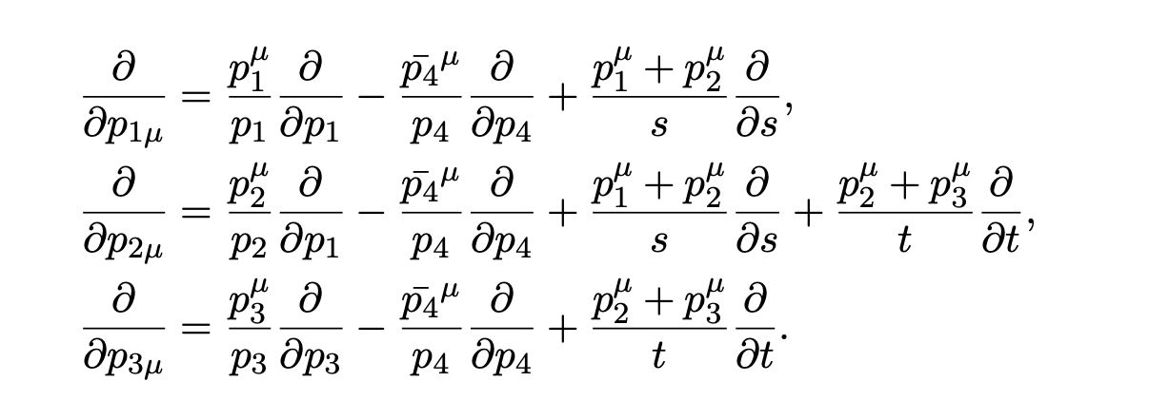
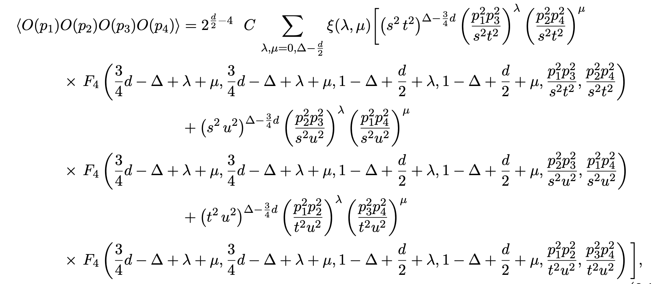
Scalar reduction of the conformal constraints
Maglio, Theofilopoulos, CC
For Yangian symmetry scalars

Slide 13
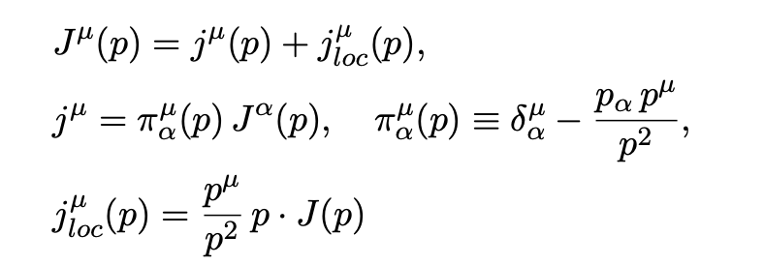
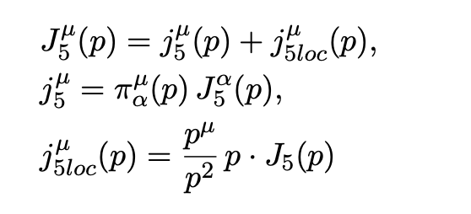
Lionetti, Maglio, CC, 2023
AVV
Defining equations
By functional differentiations wrt
backgrounds
L/T decomposition
transverse
longitudinal

Slide 14
Longitudinal sector determined by the anomaly: the inclusion of an anomaly pole
TRANSVERSE SECTOR
SCHOUTEN RELATIONS
Simplification

Slide 15
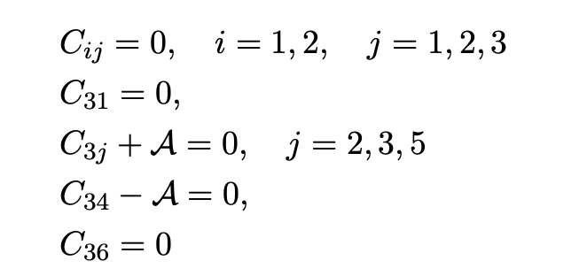
The anomaly enters in the CWIs
equations

Slide 16
3K Integrals

Slide 17
A_1=0

Slide 18
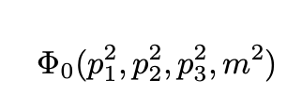
SUMMARY AVV
Notice that CWIs have “forced” the anomaly coefficient into the transverse
sector as well.
This is in agreement with Furry’s theorem (vanishing of VVV conserved currents), without
using C-invariance, but just conformal symmetry
If we move away from the conformal limit, the decomposition is still valid, but we need to identify the
Anomaly form factor (AFF)

Slide 19
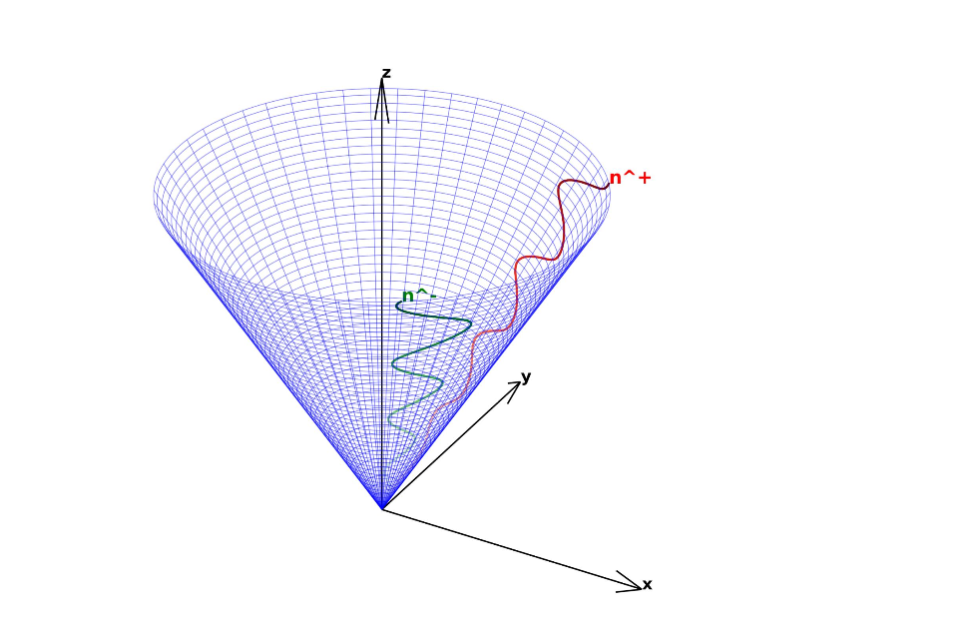
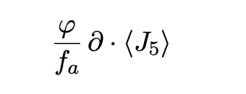

Slide 20
Lionetti, Maglio, CC, 2024
J_5 T T

Slide 21
Simplifications
Anomaly pole in the longitudinal sector. (a2)

Slide 23
SCT act endomorphically
On the tt sector
Equations can be solved by a method discussed in detail in the paper

Slide 24
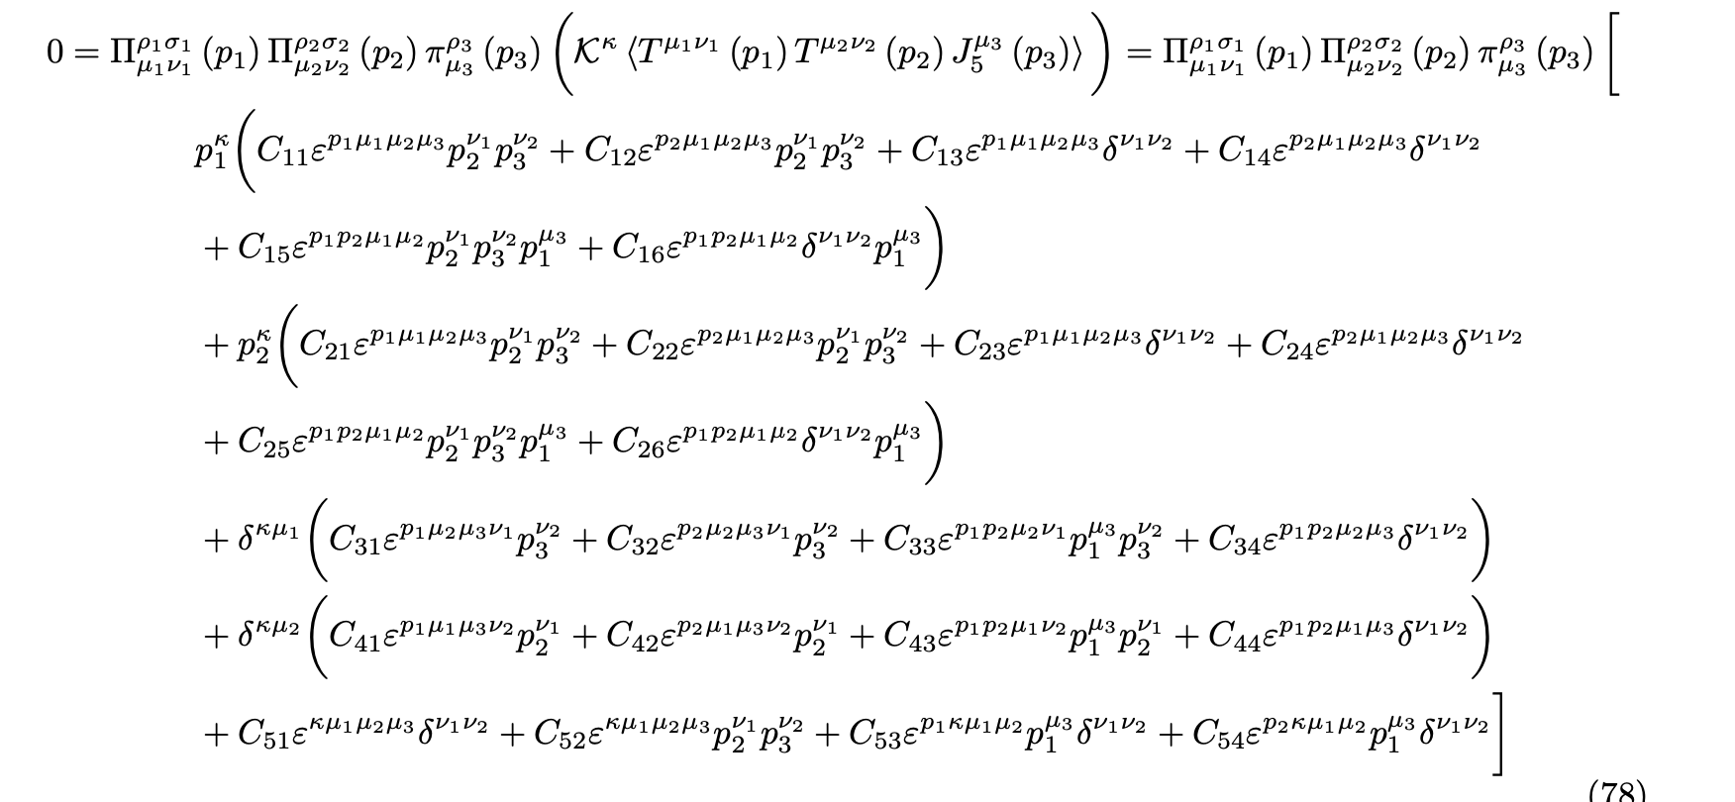
Primary second order PDE’s

Slide 25
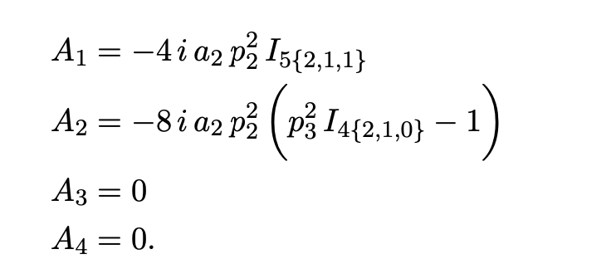
Solution
Intermediate renormalization
As in BMS, modified to account for the chiral nature of
The anomaly
The solution

Slide 26
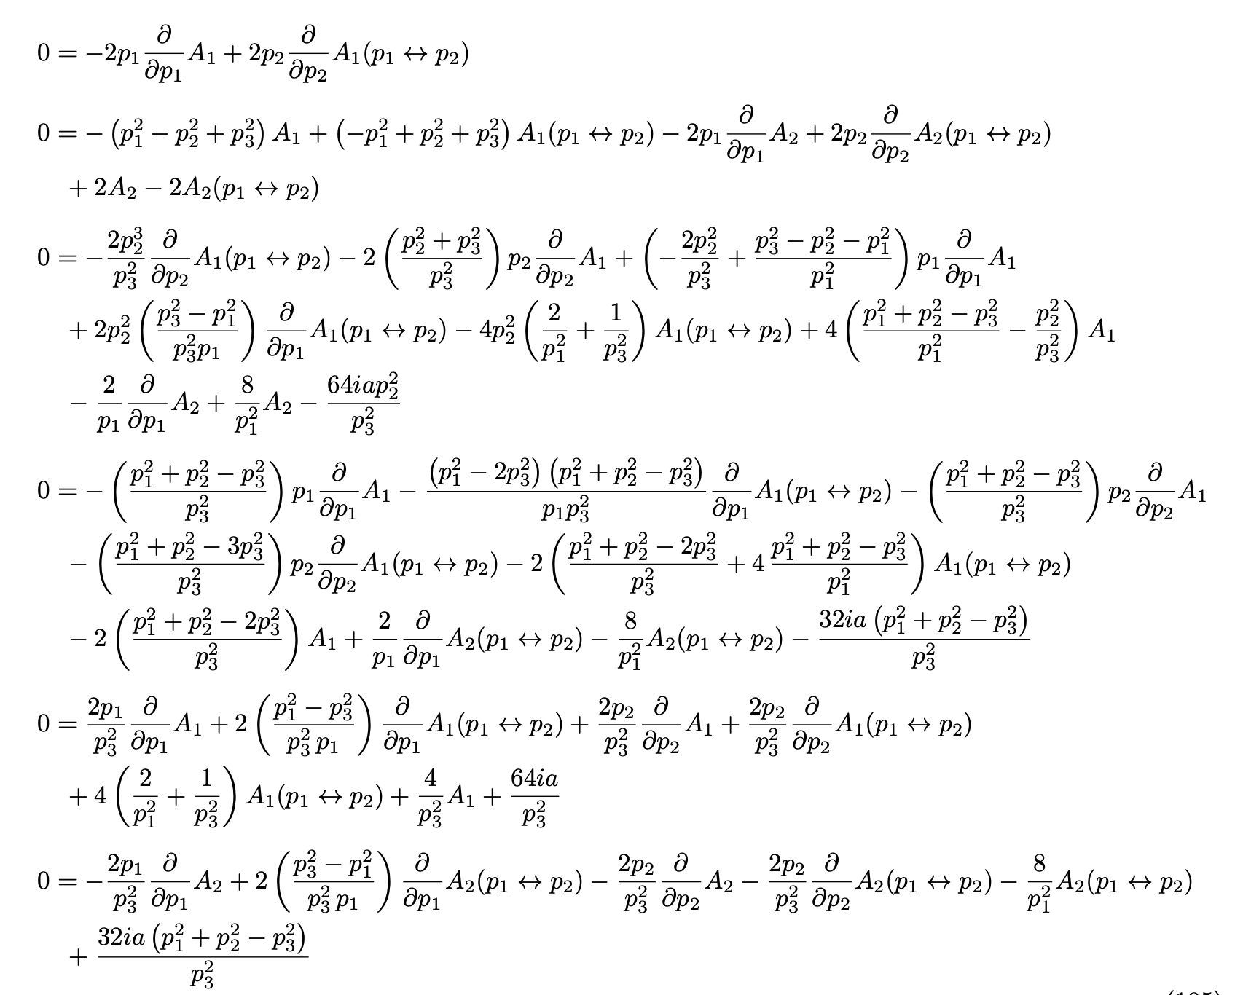
MESS (secondary equations)

Slide 28
Perturbative checks. We show how to map 3K integrals into scalar master integrals

Slide 29
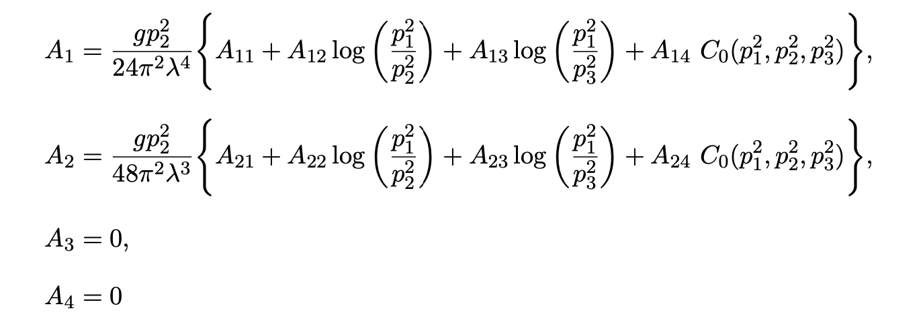
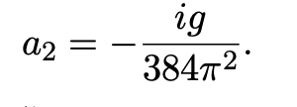
Result for the conformal solution
Amazingly simple

Slide 30
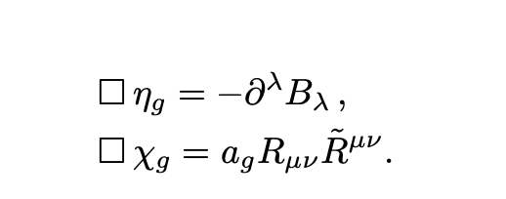
Giannotti and Mottola
Gravitational anomaly
Lionetti, Melle, CC

Slide 31
Condition to be satisfied in order to define a particle pole
No residue
Only if the two vector lines are on shell, the dynamica generates a nonzero residue

Slide 32
CONCLUSIONS
CFT in momentum space. Provides a consistent framework for the
analysis of anomaly correlators
Axion-like interactions need a mechanism of vacuum misalignment to
be defined as asymptotic states
Naïve extensions of Goldstone’s theorem are not justified

