Slide 1
Dirac Kondo effect under magnetic catalysis:
Competition with chiral symmetry breaking
KH, Daiki Suenaga, Kei Suzuki, Shigehiro Yasui, 2211.16150 (PRB)
Koichi Hattori
Zhejiang University
University of Minho - Campus of Gualtar
June. 25, 2025

Slide 2
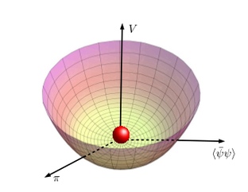
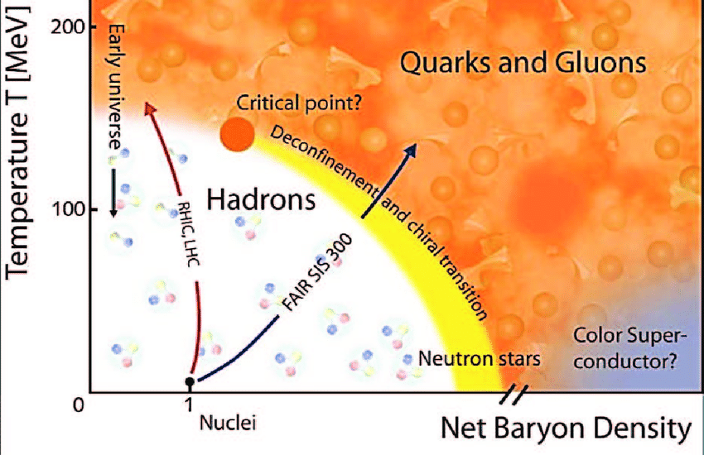
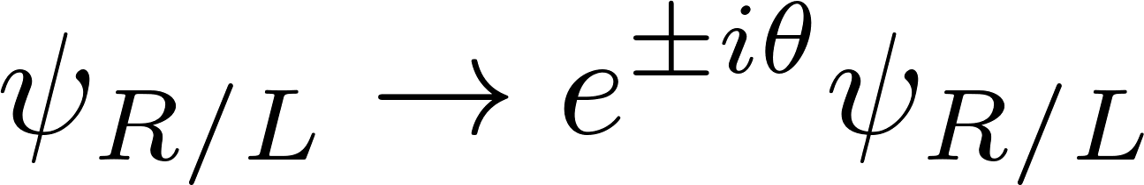
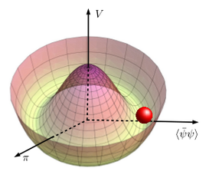
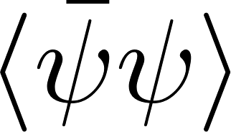
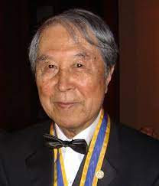
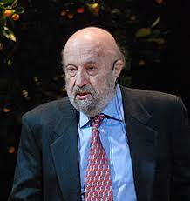
Chiral symmetry and its breaking in QCD
Temperature
Chiral symmetry is not an exact symmetry
in the presence of a finite quark mass.
→ Crossover transition
Chiral symmetry for Dirac fermions
Phases specified by the chiral symmetry
“QCD phase diagram”
Baryon density
Chiral condensate (Order parameter)
Paring induces a quark mass gap in analogy with BCS theory
Chiral condensate
(Cooper pairing in case of BCS theory)
Symmetric phase is realized in experiments at RHIC and LHC.
Lattice QCD simulation measures the chiral condensate.
Nambu
Jona-Lasinio

Slide 3
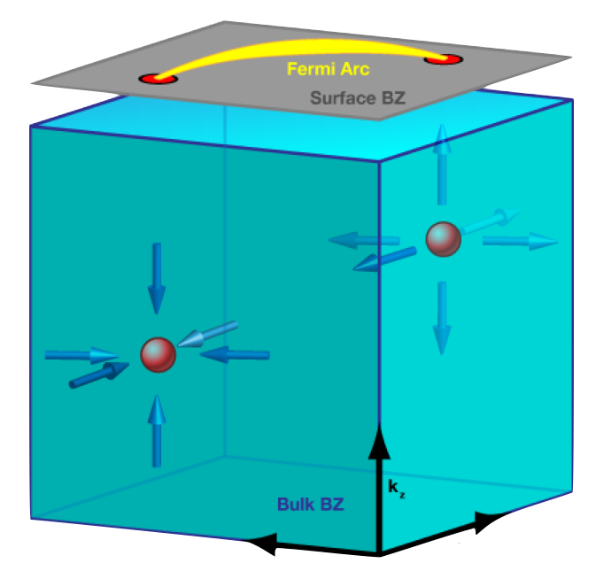
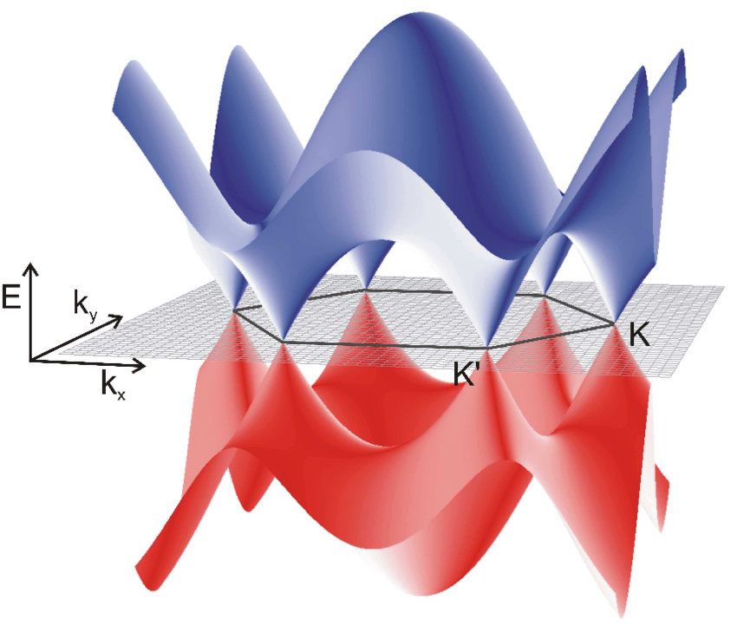
Dirac/Weyl cones in cond. matt. systems
Dirac/Weyl semimetals
Graphene

Slide 4
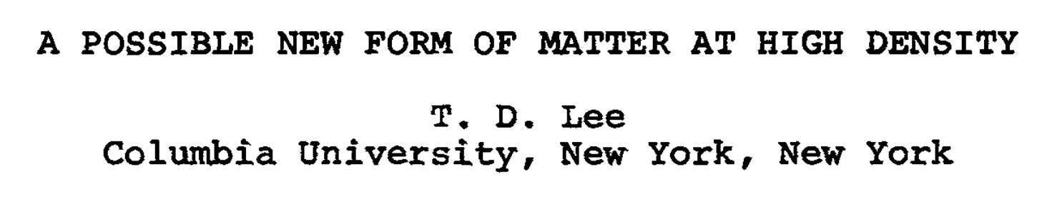
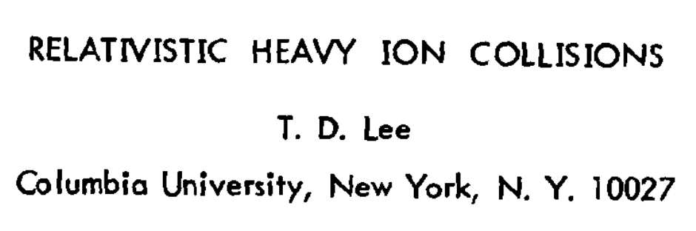
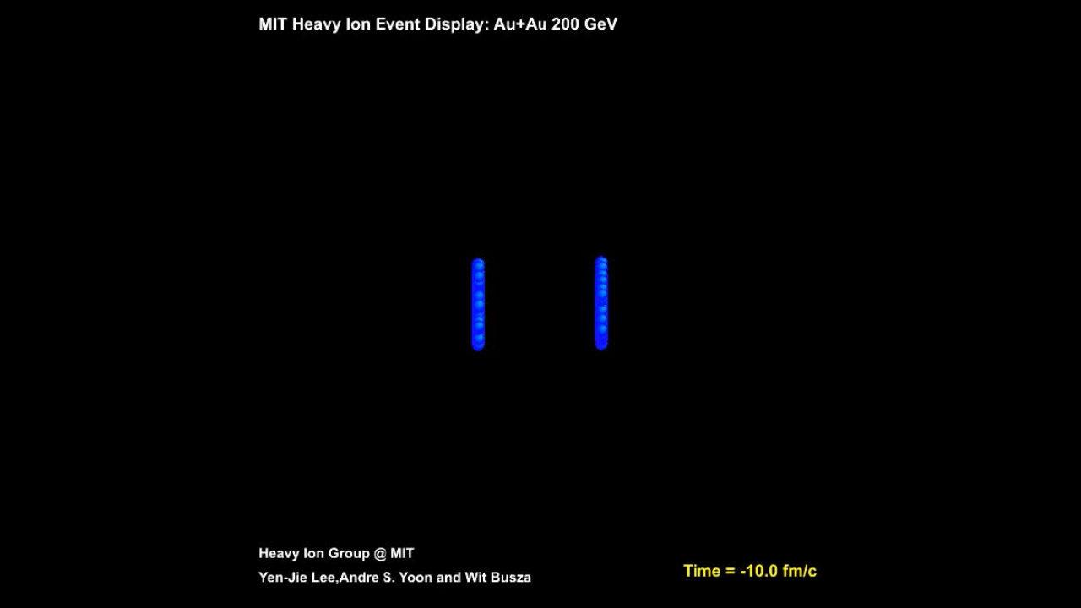
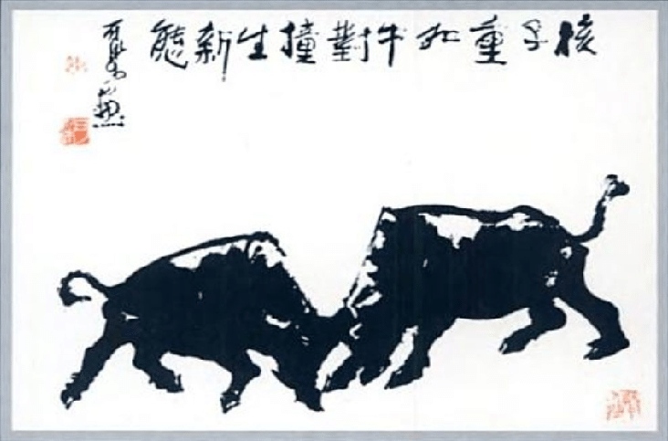
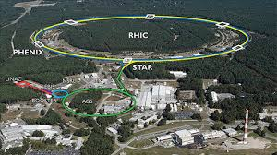
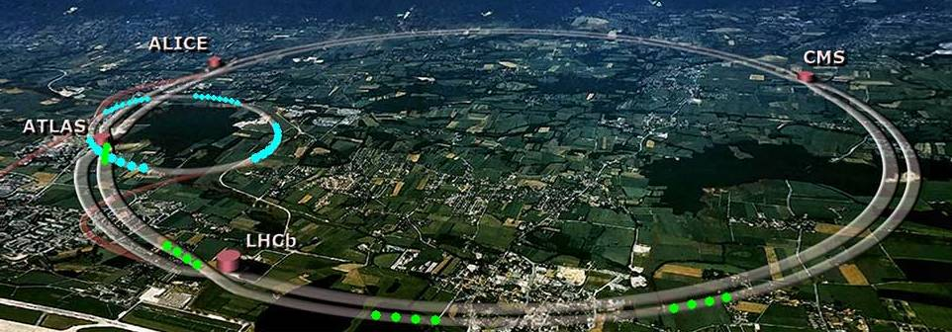
“Quark-gluon plasma (QGP)”
Reproducing the early universe with accelerators.
QGP
Relativistic Heavy Ion Collider (RHIC)
The Large Hadron Collider (LHC)

Slide 5

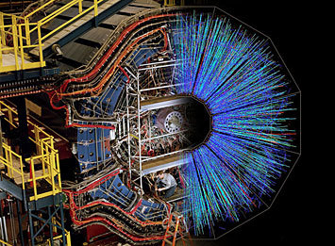
Relativistic Heavy Ion Collisions
＝ QGP ＋ Strong magnetic field + Rotation
Colliding ions are highly accelerated up to 99.995 % of speed of light.
B
Ω
Z
Z
QGP
Z
Z
Large atomic #: Z~80
＋
Large velocity:ｖ ～ c
Large vorticity in QGP
→ Experimental breakthroughs such as spin polarization of hadrons.
STAR, Nature (2017)
ALICE, PRL (2020)
ALICE, PRL (2023)
STAR, Nature (2023)
STAR, PRC (2023)
etc.
>
u
d
s
u
d
s
u
d
s
u
d
s

Slide 6
B
Key ingredients
Z
Z
1. Magnetic fields
Z
Z
→ Large degeneracy
RHIC, LHC; FAIR, NICA, J-PARC, HIAF
Neutron stars, Lattice QCD simulations
- Vanishing critical coupling strength
Strong B
- Landau degeneracy
- Chiral symmetry breaking
High density
- Fermi degeneracy
- Superconductivity
Analogy
at weak coupling
Competition
2. Heavy-quark impurities → The Kondo effect

Slide 7
Analogy btw the Fermi and Landau degeneracy

Slide 8
“Magnetic catalysis” of the chiral symmetry breaking
Klevansky, Lemmer (1989)
Tatsumi, Suganuma (1991)
Schramm, Muller, Schramm (1992)
Chiral condensate increases
in strong (chromo) magnetic fields.
Moreover, “the chiral symmetry is broken with an infinitesimal attractive interaction, i.e., even in QED.”
Gusynin, Miransky, Shovkovy (1995)
BCS (1957), Shanker, Polchinski (1992)
Analogy with the BCS theory:
“Superconductivity occurs with an infinitesimal attractive interaction.”

Slide 9
Key physics: “Dimensional reduction”
near the Fermi surface and in strong B
Fermi surface
B
Analogy
Degeneracy in 2 dim. out of 3 dim.
On the Fermi surface
In the transverse plane with respect to B
⇒ Kinematics is only determined by the residual (1+1) dim. dynamics.
Bound states inevitably emerge in the effective (1+1) dim. → Cooper pairs
(and thus independently of the coupling strength).

Slide 10
Low-energy effective theory in the 1/μ expansion
Large Fermi sphere
+ Low energy excitation along radius [(1+1) D]
+ Degenerated states in the tangential plane [2D]
Phase space volume ~ p^{d-1} dp (No suppression for d=1).
Enhanced IR dynamics induces nonperturbative physics.

Slide 11
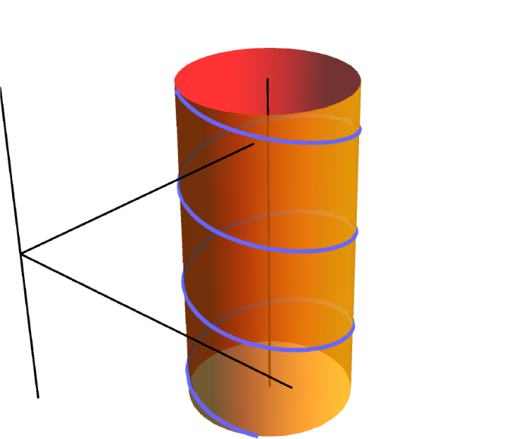
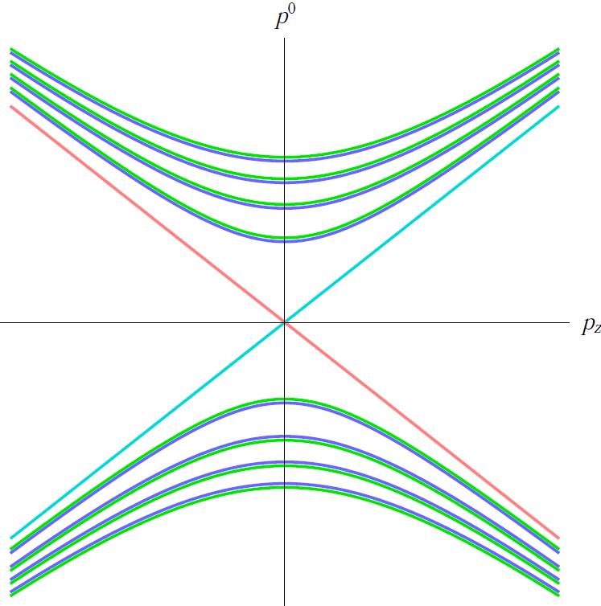
Landau level discretization
due to the cyclotron motion
“Harmonic oscillator” in the transverse plane
Nonrelativistic:
B
Cyclotron frequency
Relativistic:
In addition, there is the Zeeman effect.
L↑
R↑

Slide 12
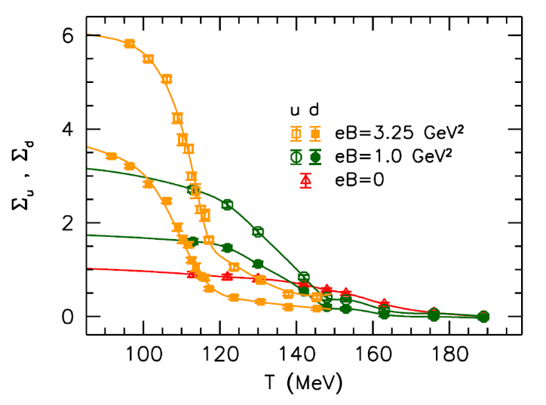
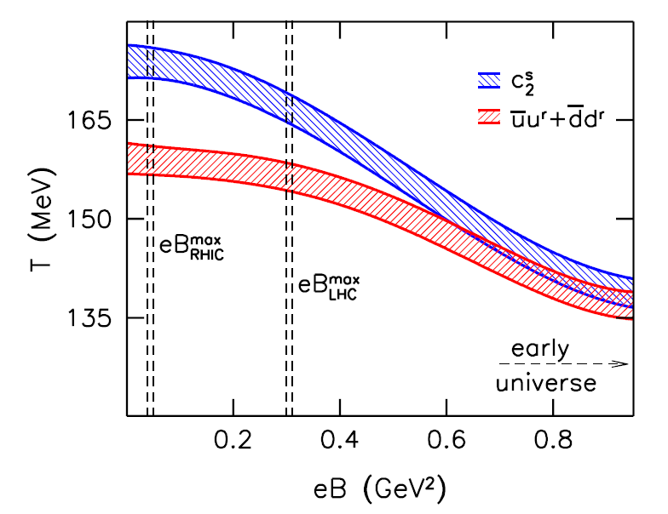
QCD phase diagram in strong B from lattice simulations
Chiral condensate in B
“Magnetic catalysis”: Chiral condensate increases (at low T).
Numerous data from lattice collaborations
Buividovich, et al. (2010- ), D’Elia, et al. (2012-),
Endrodi, et al. (2012-), Ding, et al. (2019-)
“Inverse magnetic catalysis” near the transition T
A first-order at 9 GeV² was observed
in the chiral and strange # susceptibility.
Chiral Tc in B
D’Elia et al. (2022)
Cf. Cohen & Yamamoto for deconfinement
More extensions: we discuss the phase diagram in strong B with heavy flavors.
→ The QCD Kondo effect

Slide 13
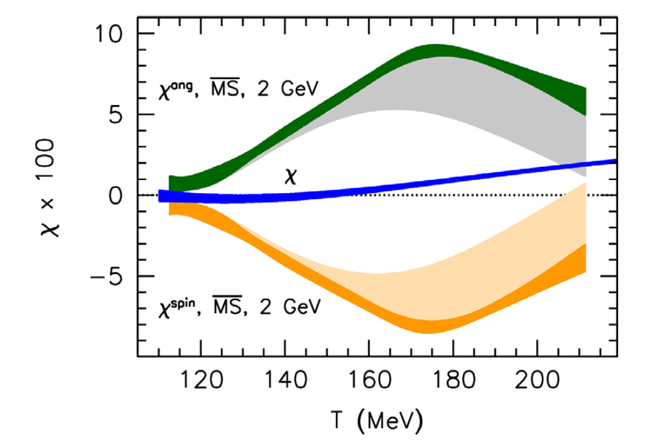
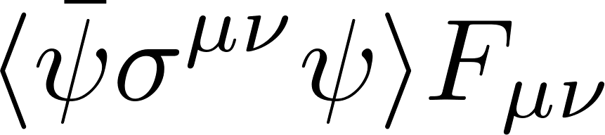
Phases of magnetism from lattice QCD
Total magnetic susceptibility (quarks+gluons)
Hight T ~ free quarks
Pauli paramagnetism vs Landau diamagnetism
3 : - 1
Low T → Confinement
Landau diamagnetism with pions (spin zero)
Breakdown
The rest (Quark and gluon orbital, gluon spin)
Total magnetic susceptibility
(= Orange curve in the above fig.)
Quark-spin contribution
(Zeeman coupling)
Yet, negative above T = 200 MeV.

Slide 14
The Kondo effect with impurities

Slide 15
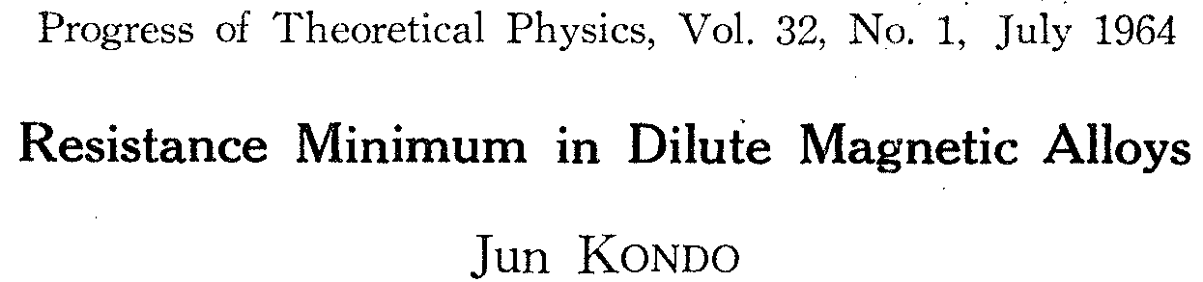
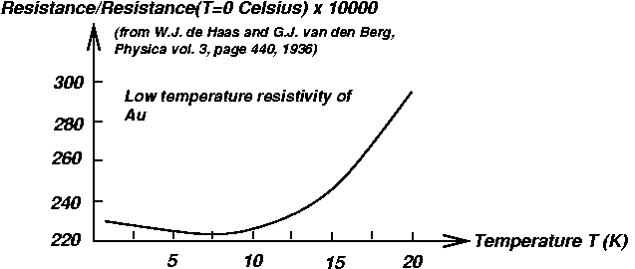
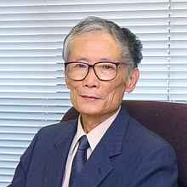
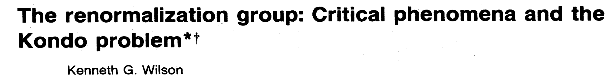
The Kondo effect
Pairing near the Fermi surface
Cooper pairing: electron-electron scattering
Kondo condensate or Kondo cloud
The formation of the Kondo condensate traps conduction electrons near an impurity and induces an anomalous increase of resistivity in low T.
Imp
Imp
The key process is the second-order spin-exchange interactions.
Fermi surface (dim. reduction)
Quantum effect from loop diagrams
Non-Abelian (Pauli) matrix
GTT
T (K)
T_{K}: Kondo temperature (Location of the minimum)

Slide 16
The QCD Kondo effect
Heavy-quark impurities in dense quark matter
Yasui, Sudoh, 1301.6830
KH, Itakura, Ozaki, Yasui, 1504.07619
- Color-exchange interactions with the Gell-mann Matrix
Q
The QCD Kondo condensate
= Heavy-light pairing in quark matter
Q
Analogy in strong B (w/o density): “Magnetically induced Kondo effect”
Ozaki, Itakura, Kuramoto (2015)

Slide 17
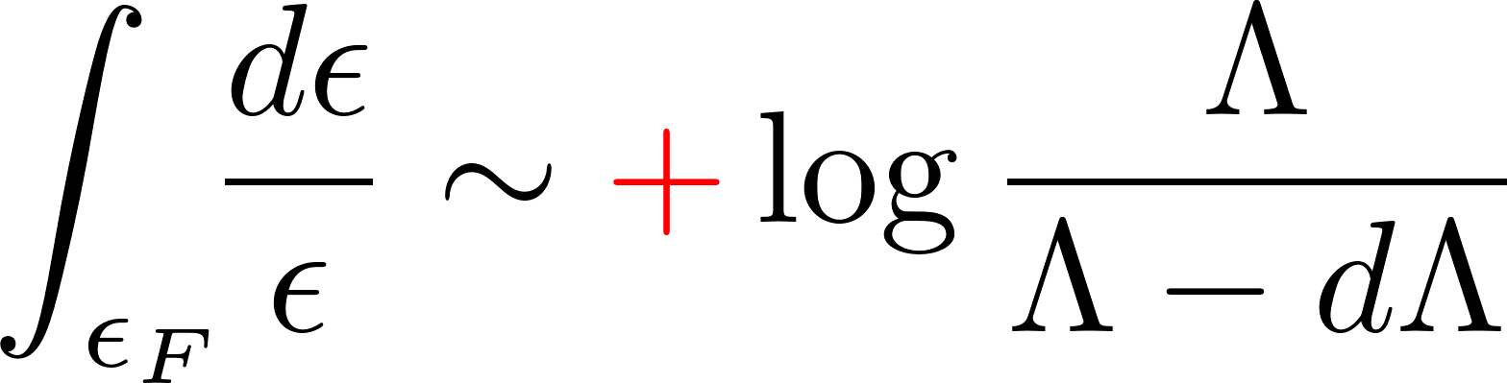
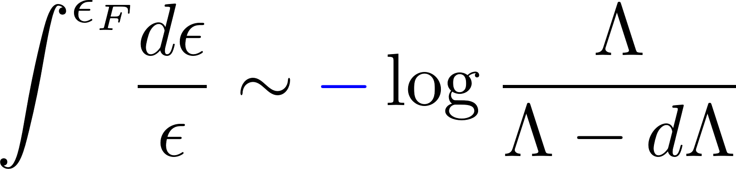
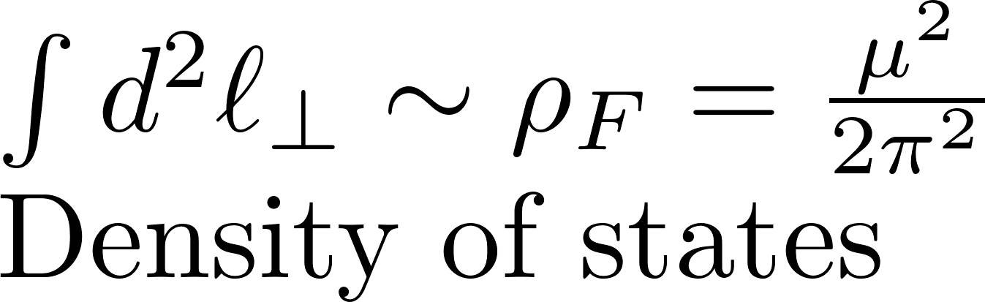
Log enhancement from the NLO scattering amplitudes
Light quark
Heavy quark
Particle contribution
Hole contribution
Large Fermi sphere
Large Fermi sphere
Avoids cancellation with non-Abelian vertices
Large Fermi sphere

Slide 18
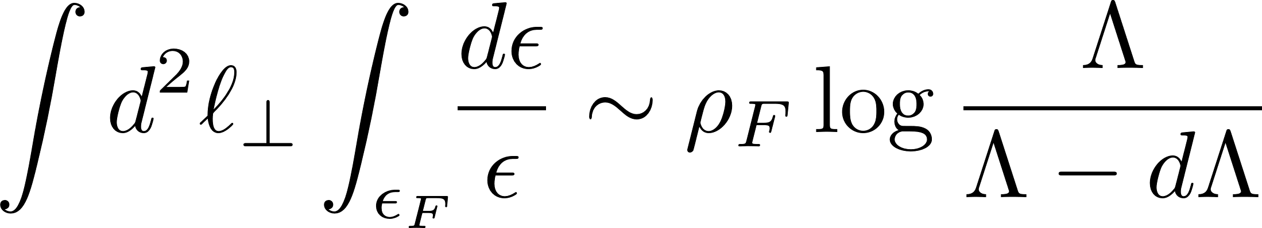
Log enhancement from the NLO scattering amplitudes
Light quark
Heavy quark
Large Fermi sphere
Large Fermi sphere
Large Fermi sphere

Slide 19
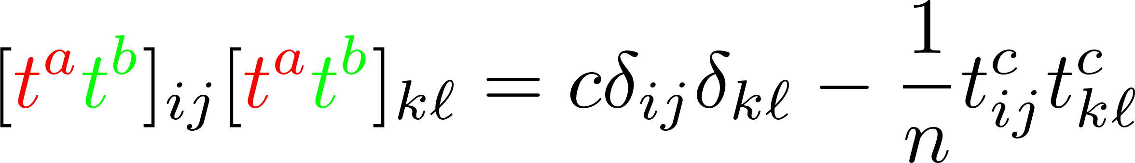
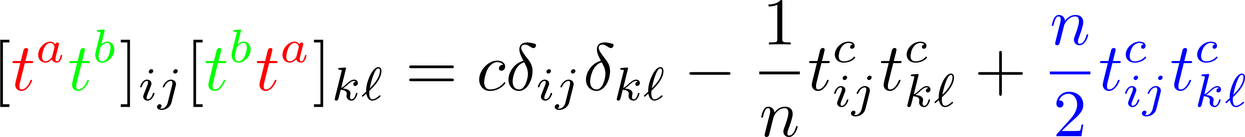
Closer look at the logs and color matrices
Particle contribution
Hole contribution
Logs corrections cancel each other in an Abelian theory (No net effect).
✔ Incomplete cancellation due to the color matrices
Particle contribution
Hole contribution

Slide 20
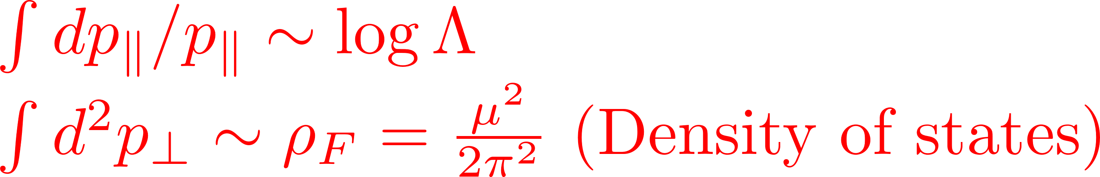
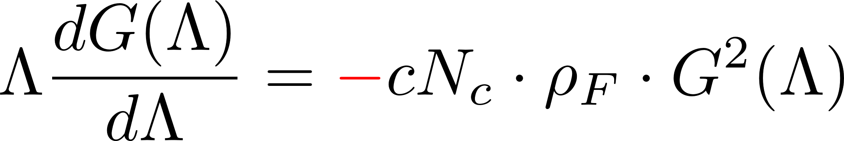
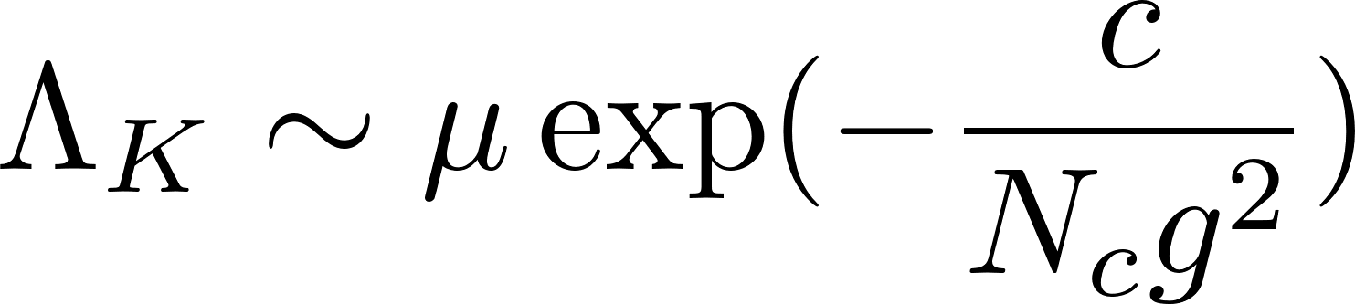
RG eq. for the QCD Kondo effect
G(Λ-dΛ)
=
G(Λ)
+
+
RG equation
Effective coupling: G(Λ)
Landau pole in
the asymptotic-free solution
Λ = 0
(Fermi energy)
Λ
Depends on the interactions.
(Debye screening mass for A⁰ → g² dep.)
Energy scale
“Kondo scale” (Landau pole)
Resistivity is enhanced in the strong-coupling regime.

Slide 21
Recent developments in the QCD Kondo effect
Finite density
Renormalization-group analysis, KH, Itakura, Ozaki, Yasui (2015)
Higher-loop effects on the fixed-point, Kanazawa, Uchino, (2016)
Phase diagram from mean-field analysis, Yasui, Suzuki, Itakura (2016)
Mapping to CFT near the fixed-point, Kimura, Ozaki (2017)
Conformal Field Theory
Consequences and more exotic effects:
The Kondo effect in the 2SC phase, KH, Huang, Pisarski (2019)
The Kondo effect induced by the chirality imbalance, Suenaga, Suzuki, Araki, Yasui (2020)
Catalysis of the chiral separation effect, Suenaga, Araki, Suzuki, Yasui (2021)
Cf. Two-color lattice study, Talk by Buividovich in “Hard Problems of Hadron Physics (2021).”
HQ Spin polarization, Suenaga, Araki, Suzuki, Yasui (2022)
….

Slide 22
Finite density
In magnetic fields
RG flows driven by the log corrections
(color) Superconductivity
Magnetic catalysis of chiral condensate
Gusynin, Miransky, Shovkovy (1995)
Light fermions
Strong coupling regime in IR → Bound states
BCS (1957),
Shanker, Polchinski (1992)
QCD Kondo effect
KH, Itakura, Ozaki, Yasui (2015)
Magnetically induced Kondo effect
Ozaki, Itakura, Kuramoto (2015)
Impurity
Kondo effect in magnetic fields
New even in cond. matt. physics
RG analysis, Ozaki, Itakura, Kuramoto (2015)
Mapping to CFT, Kimura, Ozaki (2019)

Slide 23
Competition btw chiral symmetry breaking and the Kondo effect

Slide 24
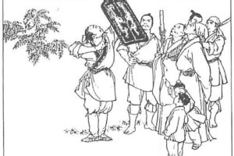
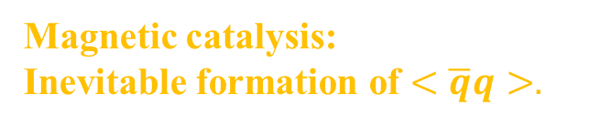
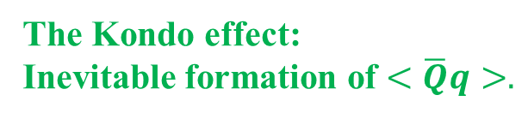
Magnetic catalysis vs Magnetic Kondo effect
- Competition between the two strong statements.
Magnetic catalysis:
Inevitable formation of $<\overline{q}q>.$
The Kondo effect:
Inevitable formation of $<\overline{Q}q>.$
Imp
Cf. Competition at finite density, Suzuki, Yasui, Itakura (2017)
Imp
“Spear and shield” from an episode in ancient China:
A weapon merchant advertising his “strongest spear” and “strongest shield” in the world.
Pairing pattern determines the true vacuum.

Slide 25
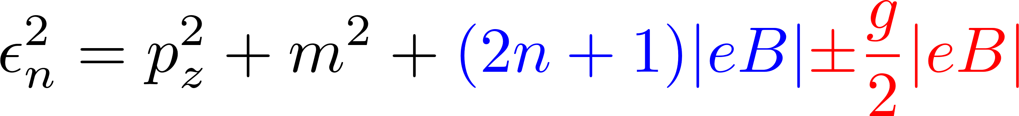
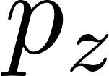
Model
Landau quantization
No effects on the longitudinal motion
Cyclotron motion ～ Harmonic oscillation
Spin polarization (Zeeman effect)
Energy spectrum
B_{z}
Light-quark kinetic term in B
(the lowest Landau level,
(1+1) dim. along B)
Light-light interactions
Heavy quark
+ heavy antiquark
Heavy-light interactions
Heavy-quark kinetic term in the LO heavy-quark expansion (Infinite mass, no spin rotation).

Slide 26
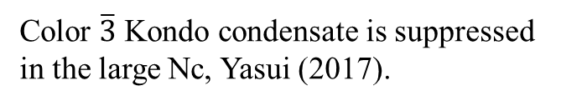
Mean-field analysis
Chiral condensate
Kondo condensate
Color $\overline{3}$ Kondo condensate is suppressed in the large Nc, Yasui (2017).
Exact diagonalization of the MF Lagrangian with M and Δ
Four eigenmodes:
Thermodynamic potential
Vacuum
Finite T
Dim. reduction: Momentum integral only in the B direction.

Slide 27
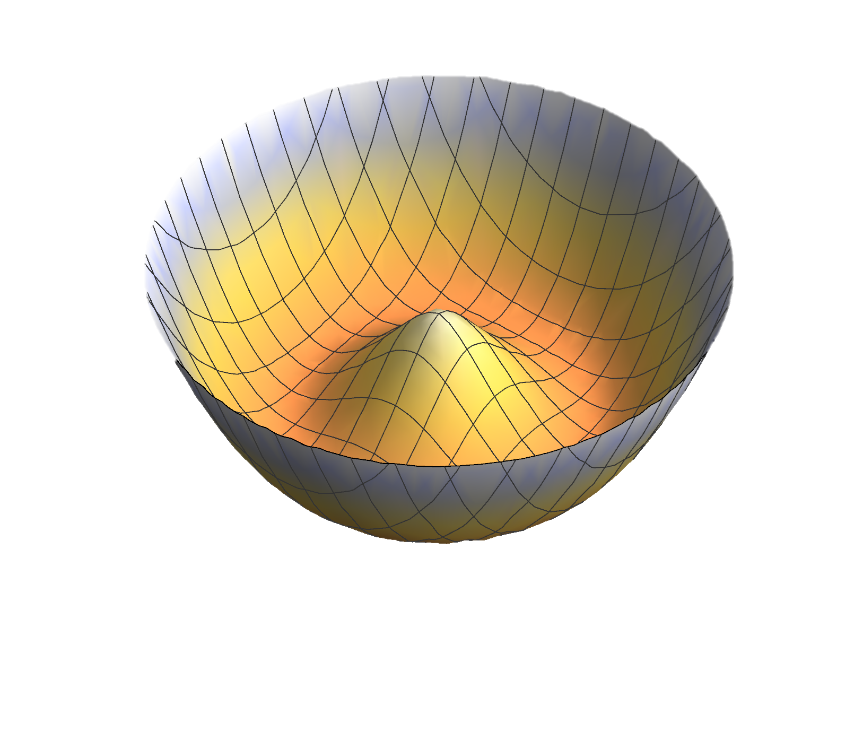
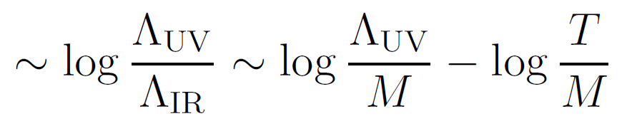
“Log repulsion” at the origin of the potential
Zero T case:
Δ
~ M² log M, Δ² log Δ
M
Nonzero condensates are always favored in the (1+1) dim.
The log dependences only arise from the 1-dim. integral in Ω (previous slide).
- Different dependences in different dimensions.
Finite T case:
the same log with the opposite sign
→ Symmetry restoration without the singularity at the origin

Slide 28
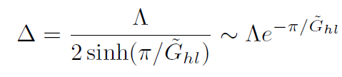
Gap equations
- Always has non-trivial solutions at zero T
The magnetic catalysis
Without “heavy-light” interactions
(and in the massless limit):
The Kondo effect
Without “light-light” interactions,
a nontrivial solution always appears for Δ in the same manner:
RHS sweeps from 0 to ∞
due to the log dependence.
The log dependences arise from
the 1-dim. integral in Ω (previous slide).
Different dep. in different dim.
The gap eq. always has a nontrivial solution for any value of G:
The same log structure.

Slide 29
Numerical results
(+ analytic results)

Slide 30
Magnetic catalysis vs the Kondo effect at zero T
- Results from numerical search of the global stationary point
Chiral condensate M
Kondo condensate Δ
Cf. Δ w/o competition (M=0)
Massless limit
Current q mass
Saturation of the magnetic catalysis
Analytic solution also available in the coexistence phase.
Chiral cond. dominates the Kondo cond.
Kondo cond. starts growing.
Chiral cond. saturates at a critical B.
New quantum critical point:
Switch over between the true vacua at zero T
M
Analytic expression for the critical B

Slide 31

Magnetic catalysis vs Kondo effect at finite T
Chiral condensate M
Kondo condensate Δ
Cf. Δ w/o competition (M=0)
Massless limit
Current q mass
Without the competition,
the Kondo condensate exhibits 1st order phase transition,
while the chiral condensate a crossover with a finite current quark mass.
Chiral pseudo Tc (w/o comp., crossover )
Without the competition, the Kondo condensate melts earlier than the chiral condensate.
Kondo Tc
in competition
Kondo Tc
(w/o competition)
Kondo Tc
(w/o competition, massless limit)
The chiral condensate increases as we increase T just after the Kondo cond. melts away.
→ Signature of the end of competition

Slide 32
Landscapes at finite T and B
- First-order transition lines
Chiral condensate
Kondo condensate
B
T
T
B

Slide 33
Phase diagram extracted from the results
New quantum critical point: Switch over
between the true vacua at zero T

Slide 34
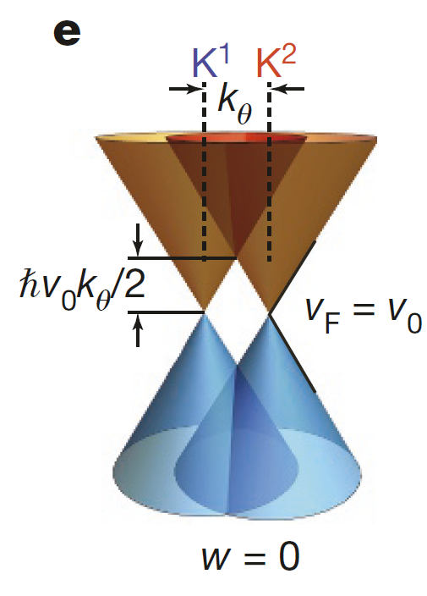
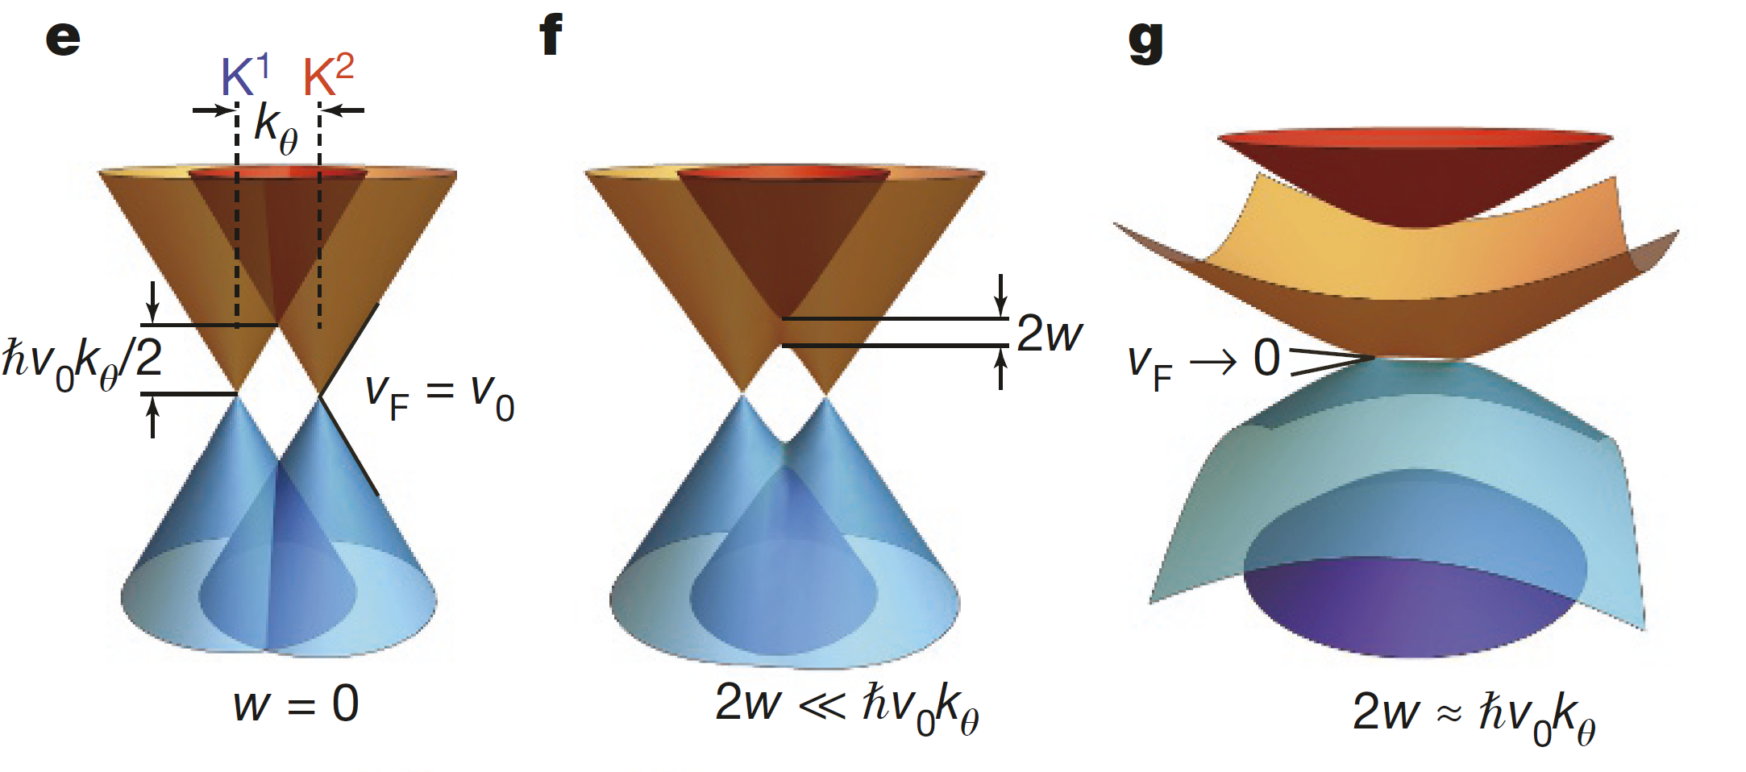
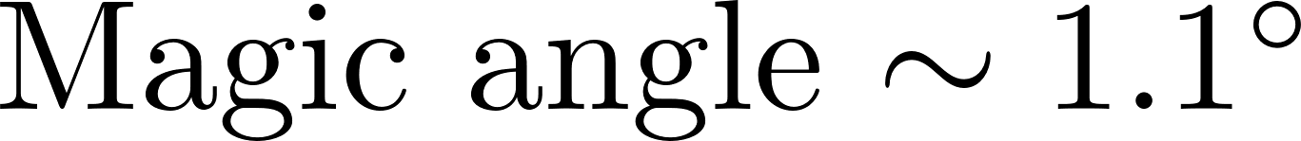
Flat bands in the twisted bilayer graphene
Moiré patterns
Morell, et al. (2010)
Bistritzer and MacDonald (2011)
Balents, et al., Nature Physics 16 725–733 (2020)
Cao, et al., Nature 556, 80–84 (2018)
Flat band
Twisted monolayer–bilayer graphene
Chen et al., Nature Physics 17 374–380 (2021)

Slide 35
Summary
Potential signatures of the competition
Saturation of the chiral condensate in strong B due to the growth of the Kondo condensate.
Anomalous increase of the chiral condensate with T just after the end of competition.
Outlook
Study by lattice simulations (Static thermodynamic quantities)
Computation of the transport coefficients (Dynamical quantities)
Applications to the Dirac quasi-particles in cond. matt. systems

Slide 36
Back-up slides

Slide 37
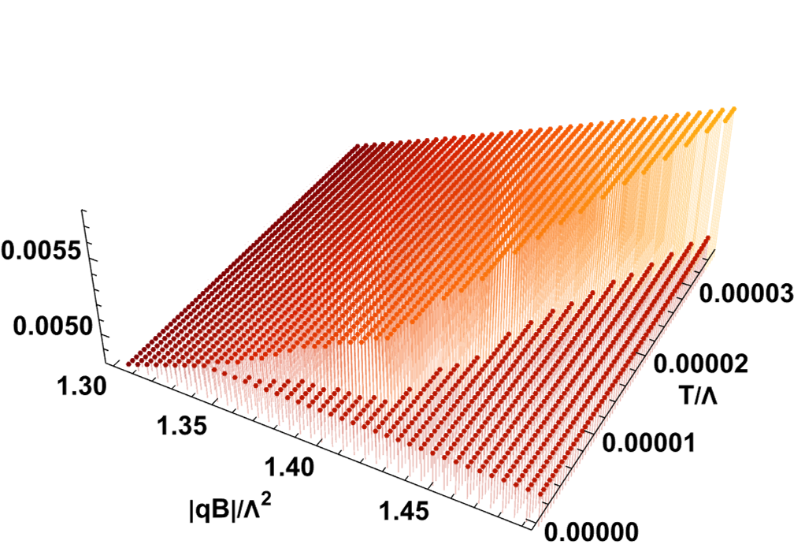
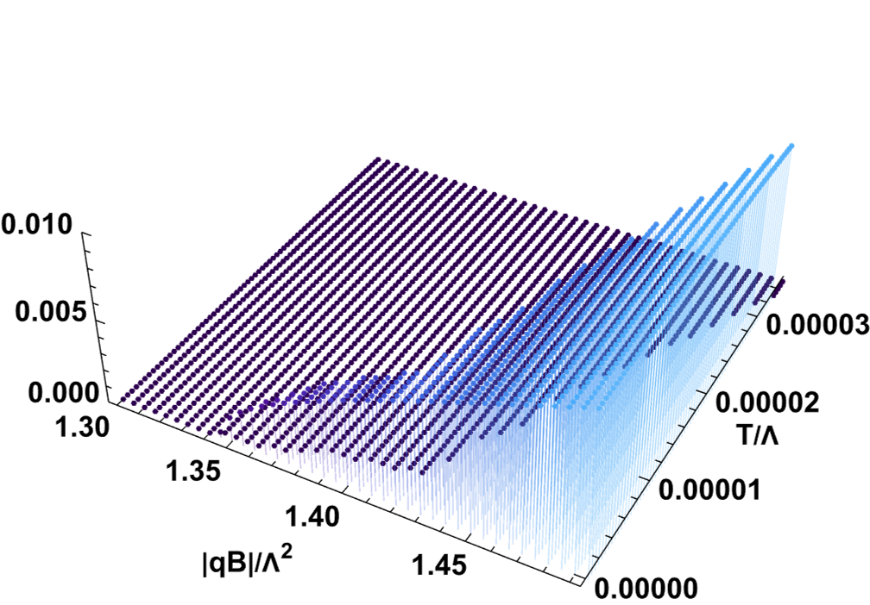
Chiral condensate
Kondo condensate
T
T
B
B

Slide 38
Impurity scatterings near a Fermi surface
Effective 4-body operator with light and heavy quark fields
with the coupling strength at the scale Λ
How does the coupling strength evolve in the IR regime, Λ --> 0?
Q
q
The LO does not explain
the enhancement of the resistance.
Q
What about the loop corrections?
Large Fermi sphere

Slide 39
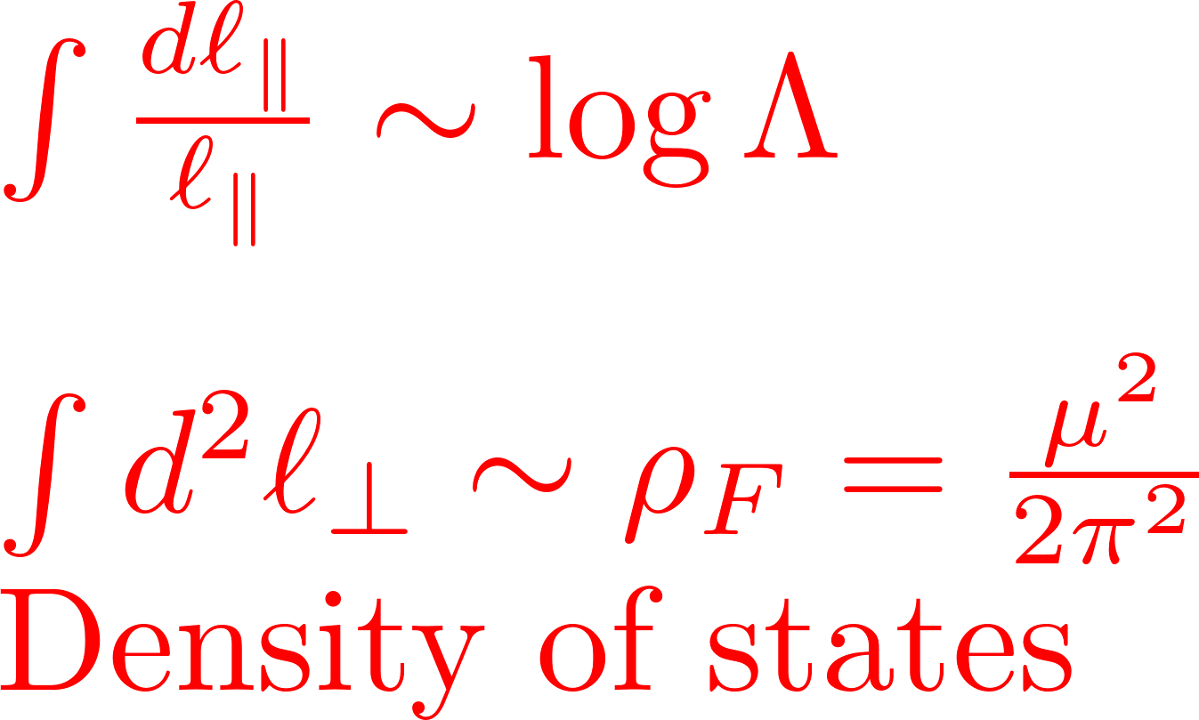
Divergence in the NLO scattering amplitudes
→ Renormalization in the low energy dynamics
Light quark
Heavy quark
Large Fermi sphere
Large Fermi sphere
Large Fermi sphere

Slide 40
Closer look at the logs and color matrices
Particle contribution
Hole contribution
Logs corrections cancel each other in an Abelian theory (No net effect).
✔ Incomplete cancellation due to the color matrices
Particle contribution
Hole contribution

Slide 41
RG eq. for the QCD Kondo effect
G(Λ-dΛ)
=
G(Λ)
+
+
RG equation
Effective coupling: G(Λ)
Landau pole in
the asymptotic-free solution
Λ = 0
(Fermi energy)
Λ
Depends on the interactions.
(Debye screening mass for A⁰ → g² dep.)
Energy scale
“Kondo scale” (Landau pole)
Resistivity is enhanced in the strong-coupling regime.

Slide 42
Scaling argument

Slide 43




Scaling dimensions in the IR
Large Fermi sphere
⇒
Spatial dimension = 1

Slide 44


Heavy-light 4-Fermi operator
No scaling for the heavy-quark impurity since it is a scattering
center for light quarks.
Marginal !! Let us proceed to diagrams.

Slide 45
IR scaling dimensions
Kinetic term
Four-Fermi operators for superconductivity
Polchinski (1992)
In general momentum config.
In the BCS config.

Slide 46
IR scaling dimension for the Kondo effect
Heavy-quark Kinetic term
No scaling since the heavy-quark impurity is a scattering center for light quarks.
Heavy-light 4-Fermi operator
Marginal !! Let us proceed to diagrams.

Slide 47
Scaling dimensions in the LLL
(1+1)-D dispersion relation → d_{ψ} = - 1/2
Four-light-Fermi operator
Always marginal thanks to the dimensional reduction in the LLL.
Magnetic catalysis of chiral condensate.
Chiral symmetry breaking occurs even in QED.
Gusynin, Miransky, and Shovkovy. Lattice QCD data also available (Bali et al.).
Heavy-light four-Fermi operator
Marginal !! Just the same as in dense matter.

Slide 48
Low-energy effective theory in the 1/μ expansion
Large Fermi sphere
+ Low energy excitation along radius [(1+1) D]
+ Degenerated states in the tangential plane [2D]
Phase space volume ~ p^{d-1} dp (No suppression for d=1).
Enhanced IR dynamics induces nonperturbative physics.

Slide 49


High-Density Effective Theory (LO)
Expansion around the large Fermi momentum
The LO Fermion propagator near the Fermi surface
(1+1)-dimensional dispersion relation
Large Fermi sphere
Spin flip suppressed
when the mass is small m << μ.
Interaction vertex in the LO

Slide 50
Heavy-Quark Effective Theory (LO)
HQ-momentum decomposition
HQ velocity
Q
Dispersion relation
Nonrelativistic magnetic moment suppressed by 1/m_{Q}
The LO HQ propagator

