Slide 1

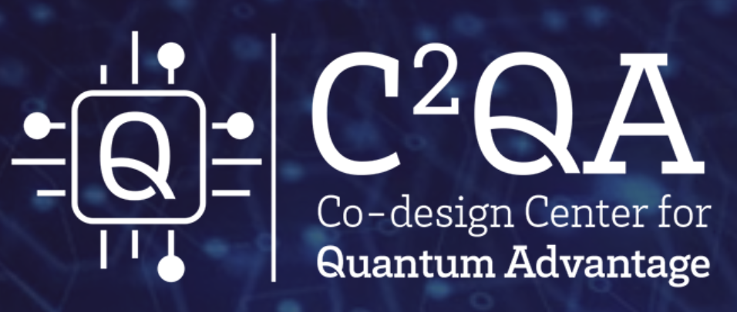


Weyl and Dirac Semimetals as a Laboratory for High Energy Physics,
Braga, Portugal, June 25-28, 2025
Chiral Magnetic Effect:
current status and open problems
Dmitri Kharzeev
1

Slide 2


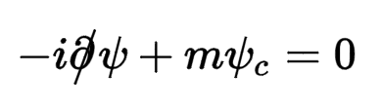
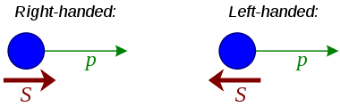

Chirality in subatomic world: chiral fermions
Fermions:
E. Fermi,1925
Dirac equation:
P. Dirac, 1928
Weyl fermions:
H. Weyl, 1929
Majorana fermions:
1937
E.Majorana, 1906-38?

Slide 3

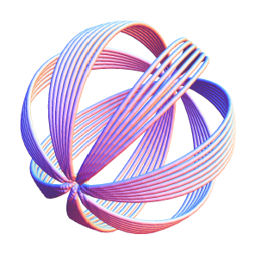
Chirality of gauge fields
Gauge fields can form chiral knots – for example, knots of magnetic flux in magnetohydrodynamics (magnetic helicity), characterized by
Chern-Simons number

Slide 4
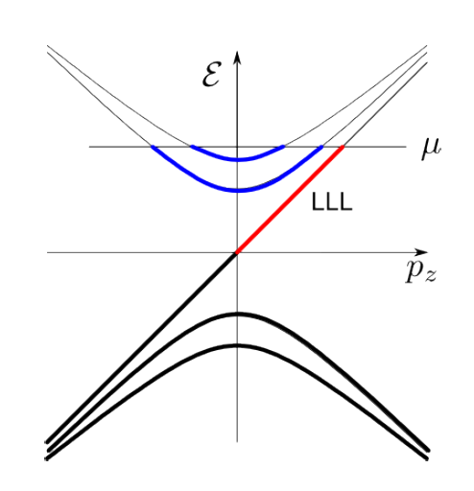


Chiral anomaly: chirality transfer from fermions to gauge fields (or vice versa)
From: Y. Hirono, DK, Y. Yin,
PRD 92 (2015) 12

Slide 5

Chirality in the vacuum of the Standard Model
The instanton and sphaleron solutions in non-Abelian gauge theories
describe transitions between topological sectors of the vacuum
marked by different integer values of the Chern-Simons number:
QCD (Quantum ChromoDynamics) vacuum:

Slide 6
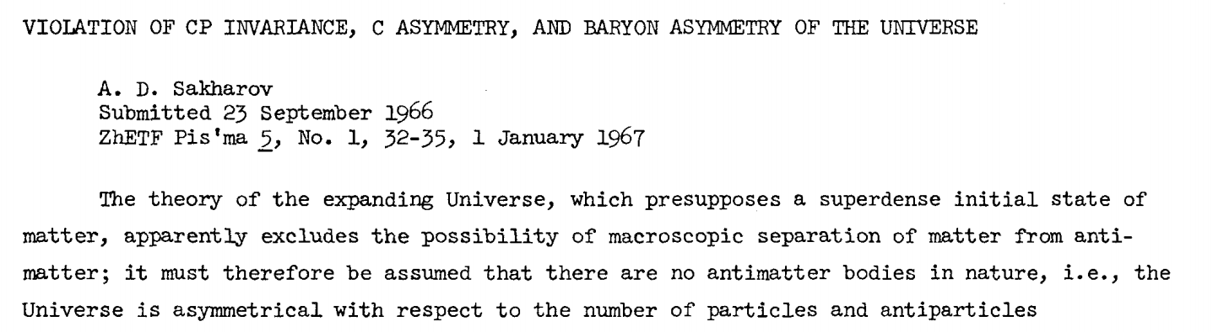
Chirality and the origin of Matter-Antimatter asymmetry in the Universe
Sakharov conditions for baryogenesis:
Baryon number violation
C and CP symmetries violation
Interactions out of thermal equilibrium
A.D. Sakharov, 1967
6

Slide 7
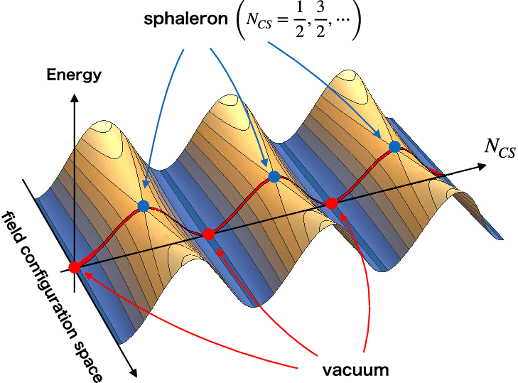
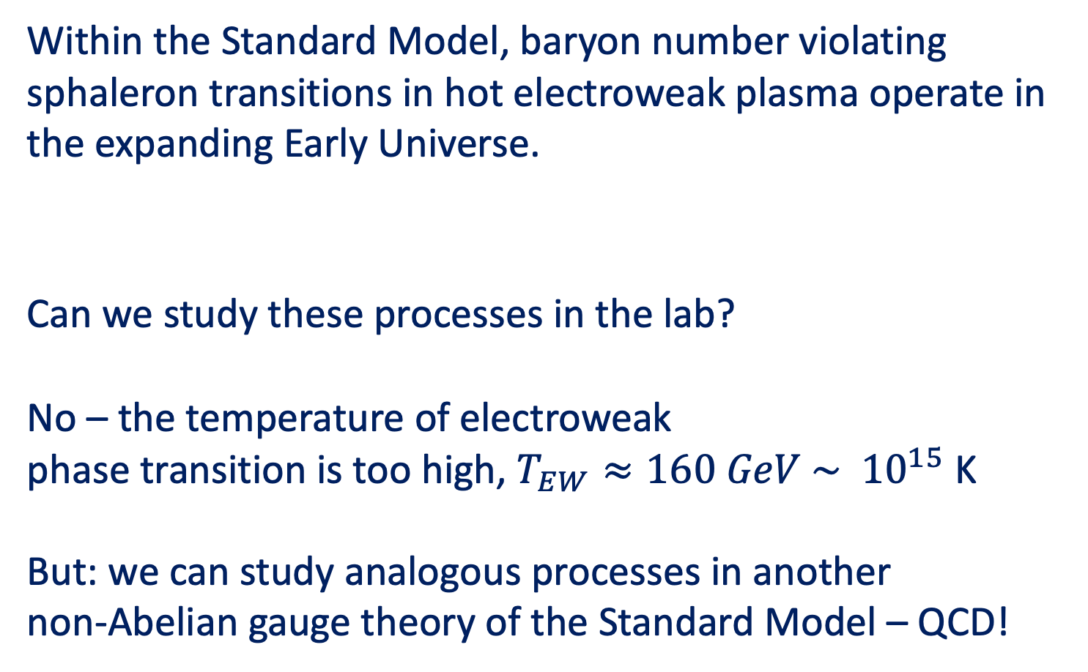
Chirality and the origin of Matter-Antimatter asymmetry in the Universe
Within the Standard Model, baryon number violating sphaleron transitions in hot electroweak plasma operate in the expanding Early Universe.
Can we study these processes in the lab?
No – the temperature of electroweak
phase transition is too high, $T_{EW}≈160 GeV \sim {10}^{15}$ K
But: we can study analogous processes in another
non-Abelian gauge theory of the Standard Model – QCD!
Graphics: Hamada, Kikuchi,’20

Slide 8
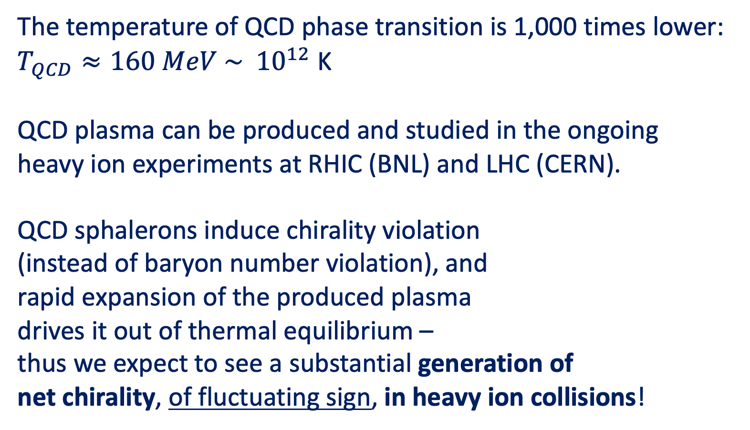
Generation of chirality in the QCD plasma
The temperature of QCD phase transition is 1,000 times lower:
$T_{QCD}≈160 MeV \sim {10}^{12}$ K
QCD plasma can be produced and studied in the ongoing
heavy ion experiments at RHIC (BNL) and LHC (CERN).
QCD sphalerons induce chirality violation
(instead of baryon number violation), and
rapid expansion of the produced plasma
drives it out of thermal equilibrium –
thus we expect to see a substantial generation of
net chirality, of fluctuating sign, in heavy ion collisions!
Graphics: Hamada, Kikuchi,’20

Slide 9
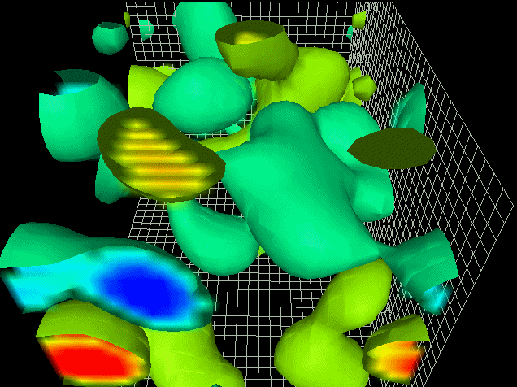
Topological transitions in QCD vacuum
D. Leinweber

Slide 10
Chirality in the vacuum of the Standard Model
Topological chirality-changing transitions between the vacuum sectors
of QCD are responsible for the spontaneous chiral symmetry breaking
and thus most of the mass of visible Universe.
Is it possible to directly observe these
chirality-changing transitions in experiment?

Slide 11
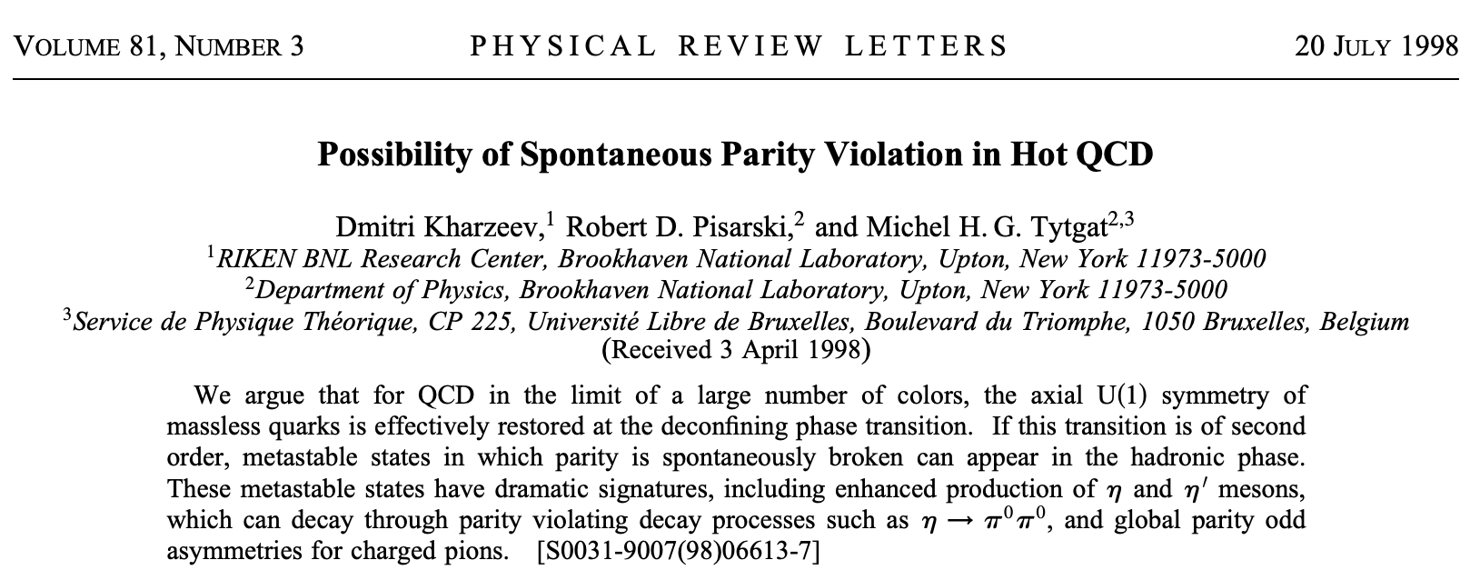


We addressed this problem in the 1998 paper with
Rob Pisarski and Michel Tytgat:
A working group with STAR experimentalists was formed to
find a way to detect this local parity violation (chirality imbalance):
J. Sandweiss, S. Voloshin, J. Thomas, E. Finch, A. Chikanian, R. Longacre, …
But after a few years of hard work it has become clear that the
proposed pion correlations are very difficult to detect.

Slide 12
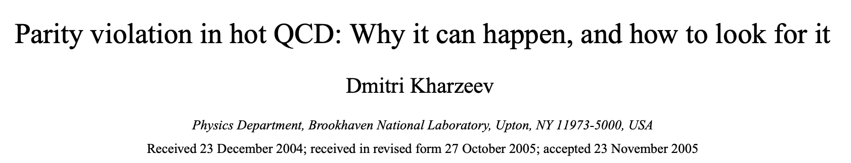

Detecting the topological structure of QCD vacuum
Topological transitions in the QCD plasma change chirality of quarks.
However, quarks are confined into hadrons, and their chirality cannot
be detected in heavy ion experiments.
Therefore , to observe these chirality-changing transitions we
have to find a way to convert chirality of quarks into something
observable – perhaps, a (fluctuating) electric dipole moment
of the QCD plasma? This would require an external magnetic field or
an angular momentum.
hep-ph/0406125

Slide 13
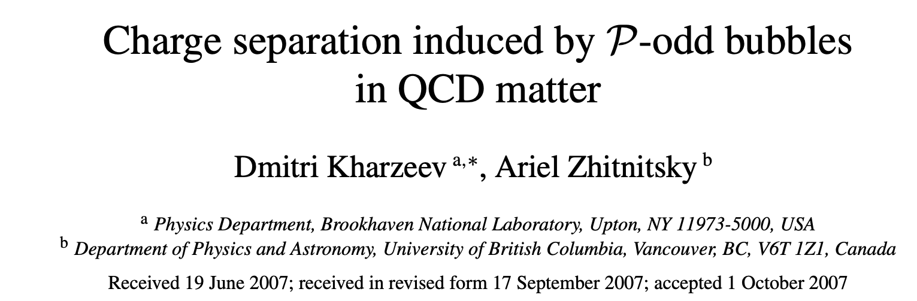

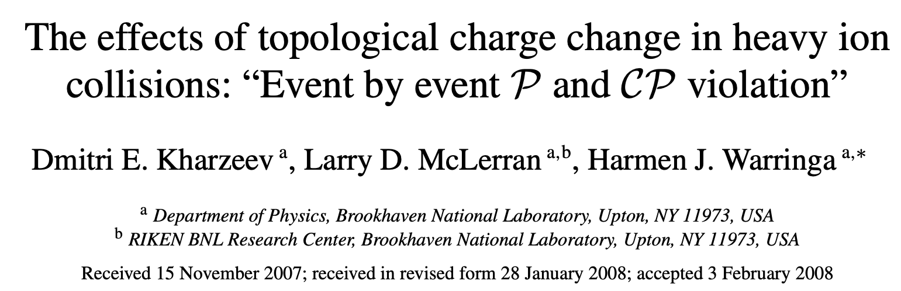


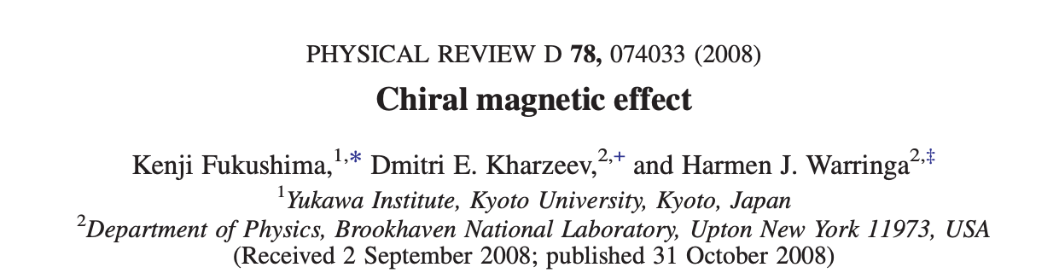

This idea was developed further:
Chiral Magnetic Effect (CME)

Slide 14
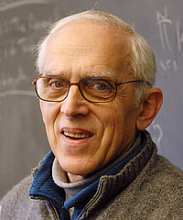
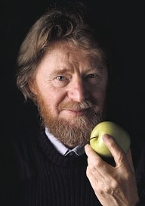
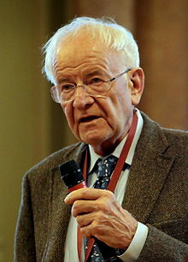
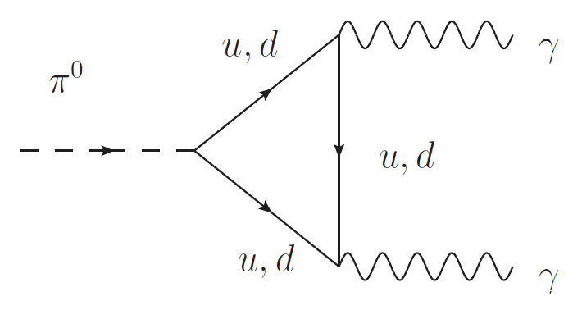
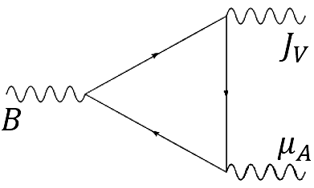
Chiral anomaly
The axial current is not conserved:
S. Adler ‘69
J. Bell, R. Jackiw ’69
V
A
V
The chiral charge is not conserved;
a chirally imbalanced state of chiral fermions is not
a true ground state of the system!
V
V
A

Slide 15
Chiral anomaly
LEFT
RIGHT
In classical background fields (E and B), chiral anomaly induces an
imbalance between left- and right-handed fermions;
chiral chemical potential:
Adler; Bell, Jackiw (1969); Nielsen, Ninomiya (1983)

Slide 16

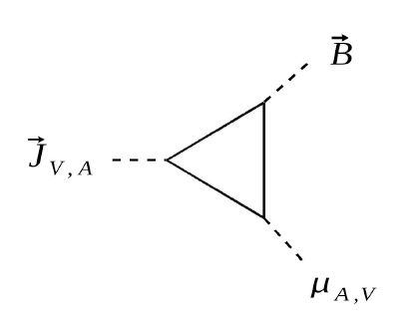



Chiral Magnetic Effect
DK’04; DK, A. Zhitnitsky ‘07; DK, L.McLerran, H.Warringa ’07; K.Fukushima, DK, H.Warringa,
“Chiral magnetic effect” PRD’08; Review and list of refs: DK, arXiv:1312.3348 [Prog.Part.Nucl.Phys]
Chiral chemical potential is formally
equivalent to a background chiral gauge field:
In this background, and in the presence of B, vector e.m. current is generated:
Compute the current through
Absent in
Maxwell theory!
Chirally imbalanced system is a non-equilibrium state
Coefficient is fixed by the chiral anomaly, no corrections

Slide 17

Chiral magnetic conductivity: discrete symmetries
P – parity
T – time reversal
P-odd
T-odd
P-even
T-odd
P-odd
cf Ohmic
conductivity:
T-odd,
dissipative
P-odd effect!
Effect persists in
hydrodynamics!
T-even
D.Son, P.Surowka ’09
DK, H.U.Yee ‘11
Non-dissipative current!
(non-equilibrium)
17
Notes:
Similar to conductivity, but at room temperature! Protected from local scattering by global topology

Slide 18
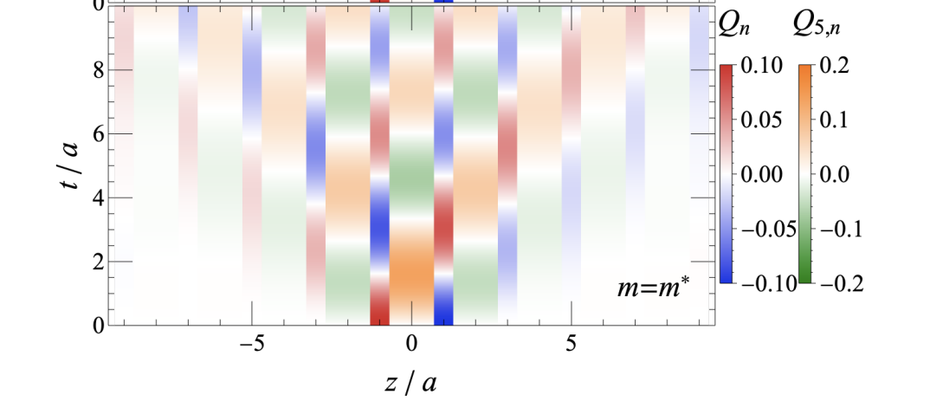

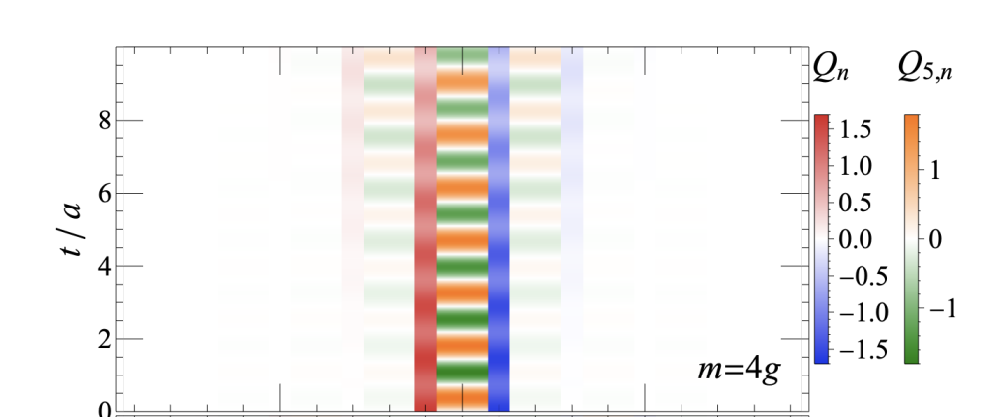

Chiral magnetic waves
Chiral magnetic wave:
coupled oscillations of
electric and chiral charges
DK, H.U. Yee, ’10
Quantum simulation reveals
the existence of a novel
nonlinear chiral magnetic
wave at large m/g
K. Ikeda, DK, S. Shi,
arXiv:2305.05685; PRD’23

Slide 19
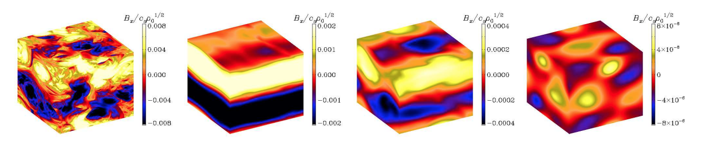
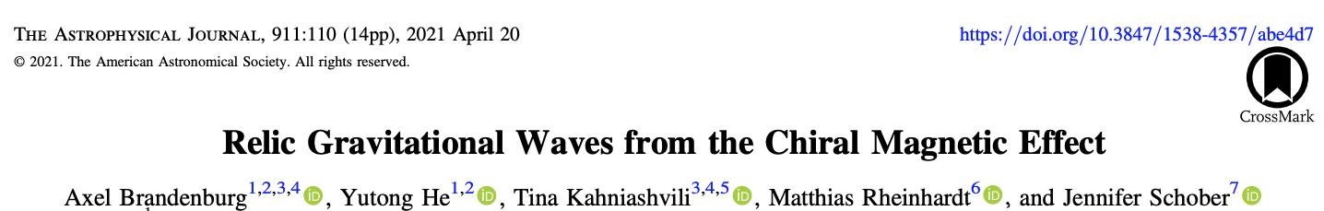
CME in the Early Universe

Slide 20
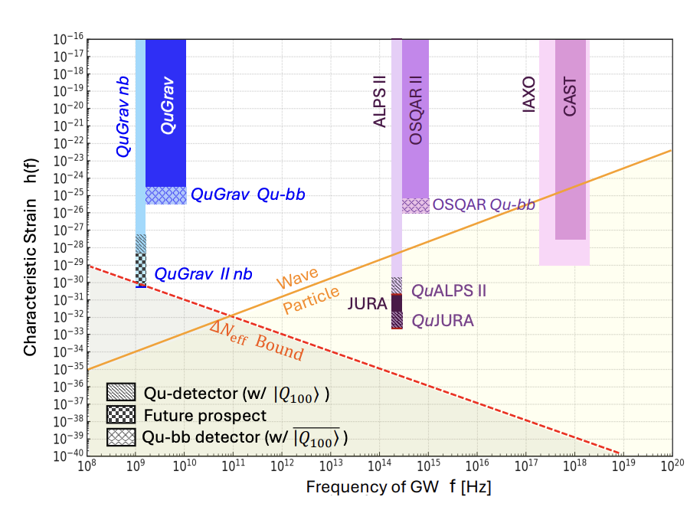
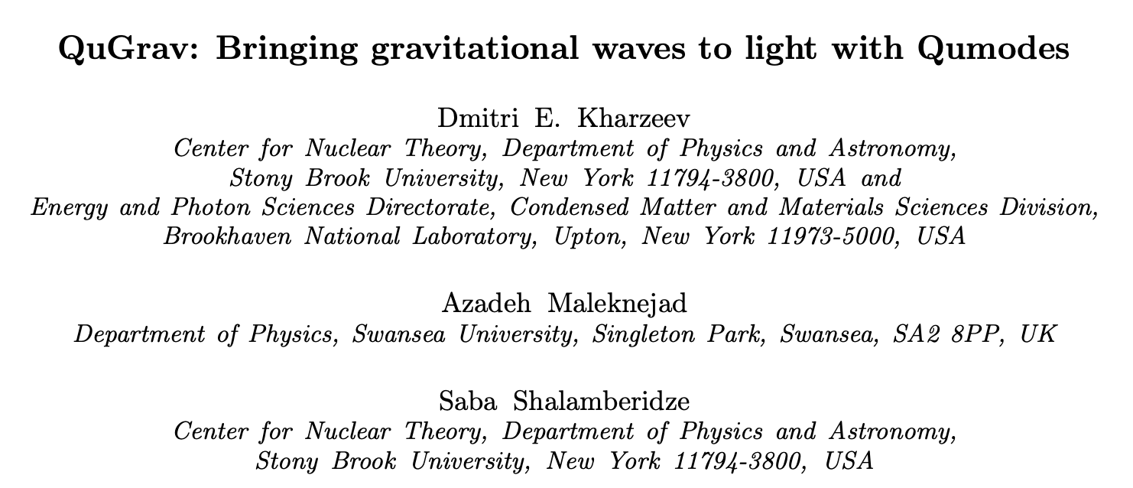
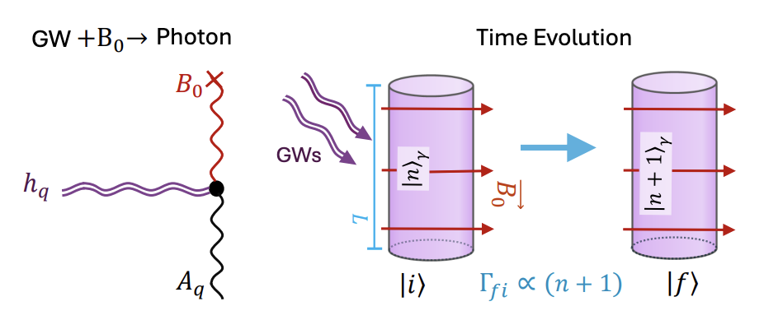
Bringing gravitational waves to light
arXiv:2506.09459

Slide 21
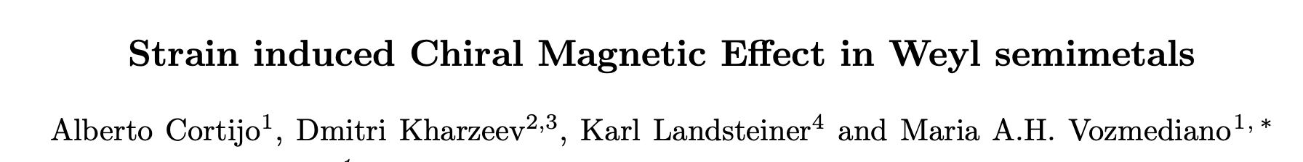
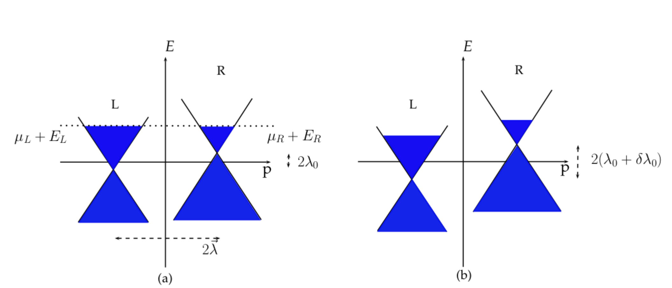
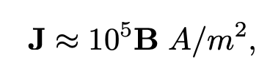
Condensed matter analog:
CME induced by strain
Phys.Rev.B 94 (2016) 24, 241405
~ 1 μA

Slide 22
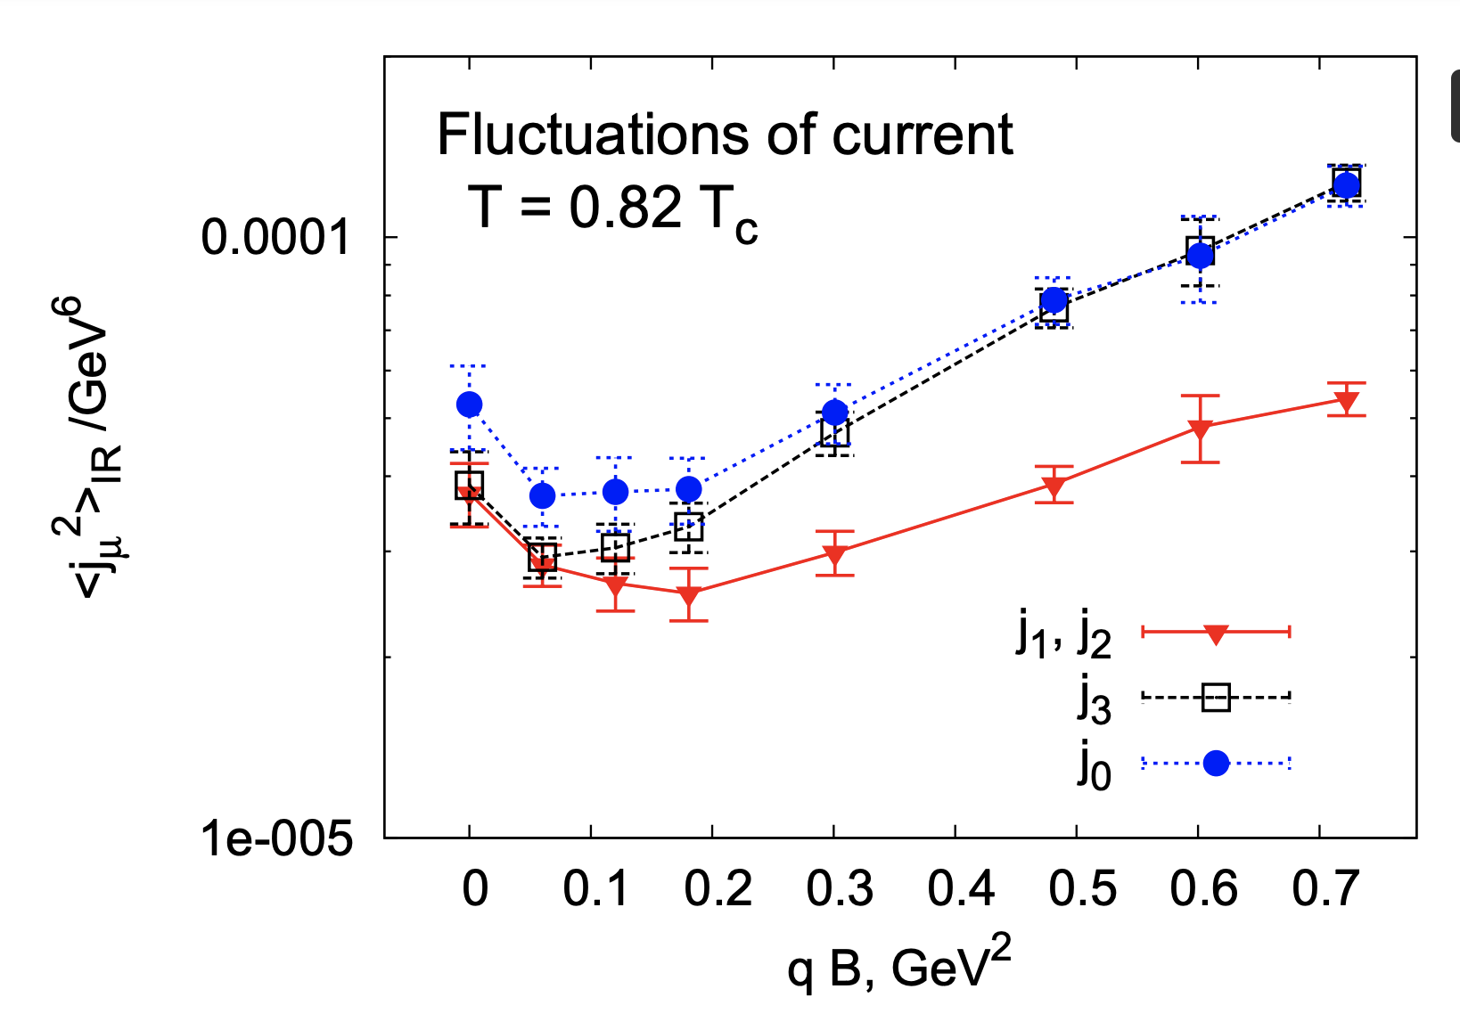
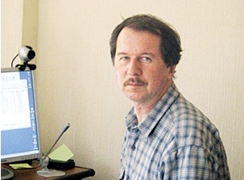
“Numerical evidence for chiral magnetic effect
in lattice gauge theory”,
P. Buividovich, M. Chernodub, E. Luschevskaya, M. Polikarpov, аrXiv 0907.0494; PRD’09
M. Polikarpov
1952-2013
Fluctuations of electric current along the direction of magnetic field are enhanced

Slide 23
“Chiral magnetic effect in 2+1 flavor QCD+QED”,
M. Abramczyk, T. Blum, G. Petropoulos, R. Zhou, ArXiv 0911.1348, PRD
Red - positive charge
Blue - negative charge
2+1 flavor Domain Wall Fermions, fixed topological sectors, 16^3 x 8 lattice

Slide 24
Can one detect QCD topological transitions in heavy ion collisions?
Relativistic Heavy Ion Collider
(RHIC) at BNL
The STAR Collaboration
at RHIC
Charged hadron tracks in
a Au-Au collision at RHIC
[STAR experiment]

Slide 25
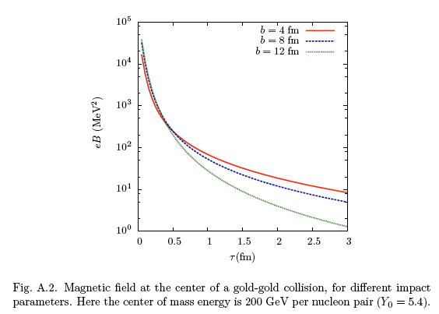
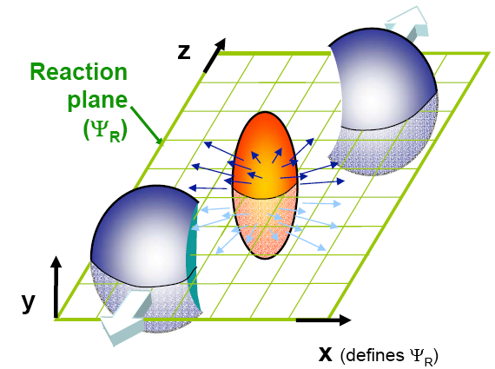
Heavy ion collisions as a source of the strongest magnetic fields available in the Laboratory
B
DK, McLerran, Warringa,
Nucl Phys A803(2008)227

Slide 26
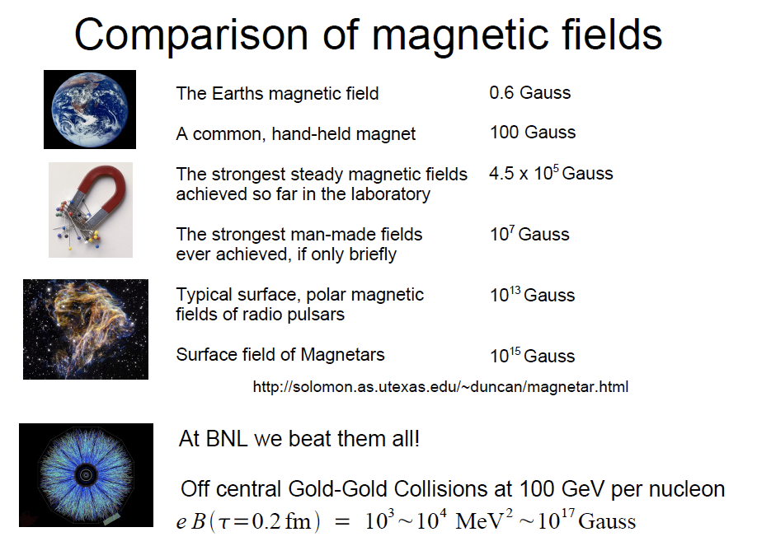
Heavy ion collisions: the strongest magnetic
field ever achieved in the laboratory
47

Slide 27
CME as a probe of topological transitions and chiral symmetry restoration in QCD plasma
Electric dipole moment due to chiral imbalance
B
excess of positive
charge
+
-
excess of negative
charge
The problem:
fluctuating sign, reflecting
topological fluctuations in QCD
- backgrounds!
DK, hep-ph/0406125; Phys.Lett.B633(2006)260

Slide 28
CME as a probe of topological transitions and Event-by-event parity violation in QCD plasma
B
+
+
-
Global Parity violation
in Weak interactions
Local, Event-by-event Parity violation
in Strong Interactions ?

Slide 29
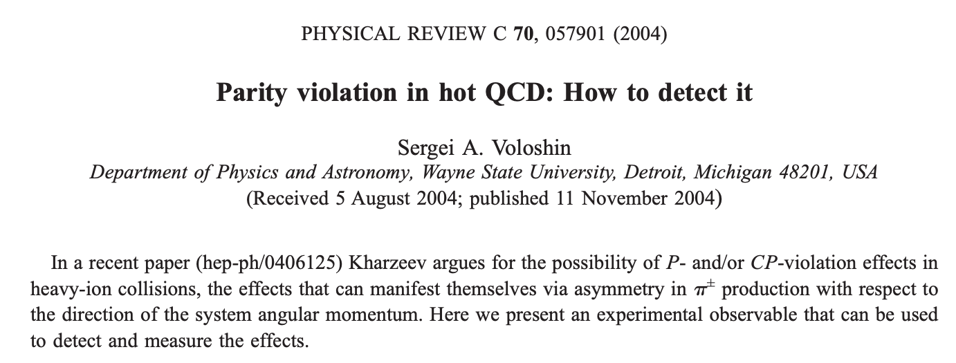

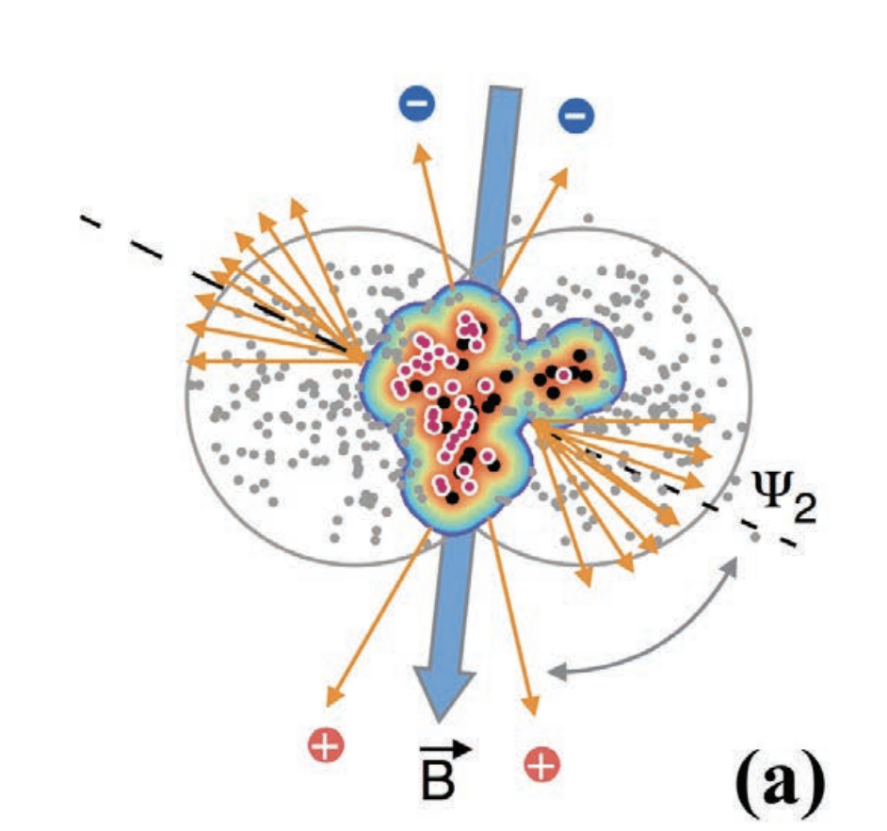
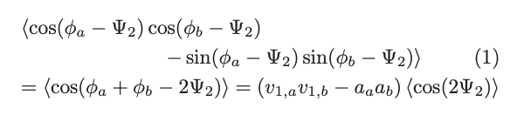
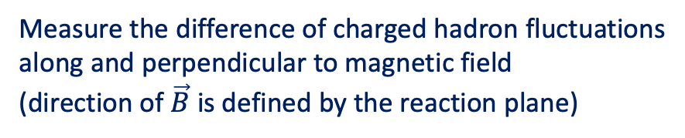
Separating the signal from background: the beginning
Measure the difference of charged hadron fluctuations
along and perpendicular to magnetic field
(direction of $\vec{B}$ is defined by the reaction plane)

Slide 30
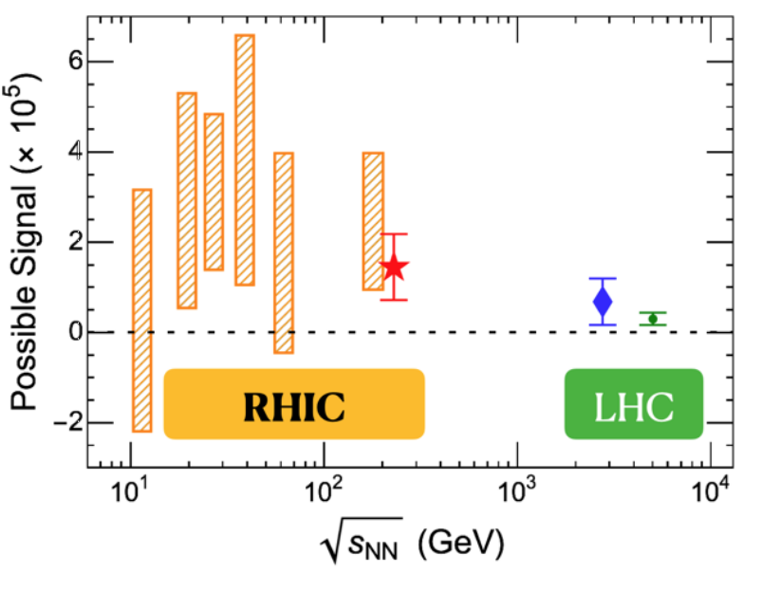


Review of CME with heavy ions: DK, J. Liao, S. Voloshin, G. Wang, Rep. Prog. Phys.’16
Review + Compilation of the current data: DK, J. Liao, Nature Reviews (Phys.) 3 (2021) 55

Slide 31
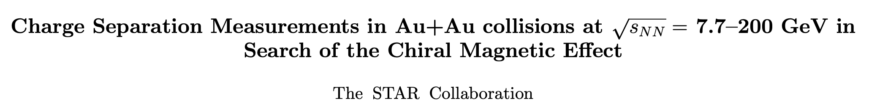
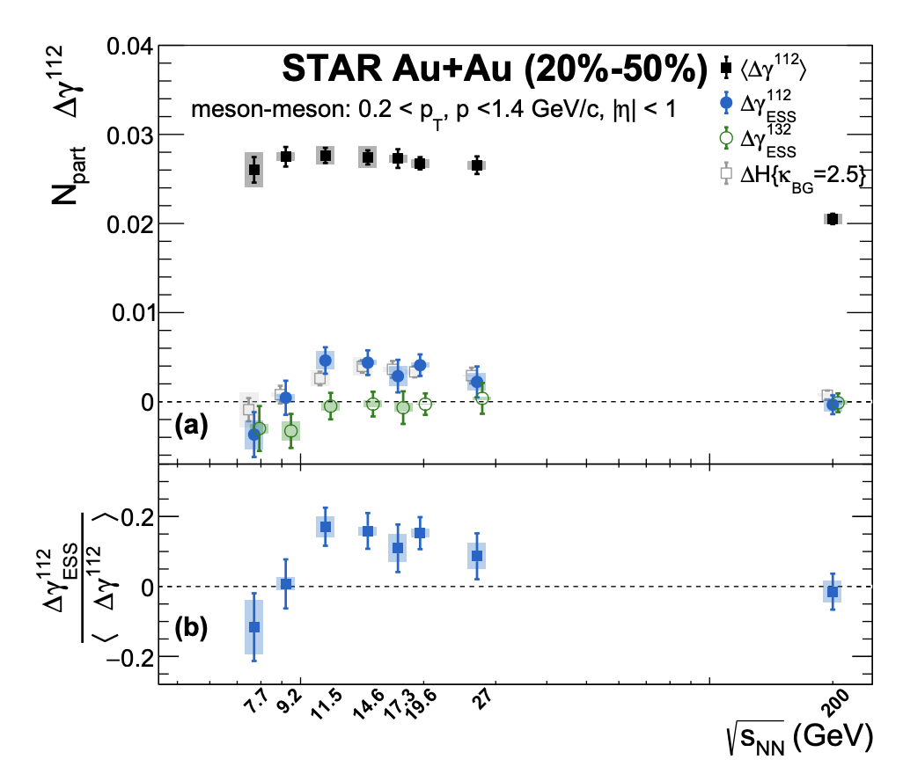
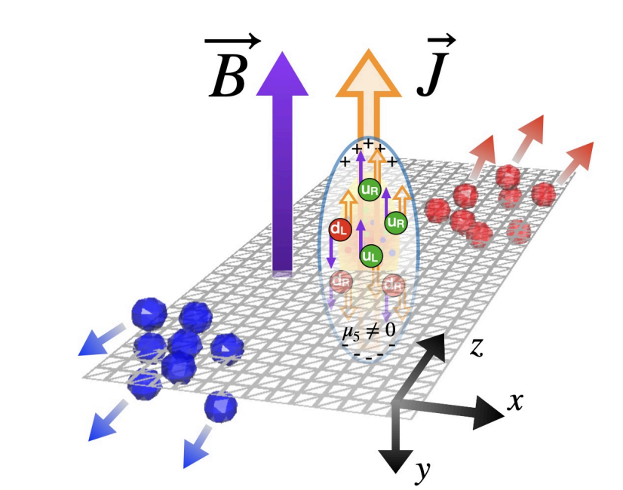
Very recent news:
STAR result on CME in beam energy scan
arXiv:2506.00275

Slide 32
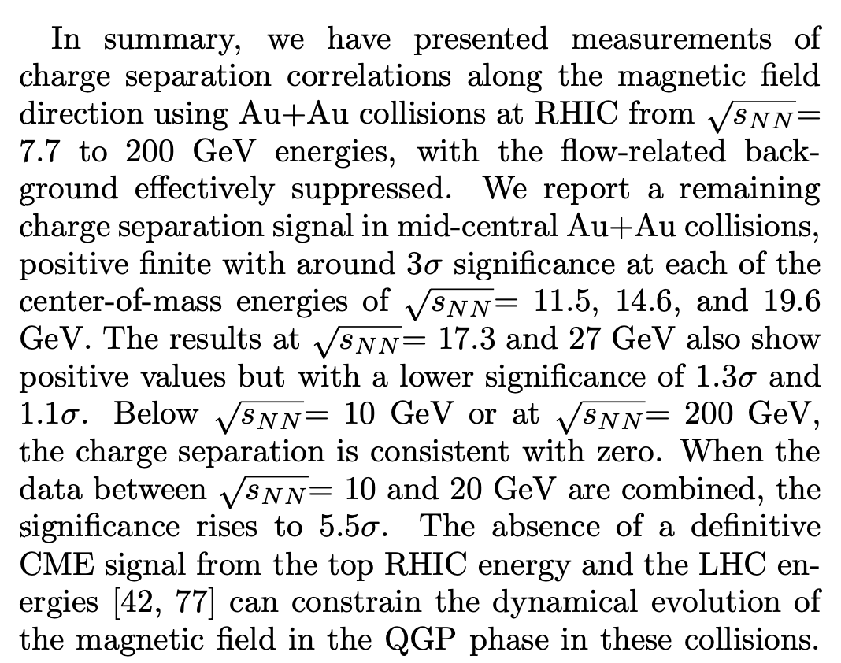
arXiv:2506.00275

Slide 33
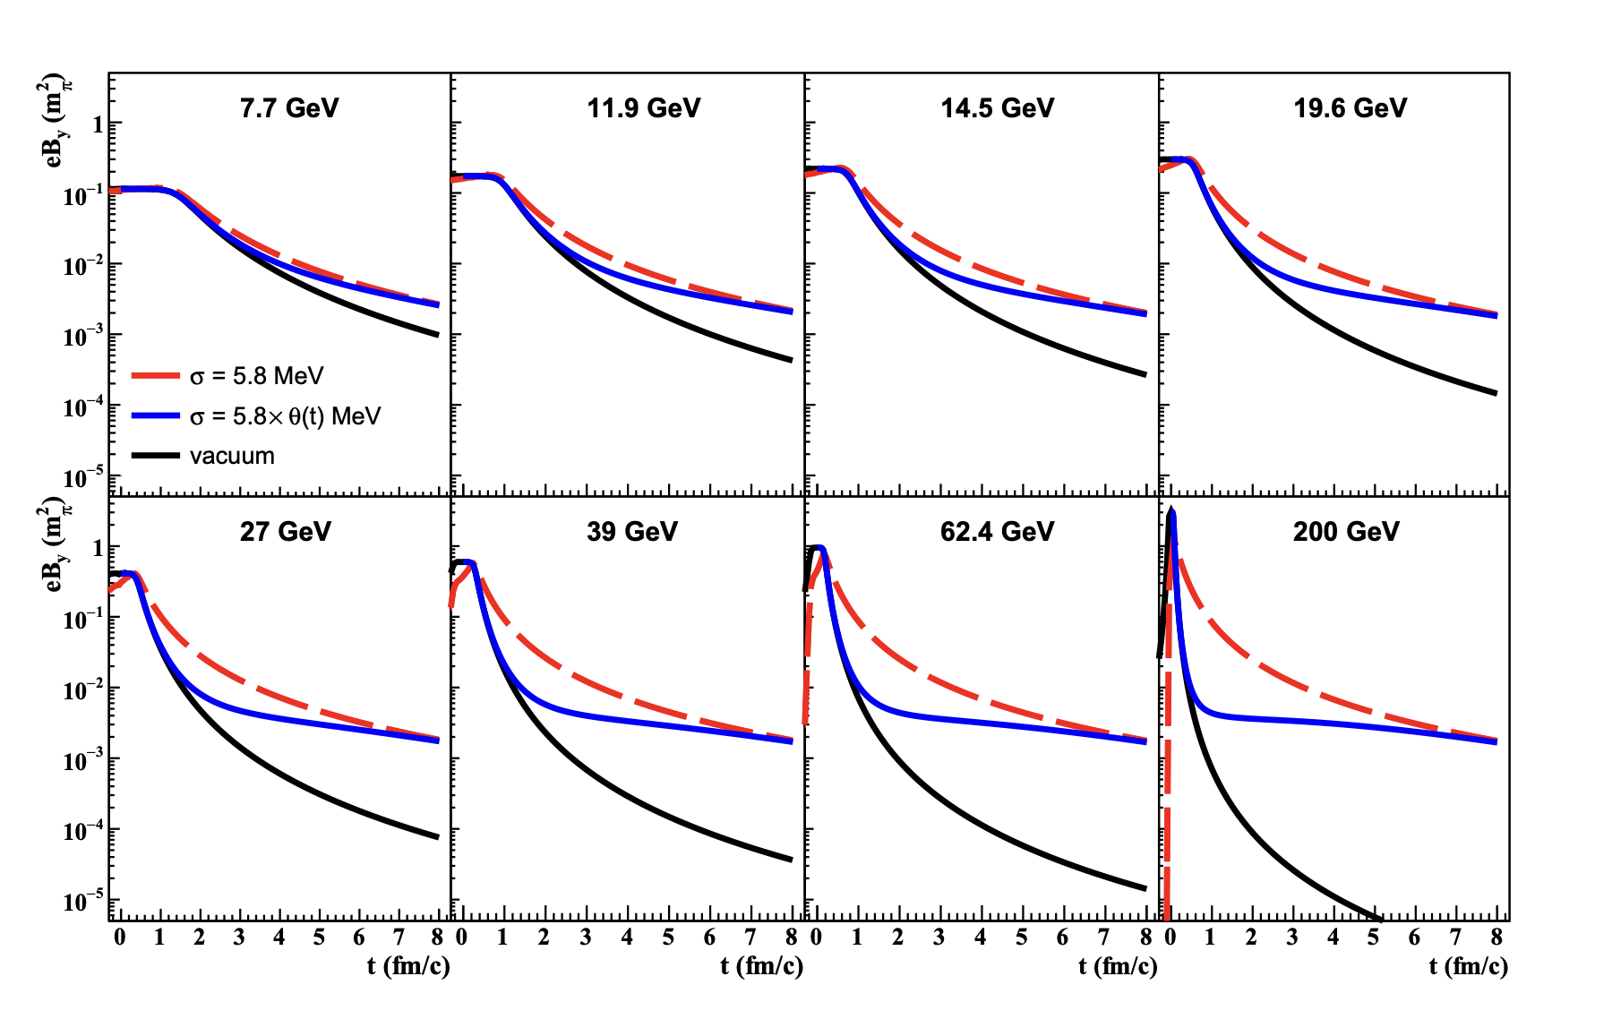
Why CME at low energies?
One reason is the longer-living magnetic field:
H. Li et al,
arXiv:
2306.02829
PRC(2024)

Slide 34
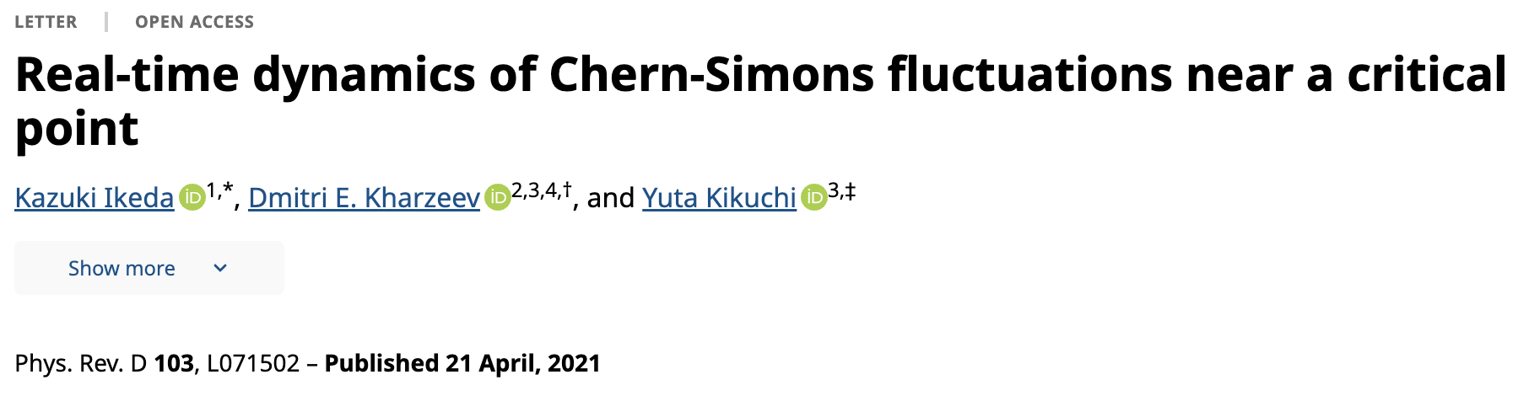
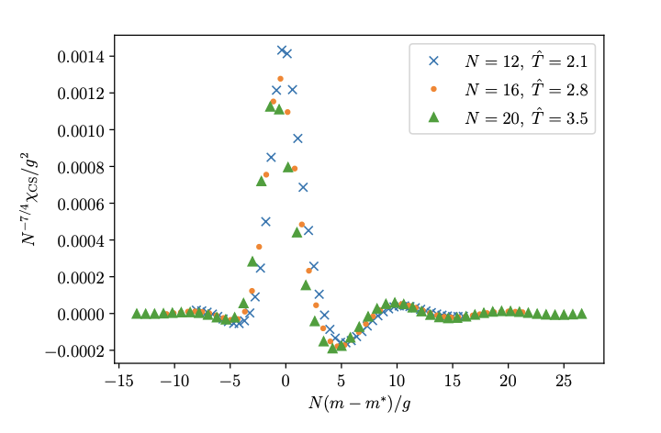
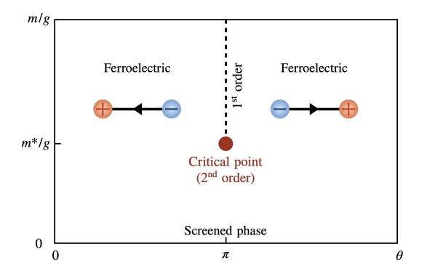
Why CME at low energies?
But there may also be another reason, revealed through
the real-time simulations: enhancement of topological fluctuations
near the critical point
Also: K.Fukushima, M. Ruggieri, R. Gatto (2010)

Slide 35
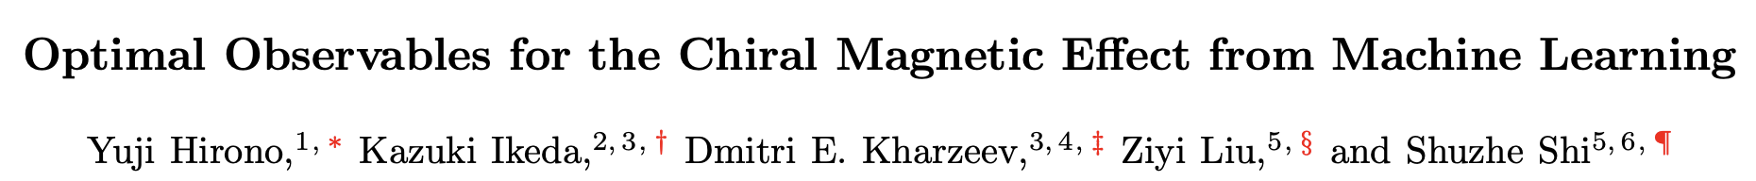

Better CME observables with machine learning
arXiv: 2504.03248
Up to 90% higher sensitivity
to CME signal than “standard”
observables

Slide 36


CME in Dirac & Weyl semimetals
Recent reviews:
N.P. Ong and S. Liang, Nature Rev. Phys. (2021); P. Narang, C. Garcia, C. Felser, Nature Mat. (2021)
Even number of space-time dimensions –
so chiral anomaly operates, can study CME!

Slide 37



CME in chiral materials
BNL - Stony Brook - Princeton - Berkeley
Nature Phys.
12 (2016) 550
arXiv:1412.6543 [cond-mat.str-el]
37

Slide 38



Parallel electric and magnetic fields source the chiral anomaly:
and thus the chiral chemical potential μ₅ ~ ΕΒ τ
The CME current is J ~ μ₅ B² τ – longitudinal magnetoconductivity ~ B² (at weak B)
D. Son, B. Spivak ‘13
Q. Li et al,
Nature Physics 12, 550 (2016)
arXiv:1412.6543

Slide 39



CME in chiral materials
Impressive results from other groups:
arXiv:1503.08179
Science ‘15

Slide 40


CME in chiral materials: optical measurements
40

Slide 41


Chiral magnetic instability
B
J
Transfer of
chiral charge
of the fermions
to the magnetic
helicity

Slide 42



arXiv:1002.1473

Slide 43


Inverse cascade of magnetic helicity
Instability at k< leads
to the growth
of magnetic
helicity
Increase of
of magnetic
helicity reduces
Inverse cascade:
M.Joyce and M.Shaposhnikov, PRL 79 (1997) 1193;
R.Jackiw and S.Pi, PRD 61 (2000) 105015;
A.Boyarsky, J.Frohlich, O.Ruchayskiy, PRL 108 (2012) 031301; PRD 92 (2015) 043004;
H.Tashiro, T.Vachaspati, A.Vilenkin, PRD 86 (2012) 105033
43

Slide 44



Self-similar inverse cascade of magnetic helicity driven by CME
helical magnetogenesis
in the Universe?
Work by A. Brandenburg, T. Vachaspati,
A. Boyarsky, O. Ruchaysky, T. Kaniashvili,…
Possible link between “helical magnetogenesis”
and baryogenesis in Early Universe:
DK, E.Shuryak, I.Zahed, arXiv:1906.0480, PRD
Y. Hirono, DK, Y.Yin, PRD’15
N. Yamamoto, PRD’16
Notes:
Trisodium bismuthide

Slide 45



Can chiral magnetic instability be observed in chiral materials?
PRD (2015)
45

Slide 46



Chiral magnetic instability
arXiv:2502.05170
Sinusoids with
amplitudes
growing in time
46

Slide 47
Summary
The interplay of chirality and quantum anomalies is fascinating.
Many novel phenomena to be explored at the current and future
experimental facilities (RHIC, LHC, EIC).
Dirac and Weyl semimetals enable tabletop experiments, with results
that are fundamentally interesting and potentially important for
applications (qubits, sensing, transducers, …)

