Slide 1
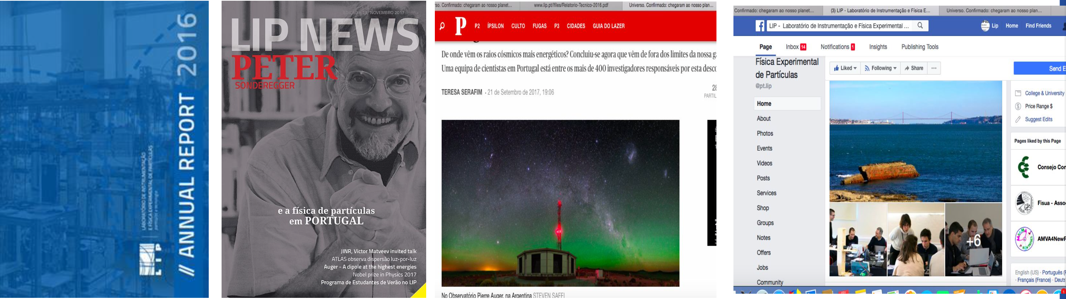
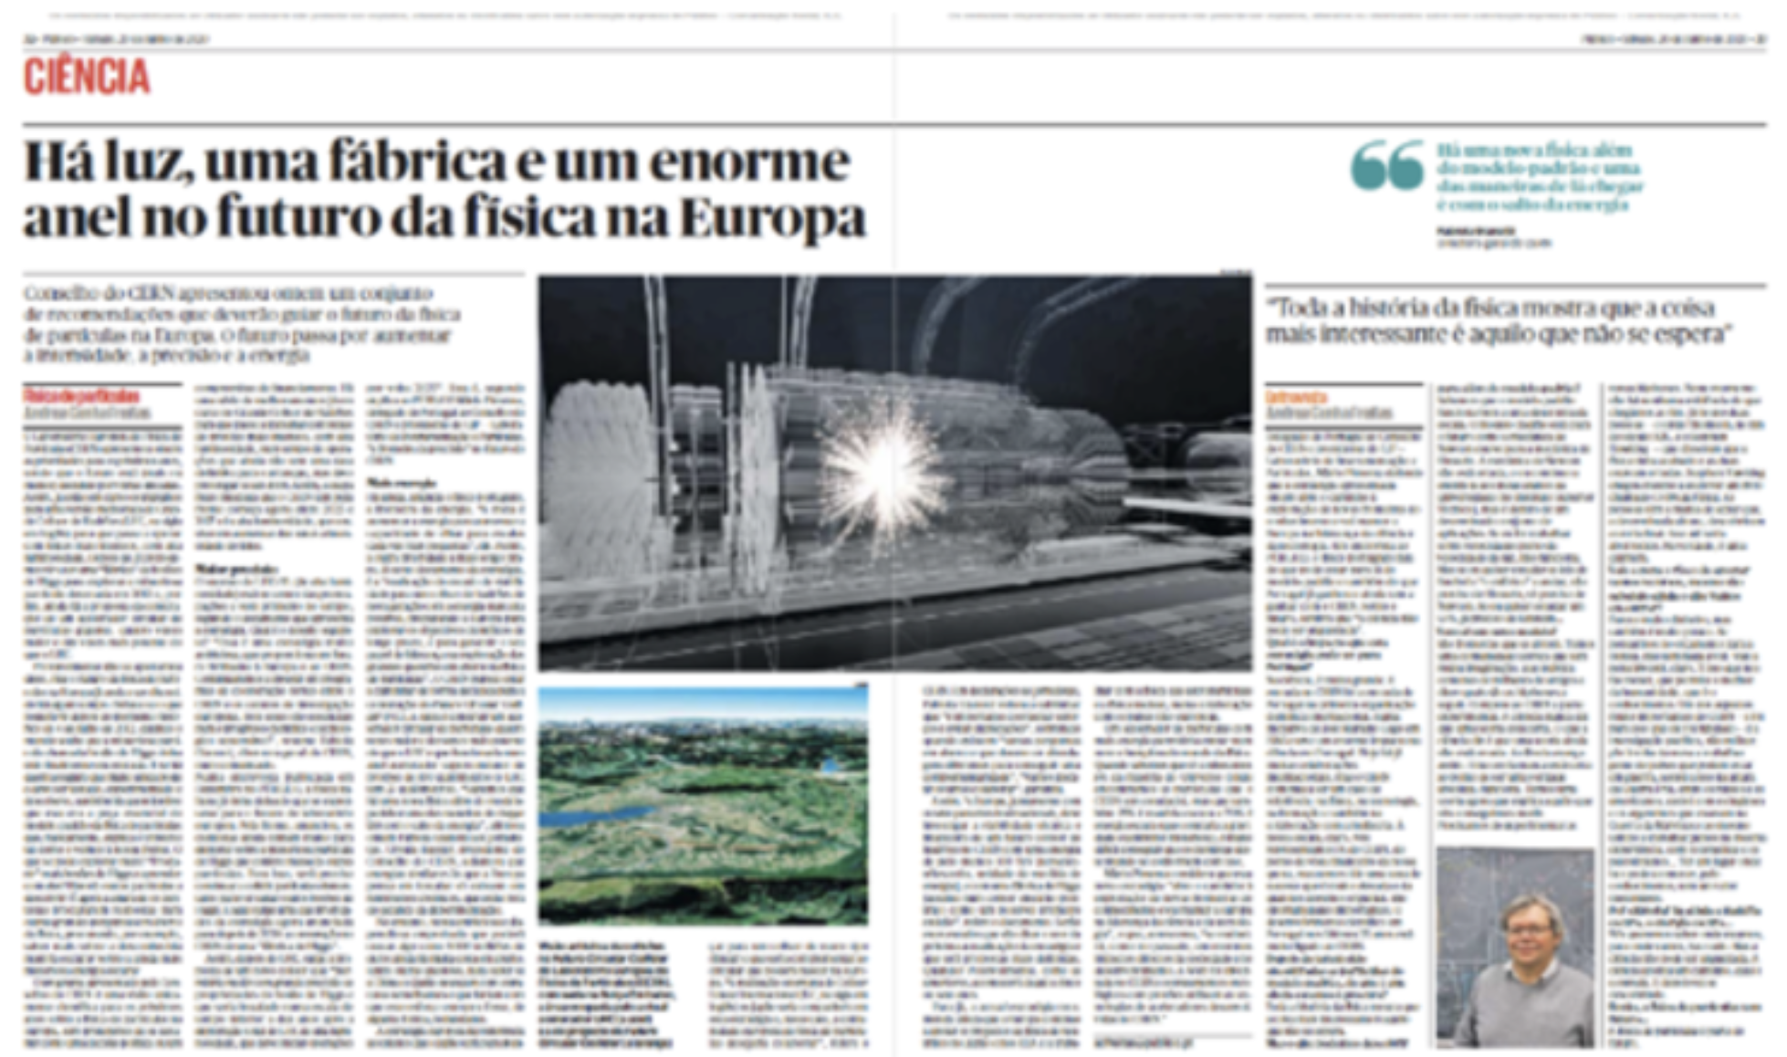
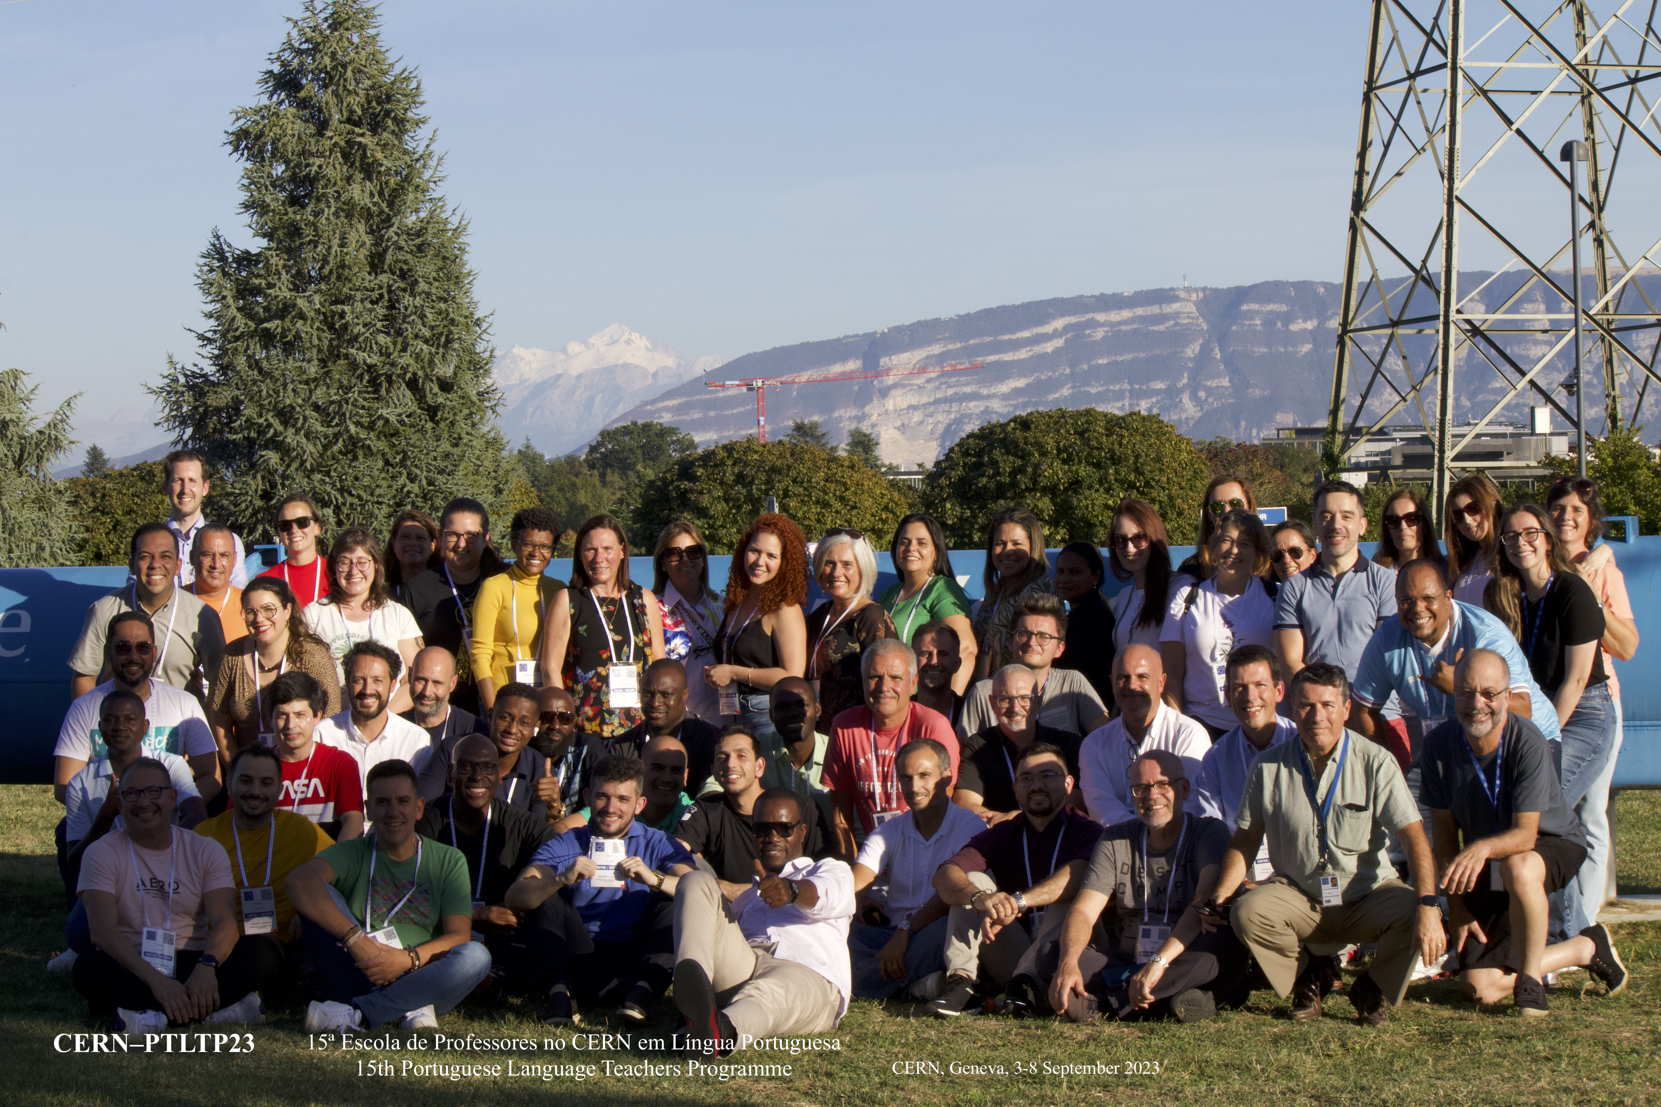
Contribution to the PT input to the
ESPPU 2026
Education,
Communications
&
Outreach
Pedro Abreu
for the
LIP-ECO group
Lisbon, January 2025

Slide 2
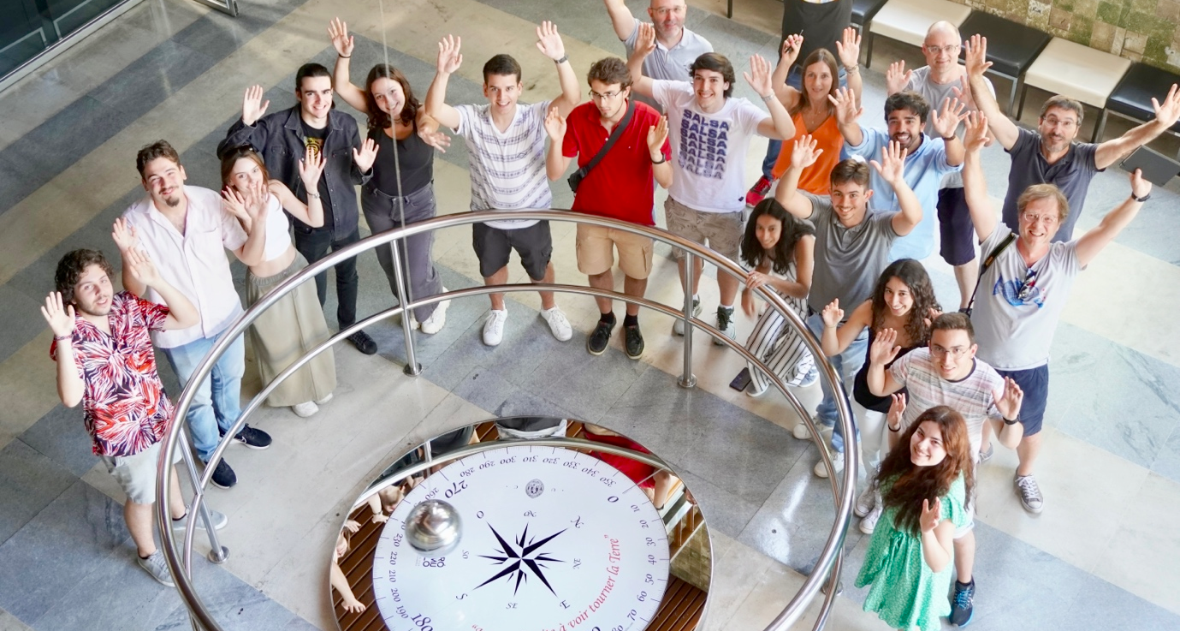
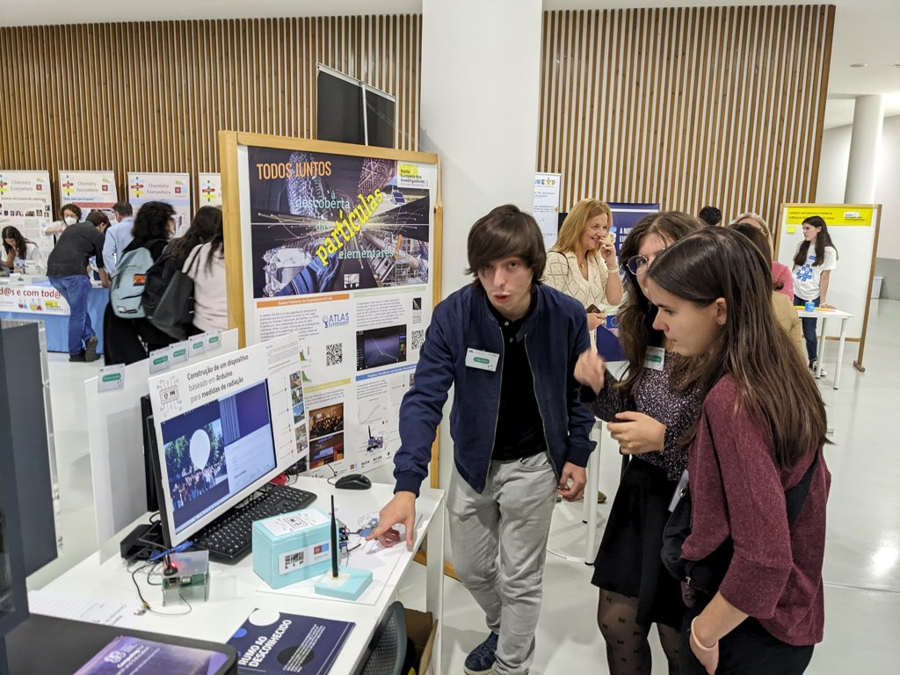
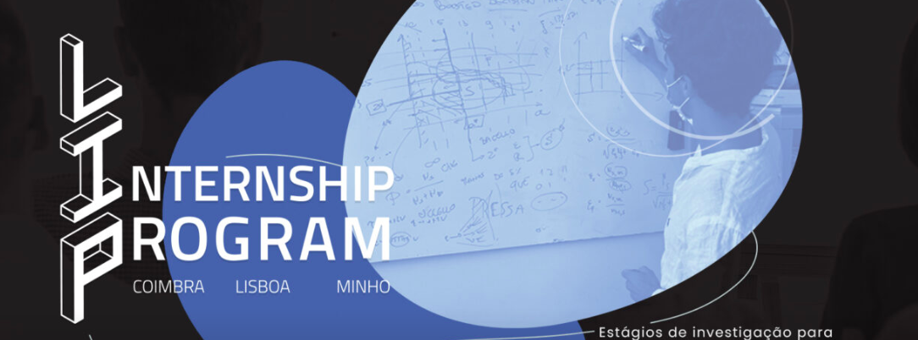
TRAIN THE STUDENTS
… and the Researchers
Open minds
Efficient communication skills
Public engagement and outreach
In academia or in specific programmes
2/8

Slide 3
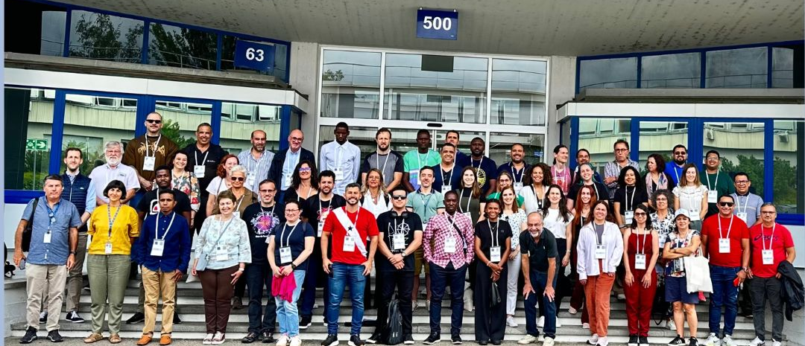
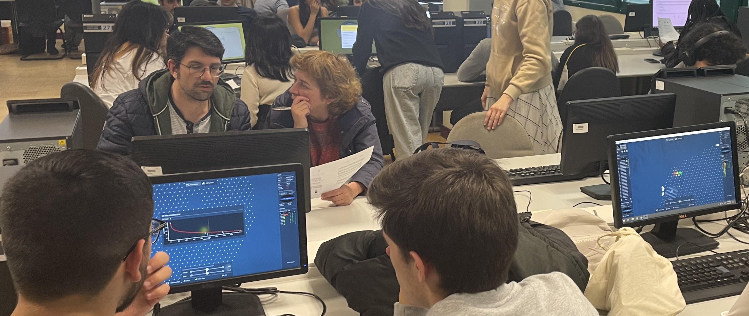
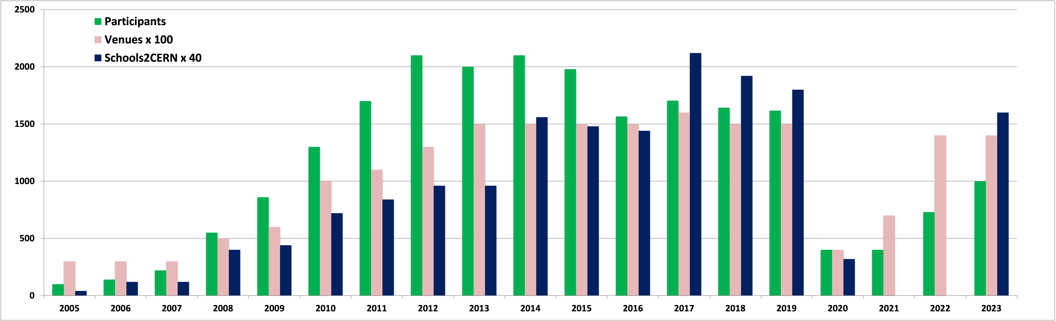
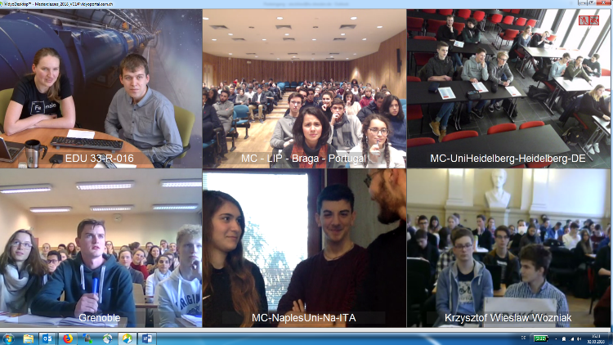
HIGH-SCHOOL TEACHERS AND STUDENTS’ ENGAGEMENT
High-quality Teachers Programmes
…such as CERN’s PT Language Teacher Programmes
Activities for high-school students
…such as IPPOG’s Masterclasses
Support for Science Clubs at Schools
…such as PT Ciência Viva Science Clubs programme
Outreach talks at schools
3/8

Slide 4
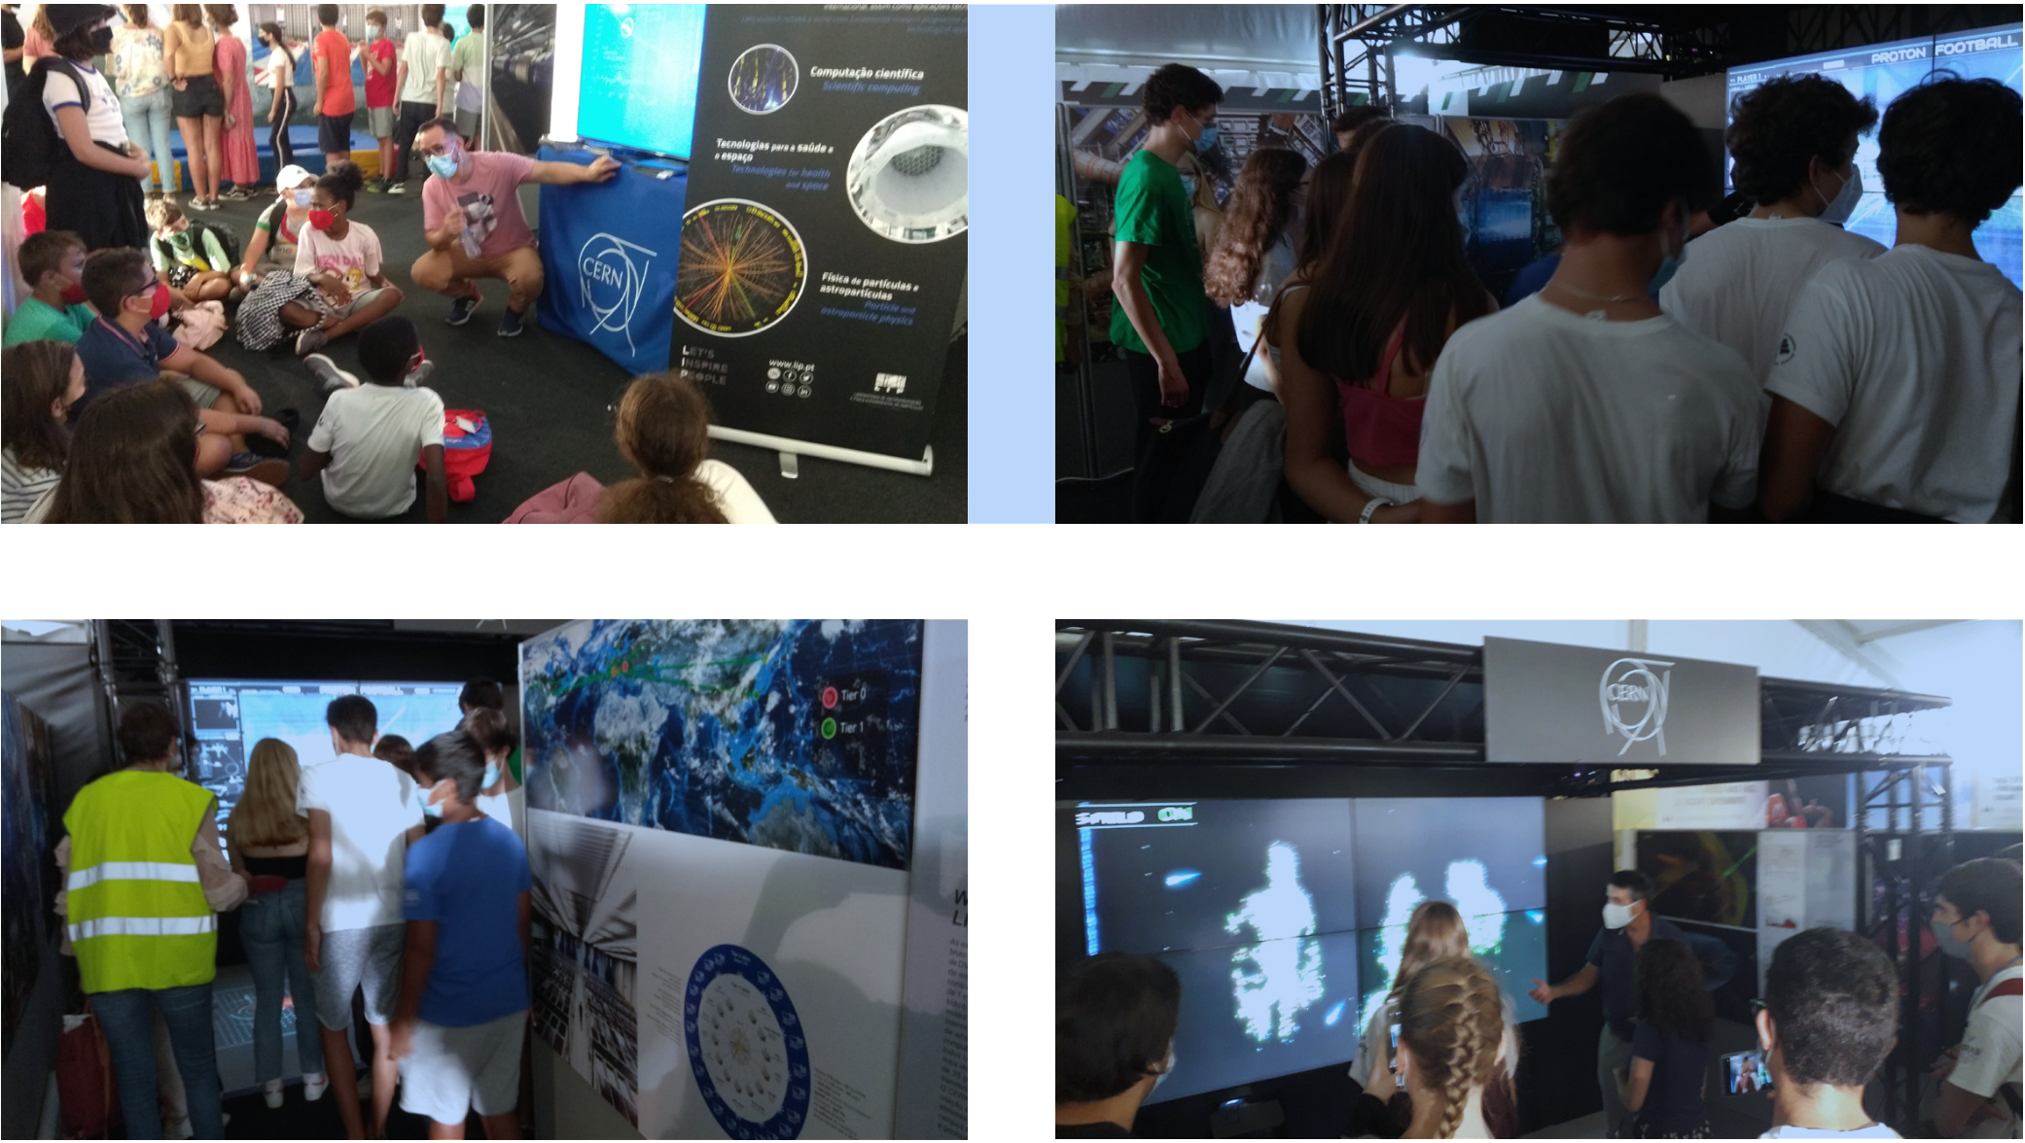
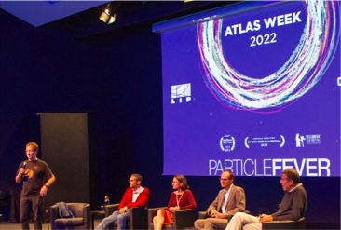
PUBLIC ENGAGEMENT AND OUTREACH
Mandatory component of a Researcher’s Activities
…with a minimum level of commitment (1%? - 2 days/year ?),
but more should be encouraged
Institute Support
…human resources, logistics, financial
Active Involvement
…of the scientists connected with the field
4/8

Slide 5
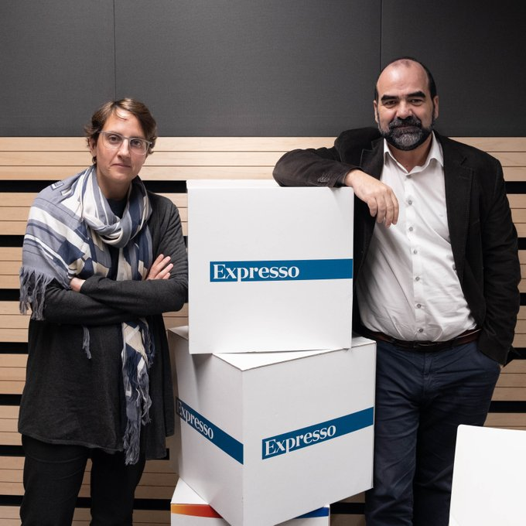
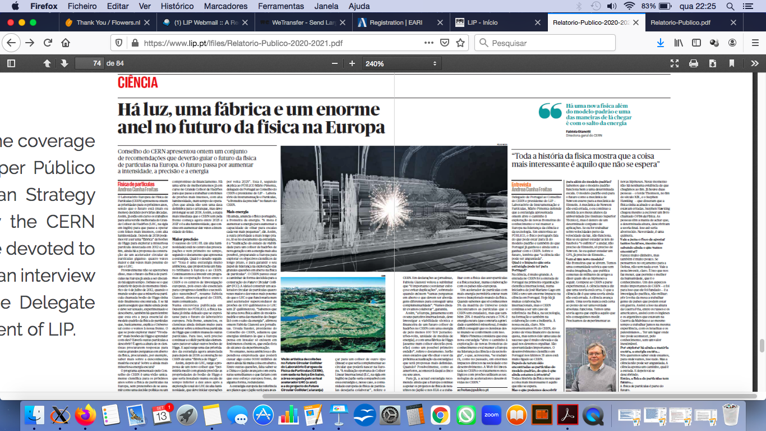
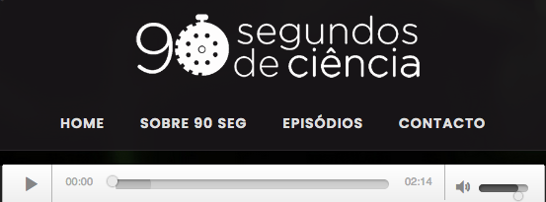
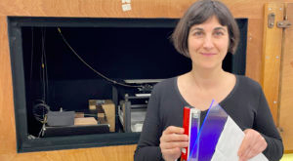
COMMUNICATION
Should be a key priority of the field
Promote its successes in all its missions
( research, R&D and applications, training highly skilled people, public engagement and international peaceful collaborations )
Networks with scientists and professional communicators
( considering target audiences, media, goals, and knowledgeable about social media )
Train the
scientists to deal
with the media!
( and social media! )
Usage of modern
communication tools
( interactive digital
platforms, storytelling
and visualization techniques )
5/8

Slide 6
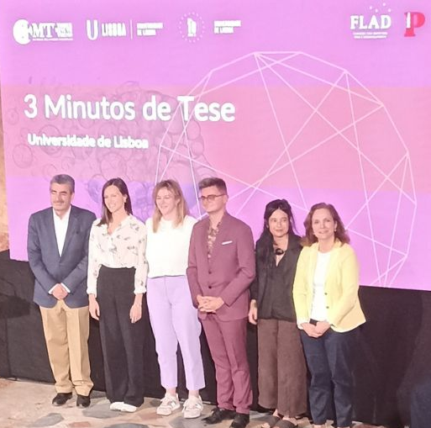
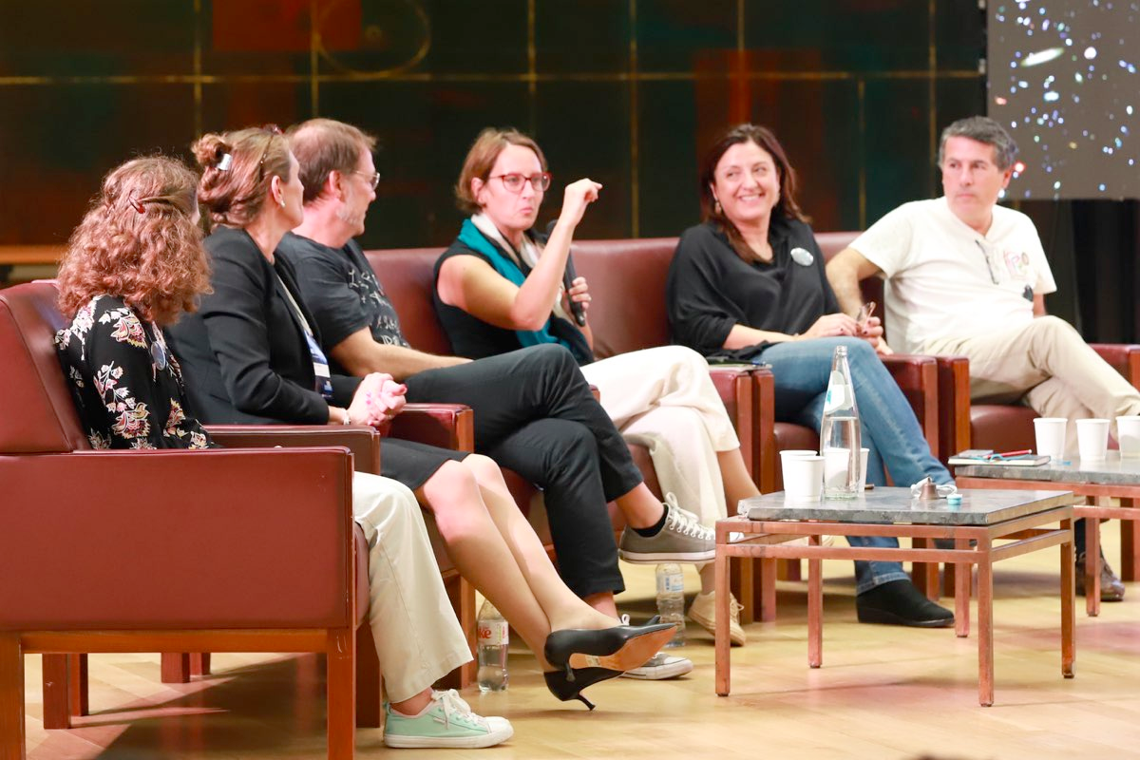
RECOGNITION
Efforts in public engagement and communication activities of Researchers
( these are as important as all other aspects of the missions of a Researcher and
should be an assessment criterion in the evaluation of her/his career )
Importance of the outreach and communication in projects
( projects should contain a minimum commitment/investment/resources to the
public communication and outreach of the project )
SCIENTIFIC DIPLOMACY
Should be encouraged in all Researchers
( they should act as Ambassadors of the field )
Dissemination in their communities
( seek understanding and support among peers [specially those outside
the field], family and friends, general audiences at public events )
@ UNIVERSAL
SCIENCE
6/8

Slide 7
Conclusions
Education, Communication and Outreach are essential pillars for the future of Particle Physics.
Many scientists, at different levels of commitment, along with experts in outreach and communication, are already engaging the public and students in different venues and carry outwards the excitement of the field.
  Communication & Outreach in our field need YOUR support and contribution,
    as actively being an ambassador of the field,
    as speaker/moderator/motivator/organiser/educator/tutor,
    as evaluator of projects/career assessment/applications/positions,
    consider experience in outreach when evaluating people,
    and/or helping creating the conditions for a better Edu-Comm-OR in PP.
…an ongoing process!
7/8

Slide 8
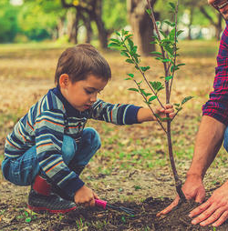




Thanks!
Comm_nication and O_treach need U
(this is a big thanks!)
to all the people already contributing!
...and for your attention!
Planting
a future
Any questions?
You can find me at abreu@lip.pt
8/8

