Slide 1
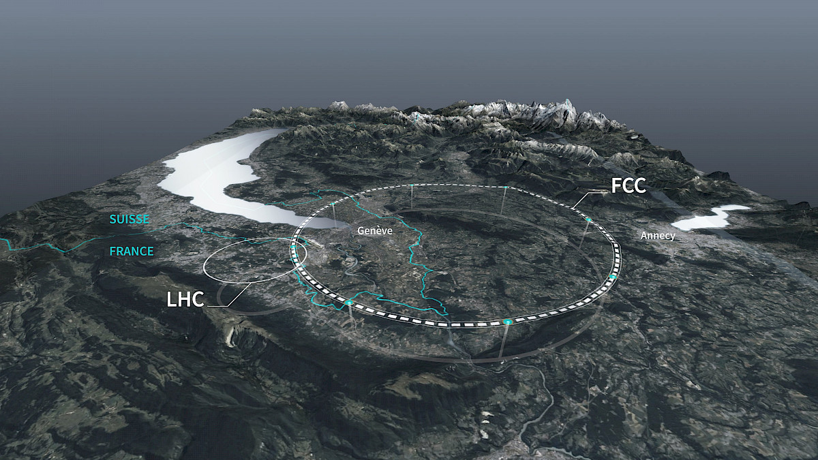
European Strategy Discussion LIP-Lisbon - 20 January 2025
FCC – the Future Circular Collider
Ricardo Gonçalo – UC / LIP

Slide 2
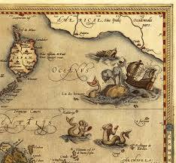
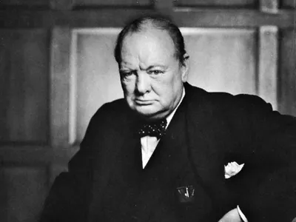
Why we need a new collider?
Standard Model confirmed up to scales of O(TeV)
No new physics evident
And yet we know it must be there!
Dark energy, dark matter, matter-antimatter asymmetry…
SM-like Higgs boson discovered
Higgs couplings essential to understand deep structure of the Universe
Higgs couplings → particle masses → size of atoms, nuclei stability, stellar physics, etc
Higgs self-couplings → EW symmetry breaking in early Universe
Matter-antimatter asymmetry → CP violation in Higgs sector?
HL-LHC will make much progress, but…
No “no-loose theorem” any more!
We need a broad experimental programme to push the beyond current knowledge
Both precision and higher energy contribute to new physics sensitivity
“Plans are of little importance, but planning is essential.”

Slide 3
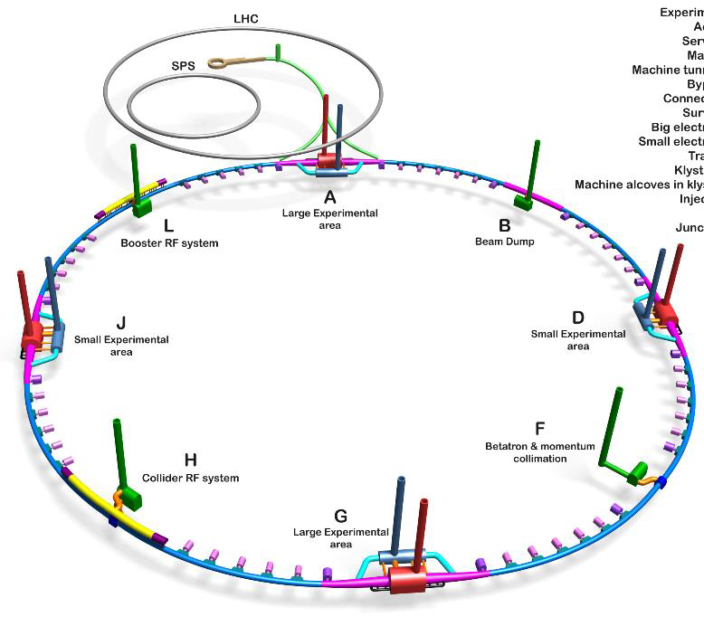
Why we need the FCC?
FCC-ee: e+e- collider is the first goal!
Runs: Z (200ab⁻¹), WW (20ab⁻¹), ZH (10ab⁻¹), top (2 ab⁻¹)
Ultimate precision in Higgs/EW/top physics
FCC-hh: √s = 100 TeV p-p collider
> 10¹⁰Higgs events; > 10⁷ di-Higgs
Explore physics at highest energy frontier
10⁶ Higgs with p_{T} > 1 TeV
Measure Higgs self-coupling to few %

Slide 4
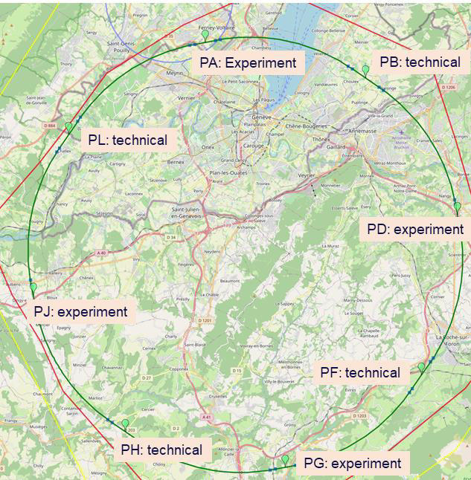
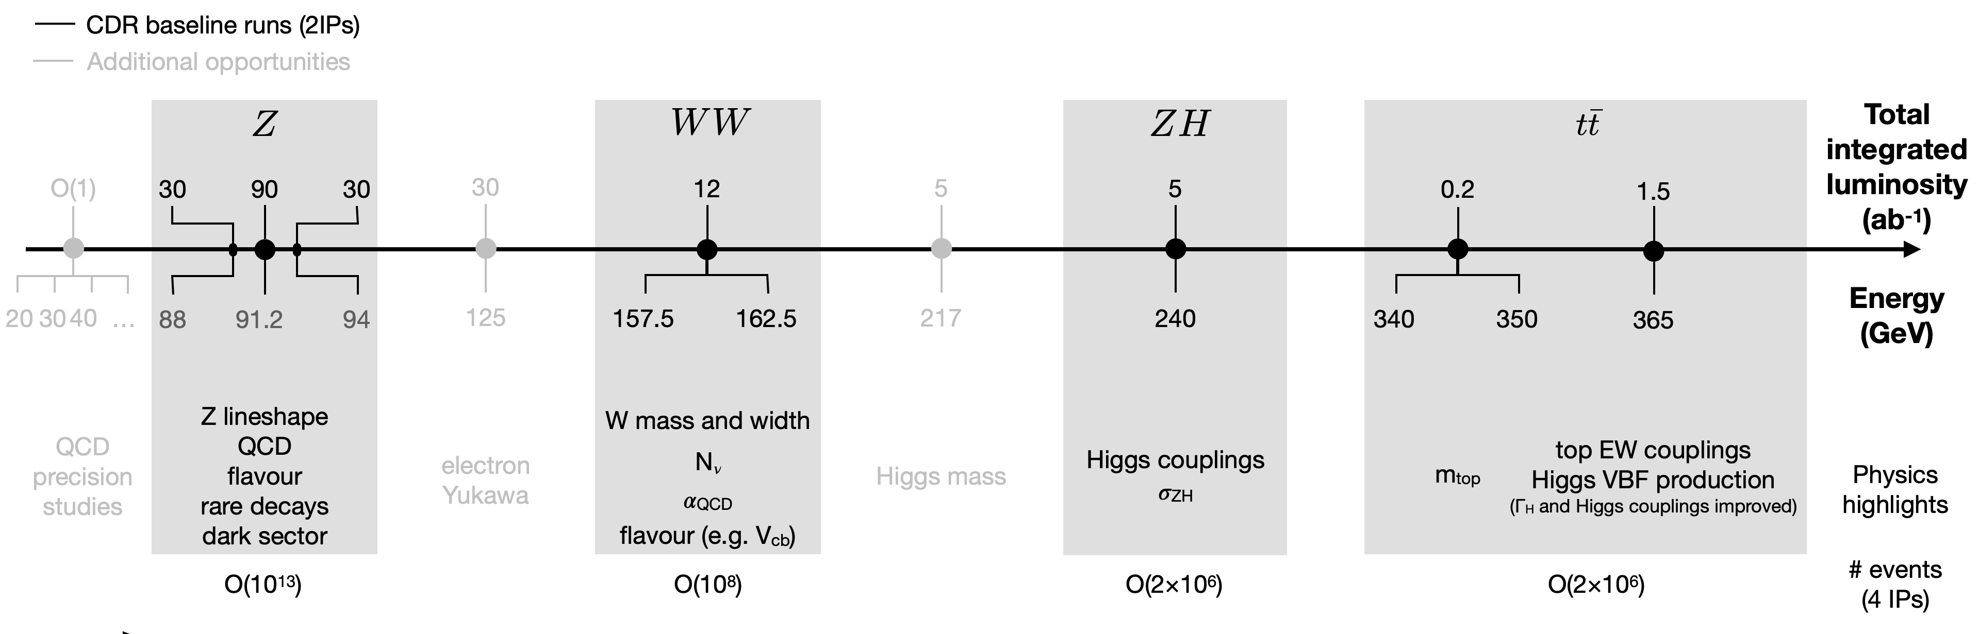
Status of the FCC?
Feasibility study: 2021 – 2026
Midterm report in early 2024 signed by 296 authors
Final report almost ready: 3 volumes
From physics case to geological, financial, environmental and technical feasibility, accelerators and detectors
Since the Midterm Report:
Four interaction points to double statistics at 4% cost increase
“Plans are of little importance, but planning is essential.”

Slide 5
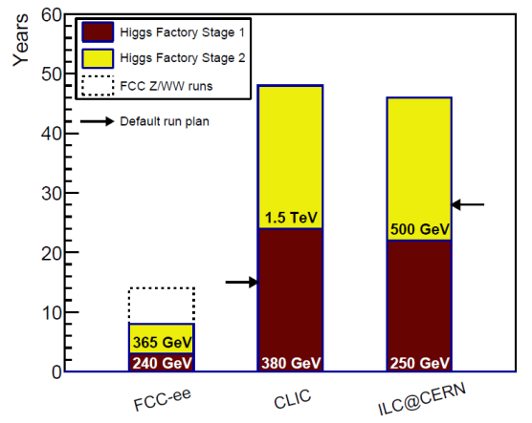
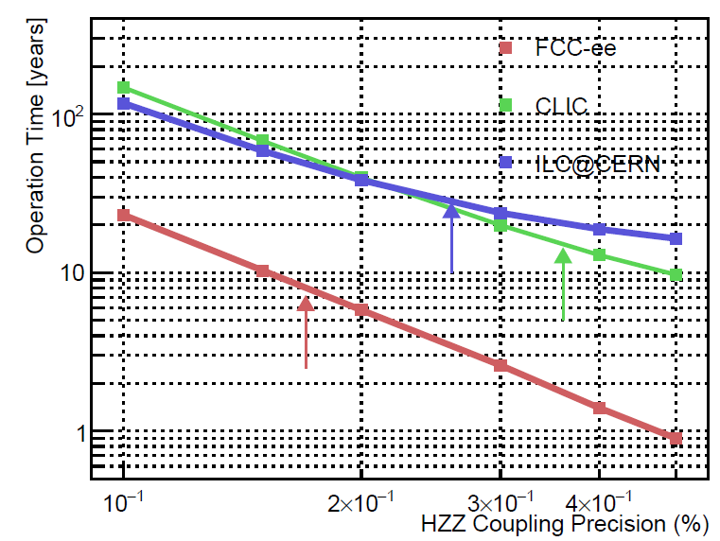
Why else do we need the FCC?
FCC-ee
Favoured by comparison with alternatives (CEPC basically same)
FCC-ee / -hh complementary programme using common infrastructure
Flagship world facility for the rest of the century…
Cost of FCC-ee:
Around 15000 MCHF including the top run
55% civil engineering & infrastructures
25% accelerators
Remaining 20%: four experiments & infrastructures
Total programme ~30 MCHF
60 € per European to be paid over 30 years
Why else?
Technology innovation and technology transfer
People training in international environment: from theory to computing and engineering
Flagship project for CERN and an anchor for science in Europe and the world
[A. Blondel, C. Grojean, P. Janot, G.Wilkinson, arXiv:2412.13130]
Default running scenarios

Slide 6
Christophe Grojean, Feb.24

