Slide 1


Software Provisioning and Infrastructure
(UMD/CMD)
Mario David (LIP), João Pina (LIP), Carlos Manuel (LIP), Jorge Gomes (LIP), Samuel Bernardo (LIP), Pablo Orviz (IFCA)

Slide 2


EGI Repositories
Repositories
The EGI Software Repository provides access for the middleware distributions (used by WLCG sites) together with some Community Repositories
Constitutes a contribution from IBERGRID to the WLCG infrastructure
Composed by:
Software Quality Assurance - validation of the products released as part of the UMD
  Software Quality criteria - definition of the criterias (done once per product)
  Software validation of the criteria - run tests against the define criterias (done for every release)
  Done by IBERGRID since 2012 now LIP + CSIC (ex partners: UPV, CESGA)
  Contract paid by EGI under competitive call
Repositories Infrastructure - provides a unified point of access for the middleware distributions (IBERGRID since 2021)

Slide 3
EGI Repositories
Repositories
Two main categories:
OS Support
AlmaLinux9 (EL9) : UMD-5
The Unified Middleware Distribution (UMD):
redistribution of traditional middleware
IGTF Distribution of Authority Trust Anchors: packages with the trust
anchor information

Slide 4
What’s new
Complete redesign of the service:
  Current infrastructure based on Nexus Repository OSS
  Release workflow implemented in GitHub and Jenkins pipelines.
Software Quality assurance - Full-automated approach
  Faster release cycle with higher automation and less manual intervention
New Functionalities:
IPV6 compliant
New backend behind a proxy (HAProxy)
  https://repository.egi.eu/sw/production/ (prod)
  https://repository.egi.eu/software/umd/ (dev)
High Availability (server side)
Full automatic process until testing
Testing -> production (manual git commit)

Slide 5
Yum repositories (UMD-5 structure)
Structure
release: Main repository with all the packages (= to production).
testing : testing repository with rpm not fully validated in production environment. RPM belonging to release declared as production ready will be moved from testing to release.
contrib: repository for specific communities or special services. (NEW)
Dropped repositories: Staged Rollout and Release Candidate
UMD-5 Production since (October 2024)
  https://repository.egi.eu/umd/distribution.html?id=5.0.0#5.0.0
  Install instructions:
  https://repository.egi.eu/umd/installation-notes.html?id=5

Slide 6
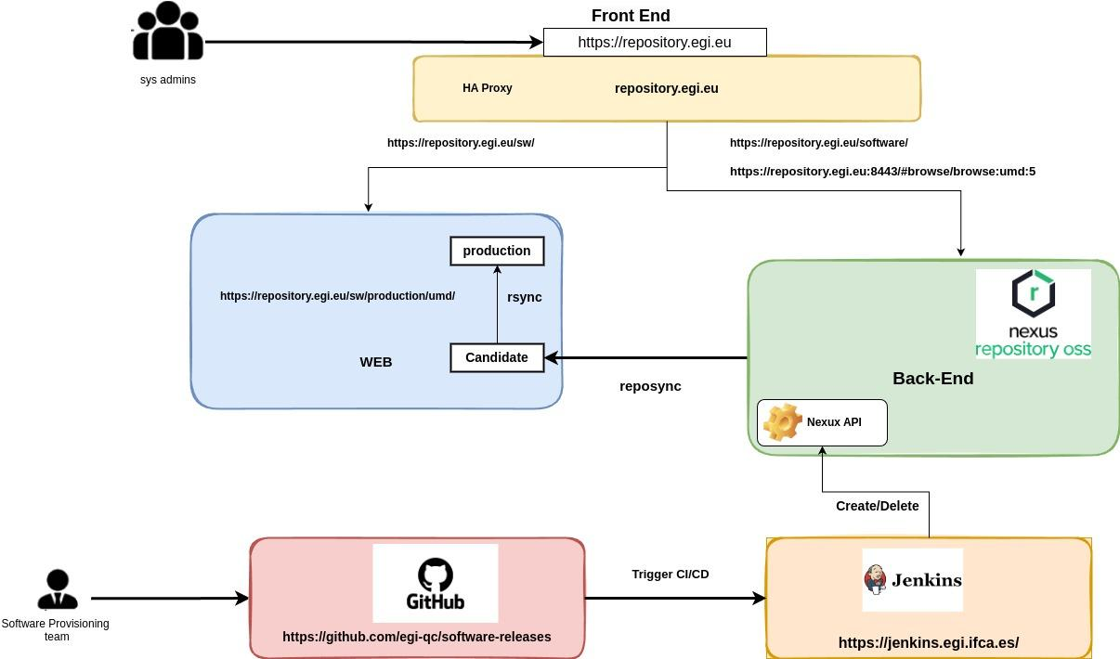
Architecture

Slide 7
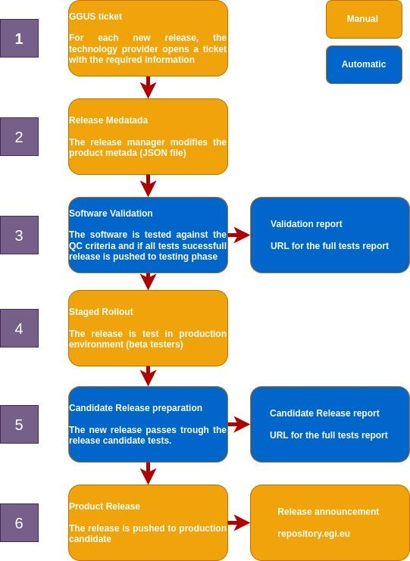
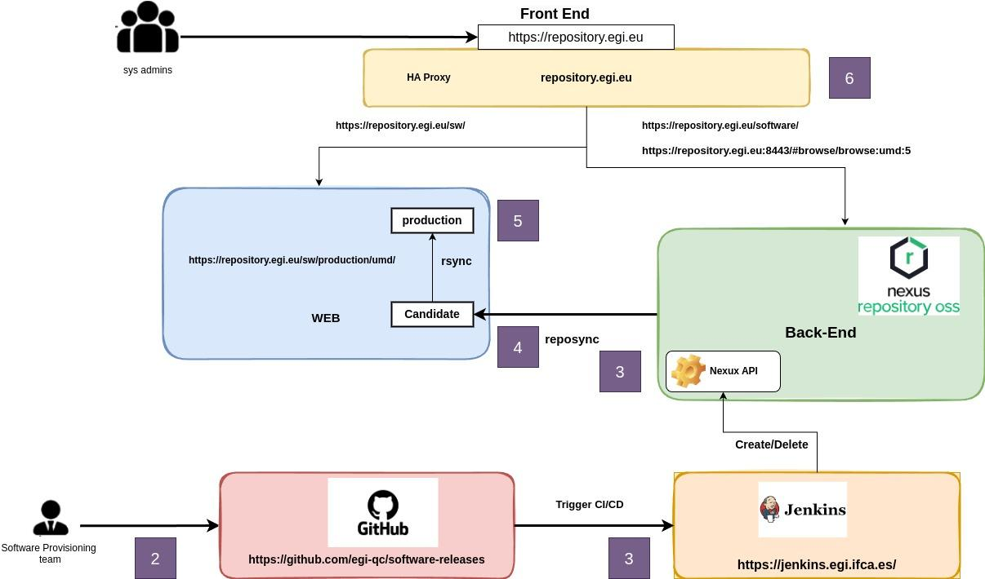
Workflow
Architecture
Workflow

Slide 8
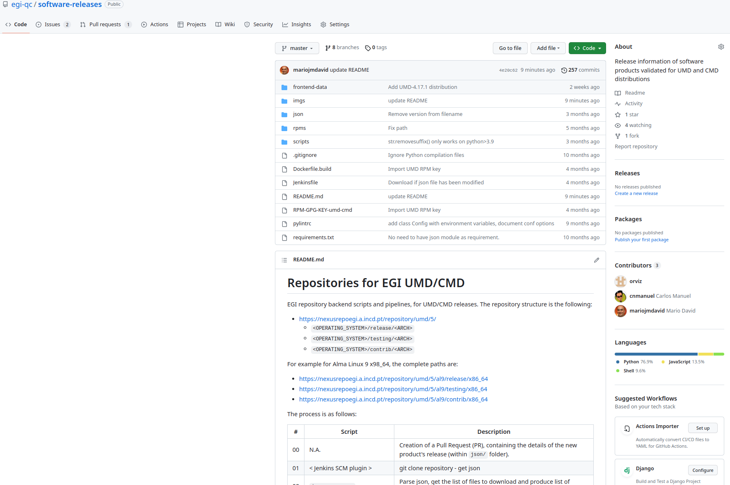
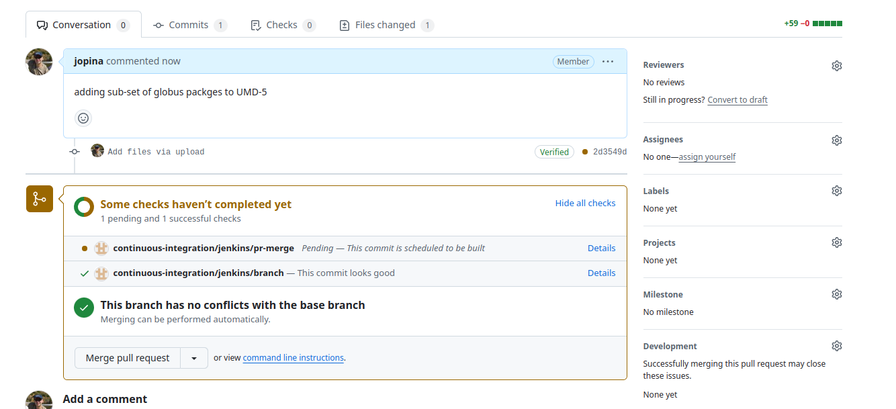
Tracking of the workflow all based on git
Git
Software provisioning process:
https://github.com/egi-qc
Software Releases:
https://github.com/egi-qc/software-releases
Ansible playbooks for install software:
https://github.com/egi-qc/umd-verification

Slide 9
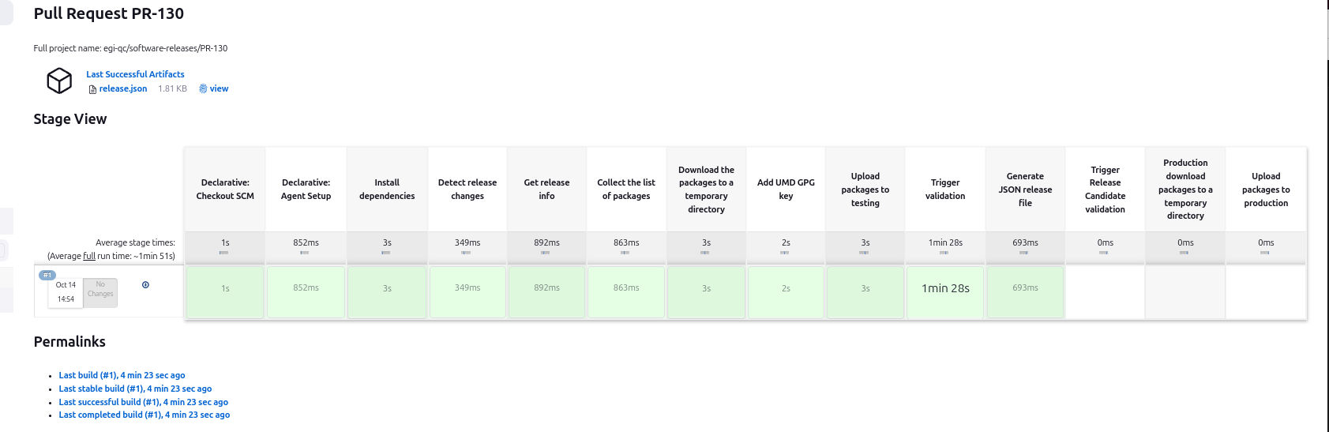
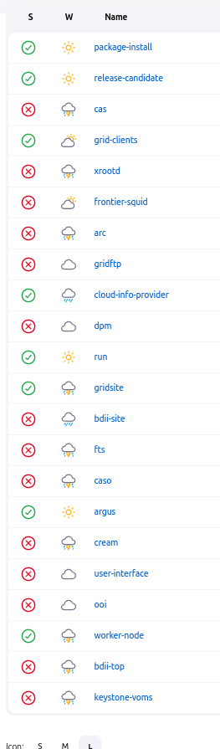
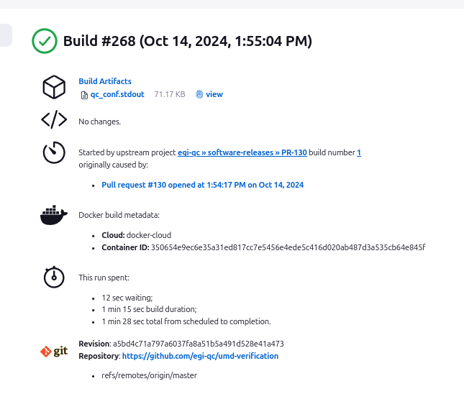
Workflow
Moving product to testing repository
3
https://github.com/egi-qc/umd-verification
https://jenkins.egi.ifca.es/job/QualityCriteriaValidation/job/package-install/268/artifact/logs/qc_conf.stdout/*view*/

Slide 10
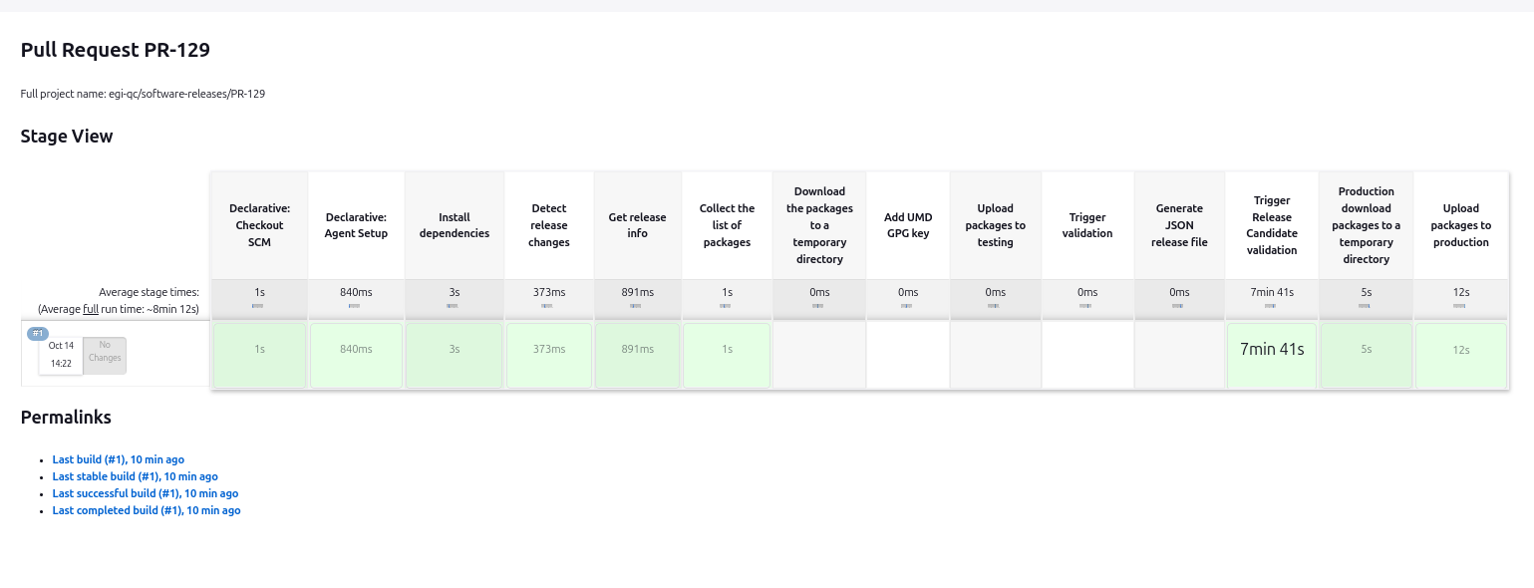
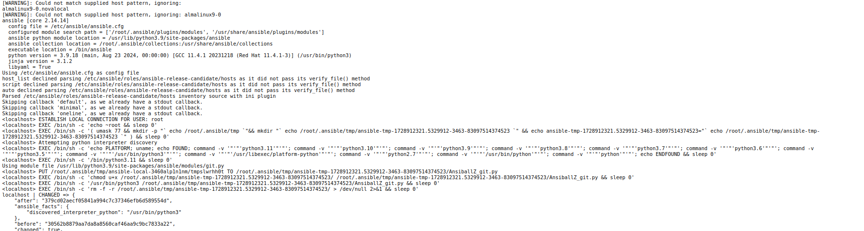
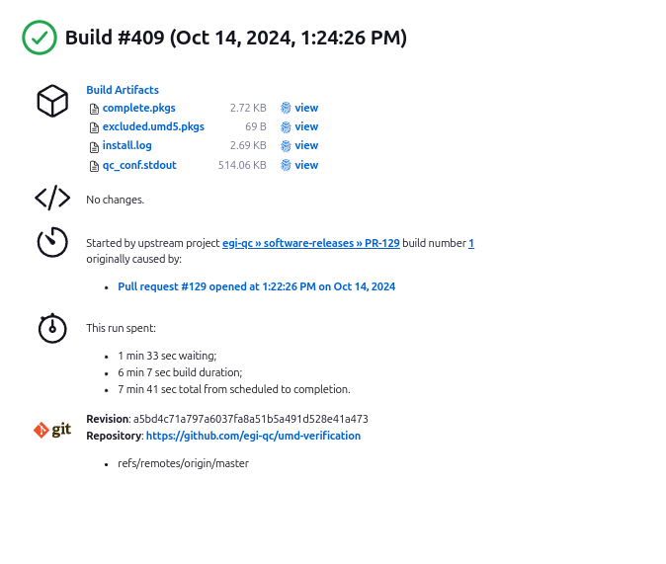
Workflow
Moving product to prod repository
5
https://github.com/egi-qc/ansible-release-candidate
https://jenkins.egi.ifca.es/job/QualityCriteriaValidation/job/release-candidate/409/artifact/logs/qc_conf.stdout/*view*/

Slide 11
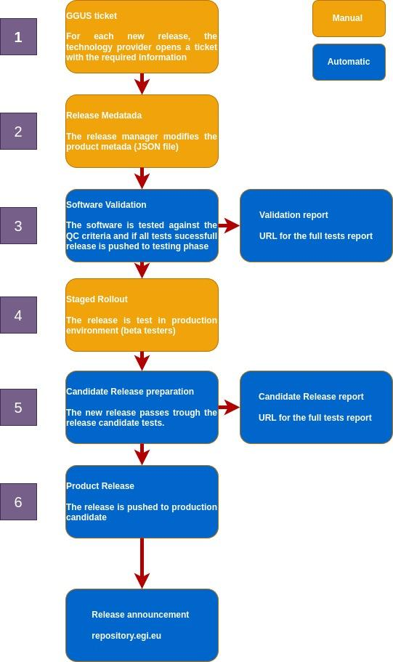
Evolution
Future:
Integration with SQAaaS from EOSC-Synergy
  Allow full pipeline tests
Allow it to be used by external users:
  EGI / EOSC marketplace
SQAaaS

Slide 12

Questions?
Repositories for UMD and CMD
End

Slide 13
Yum repositories (new structure)
Nexus
Production
[UMD-5]
name=UMD 5 main repository (Alma Linux 9)
baseurl=https://repository.egi.eu/sw/production/umd/5/al9/release/$basearch
enabled=1
priority=1
gpgcheck=1
gpgkey=https://repository.egi.eu/repository/umd/5/UMD-5-RPM-PGP-KEY
EPEL 9 required
UMD higher priority than EPEL
Priorities already part of DNF
Need crb almalinux9 enabled
No more base / updates >> release

Slide 14
Yum repositories (new structure)
Nexus
Testing
[UMD-5-testing]
name=UMD 5 nexus testing (Alma Linux 9)
baseurl=https://repository.egi.eu/sw/production/umd/5/al9/testing/$basearch
enabled=0
priority=1
gpgcheck=1
gpgkey=https://repository.egi.eu/repository/umd/5/UMD-5-RPM-PGP-KEY
Packages under testing but already validated

Slide 15
Yum repositories (new structure)
Nexus
External Contribution (new)
[UMD-5-contrib]
name=UMD 5 contrib (Alma Linux 9)
baseurl=https://repository.egi.eu/sw/production/umd/5/al9/contrib/$basearch
enabled=0
priority=1
gpgcheck=1
gpgkey=https://repository.egi.eu/repository/umd/5/UMD-5-RPM-PGP-KEY
Packages under testing but already validated: Caso

Slide 16
UMD/CMD new Workflow
Pipeline
Workflow
https://github.com/egi-qc/software-releases
json_parser.py
download_pkgs.py (option 0)
rpm_sign.sh (option 0)
upload_pkgs.py
(option 0)
clean.sh
json_parser.sh
(option 1)
release-candidate(jenkins job)
package-install (jenkins job)
upload_pkgs.py
(option 1)
Approved the Release (Testing/Production repository)

Slide 17

Pipeline
https://github.com/egi-qc/software-releases
The pipeline is as follows:
json_parser.py: parse json, get the list of files to download and produce list of filenames (packages).
download_pkgs.py (option 0): download the packages to a temporary directory.
rpm_sign.sh (option 0): rpm sign each package.
rpm_sign.sh (option 0): verify signature of each package.
  a. verification of the packages
upload_pkgs.py: upload each package to nexusrepo.
Package-install: Validate package installations from testing repository and perform functional tests.
release-candidate: Install all packages in release repo together with the new packages from testing
json_parser.sh: Produce new json file as asset of the new release
clean.sh: clean temporary directories.

