Slide 1
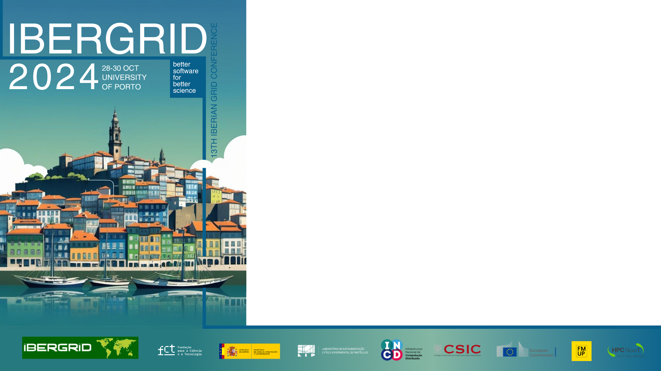
RIECS-Concept:
Conceptualizing a Pan-European
Research Infrastructure for Citizen Science
Fermín Serrano Sanz
RIECS-Concept coordinator
BIFI-Unizar, Fundación Ibercivis
fermin@ibercivis.es

Slide 2

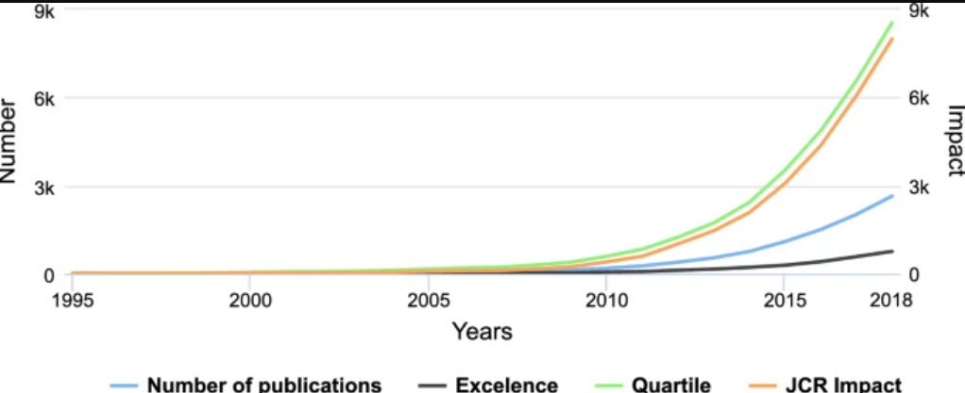
Where are we now
Policies←(citizen) science→society
Everyone should have online access to key public services in the EU
European Declaration on Digital Rights and Principles for the Digital Decade.
Citizen Science (CS) is a mature environment with increasing number of papers and impacts
Increasing policy support (funding mechanisms like HEU, also EOSC, national laws, etc)
Digital technologies are driving the evolution of CS BUT also introducing challenges: complexity and fragmentation, inconsistent methodologies, disengagement.
Current funding is supporting growth with reduced overall effectiveness due to these issues (e.g. budget constraints and their impact on data management.
Need for a unified infrastructure
for CS in Europe
“2M participants in biodiversity citisci projects represents 2,5 Bn dollars” (USA.gov)

Slide 3
RIECS-Concept: Towards a
Pan-EU RI for Excellent CS
Assess Technical Feasibility: Develop an open inventory of technological components (services and resources including accessibility) ensuring consistency in data and metadata.
Strategic Roadmap: Co-design a governance and sustainability roadmap for decision-makers, aiming to be integrated into ESFRI (European Strategy Forum on Research Infrastructures).
Governance: Engage stakeholders to shape the infrastructure's design.
Transversal: with the focus on health, climate change, earth observations (non-exclusive domains).
36 months project, starting 1st January 2025

Slide 4
Vision ← Action
Distributed infrastructure with competitive access.
Shared governance with national reference centers, competence centers, and more.
Ibercivis + ECSA co-coordinators along with 12 partners: Citizen Science Global Partnership, IIASA, CSIC, OeAD, ZSI, Univ. Malmö, UNIMIB, CPN.RS, Univ. Vilnius and Univ. Zurich.
TBD: workshops, consultations, MoUs with existing RIs, EOSC, etc.

Slide 5
Long-term commitment
TIME 3 years 3-6 years 5-8 years 6-9 years 7-10 years
RIECS-Concept
Concept development,
co-design and roadmapping
Scientific and communities leadership
Some services operational (across few countries)
Political support, business case
Assessment, federation and
upscale at EU level
Business plan, legal entity preparation
Some services
fully operational
Implementation and operation. Secure funding
Complete set of services
fully operational
at EU level
Long term operation, financial sustainability, excellent research

Slide 6
Let’s engage!
Unlock long-term benefits with an integrated, cross-disciplinary infrastructure that will impact multiple global communities.
Be part of co-designing and shaping the future of Citizen Science through RIECS-Concept.

