Slide 1
Accelerating the ATLAS Trigger System with Graphical Processing Units
8th IDPASC Student Workshop
16/10/2024
Nuno dos Santos Fernandes

Slide 2
ATLAS & Trigger

Slide 3
ATLAS and its Trigger System
A Toroidal LHC Apparatus: one of the two general-purpose detectors at the LHC
The ATLAS Trigger is used to filter the detected events to ensure a manageable output rate
Two stages:
Hardware-based (Level 1/Level 0)
Software-based (High-Level Trigger/Event Filter)
ATLAS Dectector
40 MHz
Phase I
(Present)
Phase II
(HL-LHC)
Custom Hardware
Level 1
Level 0
100 kHz
1 MHz
The High-Luminosity LHC Upgrade will increase the luminosity, making event reconstruction more computationally demanding
The Phase II ATLAS upgrade needed for the High-Luminosity LHC increases event rate at the software-based stage from 1 kHz to 10 kHz
This higher computational load requires more computing power and/or better optimization
Alternative: hardware acceleration
Ongoing studies for both FPGA and GPU acceleration
“ Computer Farm ”
High Level Trigger
Event Filter
1 kHz
10 kHz
Storage
Diagram of the ATLAS Trigger System
Nuno dos Santos Fernandes
Accelerating the ATLAS Trigger System with Graphical Processing Units
3

Slide 4
GPU Programming

Slide 5
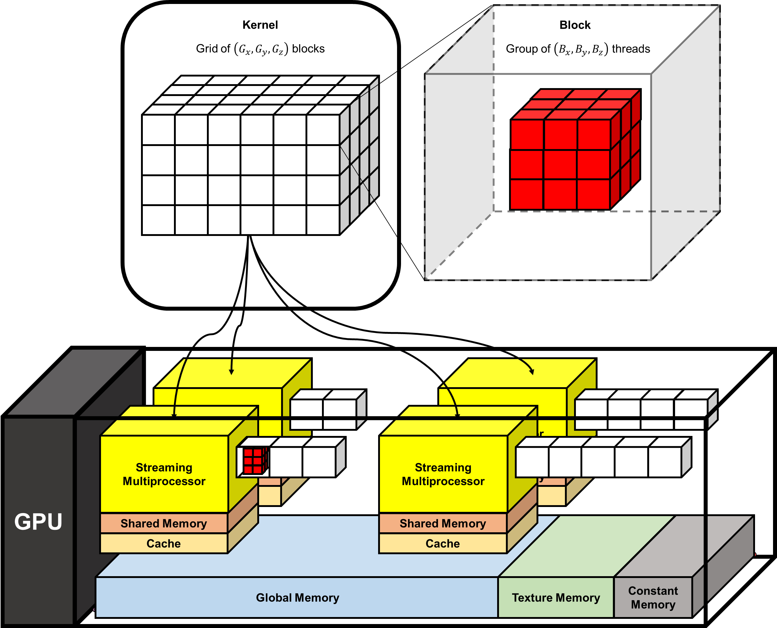
GPUs and GPU Programming
Graphical Processing Units
Developed and designed to render 3D graphics
Highly parallel operations → highly parallel design
“SIMT”: Single Instruction – Multiple Threads
Branching is problematic
Memory access patterns must be carefully considered
Nuno dos Santos Fernandes
Accelerating the ATLAS Trigger System with Graphical Processing Units
5

Slide 6
Calorimeter Clustering Algorithms

Slide 7
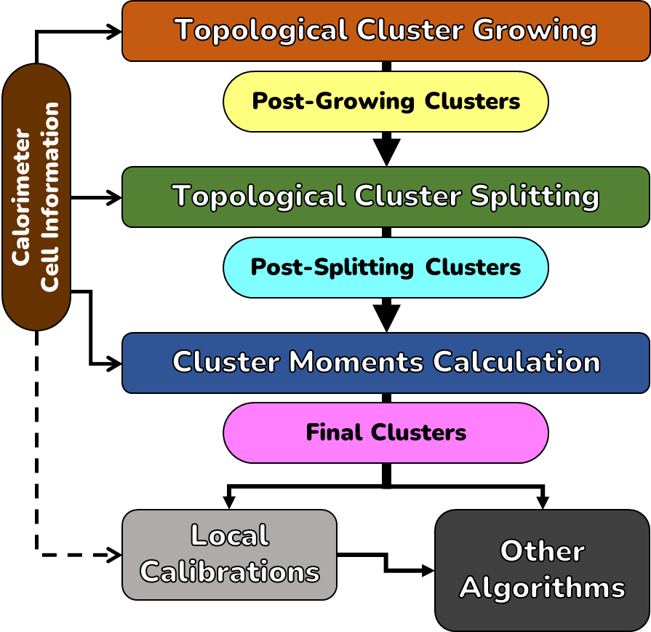
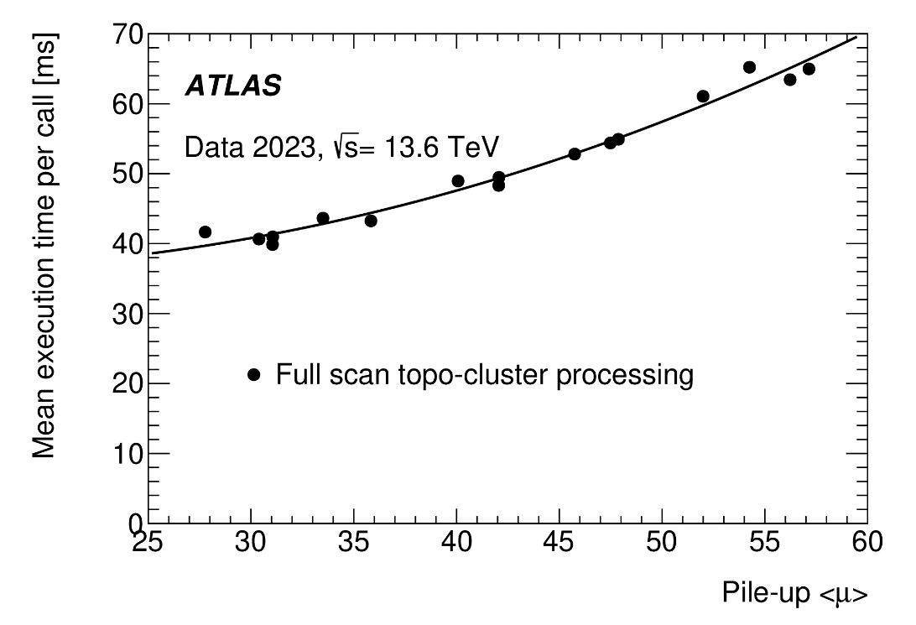
Topological Clustering
Topological Clustering is the currently used approach for calorimeter reconstruction in ATLAS
Among the top 20th most computationally demanding algorithms within the ATLAS trigger
Three main steps: cluster growing, cluster splitting, cluster moments calculation
Clustering typically groups up several tens of calorimeter cells, some clusters may be significantly larger
Several hundred to a few thousand clusters per event, depending on the physical process
Significant dependence on the number of collisions per bunch crossing (μ) in terms of the execution time
Nuno dos Santos Fernandes
Accelerating the ATLAS Trigger System with Graphical Processing Units
7

Slide 8
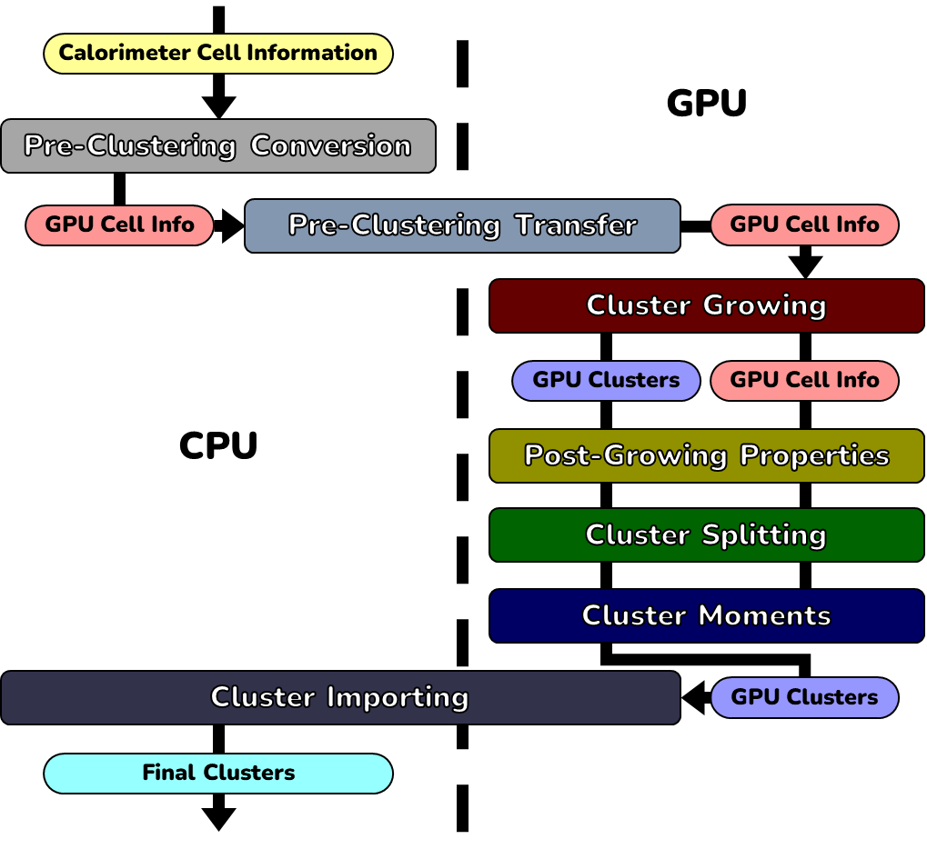
Topo-Automaton Clustering
Topological clustering is not accelerator-friendly: a different algorithmic approach is needed
Tags express the cluster assignment of the cells
Tag propagation rules to grow and split the clusters
Formally equivalent to a cellular automaton, hence Topo-Automaton Clustering
Fully implemented in the GPU using CUDA
100% agreement in cell assignment can be achieved between CPU and GPU, any reasons for differences if certain options are taken are fully understood
Basic cluster properties (e. g.: energy, η, φ) yield similar values (within floating point accuracy)
Some cluster moments have greater differences due to accumulated and compounded floating point errors
The data structures used in the CPU part of the code cannot be used directly in the GPU, so we need to convert between the two representations
Nuno dos Santos Fernandes
Accelerating the ATLAS Trigger System with Graphical Processing Units
8

Slide 9
Results

Slide 10
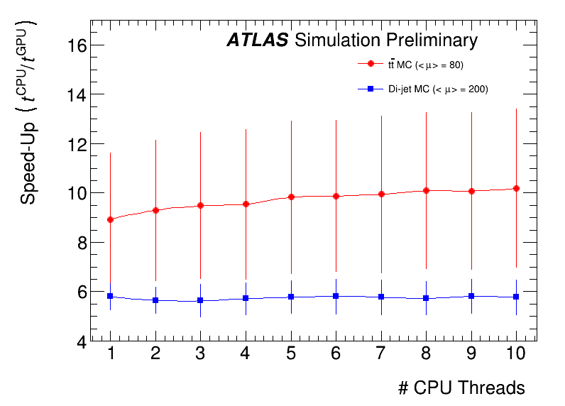
Speed-up from GPU Acceleration in Relation to the CPU Implementation
-
We currently achieve a speed-up of ~5.9 for di-jets, ~8.9 for tt, considering all data conversions and transfers.
The speed-up depends on the complexity of the event (number and size of the clusters), mostly due to CPU scaling.
Nuno dos Santos Fernandes
Accelerating the ATLAS Trigger System with Graphical Processing Units
10

Slide 11
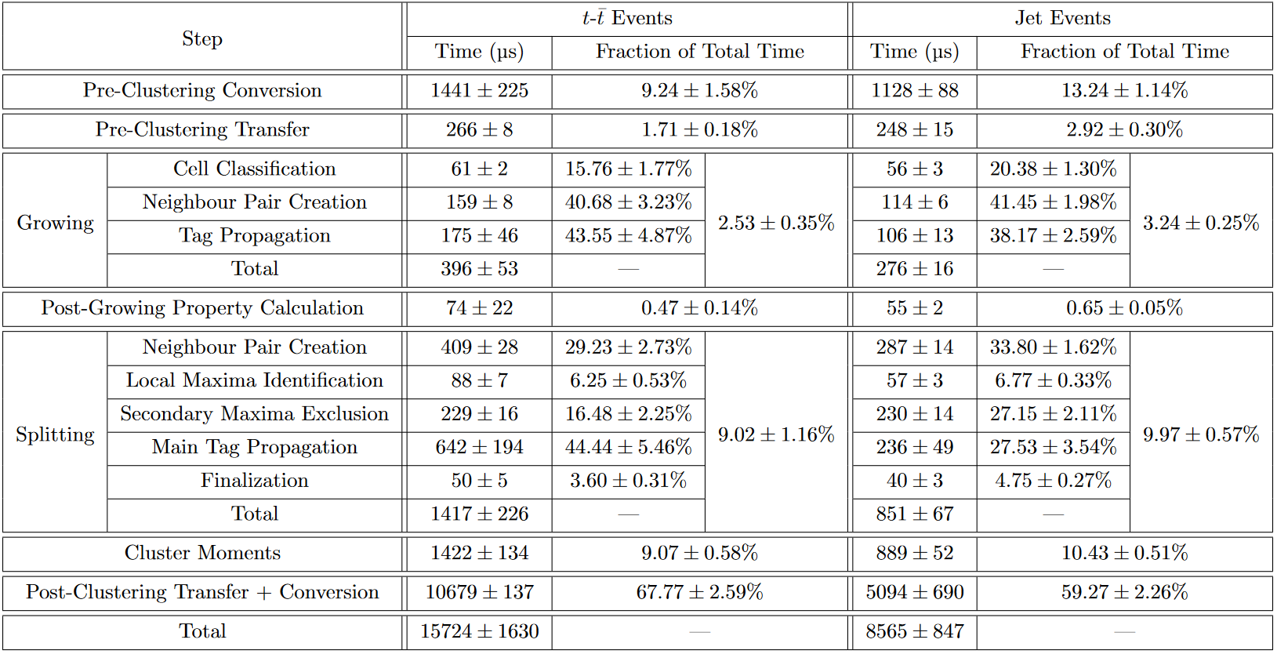
Breakdown of GPU Execution Times
Main bottleneck: converting the GPU data structures representing the clusters back to CPU-compatible structures
Nuno dos Santos Fernandes
Accelerating the ATLAS Trigger System with Graphical Processing Units
11

Slide 12
Summary and Future Efforts

Slide 13
Summary and Future Efforts
Topo-Automaton Clustering fully implemented and working, for cluster growing, cluster splitting and cluster moments calculation, with configurability on a par with the CPU implementation (essentially, drop-in replacement)
First completed prototype for ATLAS Phase II, well ahead of schedule
A very significant speed-up was found (factor of ~5.9 for di-jet events, ~8.9 for denser tt events)
A significant portion of the GPU event processing time (60~70%) is spent in data conversions
A general solution to mitigate the data structure conversion overhead is under development (Marionette)
Integration with the current implementation of Topo-Automaton Clustering to follow
At least a factor of 2 improvement on the current speed-up seems feasible
Lessons learned and experience gained from this development have fed back into general hardware acceleration-related development within ATLAS and in particular the ATLAS Trigger
Currently co-coordinator of HLT Calo, responsible for the calorimeter reconstruction in the High Level Trigger
A final decision on using this approach in the ATLAS Trigger depends on a general technical assessment of the feasibility and/or performance of GPU-accelerated algorithms, being scheduled for next year
The approach is also being considered for offline reconstruction on grid sites where GPUs are available
-
Nuno dos Santos Fernandes
Accelerating the ATLAS Trigger System with Graphical Processing Units
13

Slide 14
Thank you for your attention!

Slide 15
Backup Slides

Slide 16
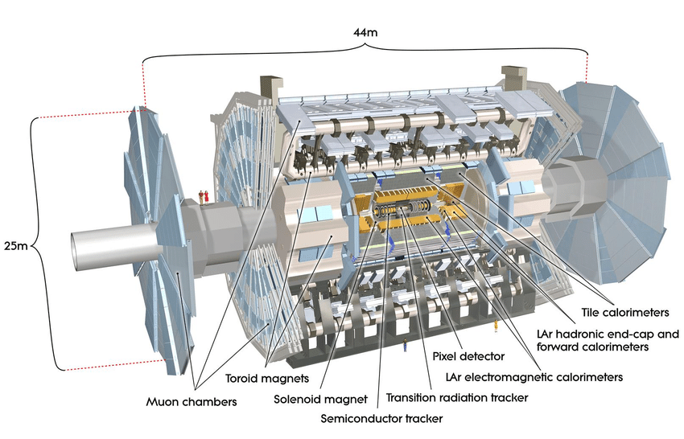
The ATLAS Experiment
A Toroidal LHC Apparatus
One of the two general-purpose detectors at the LHC
Three layers:
Inner Detector
Calorimeters
Muon Spectrometers
10⁸ electronic channels
187652 calorimeter cells with multiple gain paths to optimize resolution versus dynamic range of operation
Nuno dos Santos Fernandes
Accelerating the ATLAS Trigger System with Graphical Processing Units
16

Slide 17
Conditions of the Benchmarking
Samples correspond to two kinds of Monte-Carlo simulated events:
tt events: 3000 events, $μ=80$
di-jet events: 10000 events, $μ=200$
Results were obtained on a remote server provided by the Brookhaven National Laboratory: GPU is a Tesla P100, CPU is a Xeon E5-2695 v4
Time measurements were based on a per-thread clock
For a single thread, “any clock” would work
The CPU – GPU comparison is a bit lopsided, though…
For more threads, timing and speed-up are representative, but throughput is a best-case estimate
Essentially, we are assuming everything is always running in parallel
This is due to several limitations when trying to benchmark within the ATLAS software
-
Nuno dos Santos Fernandes
Accelerating the ATLAS Trigger System with Graphical Processing Units
17

Slide 18
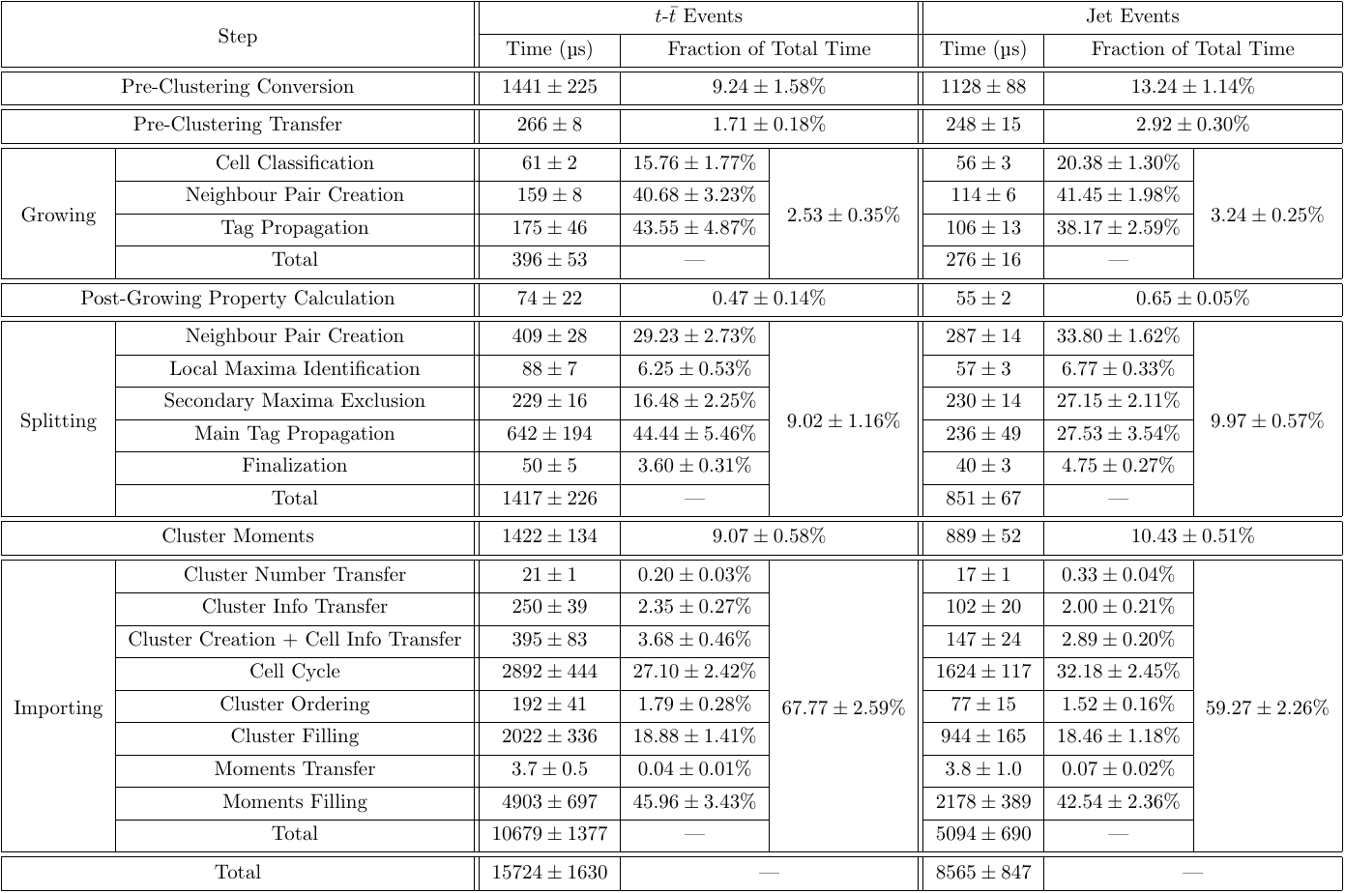
Breakdown of GPU Execution Times
Nuno dos Santos Fernandes
Accelerating the ATLAS Trigger System with Graphical Processing Units
18

Slide 19
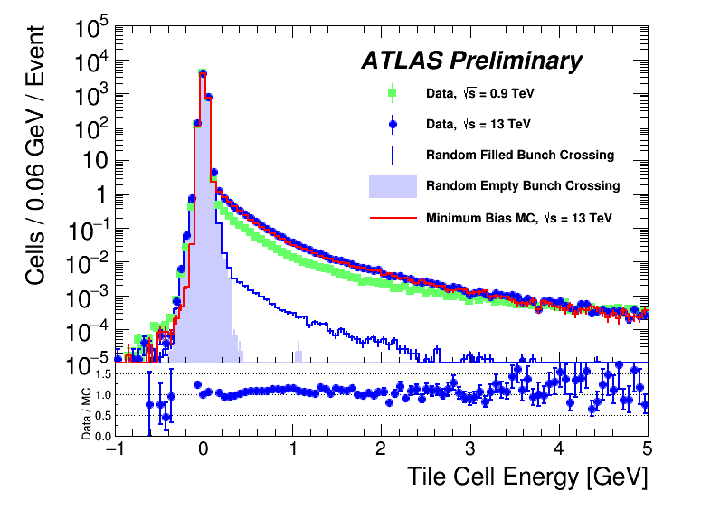
Calorimeter Reconstruction Algorithms
Showers deposit their energy in a finite region of space: a calorimeter cell
Calorimeter cells organized in up to 28 different sampling layers
Two main sources of noise: electronic read-out and pile-up
The noise estimate is typically a function of the gain of the cell
For the Tile calorimeter, the electronic noise can be estimated by a two-Gaussian model, which involves more sophisticated computations (inverse error function of error functions)
Reconstruction of showers generated by outgoing particles in the calorimeters of the ATLAS experiment
Nuno dos Santos Fernandes
Accelerating the ATLAS Trigger System with Graphical Processing Units
19

Slide 20
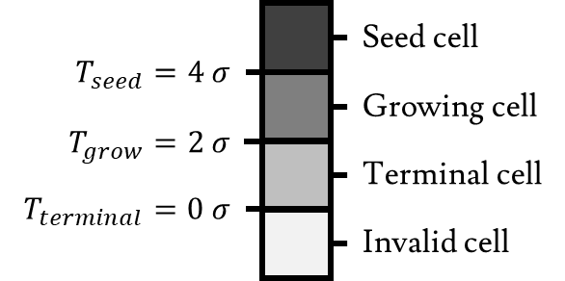
Topological Clustering
Two main algorithmic stages:
Cluster growing: iteratively assign cells to clusters based on the SNR (classify cells as seed, growing or terminal, clusters grow out from the seeds to their neighbouring cells in an order defined by the SNR of the seed, clusters are merged if they touch through growing cells)
Cluster splitting: split the clusters around local maxima of the energy to distinguish different objects travelling in the same direction (identify local maxima, exclude maxima from certain regions of the detector that overlap in certain directions to favour layers with greater radiation depth, start growing the clusters to neighbouring cells in an order defined by the energy of the cells, cells that can belong to more than one maximum are shared, shared cells grow clusters only in the end and are weighted based on the energy and distance to the centroid)
Nuno dos Santos Fernandes
Accelerating the ATLAS Trigger System with Graphical Processing Units
20

Slide 21
Limitations of Topological Clustering
Resizing a container is difficult to do in parallel, and it goes against the memory model of both GPUs and FPGAs
Topological Clustering involves keeping track of multiple lists¹ of cells, especially for cluster splitting
The clusters themselves are also expressed as lists¹ which must be resized as we add and remove cells
For a more parallel-friendly implementation, we can instead mark the cells that belong to each cluster with a “tag”
By constructing these tags appropriately, the sorting steps can be skipped entirely: floating point numbers that follow the IEEE-754 standard can be put in a “total ordering” where the bit patterns, interpreted as integers, are ordered in the same way as the original floating point numbers
By defining a set of rules for how these tags are propagated from a cell to its neighbours, one can replicate the entire behaviour of the iterative parts of cluster growing and cluster splitting while only considering each pair of neighbours independently from each other (potentially in parallel, as long as tag updates are thread-safe)
Since we have both a state for each cell and can specify the rules for how that state changes based on the neighbourhood, this is equivalent to a cellular automaton, hence Topo-Automaton Clustering
¹ – “List” is used here in the sense of an ordered collection of items; specifically, they correspond to dynamically allocated arrays, or “vectors” in C++.
Nuno dos Santos Fernandes
Accelerating the ATLAS Trigger System with Graphical Processing Units
21

Slide 22
Topo-Automaton Clustering
Cluster tags are 64-bit integers with specific structure:
The tags are propagated through pairs of neighbouring cells satisfying the conditions for clusters to expand
We handle each pair of cells in parallel, using appropriate atomic operations when needed
Additional logic (e. g. keeping a cell to cluster index table) reduces the number of iterations
All necessary temporary information stored in the same block of memory meant to hold the cluster moments (calculated only at the end), everything can be pre-allocated
Total per event memory footprint is ~80 MB
Cell geometry and neighbourhood relations also need to be stored: ~100 MB of constant information
Cluster growing tag structure
Cluster splitting tag structure
Nuno dos Santos Fernandes
Accelerating the ATLAS Trigger System with Graphical Processing Units
22

Slide 23
Topo-Automaton Cluster Growing – Anatomy of a Tag
High bit to distinguish valid tags from terminal and growing cells
Assumptions:
Less than $2^{16}=65536$ clusters
Less than $2^{12}$ propagation steps
Flag for preventing merges through seed cells (1 only in some edge cases with non-absolute value thresholds)
12 bit counter ($2^{12}−1−\#\text{propagations}$)
Signal-to-noise ratio in total ordering
Index of the seed cell
Nuno dos Santos Fernandes
Accelerating the ATLAS Trigger System with Graphical Processing Units
23

Slide 24
Topo-Automaton Cluster Splitting – Anatomy of a Tag
Primary maxima flag
Assumptions:
Less than $2^{16}=65536$ clusters
Less than $2^{12}$ propagation steps
Non-shared cells flag
12 bit counter ($2^{12}−1−\#\text{propagations}$)
Cell energy (all set for original clusters)
Index of the cell (or cluster index for original clusters)
Nuno dos Santos Fernandes
Accelerating the ATLAS Trigger System with Graphical Processing Units
24

