Slide 1
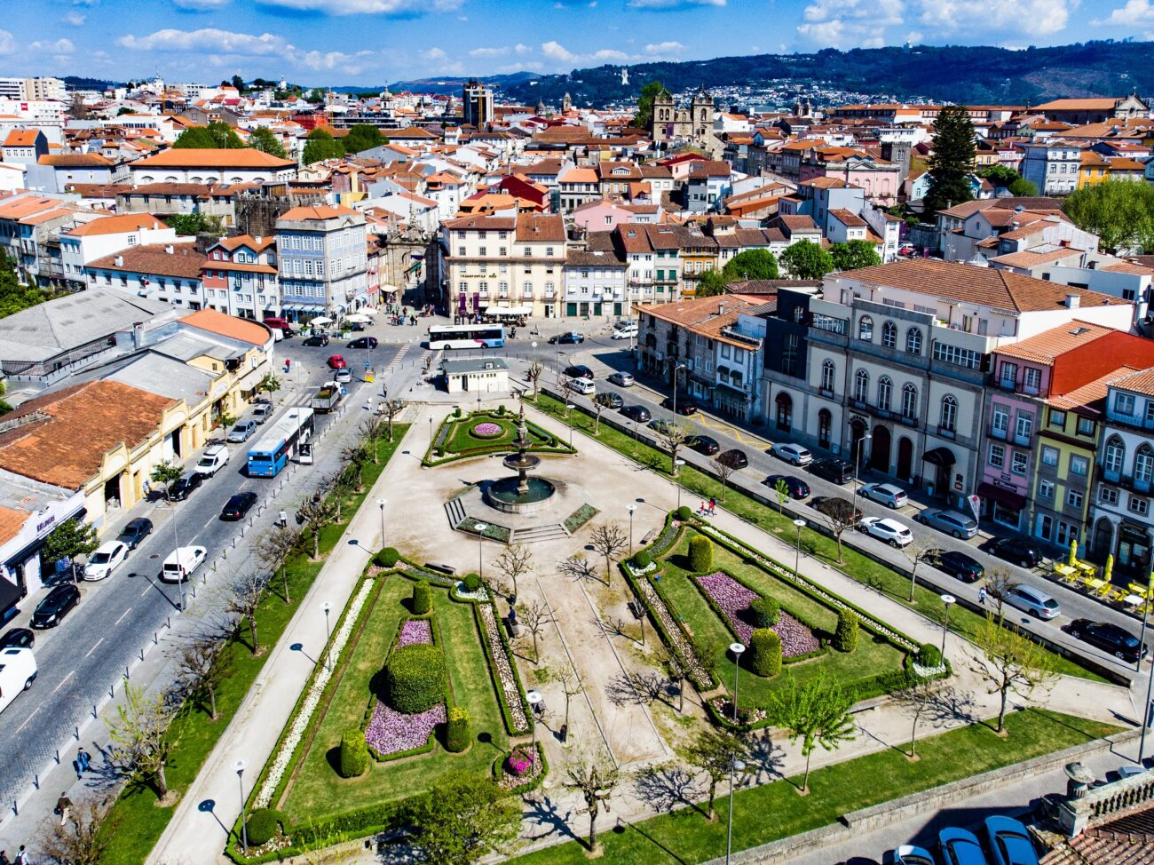
Towards precise in-medium parton-showers for jet production
Marco Leitão
Instituto Superior Técnico
LIP – Lisboa
Supervisors
Guilherme Milhano (LIP/IST)
Alba Soto Ontoso (U. Granada)
Gregory Soyez (IPhT-Saclay)
8th IDPASC/LIP PhD Students Workshop, Braga
16th October 2024

Slide 2
Quark-Gluon Plasma
State of matter in extreme conditions of temperatures and densities where quark and gluons (partons) are free/deconfined (colored medium)
g
c
d
d
Universe was in the Quark-Gluon Plasma phase in its first microsecond of existence
b
u
g
b
t
g
Can be studied using jets from Heavy-Ion collisions, where a droplet of the plasma is produced
c
1/6
Marco Leitão (LIP/IST)
8th IDPASC/LIP PhD Students Workshop, 16th October 2024

Slide 3
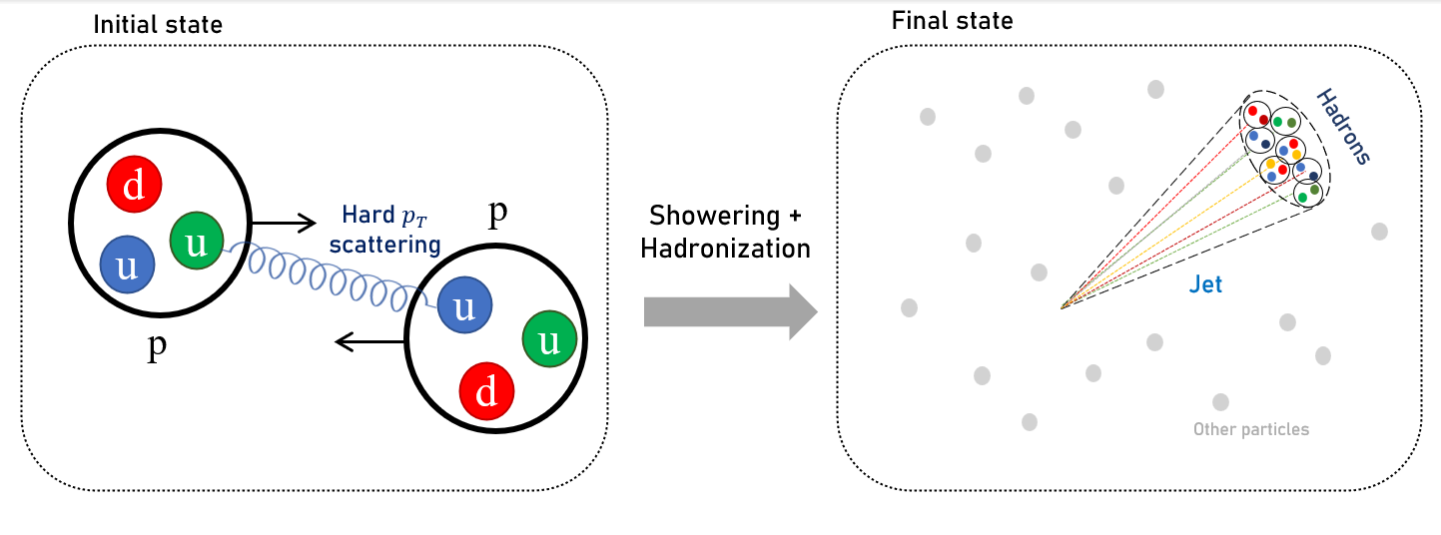
Jets
Jets: collimated spray of hadrons produced in many collisions (e.g. $e^{+}e^{−}$, pp and AA)
They occur when the transverse momentum of incident partons is high (hard particles)
(pp collision)
Proton-proton collisions
Heavy-Ion collisions
Jets evolve in the vacuum
Jets evolve in a dense medium: the Quark-Gluon Plasma
2/6
Marco Leitão (LIP/IST)
8th IDPASC/LIP PhD Students Workshop, 16th October 2024

Slide 4
Parton-Showers
Partons participating in a hard scattering are expected to undergo a parton-shower, followed by a hadronization process, producing a jet
Hadronization
Quark-Gluon Plasma medium influences the parton-shower component of the jet evolution
Parton
Current theoretical precisions:
Vacuum: NLL (PanScales, $e^{+}e^{−}$)
Medium: LL
Insufficient
Parton-Shower
Goal: Medium NLL for jet production
3/6
Marco Leitão (LIP/IST)
8th IDPASC/LIP PhD Students Workshop, 16th October 2024

Slide 5
Refining in-medium parton-showers
Development of NLL parton-showers in proton-proton collisions
Theoretical description of parton in-medium interactions
IPhT-Saclay
LIP
U. Granada
Currently here! ☺
In-medium Monte Carlo parton-shower for jet production
4/6
Marco Leitão (LIP/IST)
8th IDPASC/LIP PhD Students Workshop, 16th October 2024

Slide 6
Summary
Jet physics is a crucial tool to probe the primordial liquid: Quark-Gluon Plasma
Parton-showers are the intermediate process of jet production, and are affected by the presence of the medium
Current shower theoretical descriptions lack precision in order to keep up with the increasing precisions of the LHC and RHIC programmes
This work aims at refining in-medium parton-showers for jet production, addressing vacuum and medium dynamics separately and finally assembling these ingredients
5/6
Marco Leitão (LIP/IST)
8th IDPASC/LIP PhD Students Workshop, 16th October 2024

Slide 7
Thank you for your attention!
6/6
Marco Leitão (LIP/IST)
8th IDPASC/LIP PhD Students Workshop, 16th October 2024

