Slide 1
A couple of ideas for the future of LIP
Alessandro De Angelis
Università di Padova, INFN e INAF, LIP/IST Lisboa
Rappresentanza permanente d’Italia alle Organizzazioni Internazionali, Paris
LIP Lisboa, 2024
Lead Proposer: Alessandro De Angelis (Italy)
co-Lead Proposer: Vincent Tatischeff (France)
co-Lead Proposer: David Berge (Germany)

Slide 2
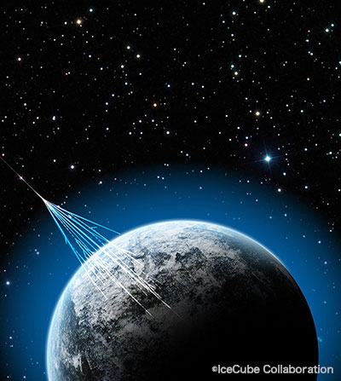
2012 – The Higgs boson was found (where it had been calculated to be)
We cannot avoid being amazed by the power of experimental physics, and by the mysterious power of mathematics – the ability of equations written on pieces of paper to predict previously unknown aspects of nature, and to be, as Paul Dirac said, more intelligent than their creators

Slide 3
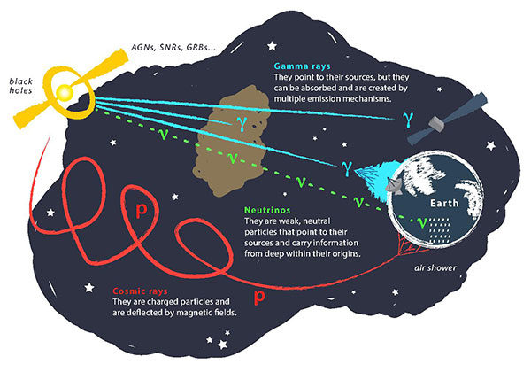
The XX century has seen the development of multi-wavelength astrophysics, up to gamma rays, the border between the wave-like and the particle-like nature of matter
In the XXI century, we detected new cosmic messengers (cosmic rays and gravitational waves) coming from astronomical objects. Through this “multi-messenger astronomy” one can understand new fundamental aspects of the production of radiation
Charged
Multi-messenger astrophysics uses photons in various wavelengths (gamma rays in particular) and non-photon signals such as cosmic rays (nuclei, neutrinos…) and gravitational waves for fundamental physics & astronomy

Slide 4
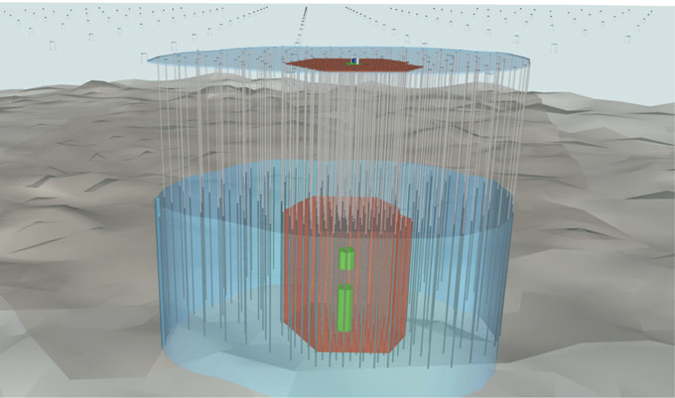
2007: First correlation of cosmic rays with active galaxies (Auger)
2013: First evidence of cosmic neutrinos (IceCube)
2015: First gravitational wave (LIGO)
2017: First simultaneous observation of GW/gamma (LIGO-Virgo/Fermi)
2017: First simultaneous observation of neutrino/gamma (IceCube/Fermi+Magic)
2023: First neutrino clusters (IceCube)
Gammas, neutrinos and GW are the key for the next ~10 years
Key 1:
Multimessenger Astrophysics

Slide 5
Key 2: nonaccelerator experiments
for fundamental physics
Underground detectors, large or small
Maintaining the know-how on hardware: physics is an experimental science, and hardware can be the key for discoveries (even in a table-top setup)

Slide 6
The discovery of the Higgs boson, which was believed to be the last piece of the puzzle of physics, was the glorious confirmation of the standard model
Leaving this discovery behind them, we have entered a sea for which they do not have a map. We know that the standard model is not the definitive theory of nature (it does not explain, for example, the invisible "dark matter" that dominates the universe), and this time we are navigating by sight in an open and unknown ocean. The next island may be so far away that we will never discover it
It's a little scary, particularly for funding agencies, but Portugal has a long tradition into this sector
Two recipes: large instruments and large international collaborations, but also caravelas!

