Slide 1
Observing and measuring the first lhc neutrinos
Claudia Puertas González
SND@LHC

Slide 2
MAIN IDEAS
NEUTRINOS PROPERTIES:
Low mass
No charge
Weak nuclear force
DIFFICULT TO DETECT
HOW CAN WE BE ABLE TO DETECT THEM?
High neutrino energy
High luminosity
THERE WILL BE A LOT OF NEUTRINOS AND ALSO THE NUMBER OF THEIR INTERACTIONS WILL INCREASE
Place the detector far away from where the pp collisions take place (= far from ATLAS)

Slide 3
MAIN IDEAS
SIGNAL
Muon neutrinos ☺
BACKGROUND
Neutrons and neutral kaons ☹
How can we differentiate between neutrinos and background?

Slide 4
Steps of the project
OBJETIVE:
IS THERE SOME SPECIAL FEATURE THAT ALLOWS US TO DISTINGUISH BETWEEN SIGNAL AND BACKGROUND??
STEPS:
Represent data -> HISTOGRAMS
Study the sensitivity of the experiment to observe signal
Try different event selections

Slide 5
SIMULATED DATA
TYPE OF DATA
pdg |  |  | nhits_sf | qdc_us | nhits_ds | weight
The PDG code of the particle: |  |  | The number of hits in the SciFi detector | The total charge measured in the upstream part of the hadron calorimeter/muon system | The number of hits in the downstream part of the hadron calorimeter/muon system | The weight to be applied to each event
14 | 2112 | 130
Muon neutrino | Neutron | Neutral Kaon
SciFi
US
DS

Slide 6
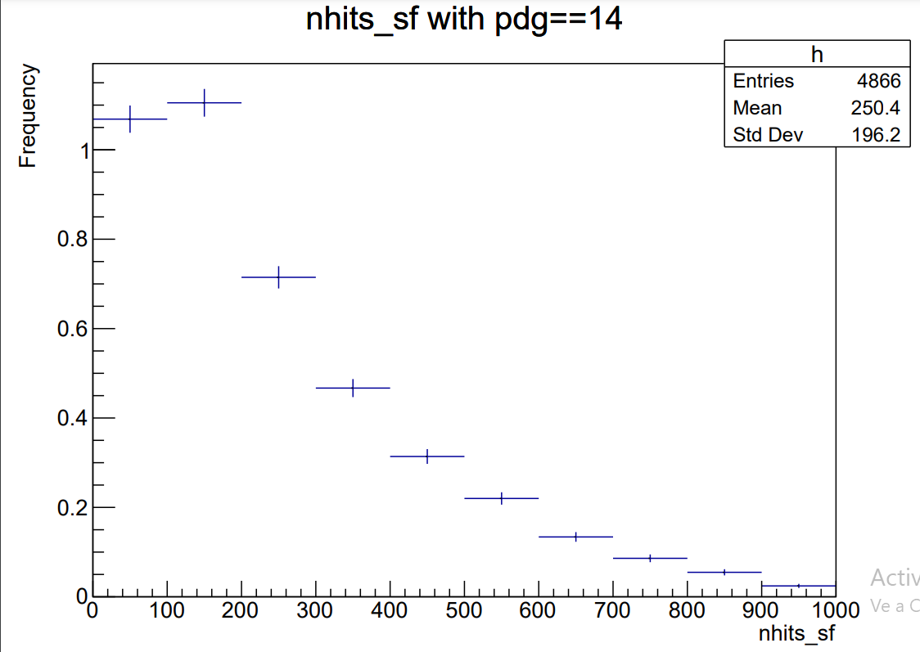
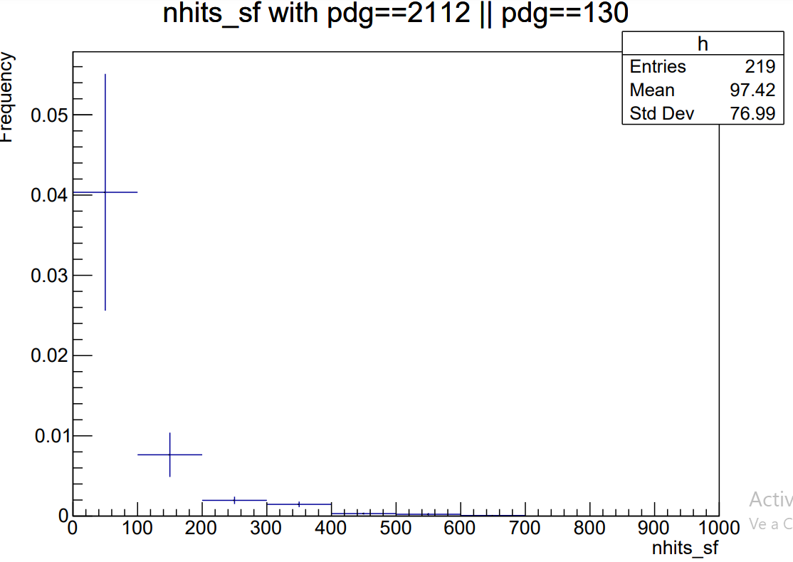
NUMBER OF HITS IN THE SCIFI DETECTOR
Signal:
Number of events: 4.18847
Background:
Number of events: 0.05

Slide 7
SENSITIVITY OF THE DETECTOR
Initial event selections
EVENT SELECTIONS
nhits_sf | qdc_us | nhits_ds
>=35 | >=700 | <=10
Sensitivity of the experiment: 2.925e-07 -> p-value
Monte Carlo Method + Poisson Distribution

Slide 8
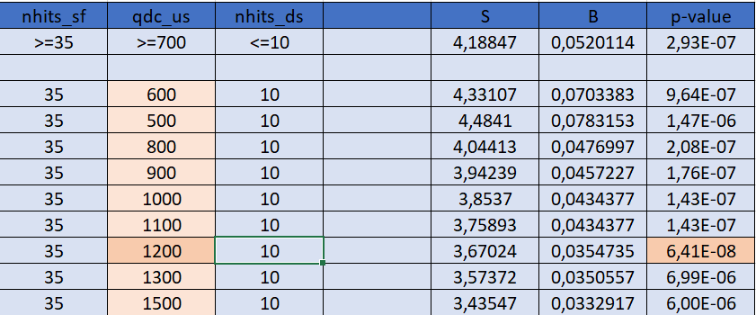
Changing Event selection -> qdc_us
MAKES SENSE: bigger qdc_us -> neutrinos

Slide 9
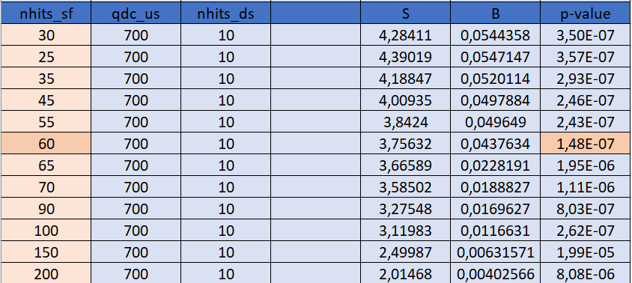
Changing Event selection -> nhits_sf
The p-value does not change too much below 35 because there is no data with that condition

Slide 10
Changing Event selection -> nhits_ds
The p-value does not change too much if we increase the number of nhits_ds

Slide 11
Combined selection
THE P-VALUE OBTAINED IS LARGER THAN WITH THE NOMINAL SELECTION (DEGRADED SENSITIVITY)
This may be due to possible correlations amongst the variables

Slide 12
SUMMARY
SND@LHC is a new detector: study neutrinos at LHC for 1º time
We learn about neutrinos and how they can be detected
SELECTION VARIATION STUDIES:
Try to improve the separation between signal and background
IMPROVEMENTS:
Can modify procedure to account for variable correlations

Slide 13
NEXT STEPS
GOAL:
Optimise data selection
Use additional discriminating variables
Explore machine learning tools

Slide 14
THANK YOU FOR YOUR TIME!
Claudia Puertas González

