Slide 1
Data Science Challenge
Fernando de Souza

Slide 2
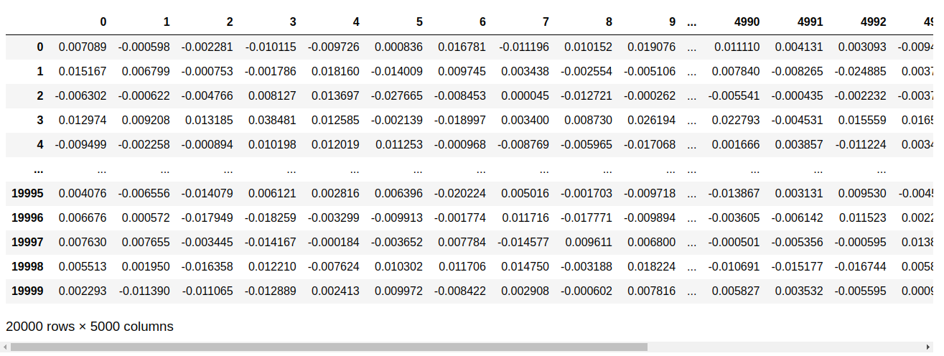
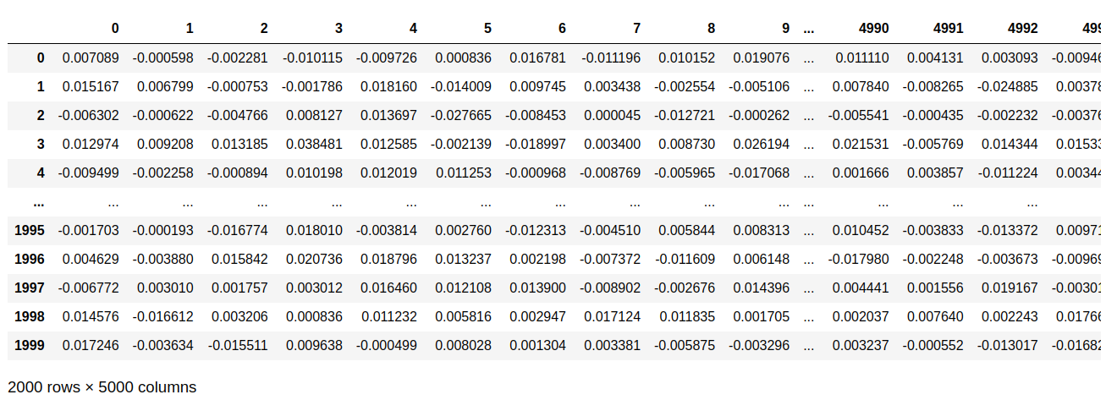
Getting the data
input_2x_S2.txt : 2 peaks waveforms input_2x_S2.txt: 1 peak waveform

Slide 3
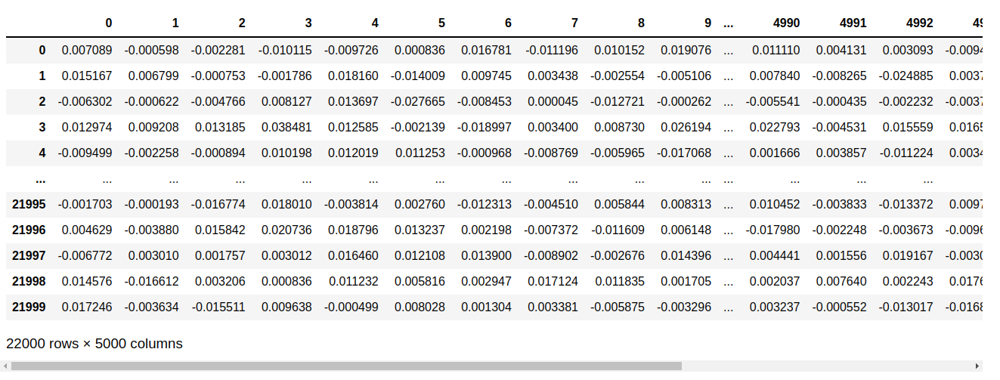
Getting the data
Joining the datasets for training

Slide 4
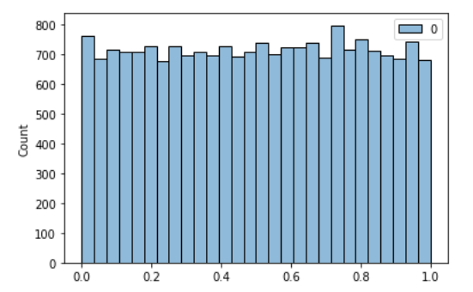
Getting the data

Slide 5
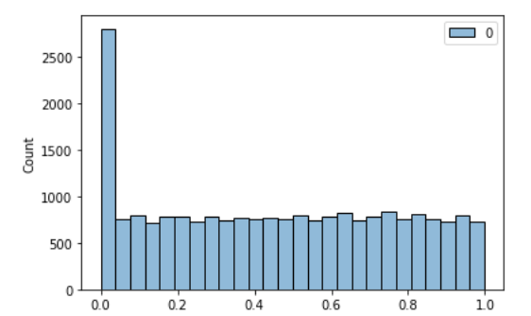
Getting the data

Slide 6
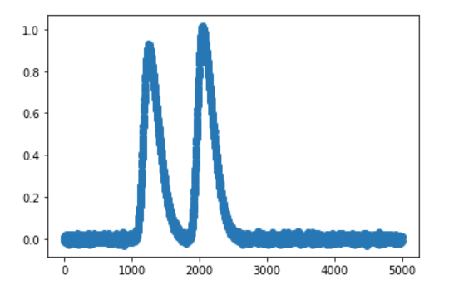
Getting the data

Slide 7
Splitting the full dataset

Slide 8
Training

Slide 9
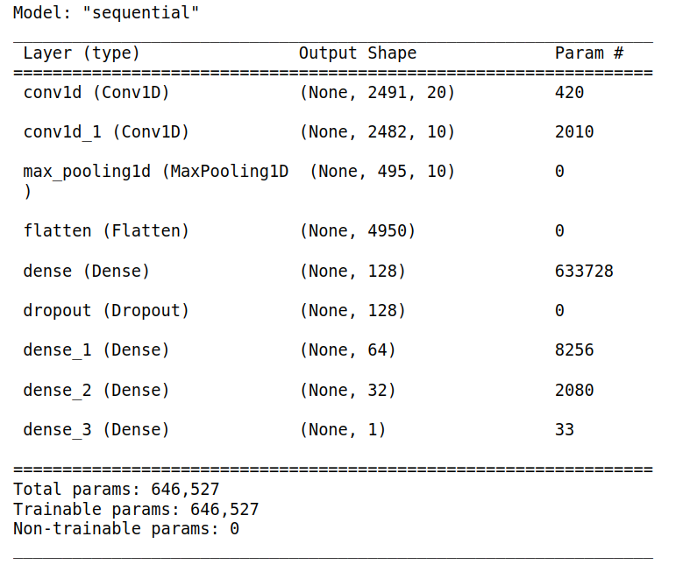
Training

Slide 10
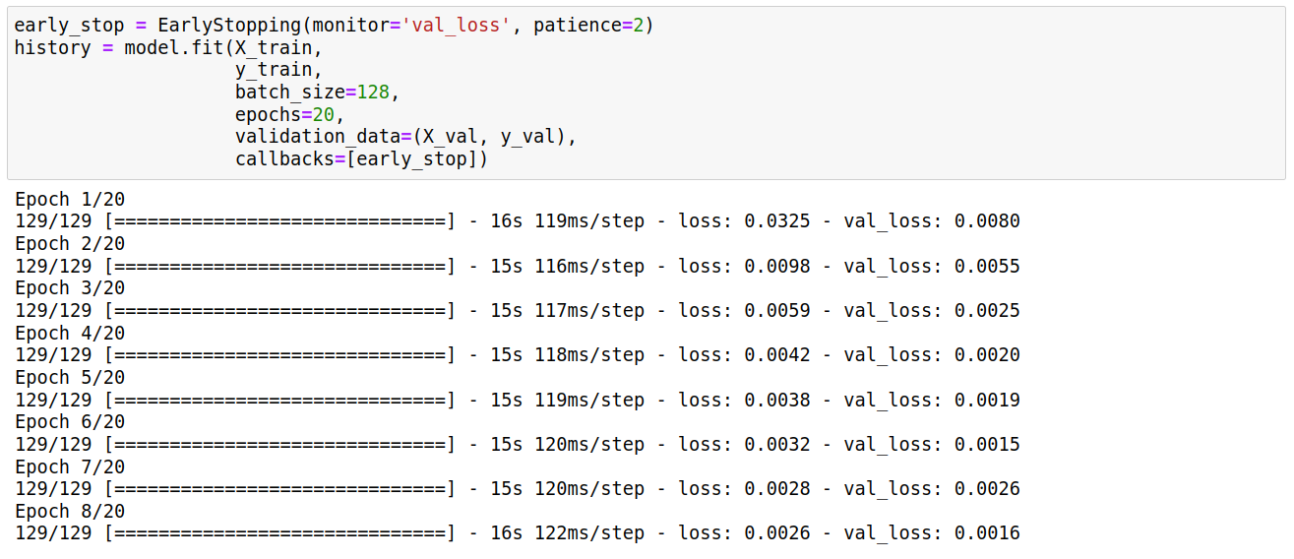
Training

Slide 11
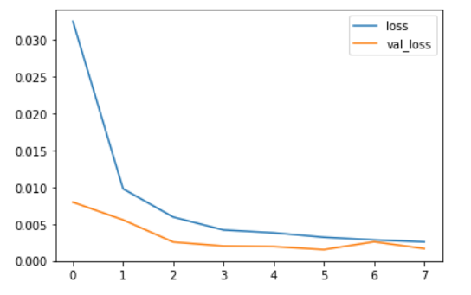
Training

Slide 12
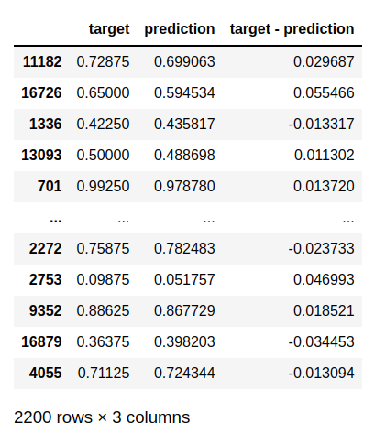
Results

Slide 13
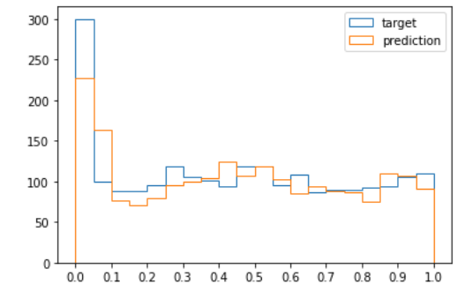
Results

