Slide 1
EOSC Projects: INFRAEOSC-07 projects
&
EGI Advanced Computing for EOSC (EGI-ACE)
Gergely Sipos
Head of Services, Solutions, Support @ EGI Foundation
EGI-ACE Project Technical Coordinator
IBERGRID 2022, Faro, 10-10-2022

Slide 2
EOSC Capacity Building projects (INFRAEOSC-07)
Distributed Computing Services
Collaboration agreement signed on 15/Oct/21:
Technical Activities
Architecture & Technical Interoperability
Service Provisioning
Technical Support
Uptake
Joint promotion
Joint events
Training
Joint EOSC training
Co-development of training materials
Research Lifecycle Management for Copernicus users
Data discovery, storage, deposition, bit preservation
EOSC-A Task Forces
Copernicus EOSC data analytics engine
Open scholarly communicationservices

Slide 3
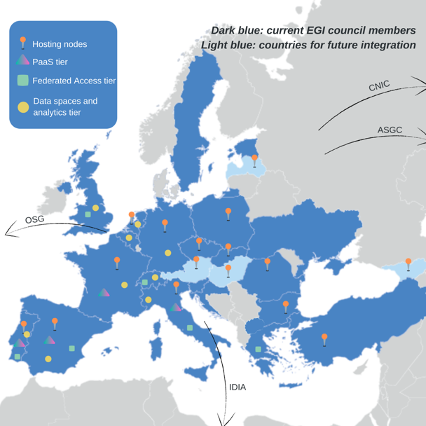
EGI-ACE facts
Consortium:
33 Partners, 23 third parties
EGI council members + RIs (~ERICs)
Scope:
49% service delivery (Virtual Access)
Co-development of ‘thematic services’
Duration:
Jan 2021 - June 2023 (30 months)
Partners from IBERGRID:
CSIC: Cloud Compute, DEEP ML/AI services
INCD & LIP: Cloud compute service
LNEC: OPENCoastS_PLUS service

Slide 4
Services for compute-intensive open science
Data Spaces
and Analytics
Data and thematic data analytics and processing tools
Thematic application services (VREs, data spaces, analytics engines, etc.)
Green Deal
Health
Fundamental Science
Humanities
Scientific
users
Platforms
generic added-value platform level services
Platform services
Interactive Computing
Automated Cluster deployment
Distributed AI training
Workload Management
Service Management, Tools, Processes, Policies
Federated
Access
Federation-wide management of data and computing
Federated Compute
Federated Identity
Federated Data
Expert
users
Federated
Resources
Compute and storage facilities
Infrastructure services
Research Clouds
Public Clouds
HTC
HPC
Accounting, Monitoring, Helpdesk, Security oversight, etc. - Integrated to EOSC Core
New! HPC Integration Blueprint: https://zenodo.org/record/6968509#.Yv9NZHYzaBI

Slide 5
Sustainable Open Science environments
EOSC USERS
Business-to-User
Business-to-Business
EOSC Portal
EGI-ACE Open Call
Ready-to-use resources/services
Self-service configuration
Short term engagement
High capacity demand
Custom configurations
Long term engagement
https://marketplace.eosc-portal.eu/
https://www.egi.eu/egi-ace-open-call/
Serving with the use of...
Continuously open, Cut-off dates every 2 months
Cloud integration programme: https://go.egi.eu/intl-cloud-integration
Local funds
(institutional/national investments)
Customer ‘pay-for-use’
EC Virtual Access funds
Budgeted in total: 80 million CPUhours
250,000 GPUhours
20 PB storage
Over 50 million CPUhours delivered so far (!)

Slide 6
Our vision for computing in EOSC
International research infrastructures and projects
…
Service Level Agreement
Resource brokering and access support
Aligned science and compute priorities
Technical federation
Identity portability + Data portability + Application portability
Operation Level Agreement
National and international compute infrastructures

Slide 8
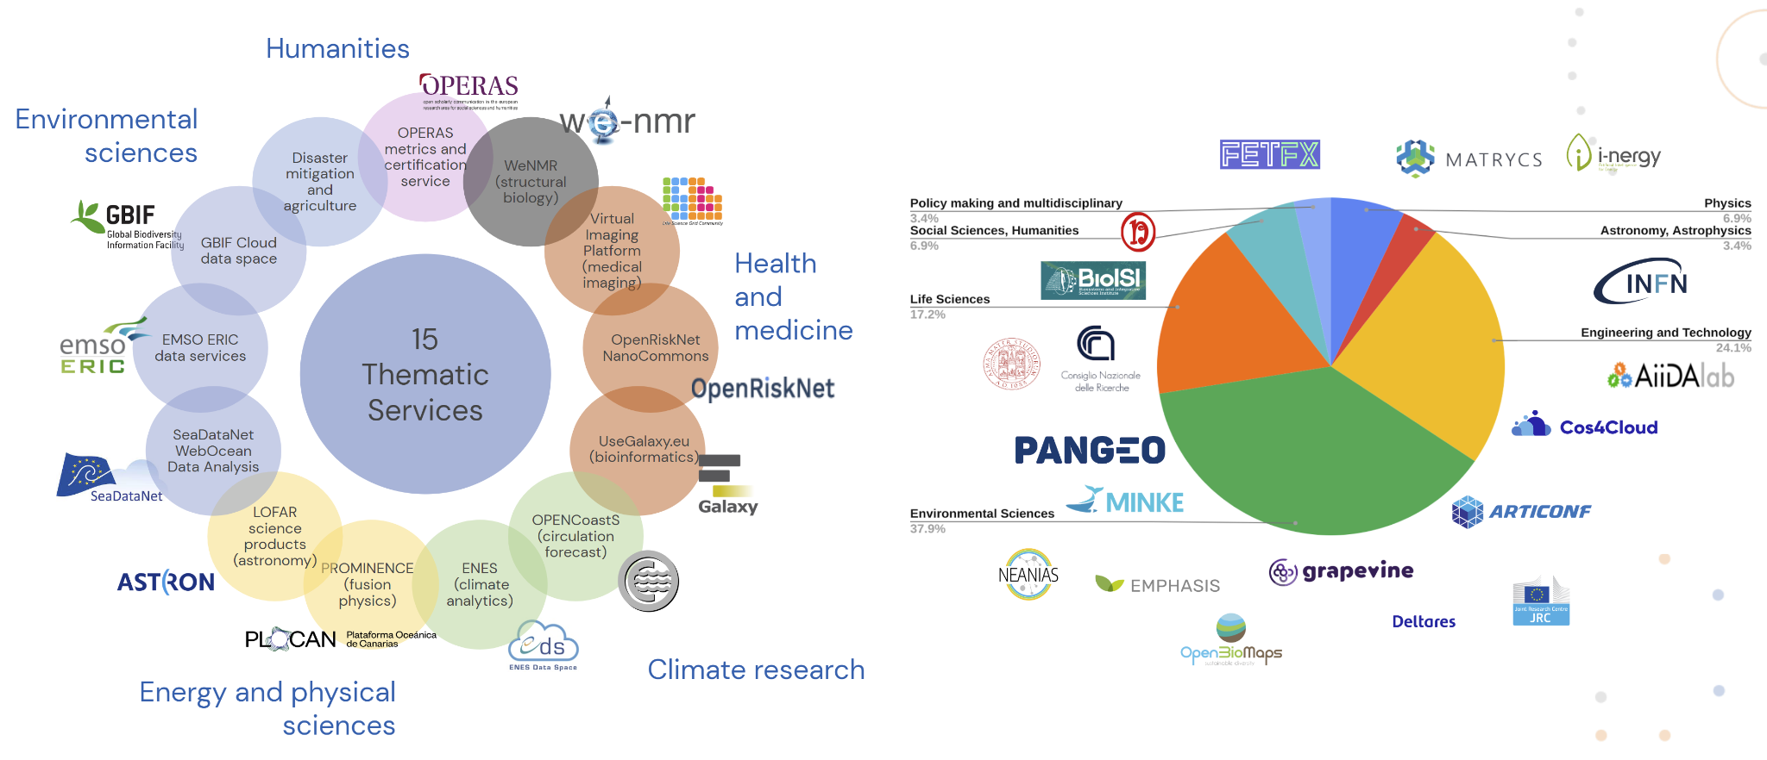
Thematic applications and application services
In the consortium
External users

Slide 9
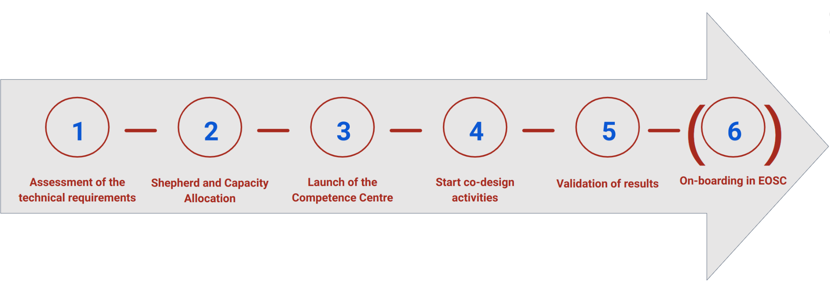
Scalable, distributed user support
Intense support period
Open Call
Shepherds and Competence Centres
Scalable and distributed structure
Brings the right expertise for each use case
Service and resource providers
Technical experts, and
Observer parties

