Slide 1
EOSC Implementation Task Forces
EOSC Spain Portugal Tripartite Event - Faro
IBERGRID 2022 - Universidade do Algarve
Researchers Engagement and Adoption

Slide 2
AG Implementation of EOSC
TFs objectives
TF PID Policy and Implementation (Chairs: Themis Zamani, GRNET; Tibor Kálmán, GWDG)
Monitor and provide community feedback on the implementation of the EOSC PID Policy and Architecture.
Make recommendations to the EC for the integration of PID services in the EOSC ecosystem, its implementation and test.
Provide input to the SRIA starting from the gaps identified in the PID in SRIA v 0.9
TF Researcher Engagement and Adoption (Franzisca de Jong, Kathrin Winkler, Sverker Holmgren)
Suggest measures to increase the participation of research communities and research performing organisations from all European regions in EOSC as well as Associated Countries.
Identify the research communities needs and requirements for research and research environments.
Ensure balanced involvement and representation for the (inter)disciplinary and domain perspective(s) on the one hand and the (inter)national and institutional perspective(s) on the other hand.
TF Rules of Participation Compliance Monitoring (Chairs: Roksana Wilk, Cyfronet)
To ensure that the entry requirements of EOSC bridge from the principles expressed in the current high-level EOSC RoP to more practical criteria for implementation in EOSC.
To define at what level RoP and other entry requirements can be reasonably monitored, and set in place a framework to enable such monitoring
To draw in community involvement in the setting of RoP and other entry requirements from the EOSC community.
To establish a durable structure that can take on the ongoing activities and continue them after the task force concludes, through an RoP Board as proposed by the Working Group on Rules of Participation.
PID Policy and Implementation
Researchers Engagement and Adoption
Rules of Participation compliance monitoring

Slide 3
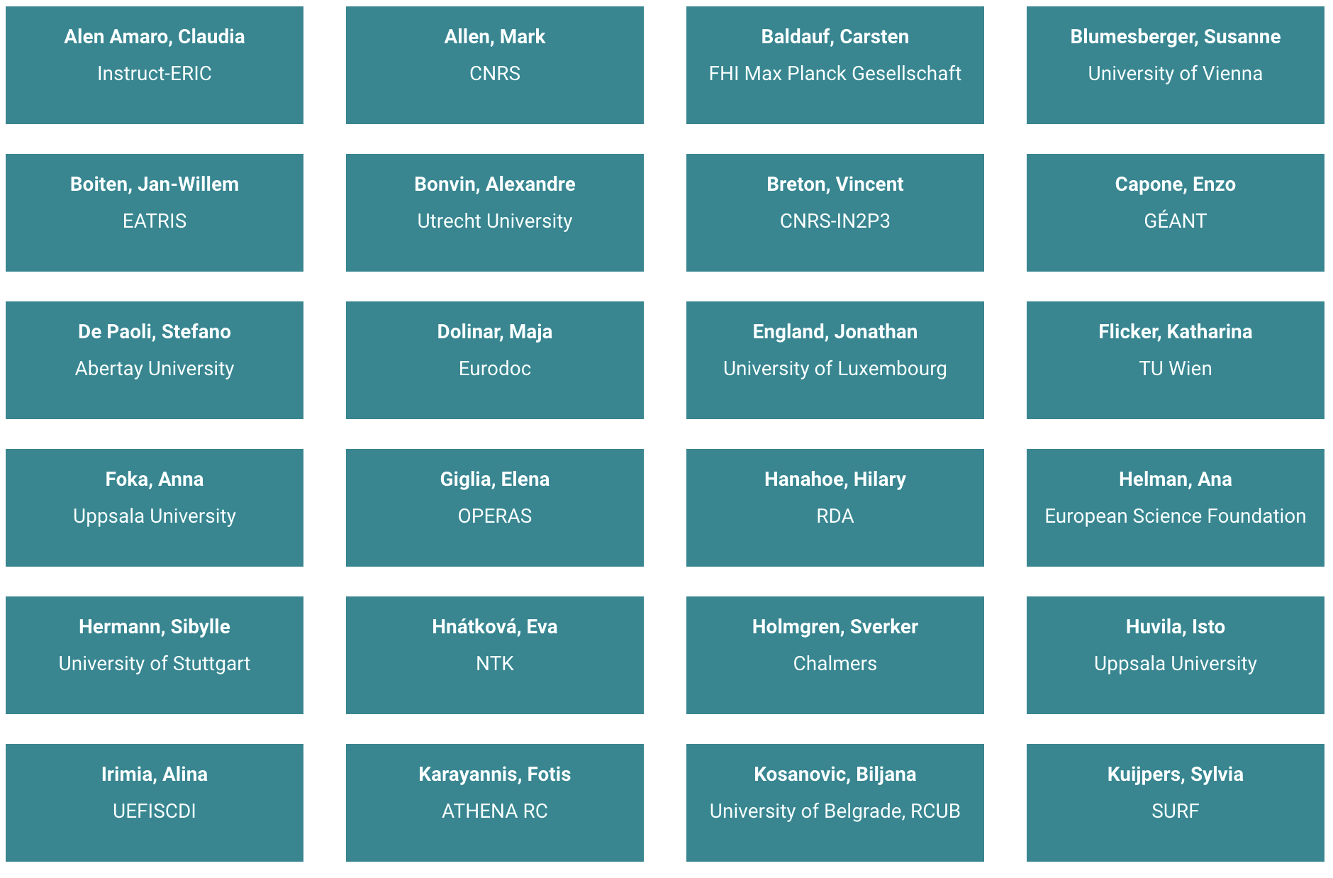
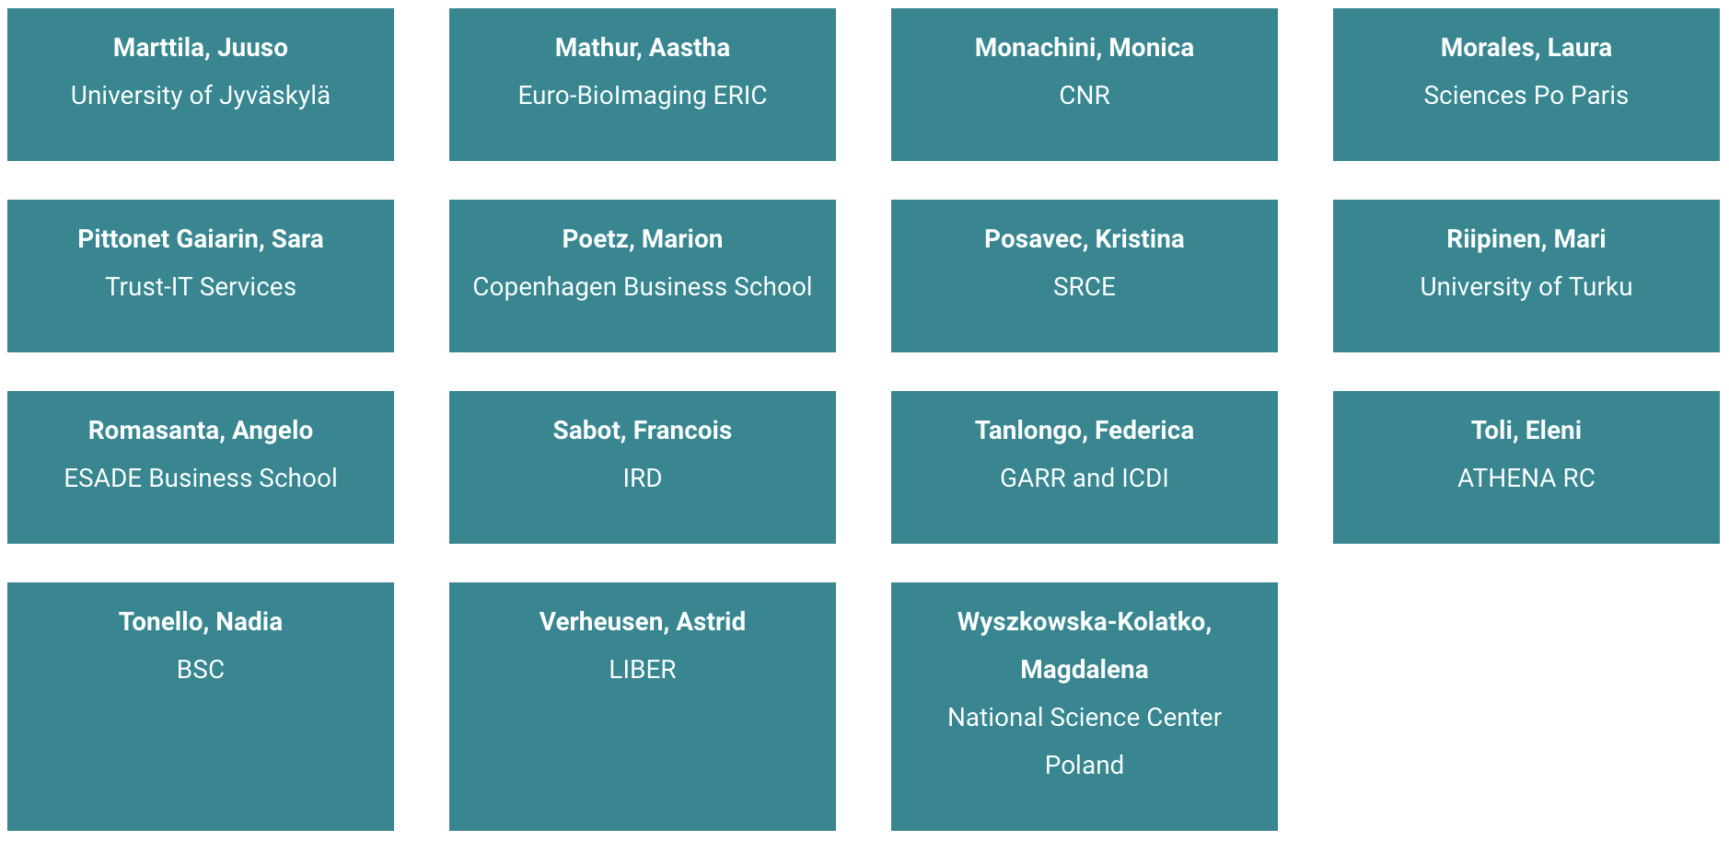
Researchers Engagement and Adoption - TF REA
https://www.eosc.eu/advisory-groups/researcher-engagement-adoption
focused on engaging diverse research communities in order to increase their participation in EOSC.
Co-Chairs
Franzisca de Jong, CLARIN ERIC
Kathrin Winkler, German Research Foundation (DFG)
Sverker Holmgren, Chalmers University of Technology
Board liaison
Suzanne Dumouchel
Sara Garavelli

Slide 4
Charter
Identify the research communities needs and requirements for research and research environments.
Suggest measures to increase the participation of research communities and research performing organisations from all European regions in EOSC as well as Associated Countries.
Ensure that EOSC services will be of actual use to the research community end-users by making sure that researchers can take ownership and an active role in shaping and furthering EOSC.
Support the engagement of researchers and their communities with EOSC so that their feedback, needs and requirements for research and research environments are integrated into the development of EOSC.
Explain the value proposition of the EOSC to research communities
Identify suitable channels for the communication with EOSC-A

Slide 5
Charter
Ensure the balanced involvement between different perspectives:
National perspectives: engage research performing institutions and national (Open Science) initiatives in order to bundle national strategies on researcher engagement and bring those to the European setting; synchronise the discussion on EOSC at the national level.
European/International perspectives: leverage international initiatives aimed at coordinating activities for Open Science and Open Research commons leverage on the RDA Open Calls for EOSC to support this.
Institutional/Disciplinary perspectives: use should be made of what has already been made available through ESFRIs, the existing science clusters and other thematic service providers. Underrepresented research communities should be targeted, engaged and supported.

Slide 6
Work Plan
Organization in SubGroups
 | Q2 - 2022 | Q3 -2022 | Q4 - 2022 | Q1 - 2023 | Q2 - 2023
All TF REA |  | Work plan
Institutional perspective Susanne Blumesberger Sibylle Hermann |  |  | Collection and report of requirements of researchers | Recommendations on training and material to share with: TF UC, Skills4EOSC, … Clustering of the individual questions | Workshop with members of university networks ( EUA, LERU, CESAER) to expand the collection of questions from the universities.
National perspective Federica Tanlongo Nadia Tonello | Definition and collection of -national structures - success stories |  | Collection and publication of success stories, to inspire and quicken the engagement and adoption in different National contexts
European perspective Eva Hnatkova Maja Dolinar | Preliminary landscape analysis of various stakeholders at European level. | Categorization and profiles of various stakeholders at European level. | Map of various stakeholders at European level | Analyze how to reach the stakeholders, identify best channels for communication | Provide recommendations on how to engage with stakeholders

Slide 7
Work Plan
SubGroup: Institutional Perspective
 | Q2 - 2022 | Q3 -2022 | Q4 - 2022 | Q1 - 2023 | Q2 - 2023
All TF REA |  | Work plan
Institutional perspective Susanne Blumesberger Sibylle Hermann |  |  | Collection and report of requirements of researchers | Recommendations on training and material to share with: TF UC, Skills4EOSC, … Cluster the individual questions according to discipline/country/… | Workshop with members of university networks ( EUA, LERU, CESAER) to expand the collection of questions from the universities.

Slide 8
Work Plan
SubGroup: National Perspective
 | Q2 - 2022 | Q3 -2022 | Q4 - 2022 | Q1 - 2023 | Q2 - 2023
All TF REA |  | Work plan
National perspective Federica Tanlongo Nadia TonelloF | Definition and collection of - national structures - success stories Templates and vocabulary to homogenize the description collecting relevant information. |  | Collection and publication of success stories, to inspire and quicken the engagement and adoption in different National contexts

Slide 9
Work Plan
SubGroup: European Perspective
 | Q2 - 2022 | Q3 -2022 | Q4 - 2022 | Q1 - 2023 | Q2 - 2023
All TF REA |  | Work plan
European perspective Eva Hnatkova Maja Dolinar | Preliminary landscape analysis of various stakeholders at European level. | Categorization and profiles of various stakeholders at European level. | Map of various stakeholders at European level | Analyze how to reach the stakeholders, identify best channels for communication | Provide recommendations on how to engage with stakeholders

Slide 10
Connection and alignment
Overlaps and potential synergies with projects, initiatives and research communities
Relevant projects such as: ○ EOSC-Future (April 2021-September 2023) ○ EOSC Enhance: https://eosc-portal.eu/enhance (until November 2021) ○ All INFRAEOSC-5 projects ○ INFRAEOSC cluster projects (ongoing into 2022) :https://www.eosc-hub.eu/eosc-hub-and-esfri-cluster-projects
Regional, national and institutional initiatives such as: ○ Open Science initiatives ○ Rector ́s conferences ○ RDA National Nodes
Research Infrastructures cluster and network organisations such as: ○ ERIC Forum ○ RDA communities of practice and discipline / domain-specific working and interest groups

Slide 11
Connection and alignment
Overlaps and potential synergies with other Task Forces
Communication with other TFs is crucial
TF Upskilling Countries to Engaging EOSC alignment, to avoid double work
EOSC-A Board liaison: very valuable job done by the, to guarantee alignment
EOSC Focus - support in meetings and collaboration for deliverables
EOSC-A Contibution to the national pages of eosc.eu and its sustainability: https://eosc.eu/tripartite-collaboration/[spain;portugal]

Slide 12
Thank you

