Slide 1
EOSC-SB
Inmaculada Figueroa
Subdirectorate of Internationalization of Science and Innovation
Ministry of Science and Innovation

Slide 2
Outline
The EOSC Steering Board
Mandate and Structure
Working Groups
Recent documents

Slide 3
The EOSC Steering Board
An expert group of the European Commission Proposed in 2020 by the EOSC Governance Board
Stated that MS/AC and EEA EFTA and the Commission should maintain a high-level strategic steering role for the EOSC implementation.
https://ec.europa.eu/transparency/expert-groups-register/screen/expert-groups/consult?lang=en&groupID=3756
Supporting the CNECT - DG Communications Networks, Content and Technology.
Created to represent the governmental institutions involved in the building of the EOSC.
Renewed for two years in 2021.
Highly active board
50 meetings since its foundation in 11/03/2021.

Slide 4
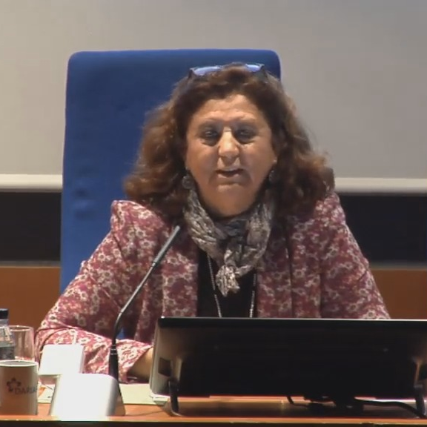
Members
Chaired by the European Commission (Thomas Neidenmark) and one member state representative (Volker Beckmann, FR)
One/Two Representatives per Member Country.
With the EOSC-A as an Observer.
Inmaculada Figueroa Rojas (ES)
João Nuno Ferreira (PT)

Slide 5
Mandate and Structure
Provide strategic advice, align national policies and cooperate with the rest of the partners to coordinate and federate efforts and investments.
Advise strategically the Commission on the EU policy for research data infrastructure and services, especially in view of the Commission’s role in the EOSC governance, and on how to better align EU and national policy developments and investments with the EOSC objectives.
Complementary to the oversight of progress by the European Partnership towards its strategic and operational objectives provided through the EOSC Partnership Board.

Slide 6
Mandate and Structure
Tasks of the Expert Group
1) Support the strategic coordination and foster convergence between the Commission, MS and AC on questions relating to the implementation of Union legislation, programmes and policies related to Open Science and EOSC.
2) Exchange experience and best practice, and consult on national strategies, plans and investments relating to digital research outputs and associated infrastructures.
3) Elaborate and propose joint positions on issues of EU and national interest pertaining to research data.
4) Review and form positions on main strategic documents developed in the context of the EOSC Partnership and communicate positions in the EOSC Partnership Board.

Slide 7
Working Groups & Policy Papers
The EOSC-SB has structured into three subgroups
Subgroup A: National Contributions to EOSC
The aim is to monitor national contributions to EOSC outside EOSC-A members as well as related policy development and financial or in-kind contributions.
Subgroup B: EOSC-SB beyond 2021
The objective is to propose a format and structure of the EOSC-SB for the following annuities.
Subgroup C: Initiatives with commercial orientation.
Focusing on analysing the impact of for profit institutions in the EOSC ecosystem.
The EOSC-SB has in its meeting on 6 April identified three policy issues of priority to be addressed:
EOSC-SB Opinion Paper: 1 EOSC and data literacy.
EOSC-SB Opinion Paper 2: EOSC and the commercial partners.
EOSC-SB Opinion Paper 3: FAIR data sovereignty in EOSC.

Slide 8
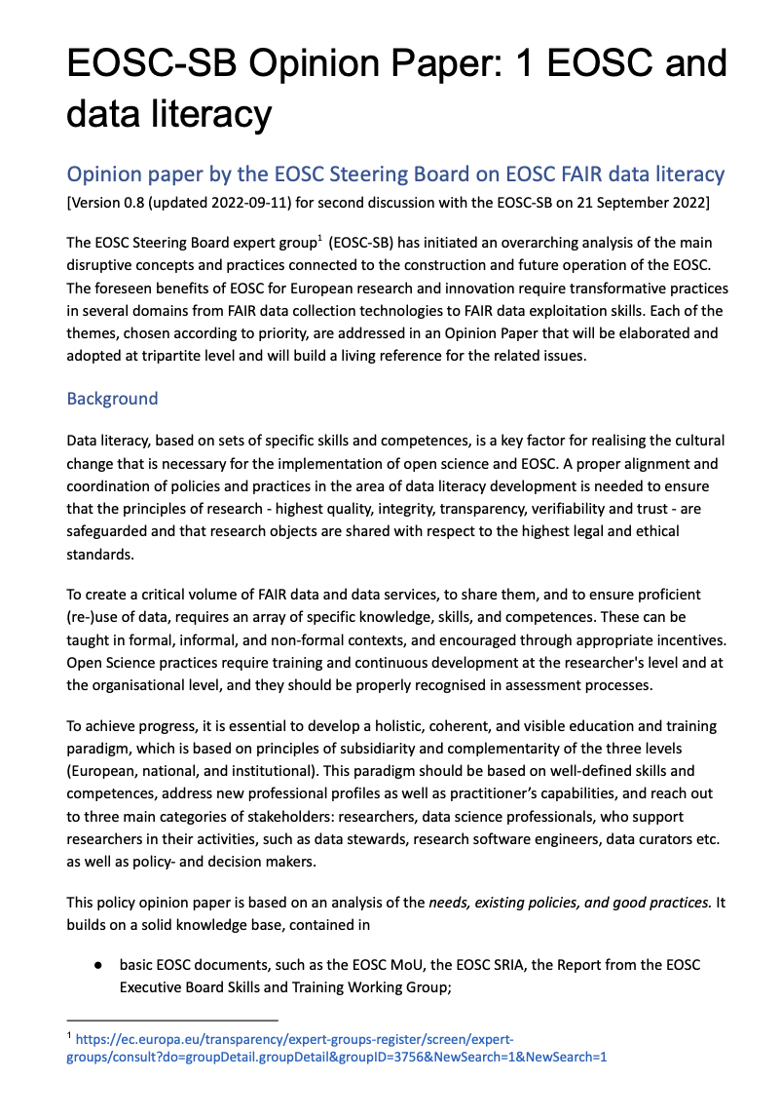
Policy Papers: EOSC and data literacy
Data literacy, based on sets of specific skills and competences, is a key factor for realising the cultural change that is necessary for the implementation of open science and EOSC.
A proper alignment and coordination of policies and practices in the area of data literacy development is needed.
Open Science practices and the creation of a critical volume of shareable FAIR data and data services, require training and continuous development at the researcher's level and at the organisational level, and they should be properly recognised in assessment processes.
The document will address recommendations at the three levels: European, National, and Institutional.
Creation of European framework and a network of Data Competence Centres for FAIR-data skills and competences, seeking coherence and strengthen collaboration.
Strengthen the national EOSC-related policies building research support staff capacity centres to provide training and frameworks for the recognition of such activities.
Incorporate FAIR data-related advanced training in the curricula of early-stage researchers and build and liase with data and digital competence centres.

Slide 9
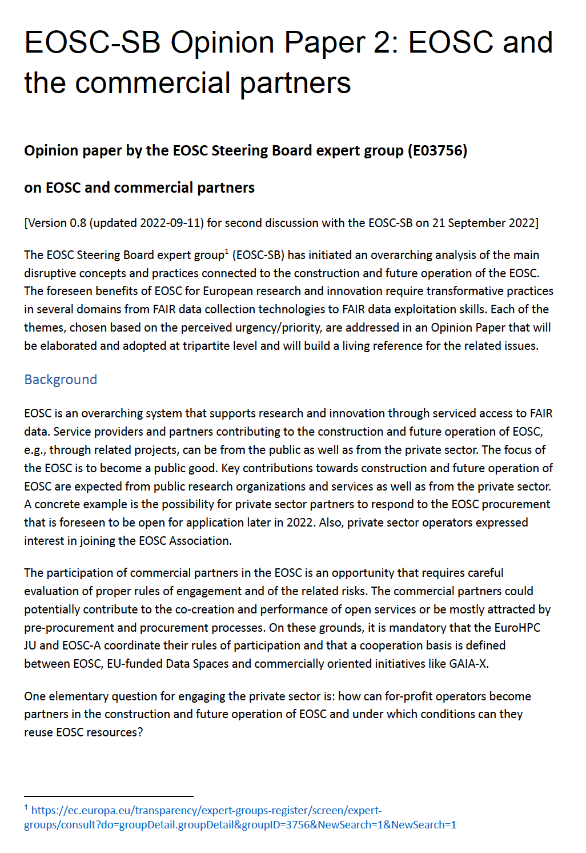
Policy Papers: EOSC and the commercial partners
EOSC is an overarching system that supports research and innovation through serviced access to FAIR data.
Key contributions towards construction and future operation of EOSC are expected from public research organizations and services as well as from the private sector.
The participation of commercial partners in the EOSC is an opportunity that requires careful evaluation of proper rules of engagement and of the related risks.
It is important to ensure
The focus of the EOSC is to become a public good.
The Rules of Participation for Commercial Partners should be carefully reviewed and discussed.
Discussion should be facilitated at national level.

Slide 10
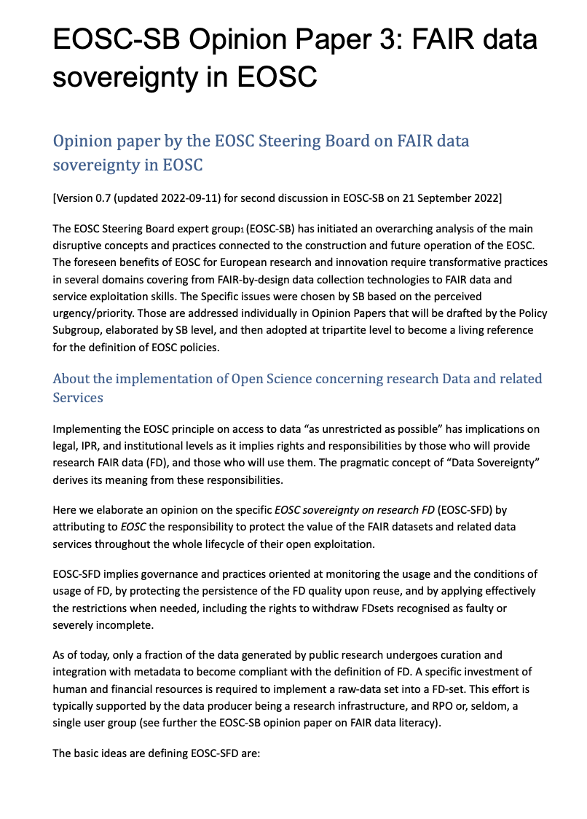
Policy Papers: FAIR data sovereignty in EOSC
Implementing the EOSC principle on access to data “as unrestricted as possible” has implications on legal, IPR, and institutional levels as it implies rights and responsibilities by providers and users.
The concept of “Data Sovereignty” derives its meaning from these responsibilities.
EOSC has the responsibility to protect the value of the FAIR datasets
FAIR Data are common goods governed by rules that must be known and understood; and
responsibilities to protect FD value of use and reuse do exist, and these need to be clearly defined.
FAIR Data sovereignty addresses
Rules of Participation and onboarding processes
Data quality and persistent integrity as a key asset in the EOSC ecosystem;
Meta-geo-localization in the EU and ACs of FD services and FD repositories;
Promotion of appropriate licensing, preservation of IPR and recognition of authorship of research FD in the EOSC ecosystem and clear statement of the ownership of data and services by EOSC partners.

Slide 11
Monitoring Activities (Subgroup A)
The purpose of monitoring policies and investments of relevance to Open Science is to support and accelerate the deployment of Open Science practices in Europe
It complements the “Additional Activities Plan” (AAP) of the EOSC-A which collects the in-kind and monetary contributions of the members of the EOSC-A.
Scope A) Benchmarking of activities on international, national, regional, and institutional level
Tasks:
Gather and analyse existing and potential EOSC-enabling policies in the MS/AC
Analyse results from regional (5B) activities in terms of building up EOSC
Identify effective use cases of EOSC-relevant national policies to fulfil the tasks of the EOSC-SB
Goals
Understand MS/AC contributions to develop EOSC, and reach a collective understanding on how to assess these contributions;
Evaluate MS/AC support to org; policies and financing mechanisms; advancing FAIR and EOSC;
Evaluate national funding complementing the contributions provided by the EOSC-A members;
Coordinate with the EOSC-A, EC, so that the benchmarking and monitoring is strategic.
Scope B) Monitor the benefits of MS/AC policies to the whole EOSC and the benefits of EOSC to the national research communities.
Tasks:
Examine the process of implementing EOSC-relevant policies. Where and when (e.g. how long after adoption) do these policies have an impact on investment?
Analyse the progress of investment of MS/AC into EOSC and its impact (for example in terms of NRENs, upgrading networks and other EOSC relevant infrastructures).
In this context, develop clear criteria and guidance for how these should be estimated, to promote comparable methods and to avoid different interpretations of how this information should be produced.

Slide 13
Conclusions
The EOSC-SB is an strategic group with national representation focused on aligning and supporting the implementation of EOSC at national basis.
It complements the activities of the EOSC Partnership (signed between the EOSC-A and the European Commission) in defining policies and in the monitoring activities.
The EOSC-SB represents the funding and policy stakeholders so a close dialogue with the community is fundamental.

