Slide 1
nRPC simulation with TOPAS
Carolina Felgueiras
Supervisiors Rita Pestana and Daniel Galaviz

Slide 2
Introduction
Motivation
How does it work?
Materials and Geometry
Source and Physics
Simulations
What is a nRPC?
Results
2

Slide 3
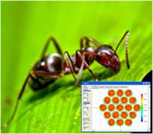
Motivation
ANTS2
TOPAS
ANTS2 is a simulation and experimental data processing package for Anger camera-type detectors
An advanced Monte Carlo simulation code that extends the Geant4 Simulation Toolkit
3
Notes:
From ANTS2 to TOPAS

Slide 4
nRPC
neutron
Resistive Plate Chamber
Gaseous detectors used in a wide range of applications such as large particles physics experiments
4

Slide 5
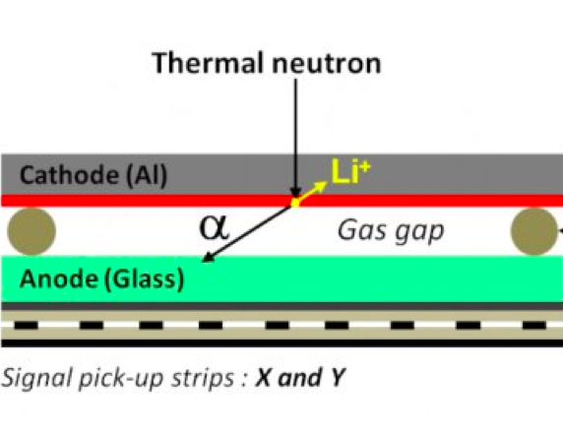
How does a nRPC work?
Neutron converter
due to neutrons being uncharged
Spacers
Resistive Ink
Insulator
5

Slide 6
How does a nRPC work?
6
Notes:
Hélio = alfa
Direçoes opostas conservação do momento/ apenas uma visto que vao em direçoes opostas ioniza o gas/ tem massas diferentes o valor de energia cinética tem de compensar esta diferença para o momento ser conservado.

Slide 7
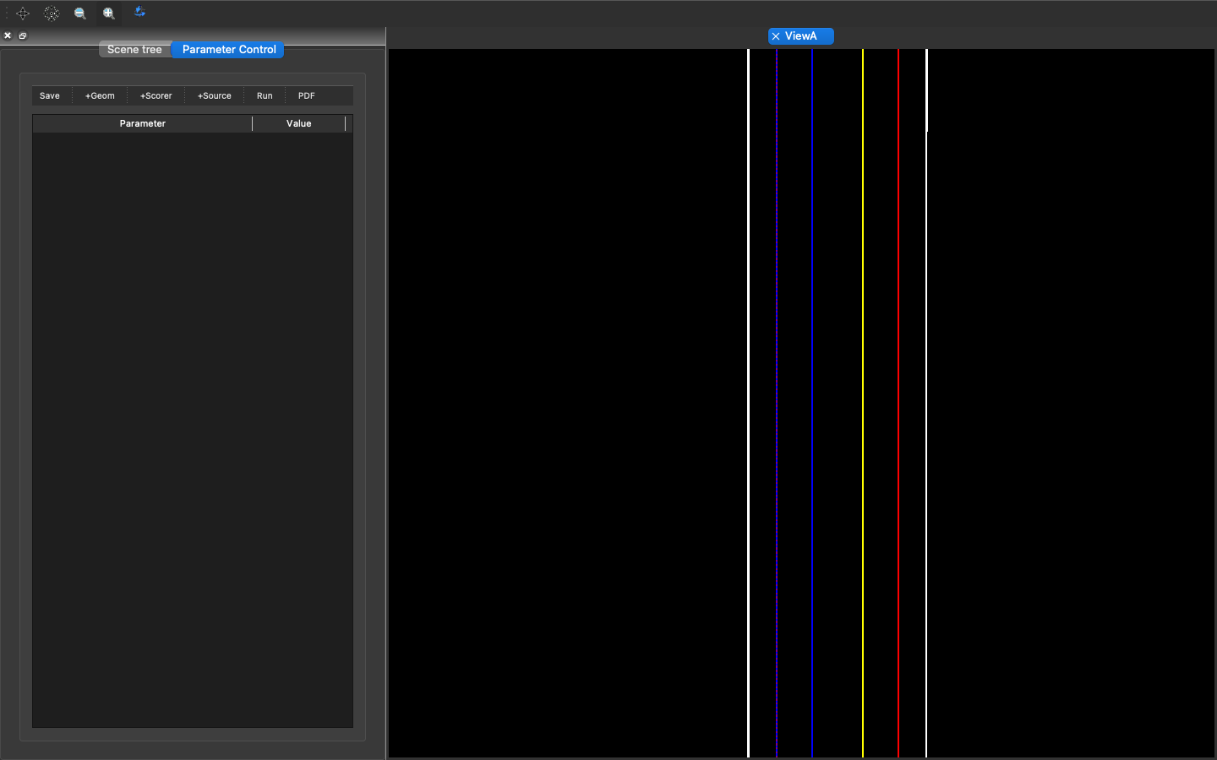
Materials and Geometry
1. PickUp (copper)
2. Glass (lime glass)
3. GasGap (C₂F₄H₂)
4. Converter (B₄C)
5. Cathode (aluminium)
6. Converter (B₄C)
7. GasGap (C₂F₄H₂)
8. Glass (lime glass)
9. PickUp (copper)
7
Notes:
nRPC dupla

Slide 8
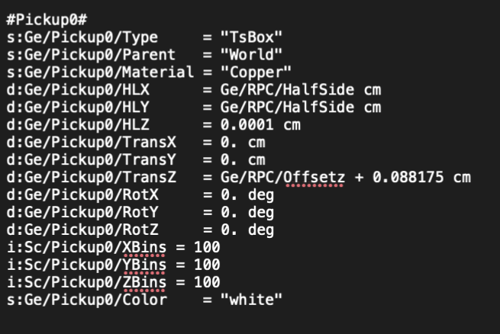
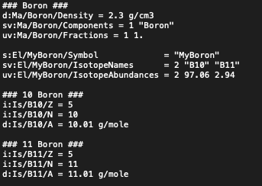
Materials and Geometry
8
Notes:
What we’ve done so far? In order to simulate a nRPC on topas, we needed to define each layer of the detector. Therefore to simulate the materials it was crucial to define each material like shown on the Picture (left). Other aspects we had to define were the beam, the energy of the neutrons, ...

Slide 9
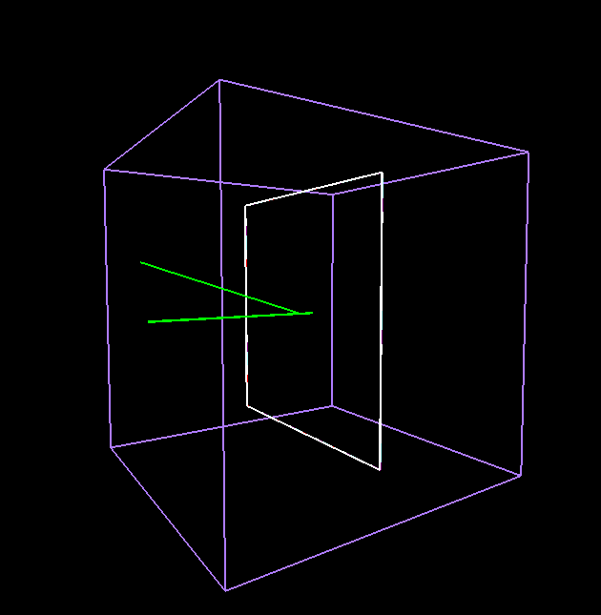
Source and Physics
Pencil Beam Source
1000 events
Thermal neutrons
9
Notes:
METER 100 eventos e energia
Fonte de PencilBeam
9

Slide 10
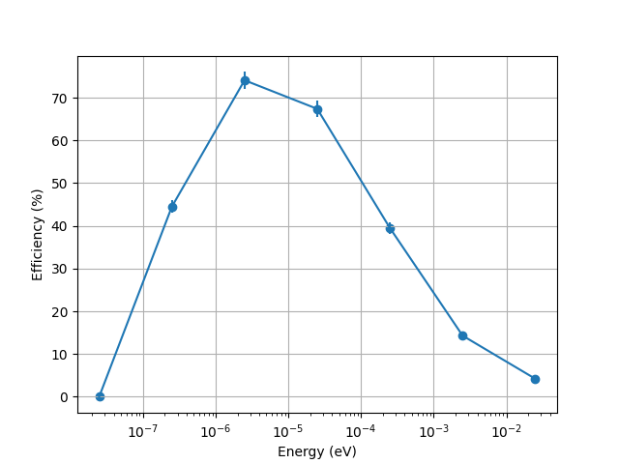
Results
Energies simulated: 2.5e-8 to 2.5e-2 eV (log scale)
Maximum efficiency: 2.5e-6 eV
Thermal neutrons (2.5e-2 eV): the efficiency is 4%
10
Notes:
METER 100 eventos e energia
Fonte de PencilBeam
10

Slide 11
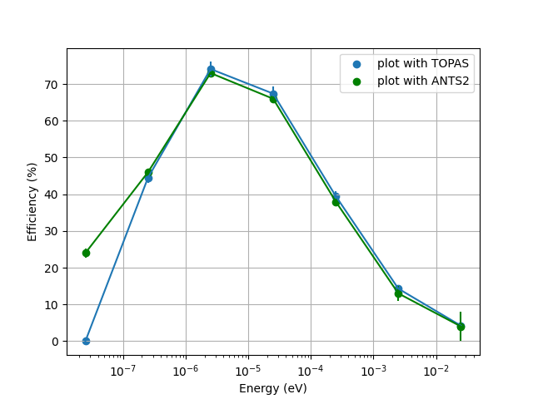
Results
Energies simulated: 2.5e-8 to 2.5e-2 eV (log scale)
Maximum efficiency: 2.5e-6 eV
Thermal neutrons (2.5e-2 eV): the efficiency is 4%
11
Notes:
METER 100 eventos e energia
Fonte de PencilBeam
11

Slide 12
Next Steps
Simulations with a RPC stack
Simulations with different energies
Simulations with a paraffin moderator
12

