Slide 1
LIP and the CMS Trigger Upgrade
Jose DA SILVA
On behalf of the LIP CMS Group

Slide 2
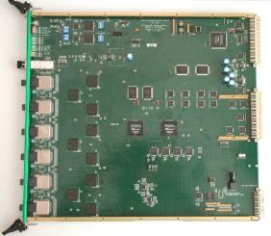
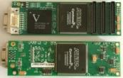
LIP CMS ECAL
Among other things, at CMS LIP is responsible by :
Readout of the ECAL data Channels
Data Concentrator Cards - DCCs
Software
TPG alignment from HCAL and ECAL to RCT
Synchronization and Link Boards (SLB)
Software
54
1080
Notes:
Future options / reasons for upgrade

Slide 3
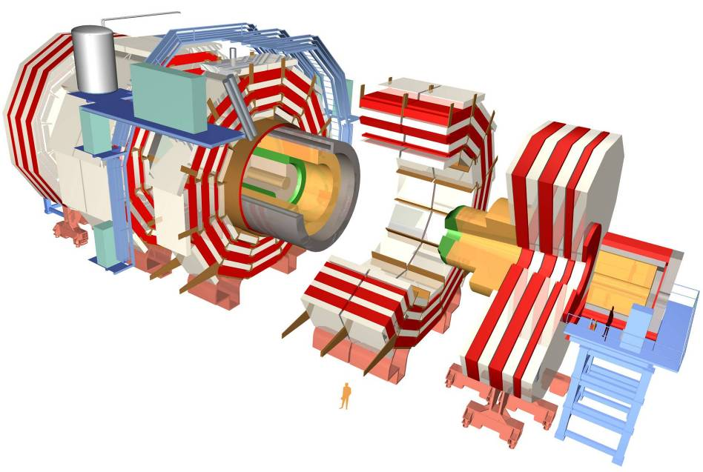
Silicon Tracker
ECAL
Barrel
+ Endcap
HCAL
Solenoid
Return Yoke
Muon Chambers

Slide 4
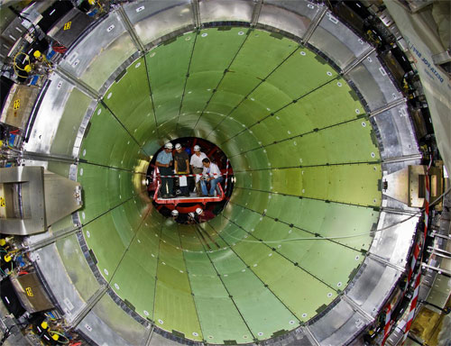
ECAL Barrel 61200 cristais
1700 xtals

Slide 5
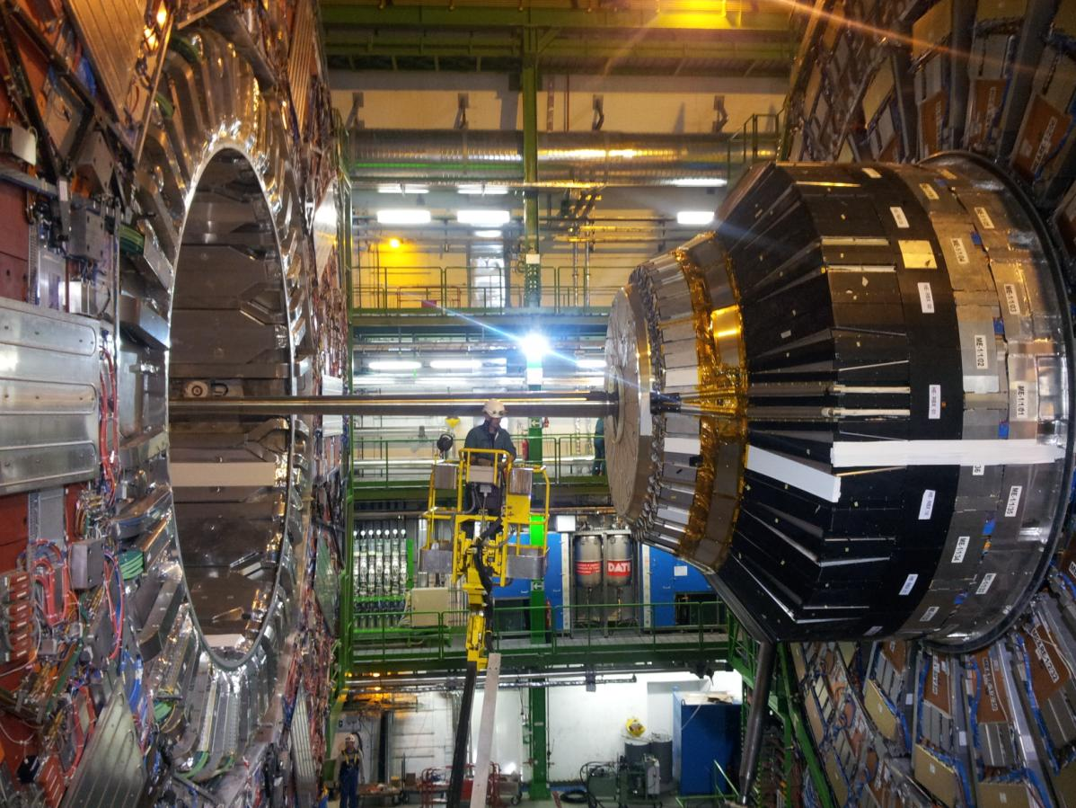
ECAL End Caps – 7000 xtals / ENDCAP

Slide 6
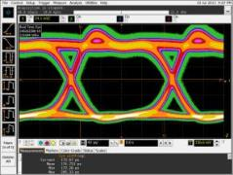
Why Upgrade the Trigger path?
Higher Luminosity and number of occurrences per BX’s from the LHC
Factor 10 more
Trigger needs to have faster decisions, more complex, decide among much more simultaneous occurrences
New electronics go optical
While designing/studying the new Trigger , we need to keep the current one
Use 4.8Gbps Dual TX optical devices on “old systems”
Notes:
Future options / reasons for upgrade

Slide 7
Today’s Implementation
HCAL HTR
Cards
HCAL FE Optical
SLBs
Regional
Calorimeter
Trigger
ECAL TCCs
RXs
ECAL FE Optical
Cables, 4 pairs @1,2Gb/s
To DAQ
SLBs
Via GCT
RXs
Notes:
TPG primitives connections for Upgrade Step 1

Slide 8
UPGRADE Phase 1
HCAL uHTR
Cards
(Q2 2013 (?)
SLHC
RCT
Cal Trigger
Processor
Cards
(Q2 2012)
HCAL
Trigger
Primitive
Optical
Splitter
(Q?)
To DAQ
HCAL FE Optical
Via BU
“AMC13”
Optical Ribbons
HCAL HTR
Cards
SLBs
Regional
Calorimeter
Trigger
ECAL TCCs
RXs
To DAQ
ECAL FE Optical
oSLBs
(Q2 2013)
ORMs
(Q4 2012)
Via GCT
Notes:
TPG primitives connections for Upgrade Step 1

Slide 9
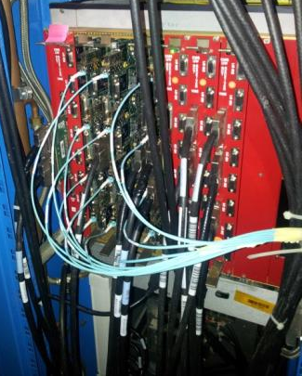
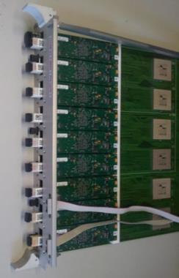
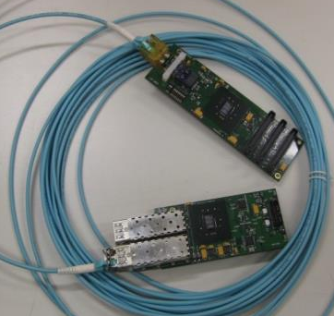
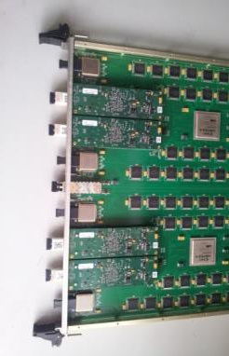
oSLBs and oRMs
We have designed a new optical link for the Trigger upgrade :
650 oSLBs – 576 to be installed (Barrel & Endcap)
650 oRMs – 540 single + 36 dual receivers to be installed
We have provided the firmware for both boards
oSLB with Dual 4.8Gbps
oRMs with 3 different firmware versions
oSLB/ oRM pairs
oSLBs over ECAL Trigger cards
oRMs on RCT cards
Notes:
Future options / reasons for upgrade

Slide 10
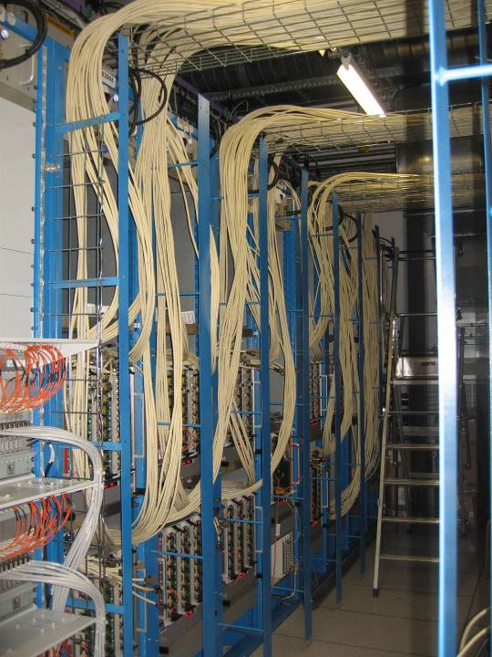
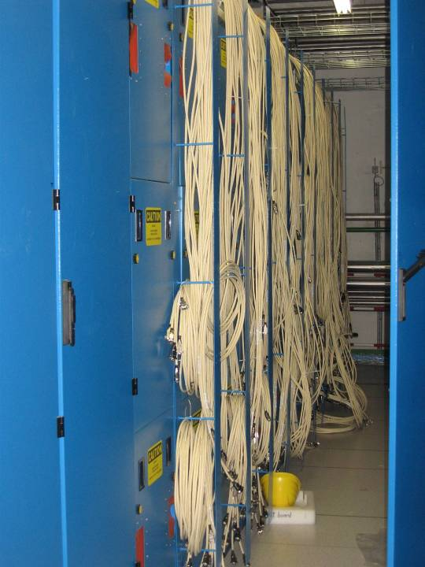
Instalacao Cabos SLB (USC55)
TO DO list

Slide 11
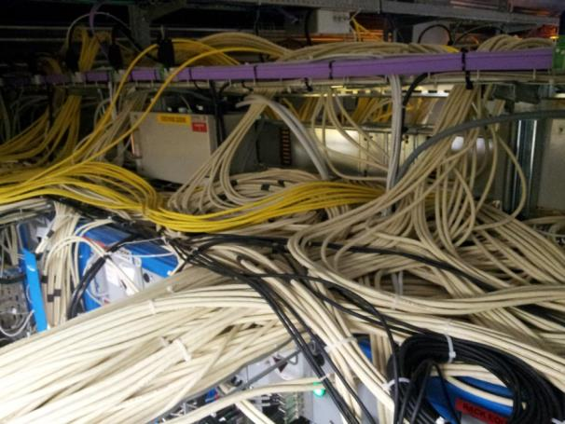
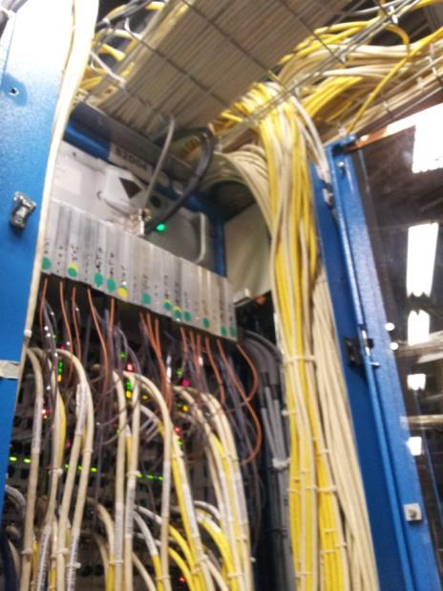
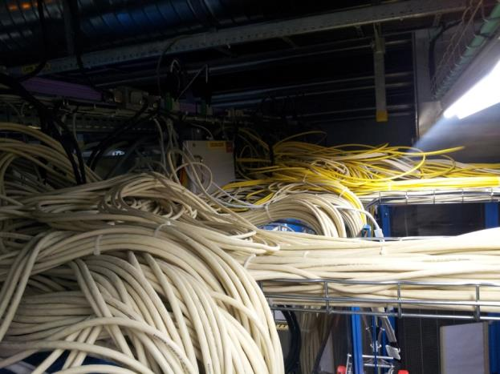
SLB cables at P5

Slide 12
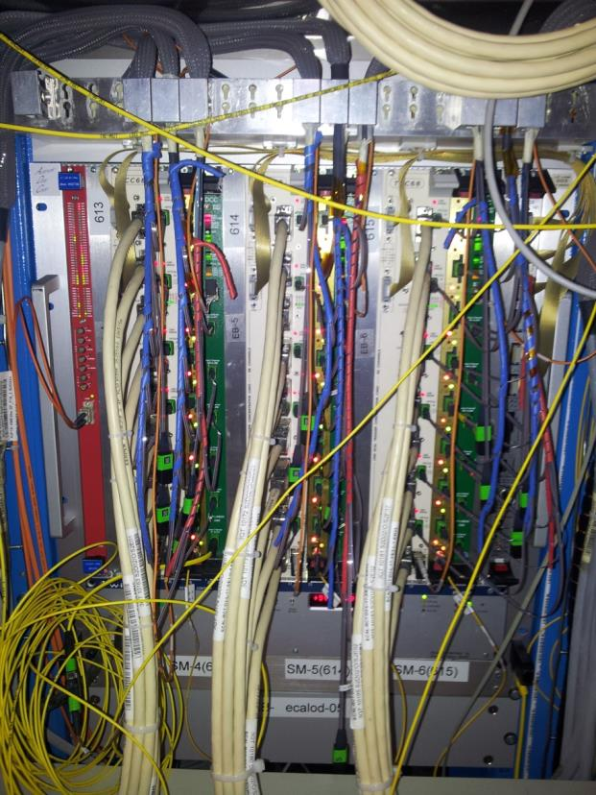
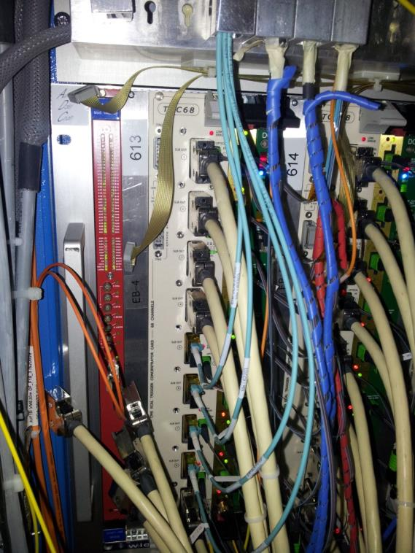
USC55 (CMS) ECAL Crates
Present with SLBs
Future with oSLBs

Slide 13
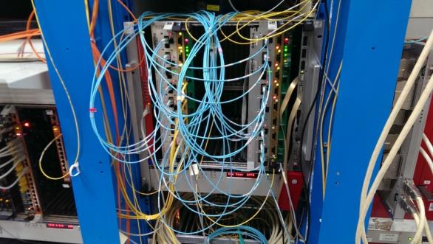
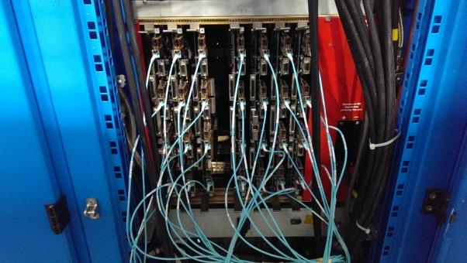
Status and planning
oSLB and oRM PCB production and validation is completed.
1300 boards tested and programmed
Install a full Barrel and one Endcap section with oSLBs
and the equivalent oRMs on the RCT side (NOW!)
Proceed with the replacement of the copper cables by the fibers
Commissioning (and maintenance) of the full system in global runs
Notes:
Future options / reasons for upgrade

