Slide 1
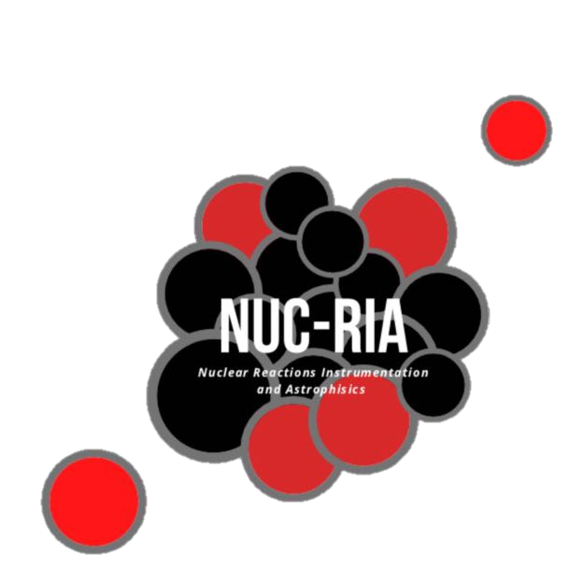
Development of a Standard Methodology for Online Dose Calculations in Air
Rita Pestana
ritapestana@lip.pt
Supervisors:
Daniel Galaviz
Sílvia Onsès
4th December 2021

Slide 2
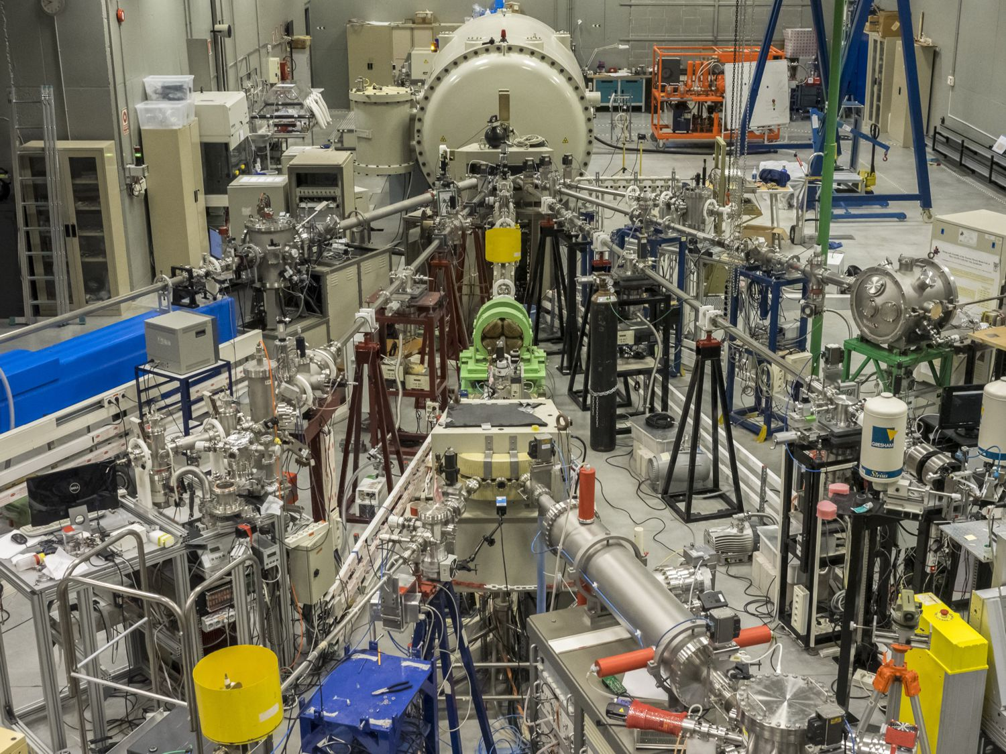
Motivation
In collaboration with the CMAM, in Madrid
Ion accelerator with a terminal voltage of 5 MV
An external beamline used for irradiating cells with protons
At the moment, the current is only measured in vacuum, using an internal Faraday cup
To perform the measurement in air the beam is stopped
This project aims to develop a methodology to measure the beam intensity in air without compromising the irradiation

Slide 3
Work line
Simulations
Design
Implementation
Tests
Stay in Madrid
March – June 2022

Slide 4
Modelling protein amyloid structures and observing the effects of radiation using the Geant4-DNA toolkit
Lia Pereira
liapereira@lip.pt
Supervisor:
Daniel Galaviz
Federico Herrera
4th December 2021

Slide 5
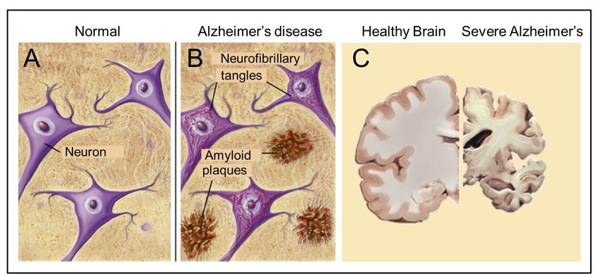
Motivation
In Alzheimer’s Disease there is the accumulation of proteins that are toxic to cells.
We want to verify if irradiation can destroy these accumulations.

Slide 6
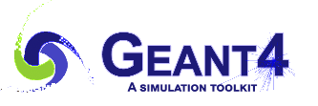
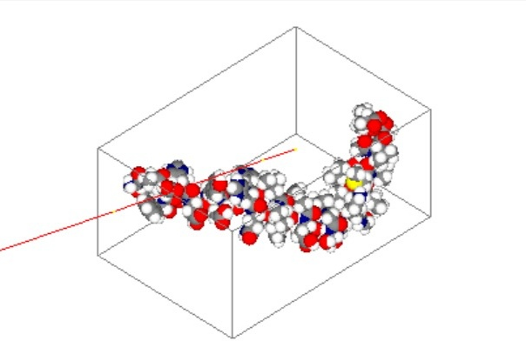
Methods
Monte Carlo Simulations
Model proteins from the Protein Data Bank
Model cells and cell cultures

Slide 7
The effects of proton therapy on protein self-organization: potential benefits for neurodegenerative disorders
Carina Coelho
cmcoelho@lip.pt
Supervisors:
Daniel Galaviz
Federico Herrera
Sílvia Onsès
4th December 2021

Slide 8
Objectives
Implementing MC algorithms to study the effects of different types of radiation on the structure and conformation of toxic amyloids
Developing a protocol for irradiation of toxic amyloids and live cells
Experimental validation of the effects of different modalities of radiation
Characterization of the biochemical and biophysical mechanisms underlying the optimal PT conditions for disruption of amyloids deposition

