Slide 1
Design and optimization of a phantom for radiobiology studies
Thesis plan presentation
Tomás Almeida – FCUL, Engineering Physics
Advisors: Brígida Ferreira & Jorge Sampaio
2021/2022
Notes:
My name is Tomás Almeida, I’m an engineering physics student at FCUL and I have a very short presentation for you, just two slides, to show you my thesis plan.
It’s titled design and optimization of a phantom for radiobiology studies and I’ll have professors Brígida Ferreira and Jorge Sampaio as advisers

Slide 2
Motivation
Most tumours treated with radiotherapy are in-depth;
Cancerous cell cultures are often irradiated for radiobiological studies to evaluate the efficiency of new treatment strategies;
Cell lines are placed inside a phantom to simulate clinical settings;
Currently available radiobiological phantoms are sub-optimal.
[1] Pancreatic cancer depiction
Notes:
Most tumours treated in radiotherapy are located at a certain depth inside the body. Cancerous cell cultures are often irradiated for radiobiological studies and experiments, like for example the dopped pancreatic cancer cells that Nísia worked on. But cell lines must be placed inside a phantom to simulate a real clinical setting. The motivation for this project comes from, currently available radiobiological phantoms being sub-optimal. They take too long to assemble on the spot (and that’s not ideal specially because access time to linacs is very limited) and they are not able to simulate different irradiation situations.

Slide 3
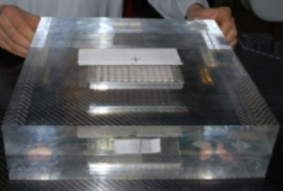
Objective
Design a phantom for Monte Carlo simulations and in-vitro radiobiological studies, that is:
Easy to assemble and fast to setup;
Able to simulate different clinical settings;
Allows for precise relative and absolute dosimetry using different detectors;
Simulate different scenarios of irradiation within radiobiological experiments, with
Make a cost benefit assessment.
Probably wont have enough time… But would be very interesting to:
Build and test the phantom. Compare experimental with simulated results (in particular for enhanced radiotherapy with NP’s)
[2] In vitro irradiation system for radiobiological experiments
Notes:
Then, the objective of this project is design a phantom for Monte Carlo simulations and in-vitro radiobiological studies that is: easy to assemble and fast to setup, able to simulate different clinical settings., allows for precise relative and absolute dosimetry using different detectors. I will also simulate different scenarios of irradiation within radiobiological experiments, using TOPAS. And make a cost benefit assessment regarding different phantom materials.
It would also be very interesting to build and test the phantom and then compare the experimental and simulated results, specially for enhanced radiotherapy with nanoparticles

