Slide 1
Joana Leitão
24 anos
Loures, Lisboa
BSc & MSc Biomedical Engineering and Biophysics
2015 - 2021
Faculdade de Ciências da ULisboa
Master thesis
Added value of combining VMAT with computer-selected patient-specific
non-coplanar IMRT beams
in radiotherapy for nasopharyngeal carcinoma and mediastinal lymphoma
2020 - 2021
Erasmus Medical Center, The Netherlands
00351 963515318
joanaleitao1997@gmail.com
LIP @ 326
PhD
Developing Multi-beam FLASH
with proton beams
2021 - 2025
LIP and IST, Lisboa
DKFZ, Germany

Slide 2
Developing Multi-beam FLASH with proton beams
Joana Leitão
Prof. Dr. Patrícia Gonçalves
Prof. Dr. João Seco
LIP Mini-School on Charged Particle Therapy

Slide 3
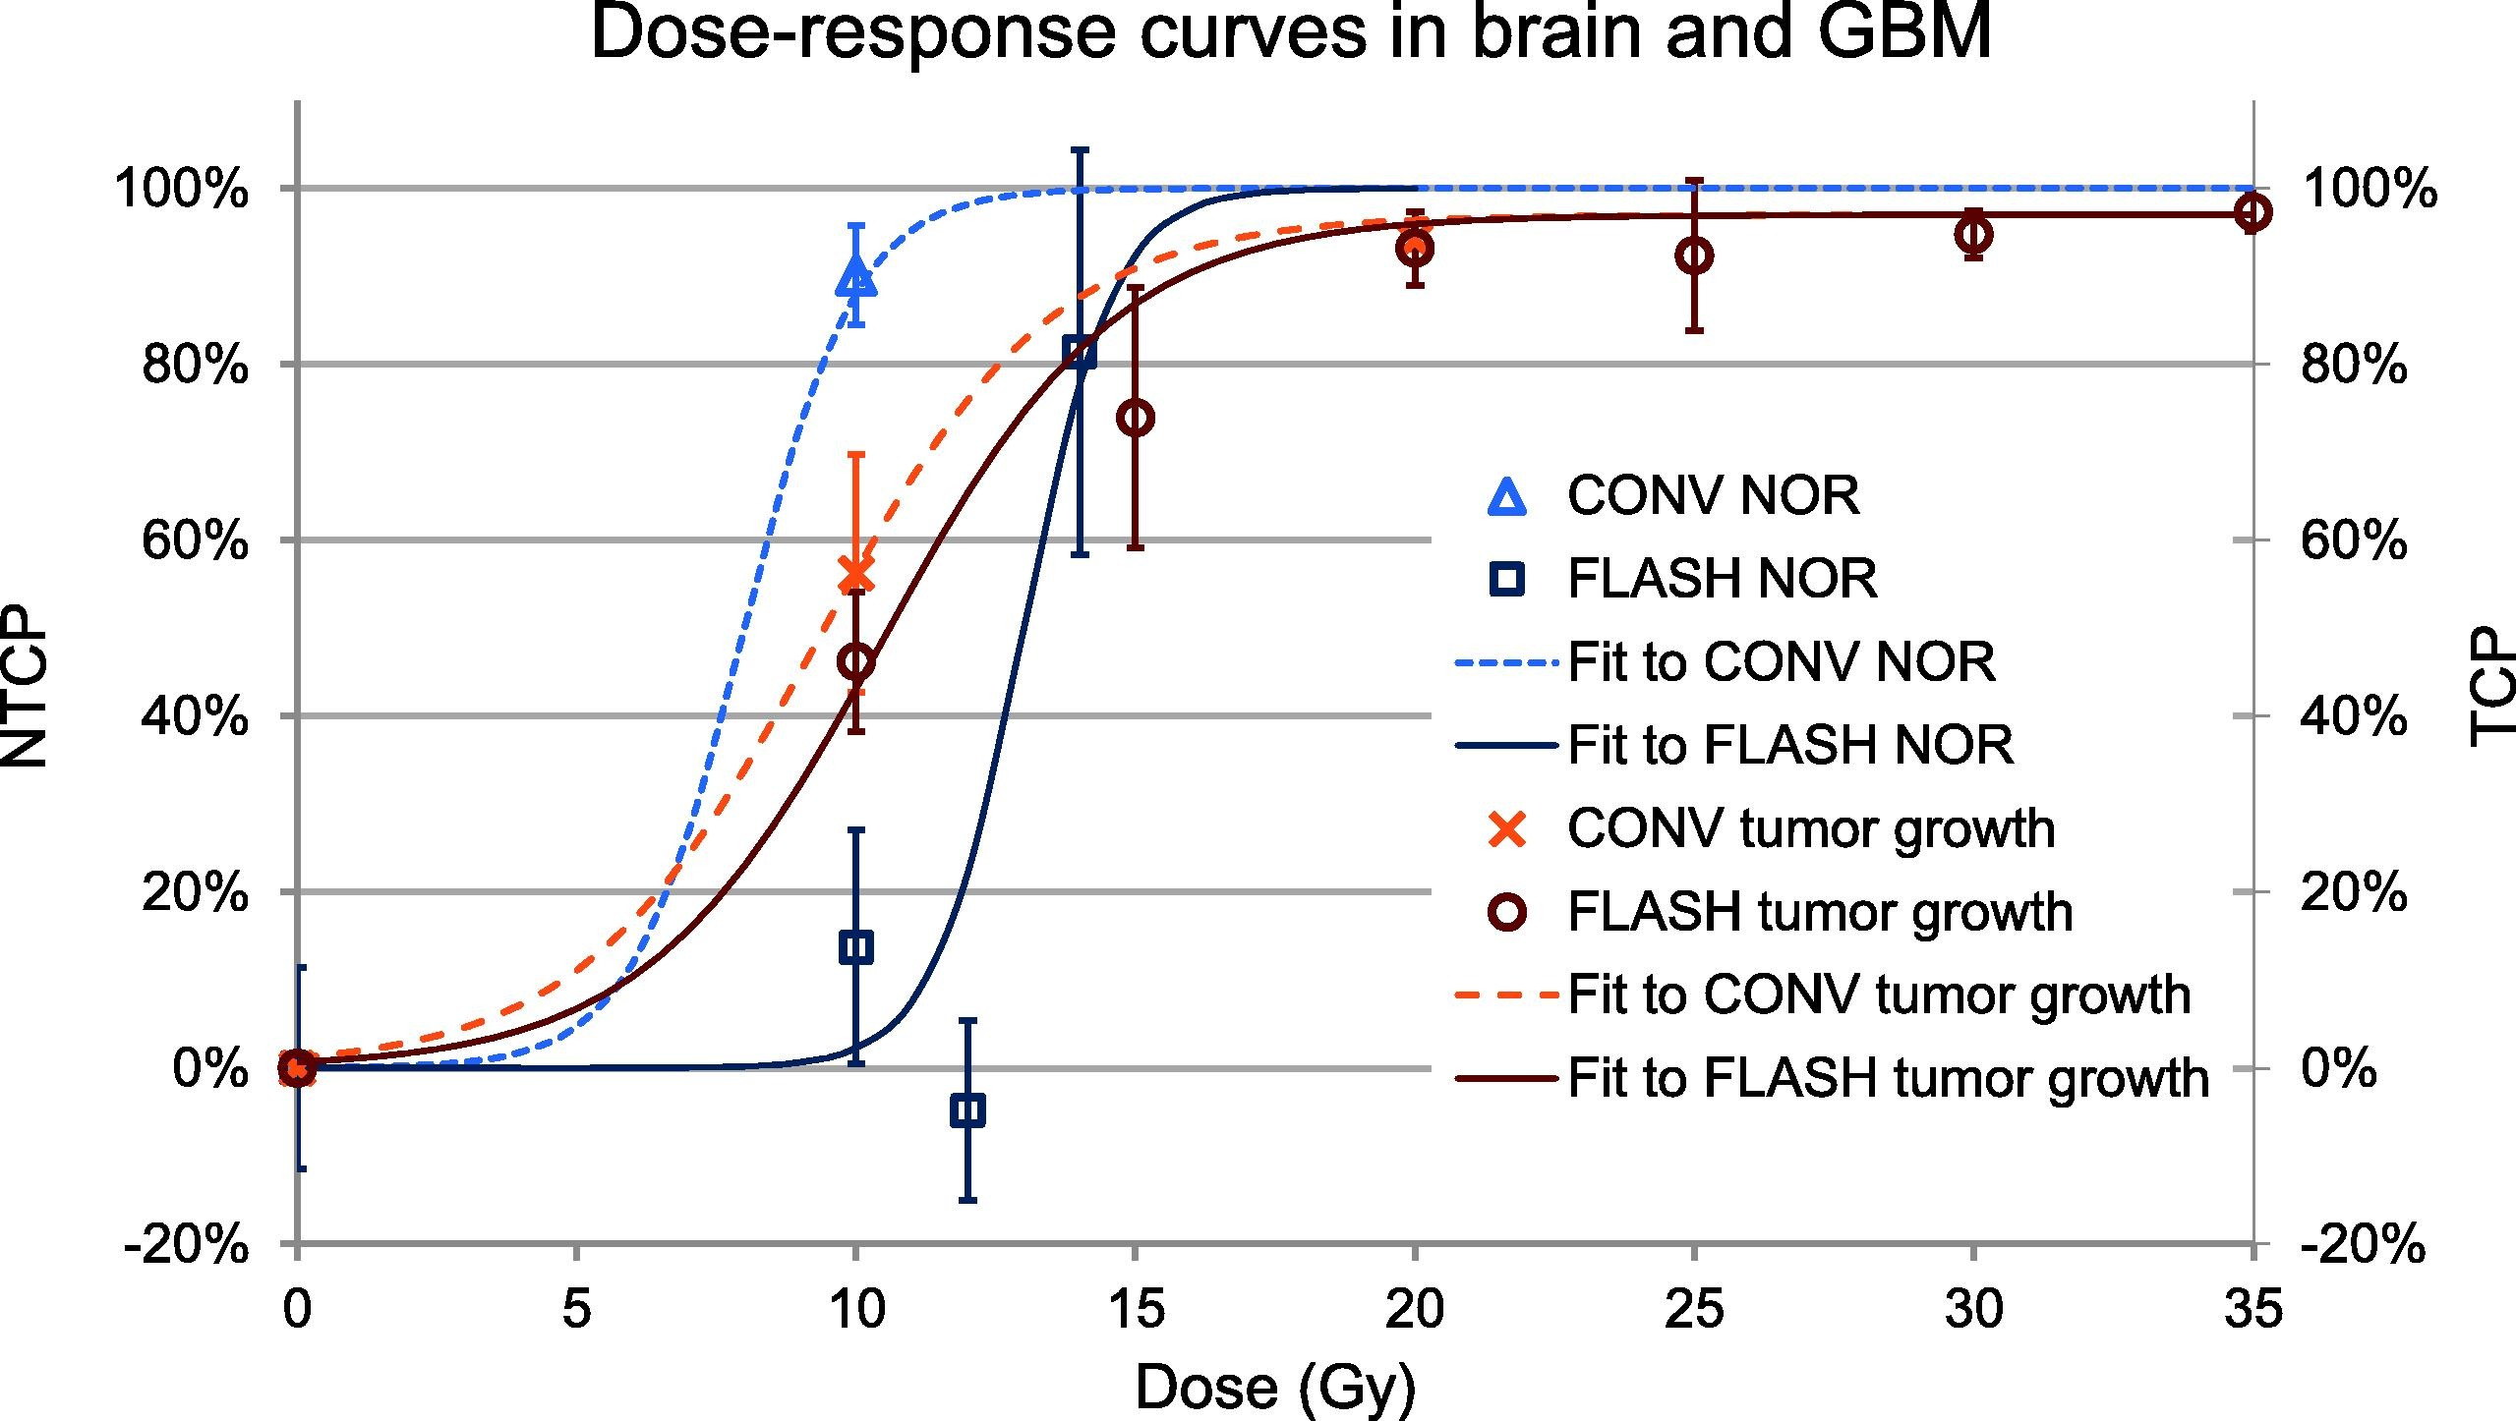
THE FLASH EFFECT
Bourhis 2019, Radiotherapy and Oncology 139 (2019) 11–17

Slide 4
ROADMAP
PHD GOALS AND PLAN
Simulations of the FLASH effect
describe physical, chemical and biological
Study and implementation of
multi-beam proton FLASH radiotherapy
Study and integration of FLASH radiotherapy with other treatment techniques
Familiarization with Geant4, TOPAS gMicroMC and TRAX-CHEM
Q1:
How does the
FLASH effect protect healthy cells, while destroying cancer cells?
Q2:
How to implement proton FLASH therapy with multi-beams?
Q3:
How to combine the FLASH technique with other treatment techniques?
Developing models for the FLASH effect
and validation
Study and optimization of treatment planning strategies for different tumors
Final analysis and writing of the thesis
Notes:
Familiarization with Monte Carlo simulation codes
Development of simulations of FLASH effect capable of describing the effect at the physical, chemical, and biological level.
Developping models for the FLASH effect and validation by intercomparing Monte Carlo codes.
Study of multi-beam proton FLASH radiotherapy and implementation strategies based on inverse planning and optimization techniques, using the MATRAD software.
Study and optimization of treatment planning strategies for different tumour locations, such as the lung, prostate, and brain.
Integration and study of FLASH radiotherapy with other treatment techniques, using the software MATRAD, which allows for treatment planning with 3D-CRT, IMRT, mini-beams and proton beam therapy.
Final analysis of all T1, T2 and T3 results and writing of the thesis.

